Slide 1

Super Hashcode Bros.
Jared Beamer, Justin Stigall, Ted Moso
jjjdggd

Slide 2



Members
Jared Beamer - Database, DAO, Security
Ted Moso - Controller & Service Layer (Business Logic)
Justin Stigall - Front End Design (HTML, CSS, Bootstrap, JavaScript)

Slide 3
The Assignment
Create a full-stack web application
Leverages the competencies we’ve covered in the entire cohort
Create a blog and content management site
Display ability to work with others as a team
Use service control tools like Bitbucket and JIRA

Slide 4
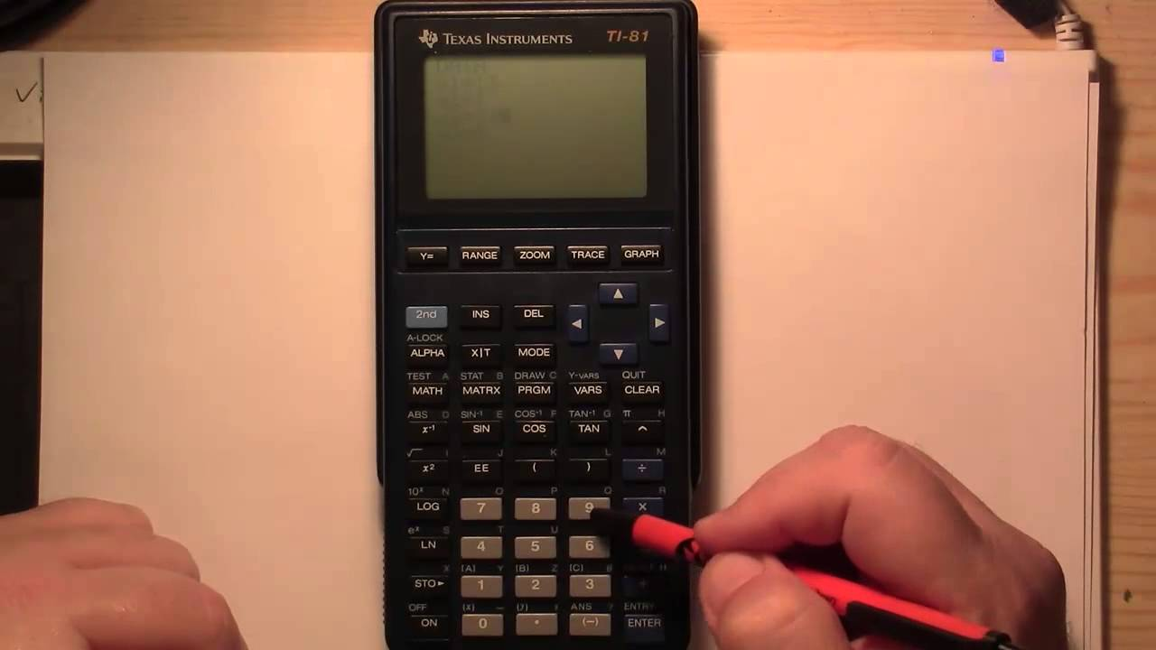
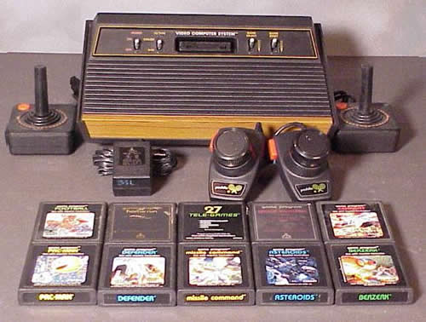
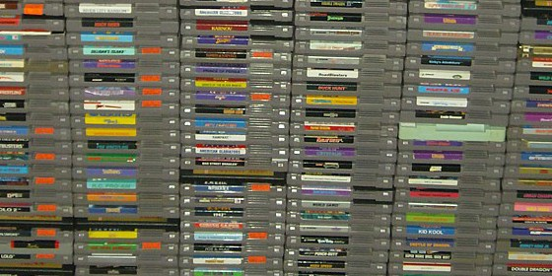
The Client
The client is a video game historian
Prefers video/calculator games from 1990 and before

Slide 5
Specifications
Display their blog posts to everyone who visited the website
Should be the only one who can approve blog posts
Write post in an editor (No writing HTML for blog posts)
Categorize posts by tags, should also be able to have multiple tags
Ability to add static pages allowing the client to write rich text/post images

Slide 6






Application Stack
Java
Spring MVC Framework
MySQL
HTML
CSS
Bootstrap
JavaScript
TinyMCE
Photoshop/Illustrator

Slide 7
Database
Jared Beamer

Slide 8
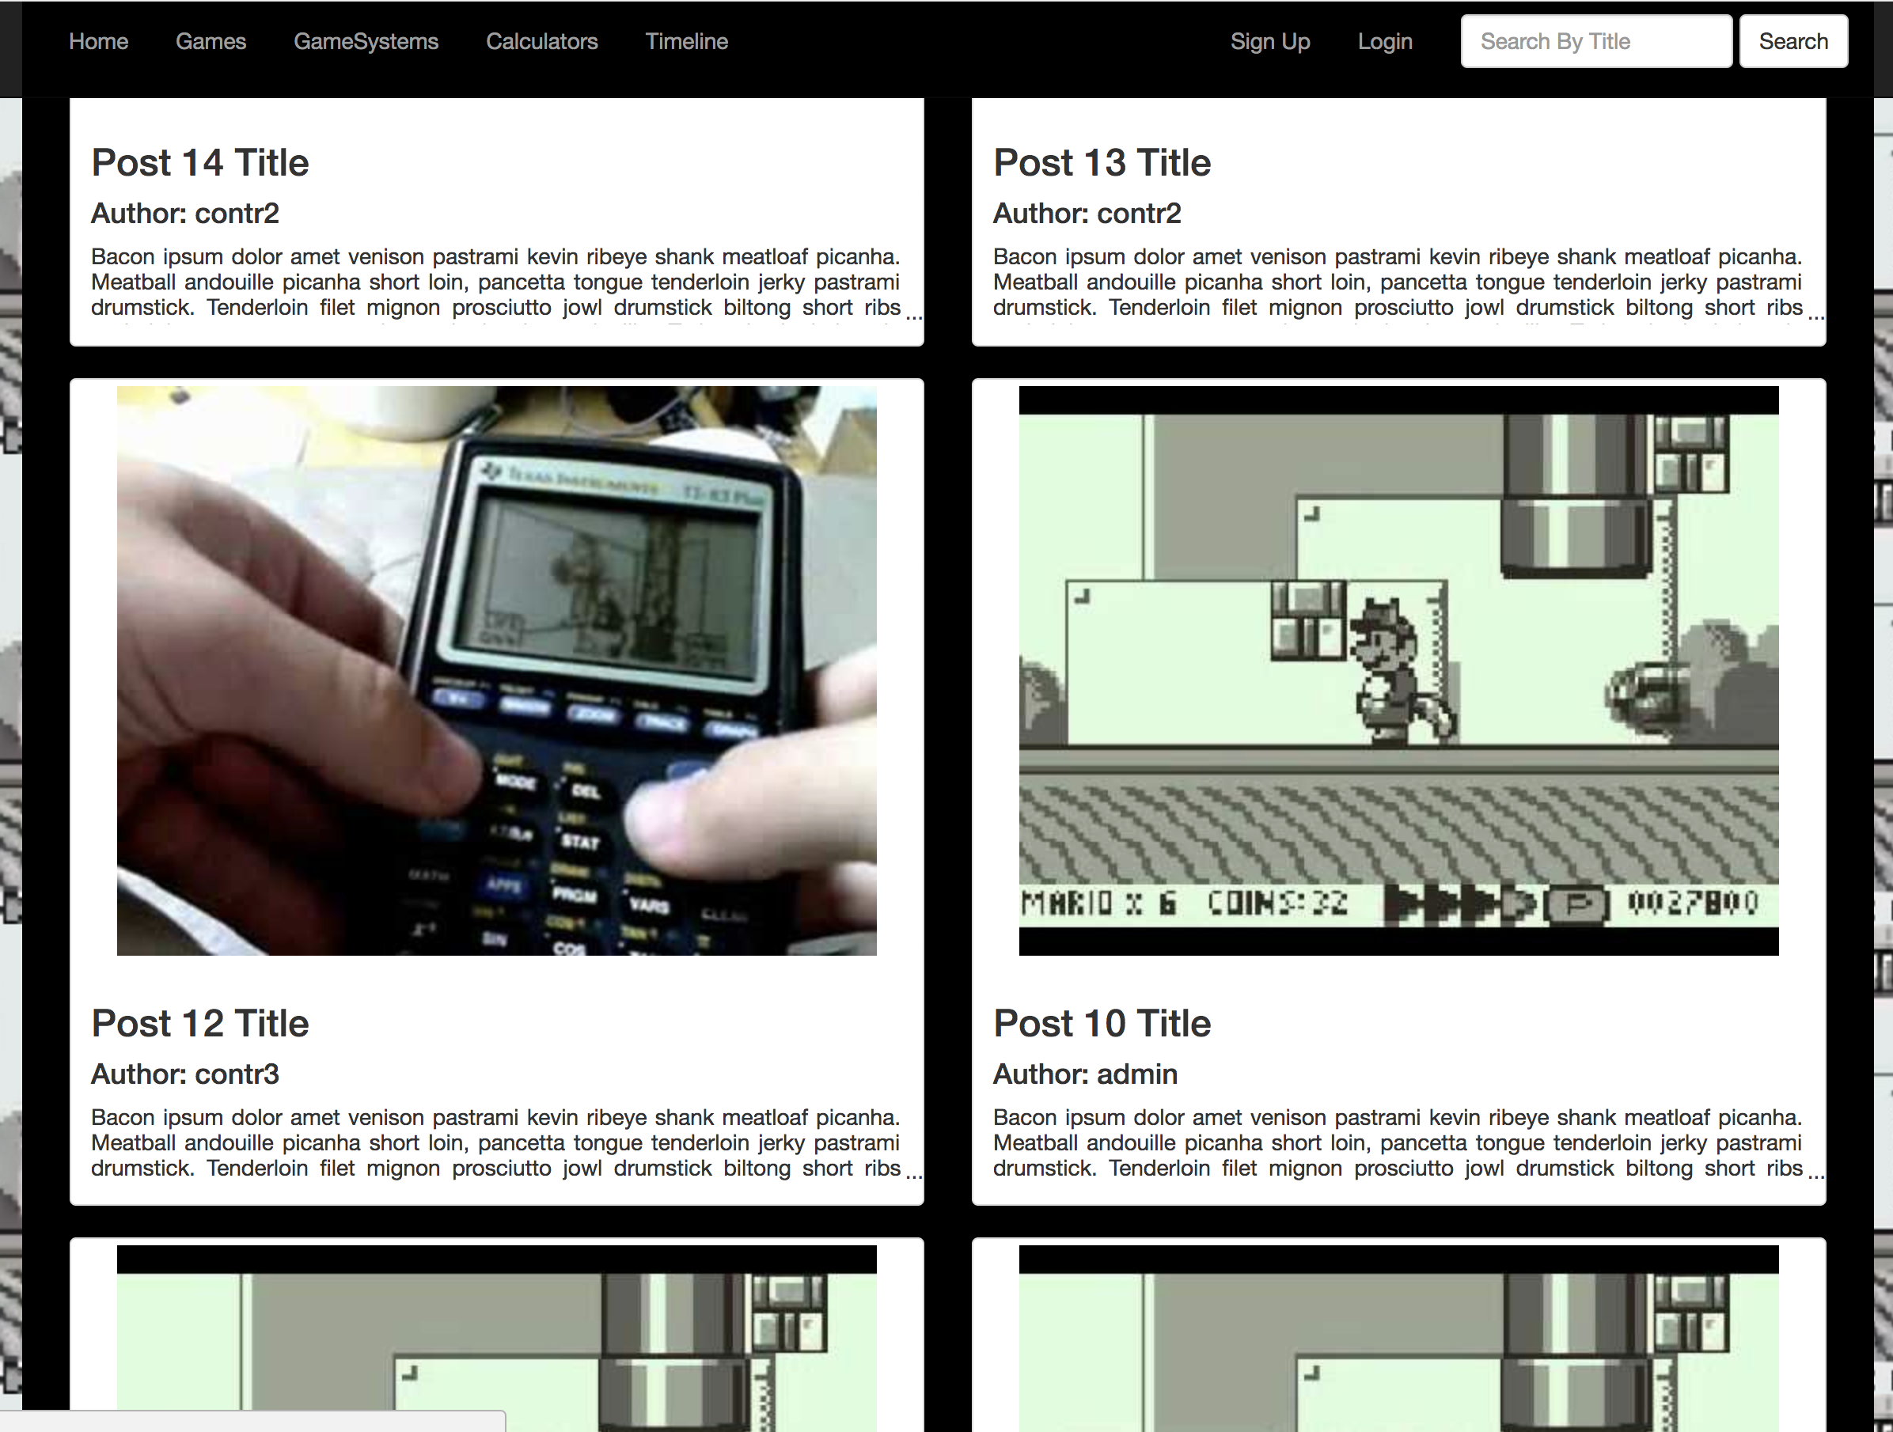

Database Tasks

Slide 9


Database Technologies
MySQL
JDBC Template
Java 8

Slide 10
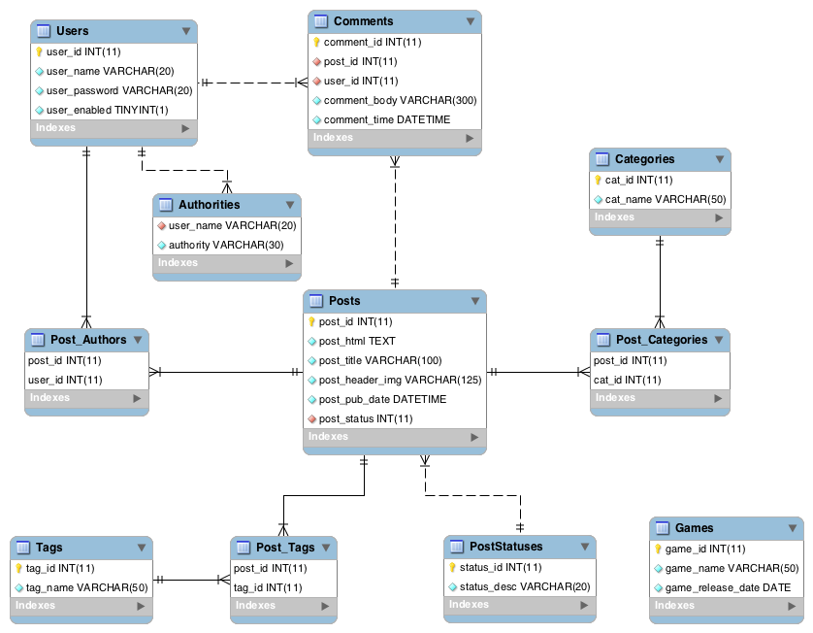
Primary Tasks
Create relational database
Normalization
Get data from the database
Table → DTO
JDBC Template
Prepared Statements
Map to DTO
Store data to database
DTO → Table
Unit testing

Slide 11
Complications
Boolean as Approved tag for Posts
Pending Posts
Creating similar DAO methods with slightly different parameters
Switched to enum with PENDING
Still hard-coded, but more flexibility
Created overloaded methods searchable by Post Status

Slide 12
Site Access
Anybody:
View Posts
View Timeline
Access Sign Up page
Logged In Users
Comment on Posts
Contributors
Create posts to be approved by Admin
Edit their own posts
Admin
Approve posts
Modify user roles/disable users
Add games to timeline

Slide 13
Controller & Service Layer
Ted Moso

Slide 14
Task
Controller
Service Layer

Slide 15
Front End Design
Justin Stigall

