Slide 1


*.rethink.orange-labs.fr
*.rethink3.orange-labs.fr
*.rethink2.orange-labs.fr
oidc-ns.kermit.orange-labs.fr
p-rethink1 161.106.201.9
p-rethink2
161.106.201.10
p-rethink3
161.106.201.11
OIDC server
instance
reverse-proxy
reverse-proxy
reverse-proxy

Slide 2
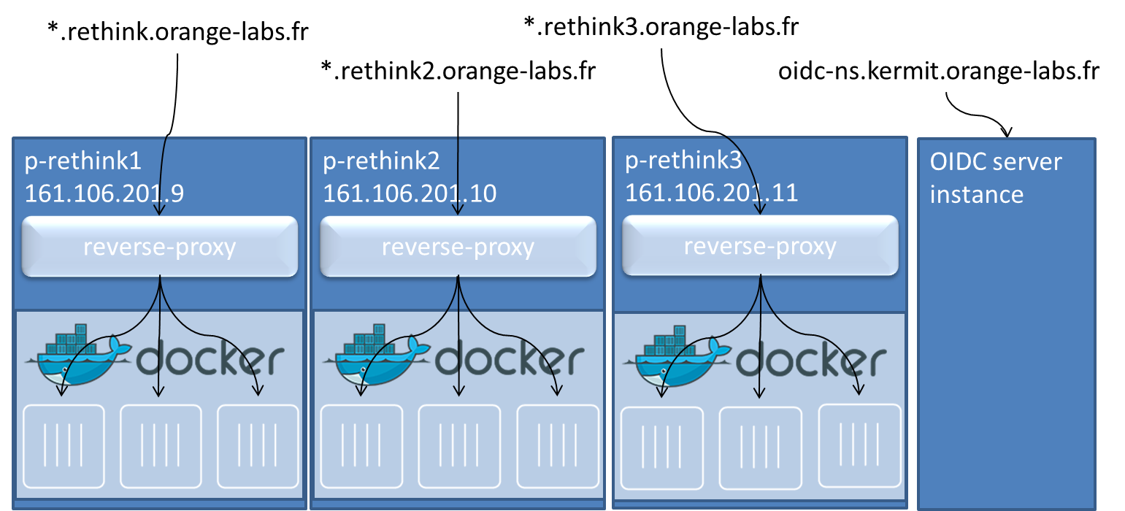

Slide 3
www.rethink.orange-labs.fr
(admin)
powercommunication.rethink.orange-labs.fr
+ subdomains
mcu.pwrcom.rethink.orange-labs.fr
energyq.rethink.orange-labs.fr
hydev.rethink.orange-labs.fr
p-rethink1 161.106.201.9
reverse-proxy
node.
Node.js runtime
registry.
Domain registry
catalogue.
PwrCom catalogue
EnergyQ
IdP
(NodeJS)
Global Registry
MCU
(to be defined)

