Slide 1


*.rethink.orange-labs.fr
*.rethink3.orange-labs.fr
*.rethink2.orange-labs.fr
oidc-ns.kermit.orange-labs.fr
v-rethink1 161.106.2.23
v-rethink2 161.106.2.22
v-rethink3 161.106.2.20
OIDC server
instance
reverse-proxy
reverse-proxy
reverse-proxy

Slide 2
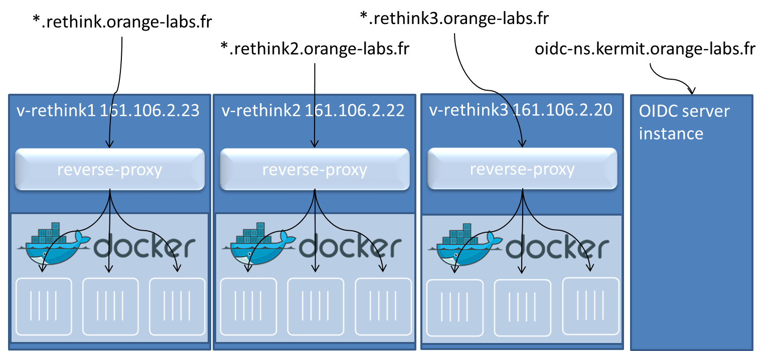

Slide 3
www.rethink.orange-labs.fr
(admin)
mcu.pwrcom.rethink.orange-labs.fr (phase 2)
powercommunication.rethink.orange-labs.fr
+ subdomains
energyq.rethink.orange-labs.fr
greg.rethink.orange-labs.fr
energyq.idp.rethink.orange-labs.fr
v-rethink1 161.106.2.23
reverse-proxy
node.
Node.js runtime
registry.
Domain registry
catalogue.
PwrCom catalogue
Global Registry
Enterprise
app
EnergyQ
IdP
(NodeJS)
MCU
(to be defined)

Slide 4
www.rethink2.orange-labs.fr
(admin)
easyapp.rethink2.orange-labs.fr
cpe.rethink2.orange-labs.fr
broker.rethink2.orange-labs.fr
coturn.rethink2.orange-labs.fr
v-rethink2 161.106.2.22
reverse-proxy
Node.js runtime
redis database
easyrtc example
coturn
CPE

Slide 5
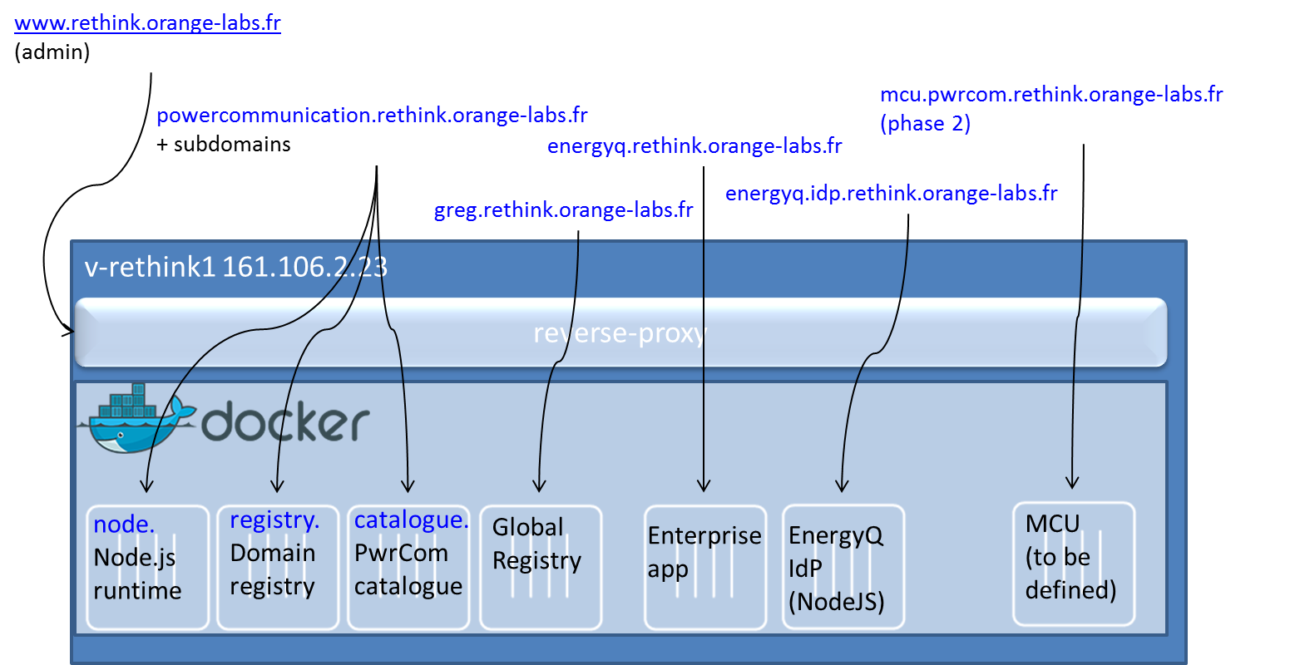

Slide 6
rethink1
Powercommunication
http://powercommunication.rethink.orange-labs.fr
energyq
http://energyq.rethink.orange-labs.fr
IdP
MCU
rethink2
Global Registry
TURN/STUN
http://turn.rethink2.orange-labs.fr
rethink3
netall
http://netall.rethink3.orange-labs.fr
QoS Broker
http://broker.netall.rethink3.orange-labs.fr
Independent IdP
OIDC IdP
https://oidc-ns.kermit.orange-labs.fr

Slide 7






Portugal Telecom
Global Registry PT
HyBroker
HySmart
HyHacker
Fraunhofer Fokus
Catalogue
Global Registry TUB
HotelGuest
Talknow
Orange
Deutsche Telekom
Global Registry Orange
idTelco2
MyCity
Participate
idTelco
powercomm
energyq
idEasy
netall
TURN1
TURN2
QoS Broker
applications
IdPs
Infra

Slide 8
Server side pf
CSP
Browser
Catalogue
Runtime
MessagingNode
DemoApp
Registry
WebApp
IdP
Global Registry
QoS Broker
TURN
TURN

Slide 9
Global Registry
Global Registry
REST Interface
Global Registry
P2P Interface
Global Registry

