Slide 1



DARK
WEB
Presented by Heritina

Slide 2
OUTLINE
01.
02.
03.
04.
WEB LAYERS
FUNCTIONING
CONTENTS AND SERVICE
CONSEQUENCE

Slide 3
WEB LAYERS
1
2
3
WEB SURFACE
DEEP WEB
DARK WEB
Indexed Site
Ex : Online Store,Actuality,...
800 000 site per day
4% of Global Web
Not Indexed Site
Ex : Document of the gouvernement,Mail Service,..
90% of Global Web
Not Indexed Site
Ex : Reddit-Like Forums,Leak Sited
6% of Global Web

Slide 4

FUNCTIONING
Browsers : Tor or I2P
Domain Extension : .onion or .i2p
VPN : NordVPN or ExpressVPN
Fundamental base :
- Anonymization
- Freedom
To Start : The Hidden Wiki or
Dark Web Links

Slide 5

CONTENTS AND SERVICE
Black Market
Sensitive Content
Illegal goods : weapons,counterfeit documents
Image or Video
Discussion Forums
Whistleblowing Plateforms
Exchanging idea on various topics
Corruption,Human abuse

Slide 6

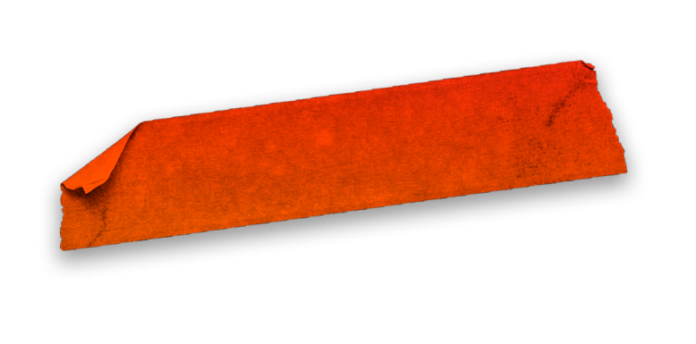
CONSEQUENCE
Disdvantage
- Security risk
- Legal or illegal ?
Advantage
No Surveillance and Censorship
- Freedom of expresion

Slide 7
THANK YOU

