Slide 1
Progress log
Internet of trash

Slide 2
What did we want to achieve?
Make a project plan
Collect evidence
Start researching technologies

Slide 3
How did we do it?
Divided up the work
Used creativity techniques
SCAMPER
Worst case scenario
Progressive abstraction
Made pictures of evidence throughout the city
Technologies were researched online

Slide 4
What were the results?
Creativity techniques lead to some new insights
Initial research lead to a shortlist of sensor technologies
Enough evidence to make a solid case was collected

Slide 5
What were the problems?
Project planning didn’t suffice yet
We had to wait for contact with the local government
Creativity techniques were quite difficult to use sometimes

Slide 6
What were the lessons learned?
Getting in touch with the stakeholders needs to be done as soon as possible
We learned how to use creativity techniques in our own context, and we found out their uses.

Slide 7
What do we want to achieve?
Get in touch with the local government and van Gansewinkel
Implement feedback on the project plan
Set up a budget request for the sensor technologies
More goals will be defined this morning

Slide 8
How are we going to do it?
Find out which people to contact
Contact them
Find out material costs
Are these costs within budget?
Feedback was received last week from monsieur
Implement this feedback

Slide 9
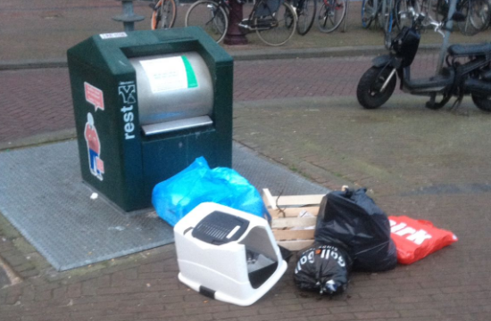

Slide 10
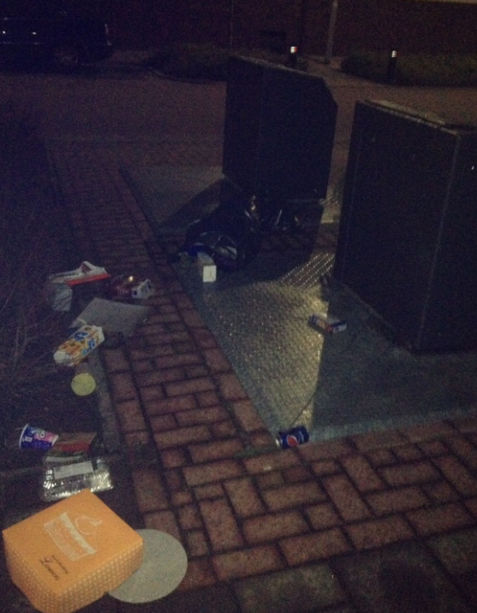

Slide 11
