Slide 1
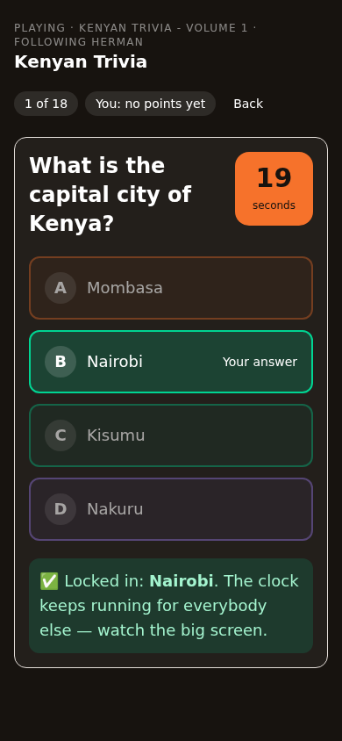
Mshikaki
We came to the meeting to play.
Somehow we left with assigned tasks.
Innovations ICT · internal walkthrough
Notes:
Screens captured from the deployed app at 172.16.1.36:8090 on 1 October 2026.

Slide 2
The meeting loop
One meeting moves through eight steps. The app never asks anybody to learn the words.
1 PLAY
2 CONNECT
3 THINK
4 DISCUSS
A game warms the room
Everybody is in the meeting
Ideas land in seconds
The room talks it through
5 DECIDE
6 ASSIGN
7 DO
8 RECORD
The agreement is written down
One owner for each task
Work moves on the board
Everything is on the trail

Slide 3
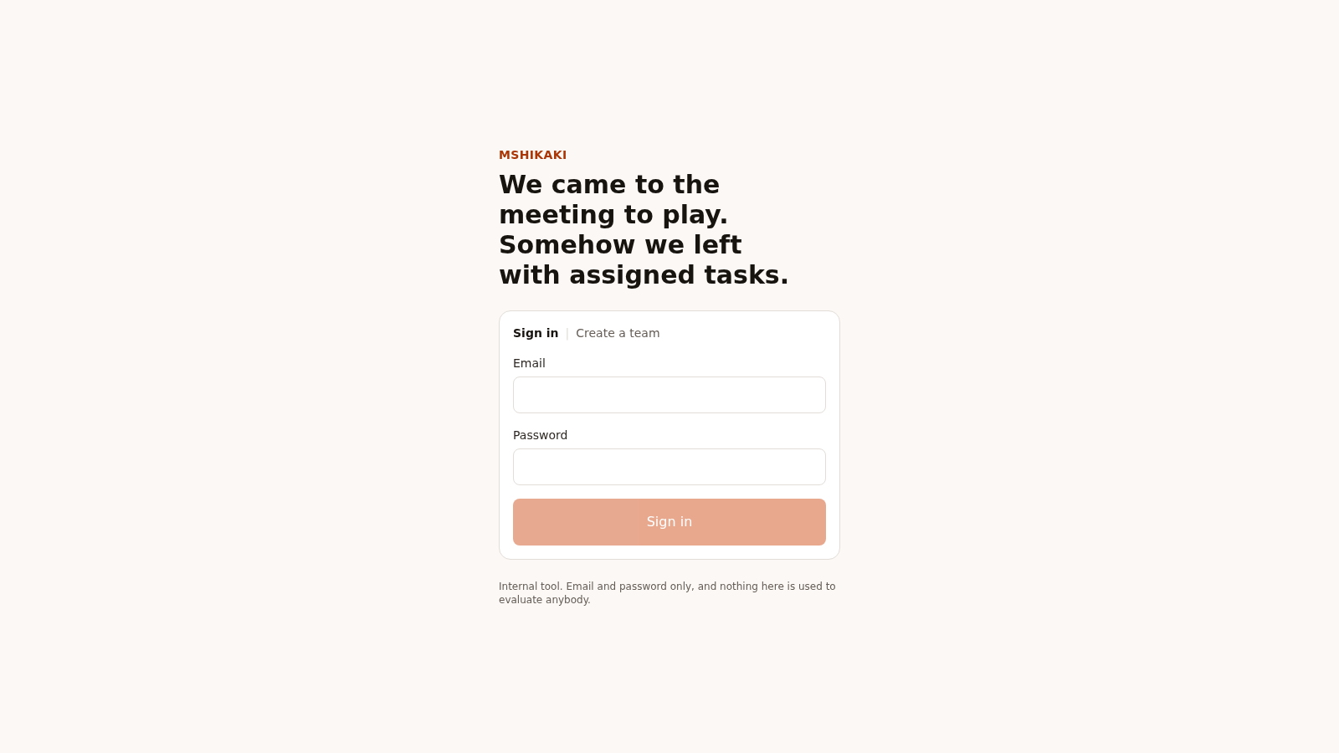
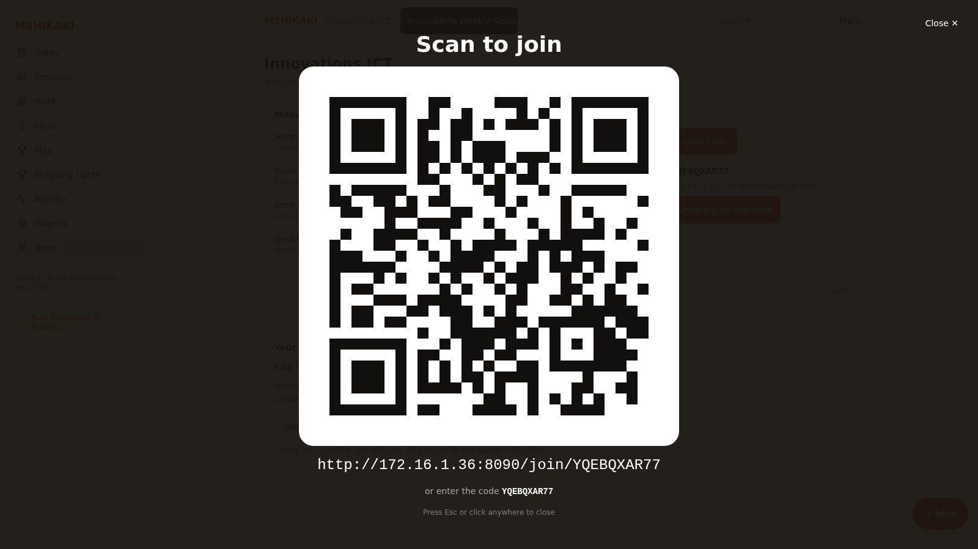
Getting in
Scan the code on the screen with a work email, or open the link a colleague shared. You land in the meeting.

Slide 4
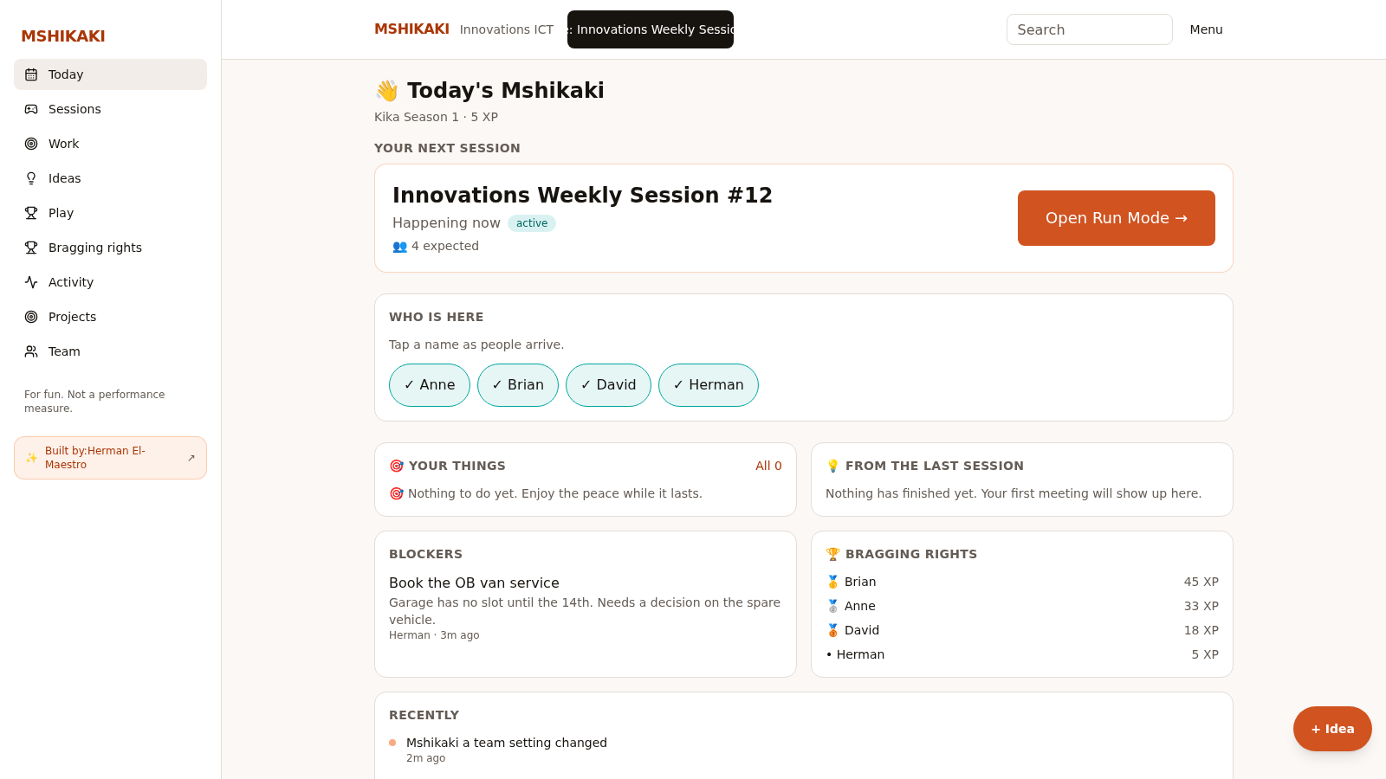
Today
Your next meeting, your own work and the last meeting's output, on one screen.

Slide 5
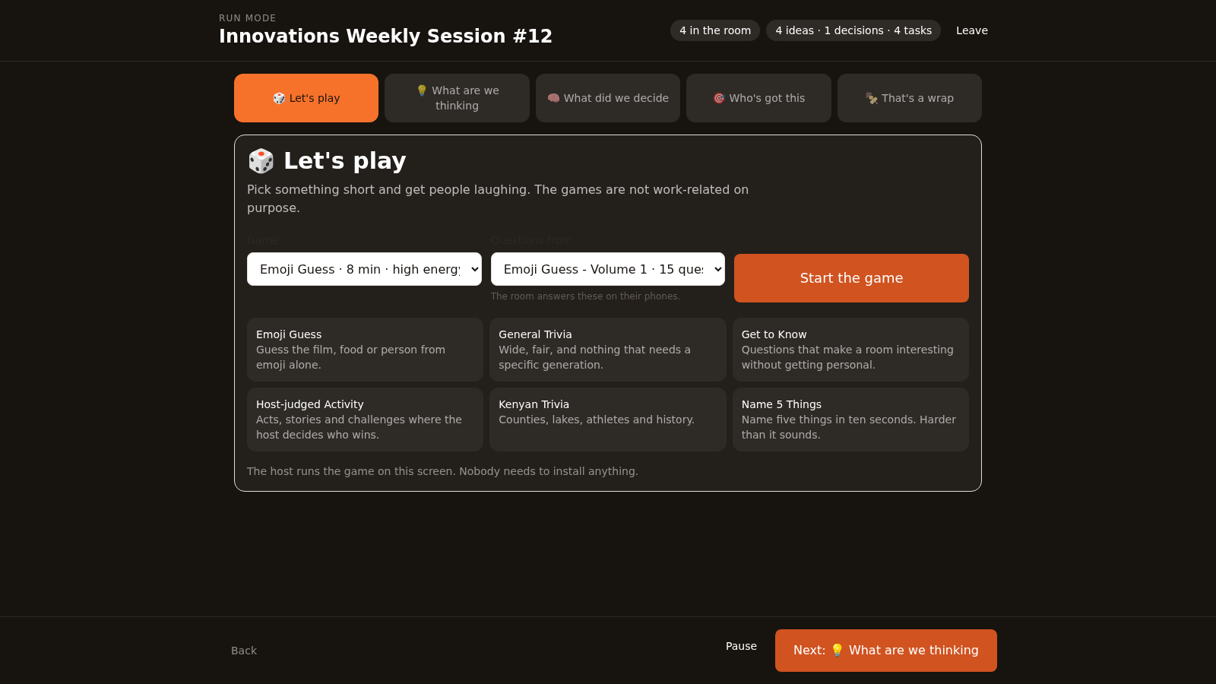
Running a meeting
One action per screen. The facilitator taps, and every phone follows to the same stage.

Slide 6
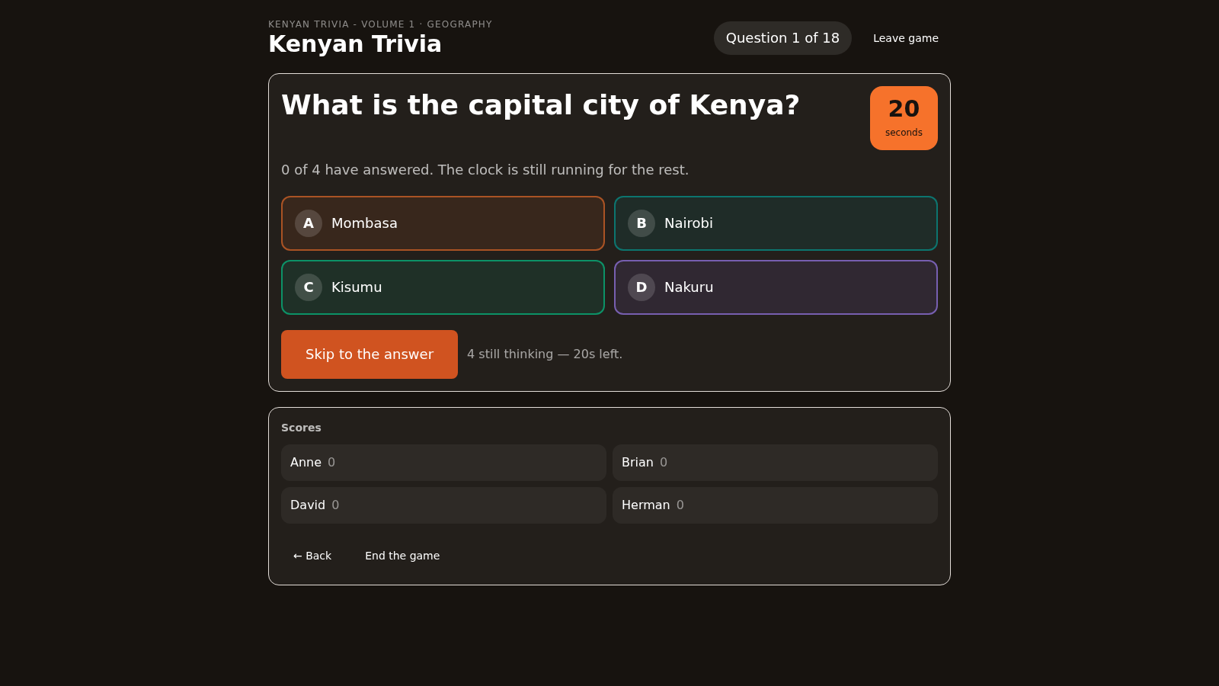
The game
The same question on the shared screen and on every phone. One clock for the room, one answer each.

Slide 7
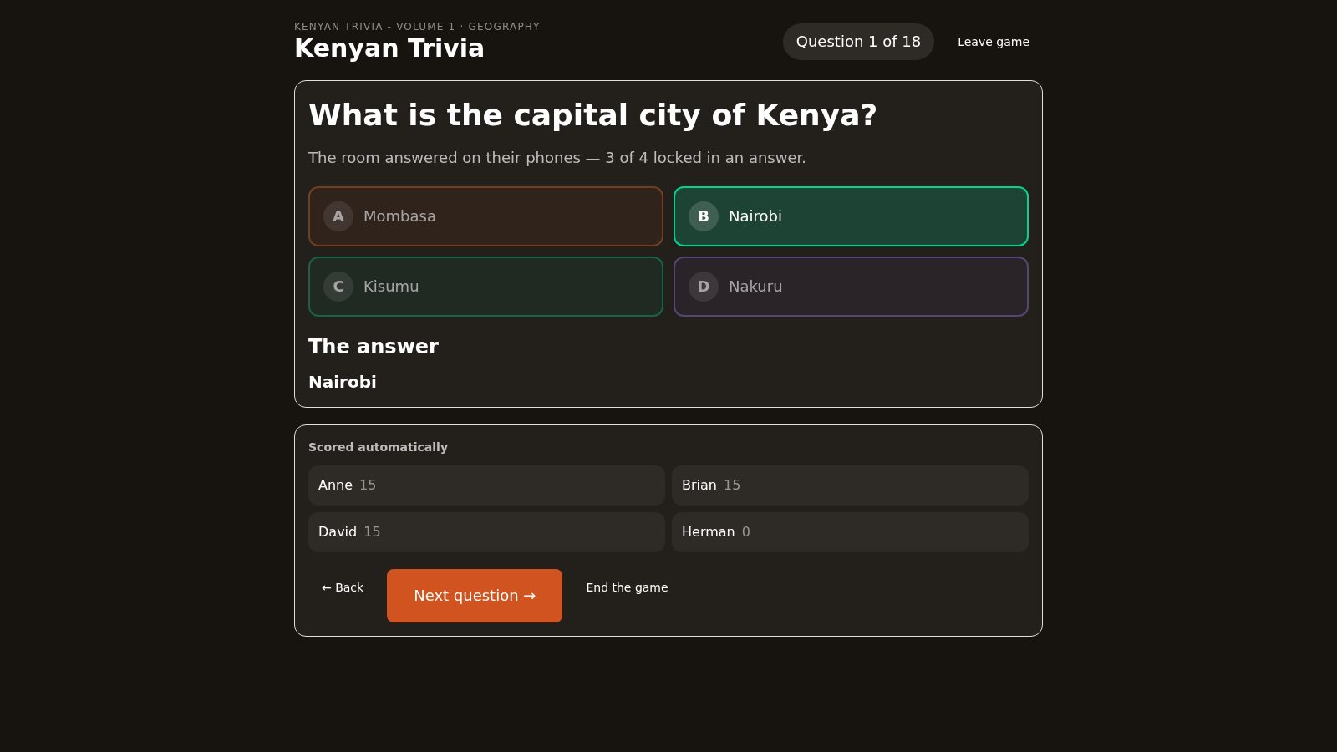
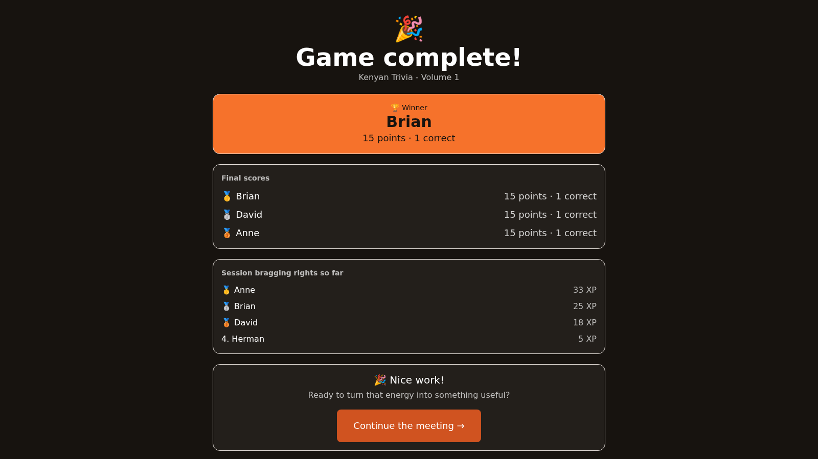
The reveal
The host reveals once and the right answers are scored together. Ten points, plus five for a quick answer.

Slide 8
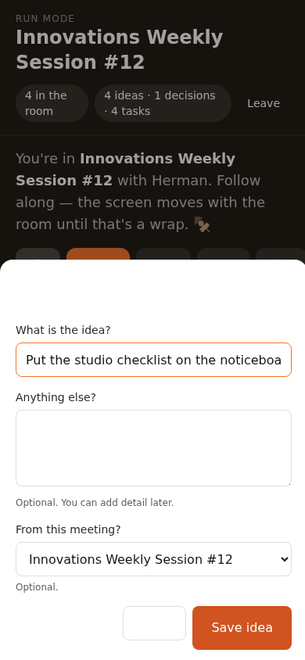
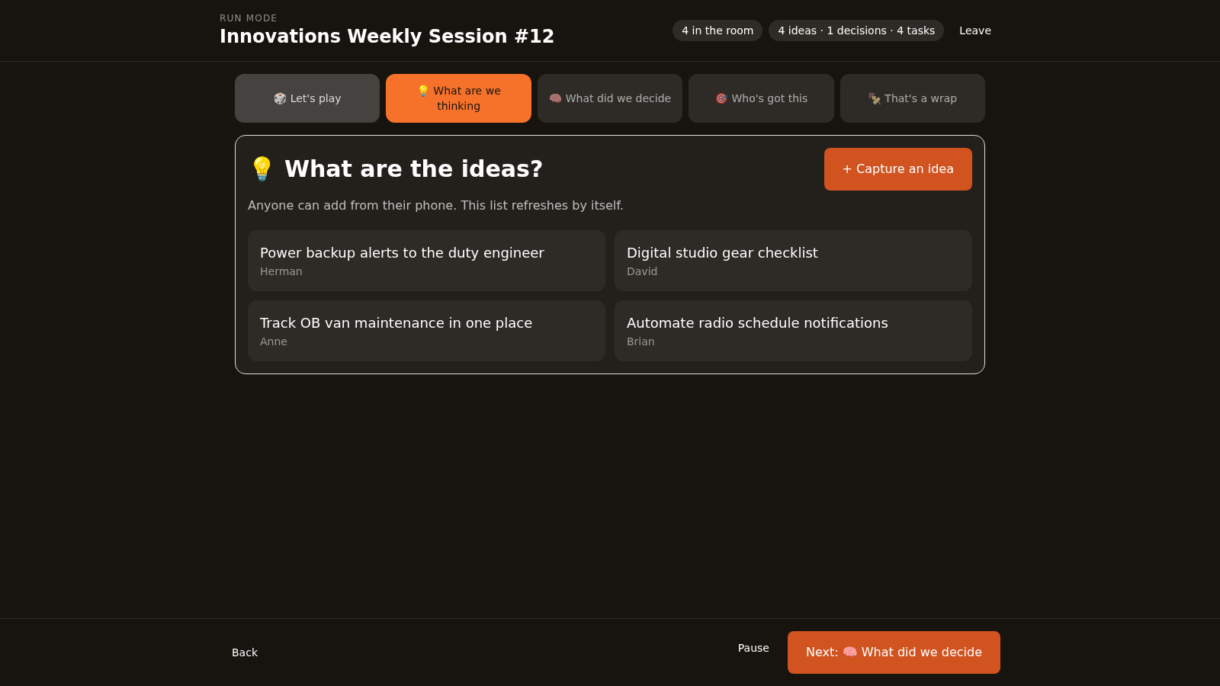
Capturing an idea
One line, saved in seconds. You stay exactly where you were in the meeting.

Slide 9
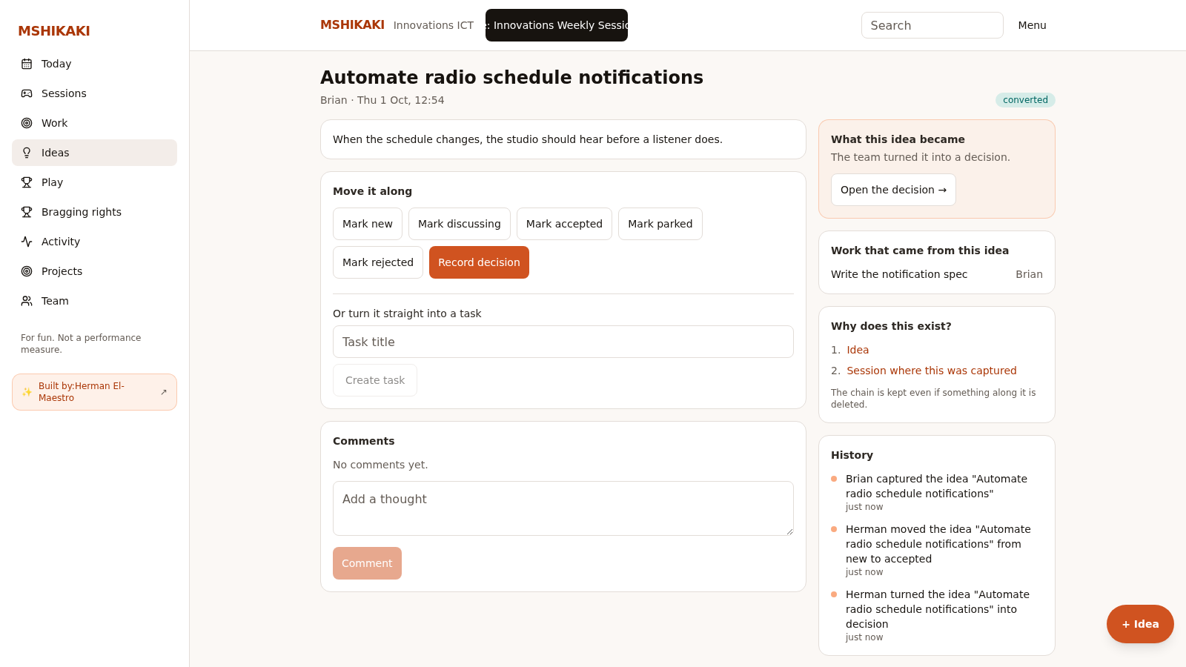
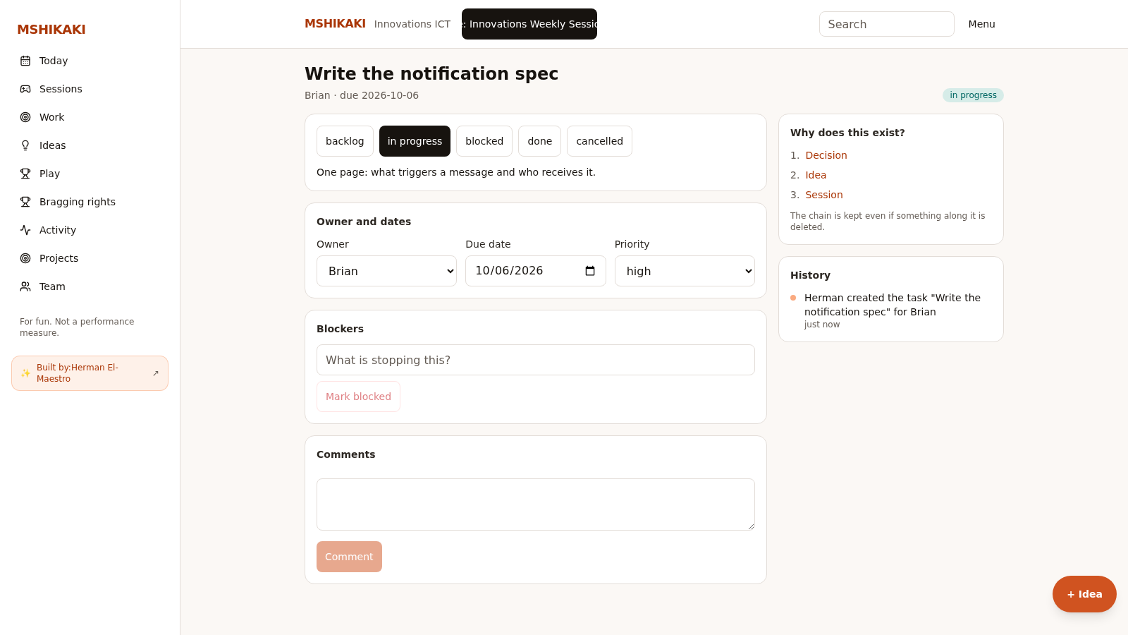
From idea to work
The decision and the task keep the idea that started them, so nobody has to remember.

Slide 10
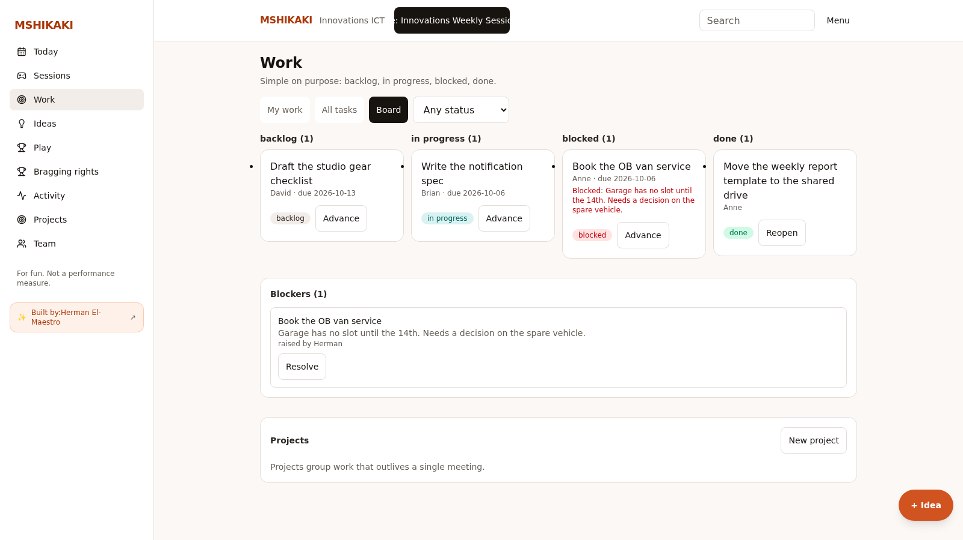
The work
Backlog, in progress, blocked and done. One owner for each task.

Slide 11
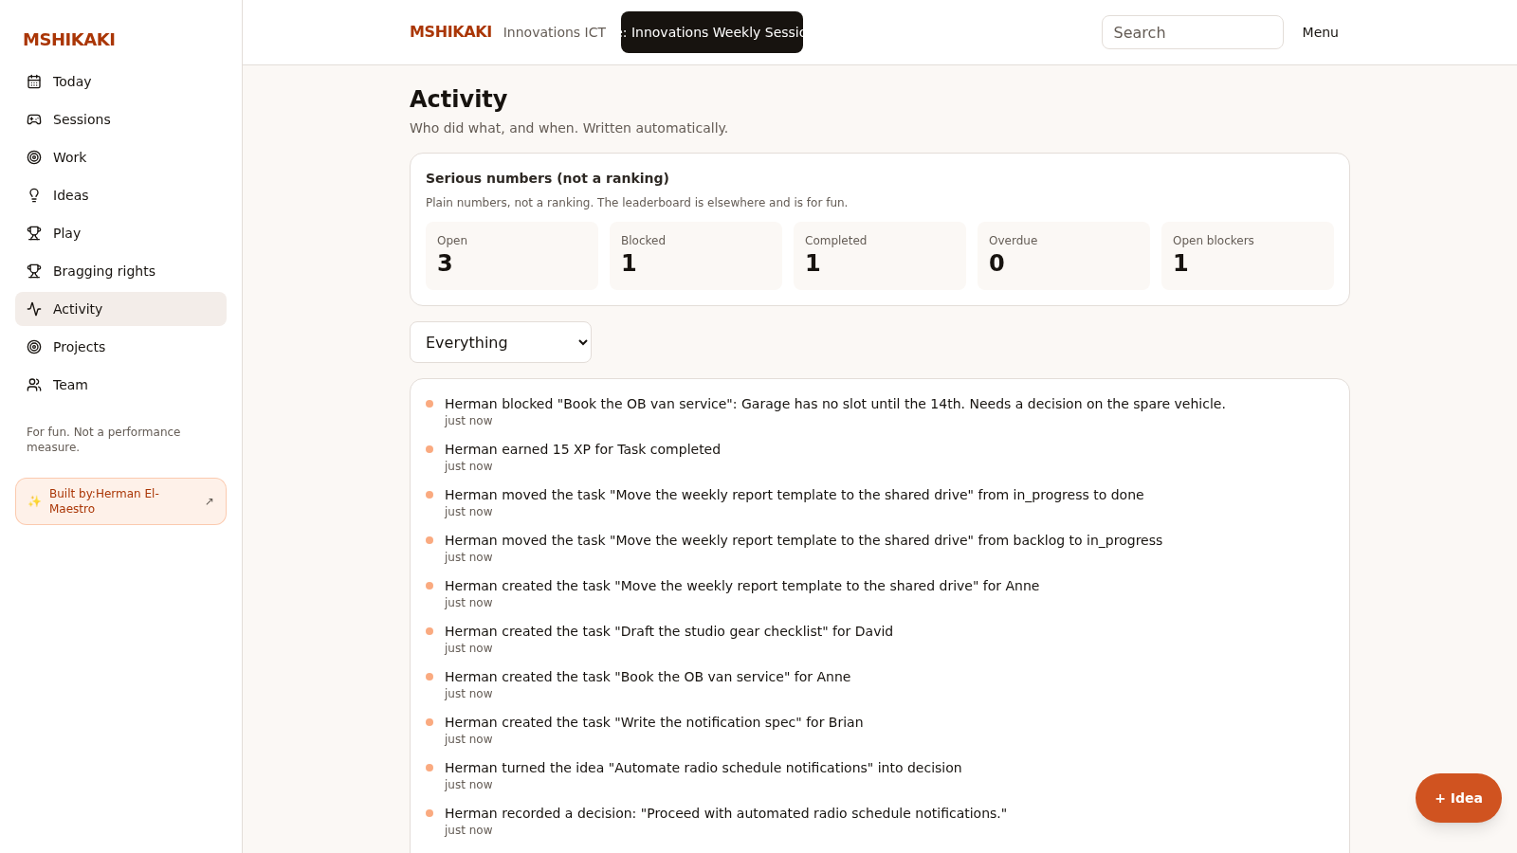
The record
Every change is written down with who, what and when. Nobody writes minutes.

Slide 12
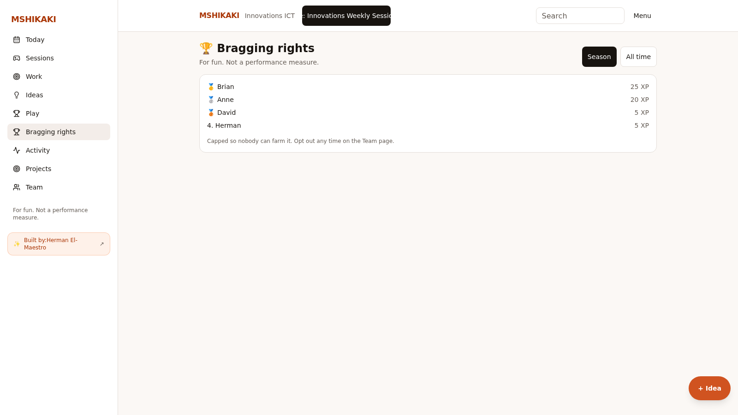
Bragging rights
XP for playing, proposing and finishing work. It is for fun, never a performance measure.

Slide 13
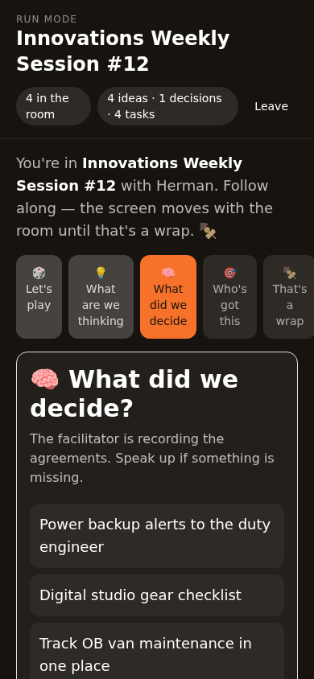
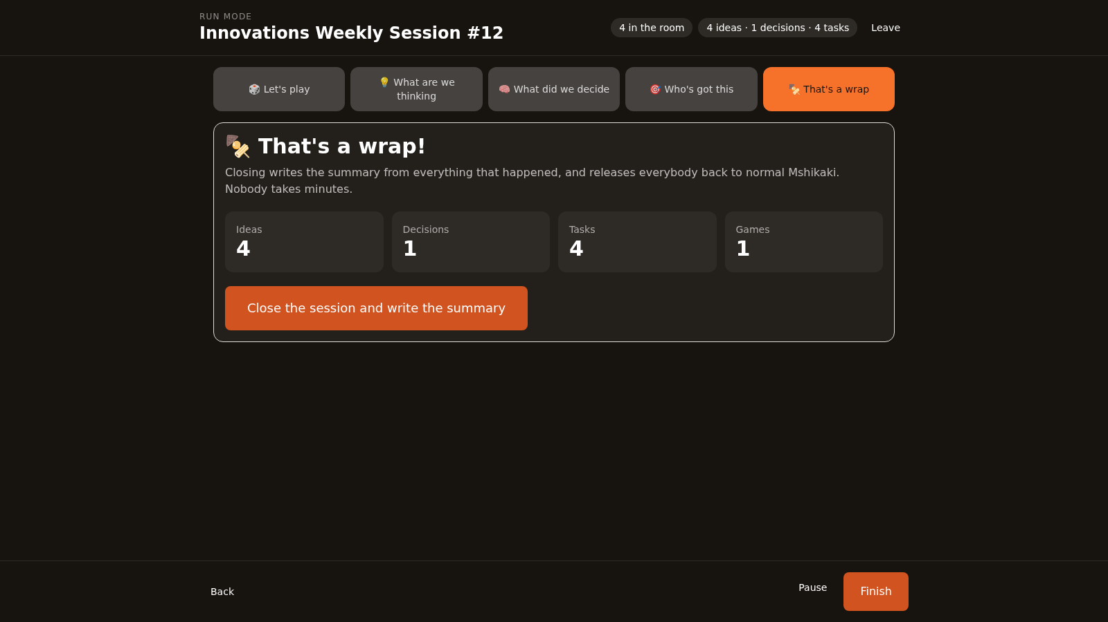
That's a wrap
The meeting closes, the summary writes itself, and everybody goes back to normal Mshikaki. Open the app, press Let's play, and let the room scan the code.

