Slide 1

Brand Style Guide

Slide 2
Brand Style Guide

Slide 3
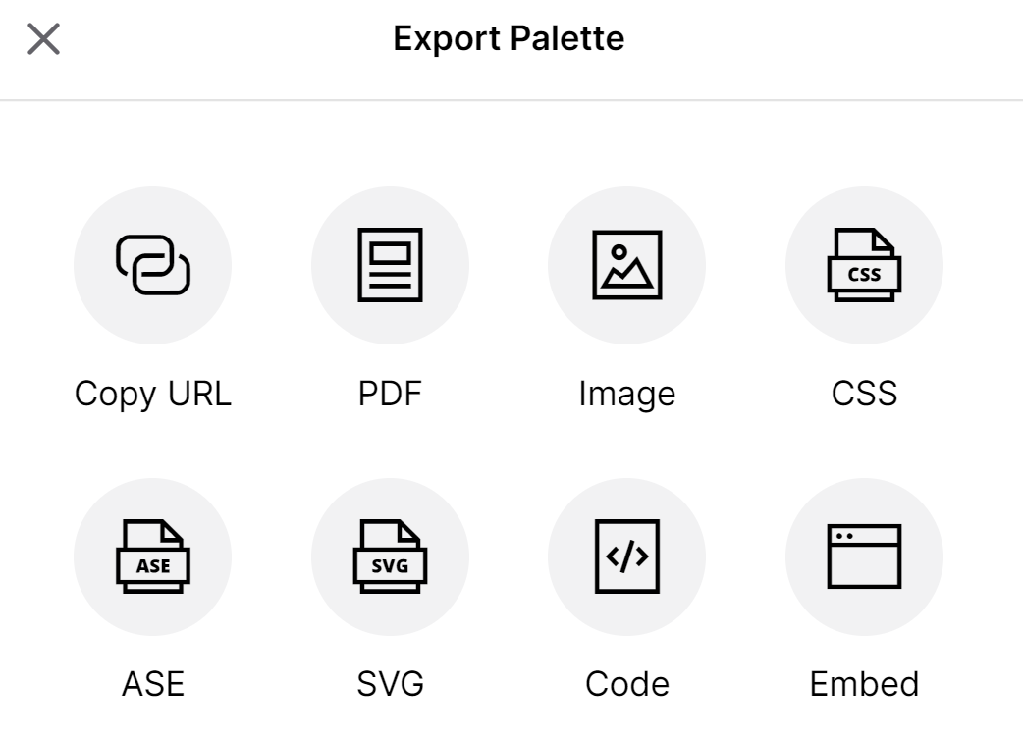
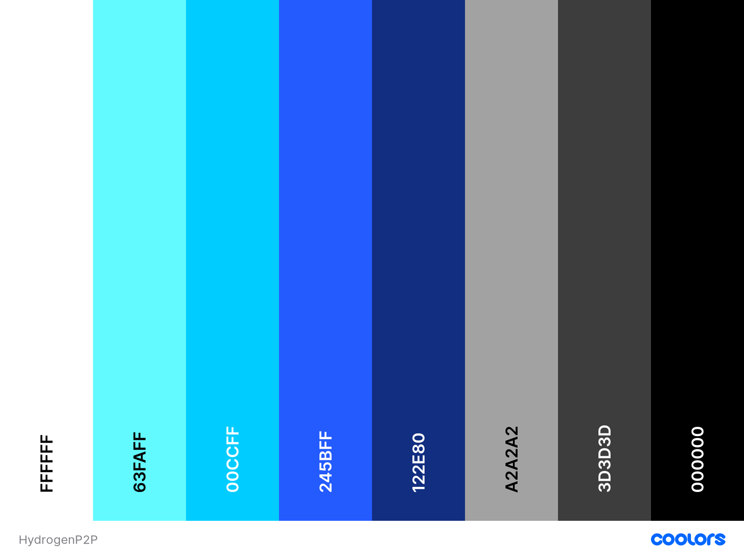
Colour Palettes
To access the colour palette, click here

Slide 4
Fonts
Poppins Black
Poppins Medium
Poppins
Poppins Light
To download font family, click here

Slide 5


Branding effects

