Slide 1
Introduction to Pulse Width Modulation (PWM)

Slide 2
What is PWM
Output signal alternates between on and off within specified period.
Control the power received by a device.
The voltage seen by the load is directly proportional to the source voltage.

Slide 3
What is PWM?
1
Duty cycle = 20%
0.2
on off
Duty cycle = 50%
0.5
on off
Width
period
Depending on the requirement the width of the pulse is modulated (adjusted).
Duty cycle = t_{on} / (t_{on} + t_{off}).

Slide 4
Why PWM?
Maximum voltage
100 %
75 %
50 %
t
Analog voltage control:
Voltage can be changed to control the motor speed
Can NIOS change voltage ?

Slide 5
Why PWM?
1
50 %
=
0
t
t
Analog control
Digital control
Digital voltage control:
Can only control ‘1’ and ‘0’
X% of maximum analog voltage = X% of duty cycle

Slide 6
PWM Control Example
Disco gate:
100 % open gate = 10 persons per second
50% open gate = 5 persons per second
Analog control:
Open 50 % gate
Total how many people can go in 10 seconds?
Digital control:
Open 100 % gate on every odd second (1,3,5,7,9, ..)
Total how many people can go in 10 seconds?

Slide 7
Usage of PWM
Motor Control
Intensity of LED

Slide 8
How to generate PWM signal ?
Software method
Using counter
Count to 100 in a loop
Set the output value to 1 in the beginning of the loop
Set the output value to 0 as soon as the counter reaches the value of required duty cycle.
Continue the process
Using interrupt
Home work
Think about the concept

Slide 9
Your tasks
Create projects in a usual way using provided SOPCINFO file.
Type the code in your application project.
Change duty cycle variable and observe the effect on oscilloscope or LED.
Using oscilloscope, verify the duty cycle.
Is it precise?
Is it efficient?

Slide 10
Software PWM
Output pin:
GPIO_0[0]
Using the manual find out the correct pin and observe the resulting PWM on the oscilloscope
In C program, use the following instructions to change the output
IOWR(PIO_0_BASE, 0, 0); // set output 0
IOWR(PIO_0_BASE, 0, 1); // set output 1
Control LED (optional):
Apply the PWM signal to LED, observe the intensity

Slide 11
You are 25 % engineer ALREADY !
Start doing things on your own
Use Google, dictionary to find a solution
Try hard, do not give up to be an expert engineer
I am sure, you all are very hard working and intelligent. You can do the job.
If you have problems call us

Slide 12
Questions

Slide 13
Hardware PWM IP
Let us use the NIOS processor as a boss
Does a boss do work by her/himself?
The boss only manages/guides/controls the people to do the job
Highest smartness is required in managing people
Do not think that your boss is an idiot !
Why the bosses have highest salary world-wide?
Career tip:
Let only people/machines/tools/computers do your job
Learn to manage them to get more salary

Slide 14
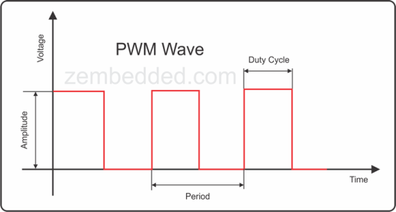
Hardware PWM IP
PWM
NIOS core
JTAG Uart
USB Blaster
RAM
Your PC
Programmable/configurable
Precise
A good obedient, the boss can RELAX !!!

Slide 15
Hardware PWM IP
Follow the simple use sequence
Enable
Configure
Modify
Disable
Only one function for controlling two PWM signals
motor_setting(phase1, duty1,
phase2, duty2,
period, enable);

Slide 16
Hardware PWM IP
motor_setting(phase1, duty1,
phase2, duty2,
period, enable);
Enable mask= 1
Disable = 0
Common period

Slide 17
Questions

Slide 18
Evaluation Scheme
Give A to the students who finish tasks by implementing C code, IP to generate the pwm wave. The students should also be clear about the difference of C code and hard IP.
Give B who just finish any task.
Give C or D to who cannot do any thing.

