Slide 1
JD COMMENT SPIDER
1245936 Hermann
1245926 Howard
1245983 Carlos
1245957 Eric

Slide 2
01
PART 1 Introduction
02
PART 2 Experimental process
CONTENTS
03
PART 3 Data Analysis
04
PART 4 Conclusion and Future Works

Slide 3
01
Introduction

Slide 4
01 Introduction
2
With the rapid development of the Internet, the World Wide Web has become the carrier of a large amount of information.Search engines, such as the traditional generic Search Engine AltaVista, Yahoo!Google and others, as a tool to assist people to retrieve information, become users access to the World Wide Web portal and guide.However, these universal search engines also have certain limitation.
In order to solve the above problems, the focused crawler of directional grasping related web page resources arises at the historic moment.
The purpose of the crawler produced by this program is to crawl the comments from the jingdong commodity page to the local for data analysis.
01
标题数字等都可以通过点击和重新输入进行更改，顶部“开始”面板中可以对字体、字号、颜色、行距等进行修改。建议正文8-14号字，1.3倍字间距。标题数字等都可以通过点击和重新输入进行更改。
02
标题数字等都可以通过点击和重新输入进行更改，顶部“开始”面板中可以对字体、字号、颜色、行距等进行修改。建议正文8-14号字，1.3倍字间距。
03
标题数字等都可以通过点击和重新输入进行更改，顶部“开始”面板中可以对字体、字号、颜色、行距等进行修改。

Slide 5
01 Problems need to be solved
2
During the Black Friday, we need to browse a large number of products and their reviews on E-commerce platforms like Amazon and JD.com.
Most of popular products' comments often have the following problems:
The number of comments is huge and it's impossible to find the information you want to refer to.
A lot of meaningless information.
Bad reviews that has nothing to do with the quality of the product.(Logistics, customer service)
01
标题数字等都可以通过点击和重新输入进行更改，顶部“开始”面板中可以对字体、字号、颜色、行距等进行修改。建议正文8-14号字，1.3倍字间距。标题数字等都可以通过点击和重新输入进行更改。
02
标题数字等都可以通过点击和重新输入进行更改，顶部“开始”面板中可以对字体、字号、颜色、行距等进行修改。建议正文8-14号字，1.3倍字间距。
03
标题数字等都可以通过点击和重新输入进行更改，顶部“开始”面板中可以对字体、字号、颜色、行距等进行修改。

Slide 6
01 Background
2
Search engines, such as Yahoo!, Google and others, as a tool to assist people to retrieve information, become a necessary way to search certain information on World Wide Web.
However, these universal search engines also have certain limitations, such as:
the results returned by search engines contain a large number of pages that users do not care about.
Some data with dense information and certain structure is not likely to be found.
Queries can only be made on keywords instead of semantics.
01
标题数字等都可以通过点击和重新输入进行更改，顶部“开始”面板中可以对字体、字号、颜色、行距等进行修改。建议正文8-14号字，1.3倍字间距。标题数字等都可以通过点击和重新输入进行更改。
02
标题数字等都可以通过点击和重新输入进行更改，顶部“开始”面板中可以对字体、字号、颜色、行距等进行修改。建议正文8-14号字，1.3倍字间距。
03
标题数字等都可以通过点击和重新输入进行更改，顶部“开始”面板中可以对字体、字号、颜色、行距等进行修改。

Slide 7
01 Tools to collect data - WebSpider
01
Web Spider, or Web Crawler, is a program or script that automatically extracts information from the World Wide Web according to certain rules.
The Internet itself is a big web, and the crawler is crawling on the web spider, if it meets resources you want, then the spider will grab it down.
The path connects a web to an other is called hyperlink.
Crawlers will follow the hyperlink to grab information on all of the pages they can.
01
标题数字等都可以通过点击和重新输入进行更改，顶部“开始”面板中可以对字体、字号、颜色、行距等进行修改。建议正文8-14号字，1.3倍字间距。标题数字等都可以通过点击和重新输入进行更改。
02
标题数字等都可以通过点击和重新输入进行更改，顶部“开始”面板中可以对字体、字号、颜色、行距等进行修改。建议正文8-14号字，1.3倍字间距。
03
标题数字等都可以通过点击和重新输入进行更改，顶部“开始”面板中可以对字体、字号、颜色、行距等进行修改。

Slide 8
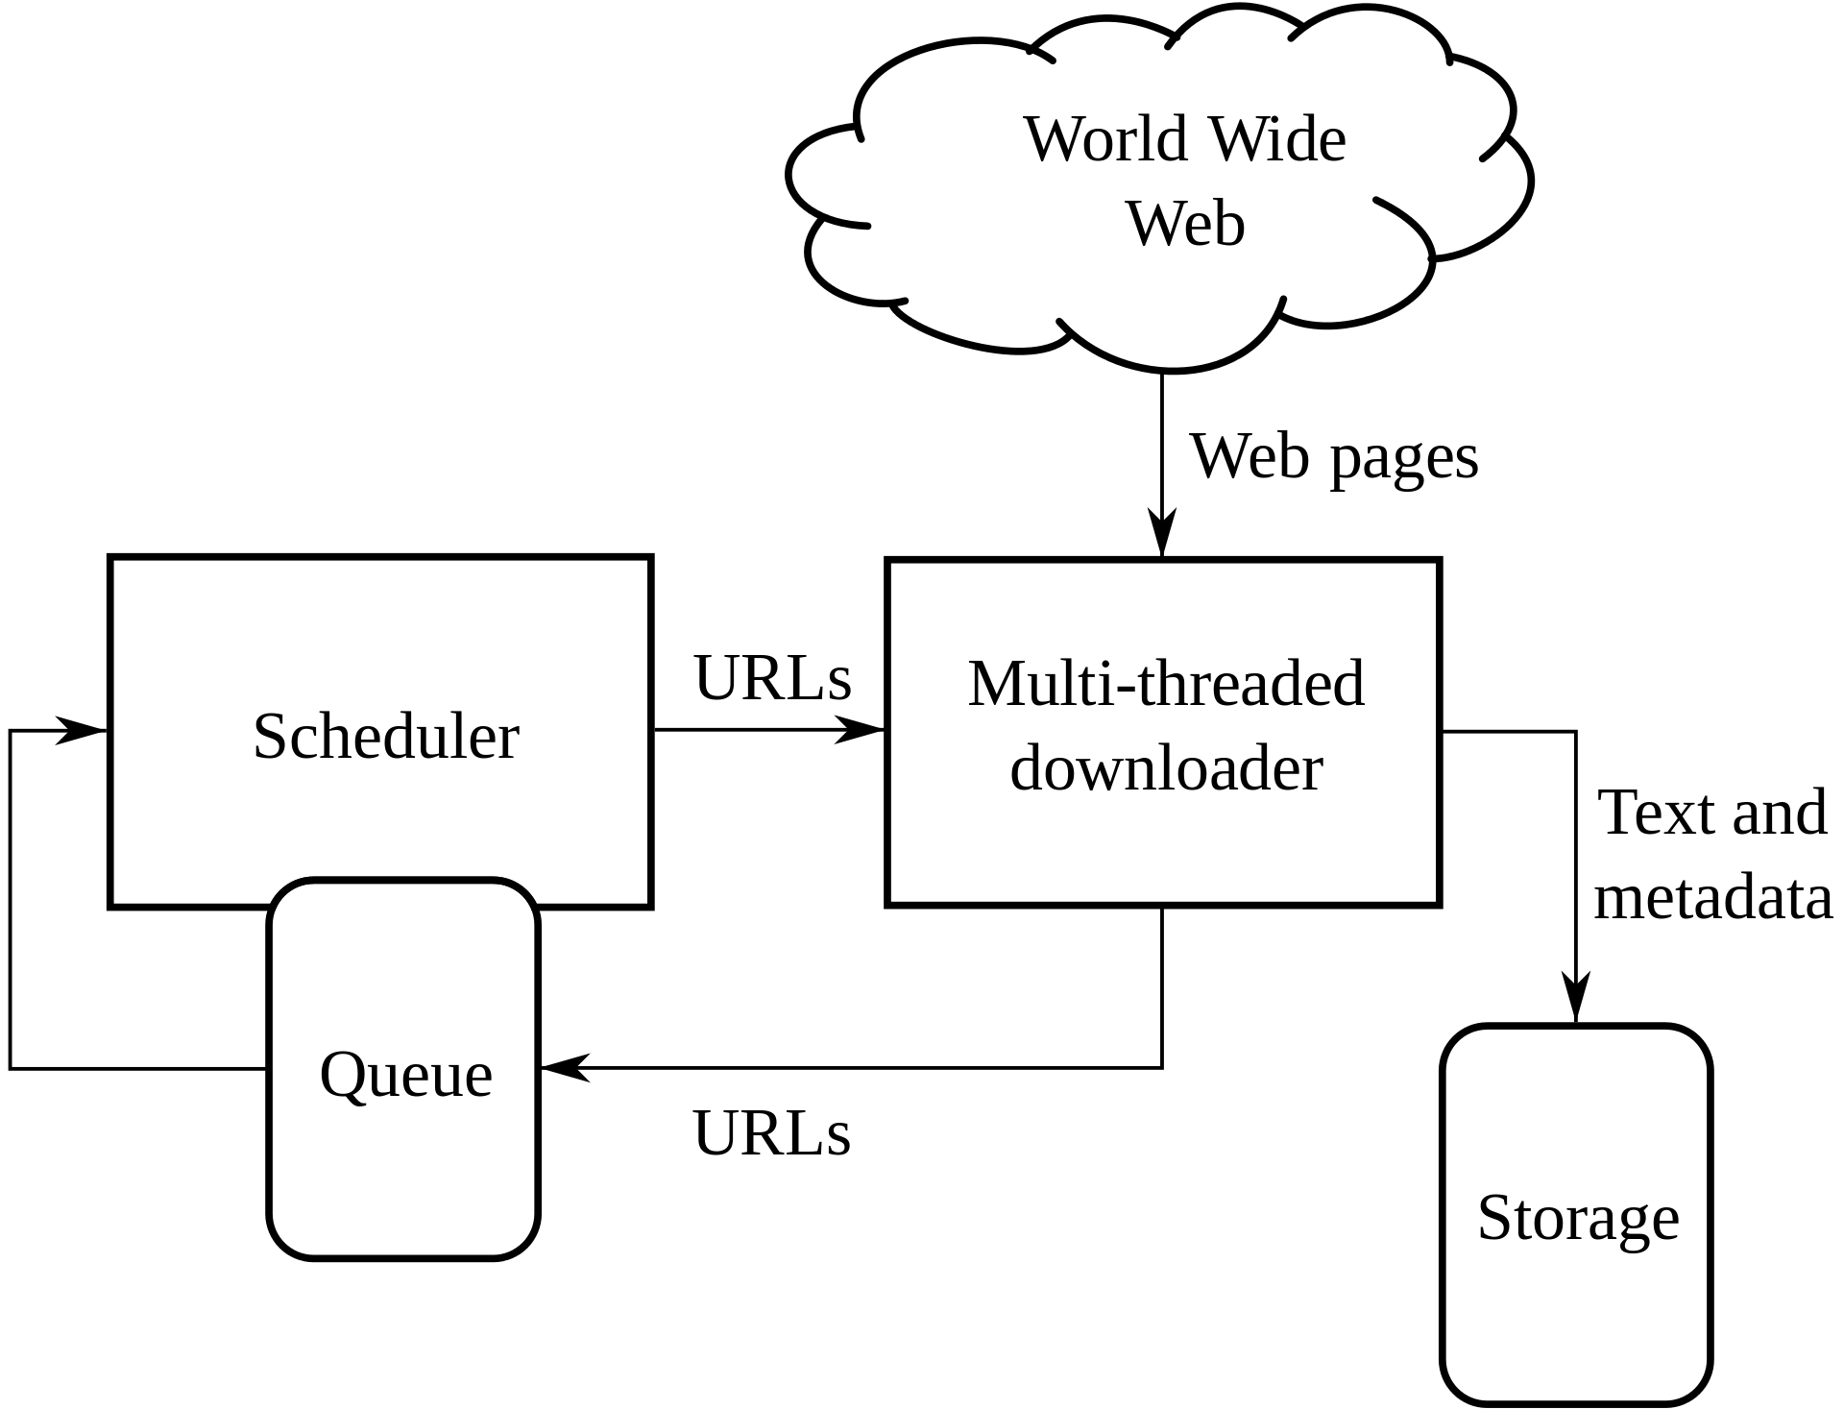
01 What is Spider?
01
01
3 Steps:
1. Send requests
2. Get responses
3. Parse pages
4. Save data to the database
标题数字等都可以通过点击和重新输入进行更改，顶部“开始”面板中可以对字体、字号、颜色、行距等进行修改。建议正文8-14号字，1.3倍字间距。标题数字等都可以通过点击和重新输入进行更改。
02
标题数字等都可以通过点击和重新输入进行更改，顶部“开始”面板中可以对字体、字号、颜色、行距等进行修改。建议正文8-14号字，1.3倍字间距。
03
标题数字等都可以通过点击和重新输入进行更改，顶部“开始”面板中可以对字体、字号、颜色、行距等进行修改。

Slide 9
01 What is Spider?
01
Request message : request line, request header, null line, and request body
01
标题数字等都可以通过点击和重新输入进行更改，顶部“开始”面板中可以对字体、字号、颜色、行距等进行修改。建议正文8-14号字，1.3倍字间距。标题数字等都可以通过点击和重新输入进行更改。
Request line: request method(Get, Post) , request url, http protocol
Request header: User-Agent, Referer, Cookie
Null line : sign of the end of request header
Request body: when the request method is post, it is the form data waiting to be s ubmitted
02
标题数字等都可以通过点击和重新输入进行更改，顶部“开始”面板中可以对字体、字号、颜色、行距等进行修改。建议正文8-14号字，1.3倍字间距。
03
标题数字等都可以通过点击和重新输入进行更改，顶部“开始”面板中可以对字体、字号、颜色、行距等进行修改。

Slide 10
01 What is Spider?
01
Response message : request line, request header, null line, and request body
01
标题数字等都可以通过点击和重新输入进行更改，顶部“开始”面板中可以对字体、字号、颜色、行距等进行修改。建议正文8-14号字，1.3倍字间距。标题数字等都可以通过点击和重新输入进行更改。
Respone line: status code, http protocol
Respone header: Describes basic information about the server
Null line : sign of the end of respone header
Respone body: Returns the requested data
02
标题数字等都可以通过点击和重新输入进行更改，顶部“开始”面板中可以对字体、字号、颜色、行距等进行修改。建议正文8-14号字，1.3倍字间距。
03
标题数字等都可以通过点击和重新输入进行更改，顶部“开始”面板中可以对字体、字号、颜色、行距等进行修改。

Slide 11
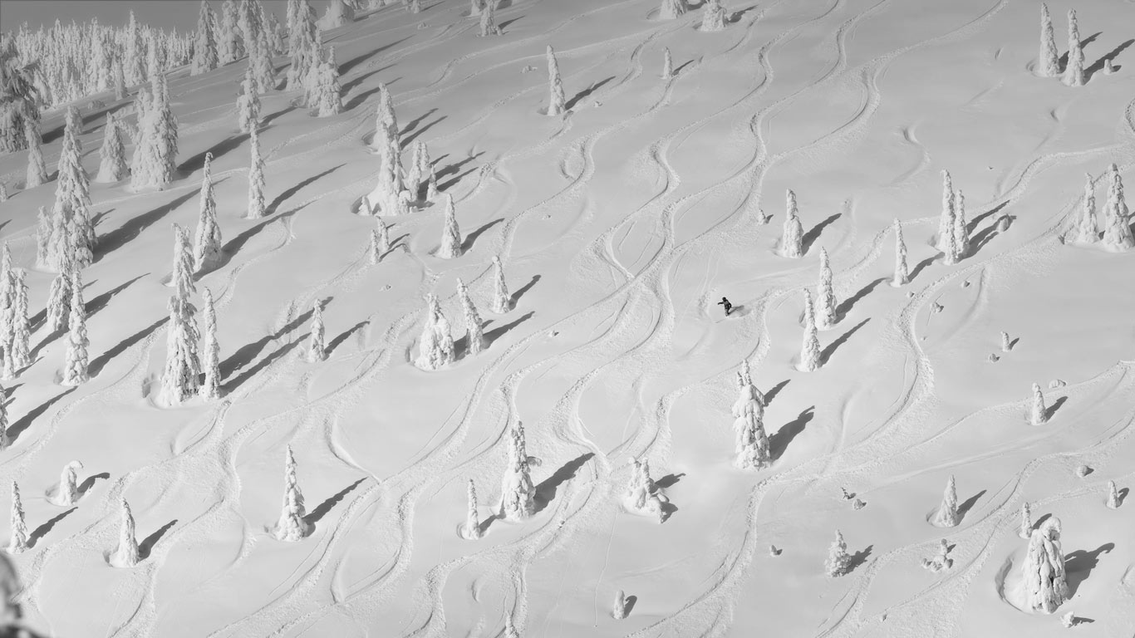
01 Procedure
02
01
02
03
Choose a certain products according to its URL on JD.com
Spider all of the comments down into an Excel worksheet.
Process and analyze the comment data.

Slide 12
02
Experimental process

Slide 13
02 Tools and Functions
2
Windows 64 1904
Python 3.8
01
标题数字等都可以通过点击和重新输入进行更改，顶部“开始”面板中可以对字体、字号、颜色、行距等进行修改。建议正文8-14号字，1.3倍字间距。标题数字等都可以通过点击和重新输入进行更改。
1.Customize the Product id on URL to change the product.
2.Get all of comments on the product's page.
3.Categorize product reviews into good, middle and bad reviews and print them to 'Comment Data.xls'
4.The comment information saved also includes : page, uid, nickname, content, create time, refername and score.
02
标题数字等都可以通过点击和重新输入进行更改，顶部“开始”面板中可以对字体、字号、颜色、行距等进行修改。建议正文8-14号字，1.3倍字间距。
03
标题数字等都可以通过点击和重新输入进行更改，顶部“开始”面板中可以对字体、字号、颜色、行距等进行修改。

Slide 14
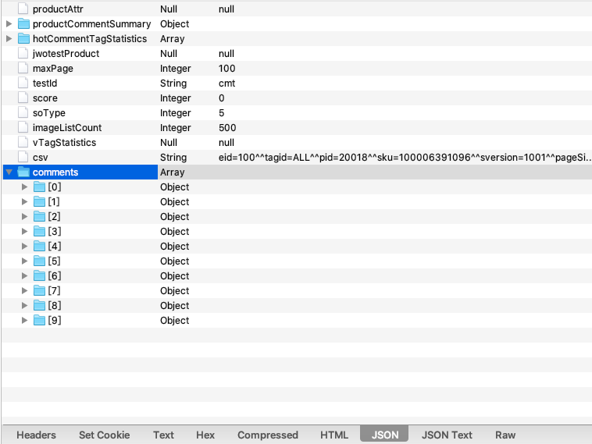
02 Process
2
1. Open Google/Firefox Browser and enter the purchase page of a certain product on JD.com.
2. Use the capture tool (Charles), open the agent and refresh the page to find the API interface of the comment content.
3. The significance of parameters in the comment URL can be known through browser debugging
4. It shows that all the comment data for the current page is here:
01
标题数字等都可以通过点击和重新输入进行更改，顶部“开始”面板中可以对字体、字号、颜色、行距等进行修改。建议正文8-14号字，1.3倍字间距。标题数字等都可以通过点击和重新输入进行更改。
02
标题数字等都可以通过点击和重新输入进行更改，顶部“开始”面板中可以对字体、字号、颜色、行距等进行修改。建议正文8-14号字，1.3倍字间距。
03
标题数字等都可以通过点击和重新输入进行更改，顶部“开始”面板中可以对字体、字号、颜色、行距等进行修改。

Slide 15
03
Data Analysis

Slide 16
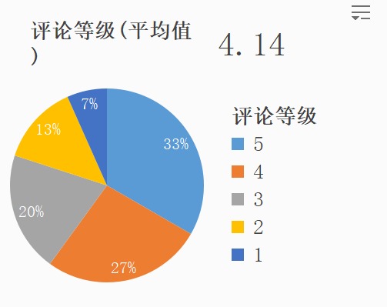
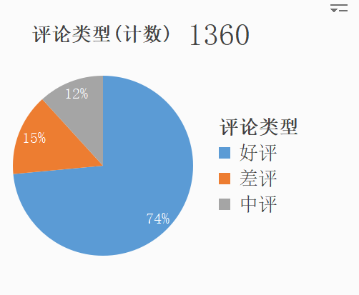
02 Data analysis
Tool: Excel content: The latest 1,360 comments
2
01
标题数字等都可以通过点击和重新输入进行更改，顶部“开始”面板中可以对字体、字号、颜色、行距等进行修改。建议正文8-14号字，1.3倍字间距。标题数字等都可以通过点击和重新输入进行更改。
02
标题数字等都可以通过点击和重新输入进行更改，顶部“开始”面板中可以对字体、字号、颜色、行距等进行修改。建议正文8-14号字，1.3倍字间距。
03
标题数字等都可以通过点击和重新输入进行更改，顶部“开始”面板中可以对字体、字号、颜色、行距等进行修改。

Slide 17
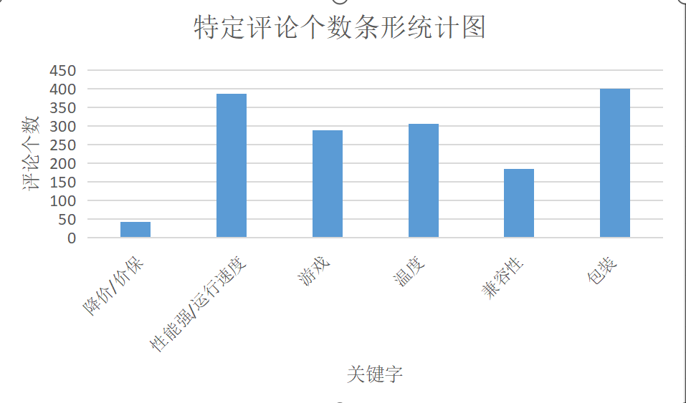
02 Data analysis
Tool: Excel content: The latest 1,360 comments
2
01
标题数字等都可以通过点击和重新输入进行更改，顶部“开始”面板中可以对字体、字号、颜色、行距等进行修改。建议正文8-14号字，1.3倍字间距。标题数字等都可以通过点击和重新输入进行更改。
02
标题数字等都可以通过点击和重新输入进行更改，顶部“开始”面板中可以对字体、字号、颜色、行距等进行修改。建议正文8-14号字，1.3倍字间距。
03
标题数字等都可以通过点击和重新输入进行更改，顶部“开始”面板中可以对字体、字号、颜色、行距等进行修改。

Slide 18
04
Conclusion and Future Works

Slide 19
04 Conclusion
2
1. Through an analysis of 1630 recent reviews, I found that the rate of poor and medium reviews for this product is much higher than the official website shows
2. 11% of customers attach importance on its compatibility.
19% of customers use it to play games and 83% among them give a good review.
21.5% of bad bad reviews was given because of the reduction of price
01
标题数字等都可以通过点击和重新输入进行更改，顶部“开始”面板中可以对字体、字号、颜色、行距等进行修改。建议正文8-14号字，1.3倍字间距。标题数字等都可以通过点击和重新输入进行更改。
02
标题数字等都可以通过点击和重新输入进行更改，顶部“开始”面板中可以对字体、字号、颜色、行距等进行修改。建议正文8-14号字，1.3倍字间距。
03
标题数字等都可以通过点击和重新输入进行更改，顶部“开始”面板中可以对字体、字号、颜色、行距等进行修改。

Slide 20
04 Future Work
2
1. Add a real-time crawler function for the crawler
2.Create a text-sentiment analysis program to rate how positive buyers are about the product
3. Improve the efficiency of keyword fetching
01
标题数字等都可以通过点击和重新输入进行更改，顶部“开始”面板中可以对字体、字号、颜色、行距等进行修改。建议正文8-14号字，1.3倍字间距。标题数字等都可以通过点击和重新输入进行更改。
02
标题数字等都可以通过点击和重新输入进行更改，顶部“开始”面板中可以对字体、字号、颜色、行距等进行修改。建议正文8-14号字，1.3倍字间距。
03
标题数字等都可以通过点击和重新输入进行更改，顶部“开始”面板中可以对字体、字号、颜色、行距等进行修改。

Slide 21
Thank you！

