Slide 1
Drone grocery delivery
A PDP problem Anthony Hermans & Federico Quin

Slide 2
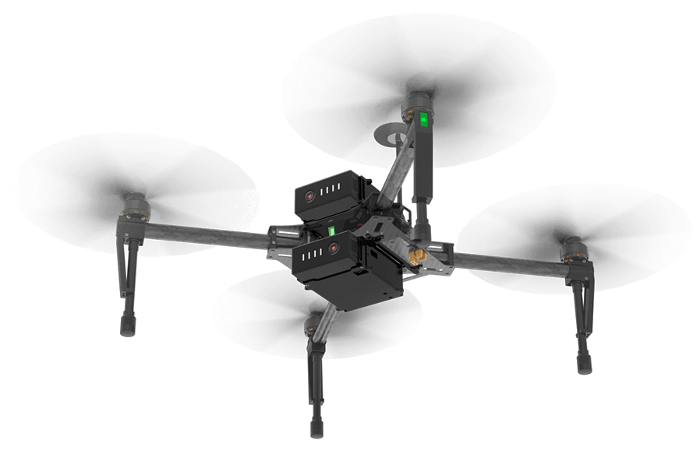
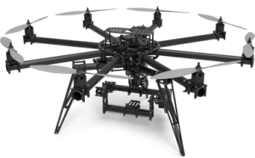
Drones / UAV’s
Two kinds:
Lightweight drone (based on DJI matrice 100)
Load: +- 3.5 kg
Battery life: 40 min
Charging time: 78 min
Speed: 17 - 22 m/s
Range: 5 km
Heavyweight drone (based on Freefly Alta 8)
Load: 9 kg
Battery life: 25 min
Charging time: 105 min
Speed: 11 - 22 m/s
Range: 3-4 km

Slide 3
The task at hand
Customer orders groceries (requests)
Order is composed at the specified supermarket (+- 5 min)
Package is done:
Pickup window
Depending on the kinds of purchased goods
Drone flies to destination
Taking into account the battery life and load capacity
Drone drops package at the customers house
Depending on the timeframe specified by the customer

Slide 4
Possible expansions
Depending on the project progress:
Prioritized packages
Combining packages
Dealing with drone crashes

Slide 5
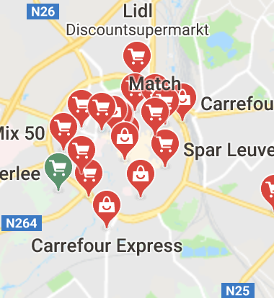
Scale
Leuven city
Different stores
A charging station
Bird’s eye view
Number of drones:
Standard 30 drones
20 lightweight
10 heavyweight

Slide 6

Routing for charging point
Central behaviour module
Information about central charging point
Coordination
Occupation
Charging point
Several chargers for each kind of drone
TODO determine amount

Slide 7
Communication and dynamism
Communication
When a drone delivers its package
Send data to central behaviour module
Dynamism
Depending on load
Increase # drones
Decrease # drones

Slide 8

Research objectives
Is a drone PDP method a good solution for grocery delivery?
Does increasing the amount of drones always have a positive effect on the performance?
Does one drone type outperform the other type?

Slide 9
Research questions for objective 1
What is the percentage of orders delivered on time during normal circumstances?
What is the average delivery time of an order during normal circumstances?
How high is the occupation at the charging station?
Notes:
During normal circumstances: Poisson process
During normal circumstances
Using only 1 type per simulation

Slide 10
Research questions for objective 2
How different is the average delivery time when using an increased amount of drones?
What is the effect of more drones on the coordination at the charging station?
What is the occupation of each drone individually when a large amount of drones is used?

Slide 11
Research questions for objective 3
Does the lightweight drone provide a better average delivery time?
What kind of drone has the highest amount of packages that are too late?
What kind of drone reduces the stress on the charging station the most?

Slide 12
Hypotheses (TODO)

Slide 13
How to proceed (TODO)

