Slide 1

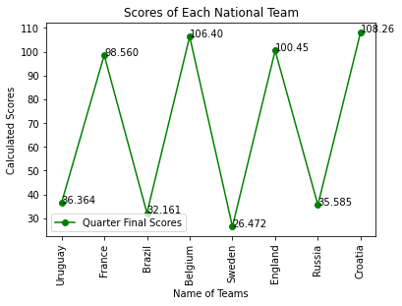
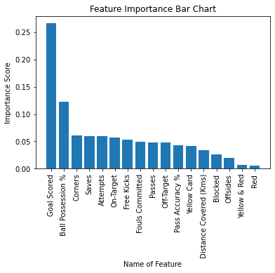
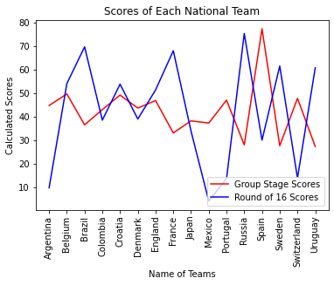
Predicting the Result of 2018 FIFA World Cup
Alex Li, Xiaoyuan Wu, Yifei Song
The George Washington University
Abstract
Methodology
Results
Conclusion
With the 2018 FIFA World Cup already happened, we have used the existing data to develop a moderately sophisticated model that will use various data (Goal Scored, Pass Accuracy, Possession, etc.) as well as the results from the Group stage to predict the final outcome of the tournament. We want to know whether it is possible to use machine learning in predicting the outcome of soccer tournaments solely based on entire team’s performance.
To achieve the goal of predicting the outcome that match with the real-world results, we attempted several different models including linear regression, logistic regression and random forest classification. We eventually settled on using a random forest to evaluate the importance of each feature from the group stage. With the importance of each feature, the model calculates a score for each team as their initial score. Later, we manipulated the scores based on the results from round of 16 and quarter finals. Finally, the scores of the teams are ranked for predicting the results of the 2018 FIFA World Cup.
Our first and foremost finding is that a machine learning model is indeed capable of helping predicting the outcome of a soccer tournament like the 2018 FIFA World Cup. Our model yielded mostly accurate results for the semi final and final base on all the previous given data from group stage and first two knockout rounds. Furthermore, we discovered that certain play style of a team may bias the entire model.
Our initial thought is to apply a linear or logistic regression to the data in hand in order to see if there is any relationship between various data, such as the number of goals scored, rate of possession and pass accuracy. While the logistic regression yielded decent accuracy when we divided test and training set to be 20% and 80% of all the teams, we realized such approach may not be the best due to lack of necessary correlations between the features and results of the games. Furthermore, we were only considering individual match’s result rather than evaluating the performance of a team across the group stage, which means some results may be biased due to the difference between two teams can vary.
In order to resolve the above issues, we settled on a random forest to calculate the importance of each feature. Our first step towards that is to group all the features of a single team during the entire group stage together. After that, we standardized the data and performed a calculation on feature importance with random forest. As a result, Goal Scored is the most important feature followed by Ball Possession %(shown in the bar chart below), which are as expected.
Our next step is to utilize the importance scores we obtained from the Random Forest and calculate a score for each of the 16 teams who advanced to the Round of 16.
For the first two knockout rounds, we applied a weighted calculations to improve the scores. Our method is straight forward for these two rounds. For the Round of 16, if a team with a lower score defeats a team with higher score, it will gain 60% of the average score of the two teams while the losing team will lose the same amount. If a team with a higher score defeats a team with lower score, it will only gain 40% of the average score of the two teams while the losing team losing the same amount. For the quarter finals, the same rules apply. We have also tried using a non-linear weight such that a larger difference between the teams’ ratings leads to a larger change in the scores. However, in the case of our dataset, this did not make enough of a difference to alter the results. After the first two knockout rounds, there are four teams remaining and their scores are ranked from high to low as our prediction for the final standing of those teams.
Our very first finding is from the feature importance scores that came from the Random Forest where number of goals scored is consistently the most important feature for advancing from the group stage to the knockout rounds. This is as expected by us since the team with the greatest number of goals will win the game and the two teams that won most games will advance from the group stage. Furthermore, in the era of tiki-taka, ball possession percentage unsurprisingly followed the number of goals scored to be the second most important feature, leading corners and attempts by a decent margin. Using the importance of each feature given by the random forest classifier, we readjust each team’s match statistics by applying the corresponding weight to each of the statistics according to their Importance. The adjusted statistics for the two matches in group stage are combined by our model, which gives us the initial scores for each team after the group stage.
However, we found out teams’ play styles may bias our scores which are calculated on each team’s statistics and feature importance. For example, Spain constantly receives a way higher score than every other team after the group stage because of its tiki-taka play style provides a higher ball possession percentage than every other team. In contrast, France, the champion of the tournament receives a relatively low score from the group stage because it scored only 3 goals during the group stage and did not have high possession. This means that after the group stage, the scores for each team generated by our model is not consistent with the final results of the tournament.
To compensate for this, the teams’ scores are readjusted after each subsequent match. Depending the difference in scores between the two teams for each match in the round of 16 and quart finals, the scores are adjusted such that if a lower rated team defeated a higher rated team, that team’s score will be increased more, and vice versa. Finally, after the quarter finals, the final scores of the remaining 4 teams will be used to determine the tournament results. As depicted on the chart, out of the top 4 teams, our model predicted the final rankings as follows: 1. Croatia, 2. Belgium, 3. England, 4. France. Compared to the correct results: 1. France 2. Croatia, 3. Belgium, 4. England. This is mostly accurate, with the only exception being France, the eventual champion, which was placed too low by our model. This suggests France had very close games in their group stage and elimination matches, and indeed this was the case.
Overall, our model was able to successfully predict the ranking of 3 out of the top 4 teams in FIFA 2018 based on their performances earlier in the tournament. Of course, the weights used in our model’s calculations can be readjusted such that the final prediction obtained is 100% correct, but this would require us to know the final results beforehand which is not possible in practical applications. Overall, the feature importance given by the random forest classifier reflects the groups stage performances for each team relatively accurately, given the assumption each team start at the same skill level. This is a potential drawback, as the relative skill level of each team’s group stage opponents were not taken into account. This means that some teams could be rated too high due to their dominance over a weaker opponent, and vice versa. We considered given each team some preassigned rating based on their expected skill level, but there isn’t a way to do this objectively, since the world cup roster for each team changes drastically each year. Ultimately, we relied on the model to utilize the two rounds of elimination matches to readjust the teams’ scores, which produced relatively good results.
We believe the biggest drawback to our model is the relatively small amount of data available. Because of the format of the FIFA games, only two teams from each of the 8 groups advance to the second round. Since the entirety of the group stage match results are needed for our model to calculate the initial team scores, each team only have at most two additional matches for us to readjust their scores. Because the teams from each group do not play each other until the single elimination matches, our model would have benefited greatly from more matches before the elimination matches, in order to more accurately establish the baseline skill level of each team relative to other teams in the tournament.
Introduction
FIFA World Cup has been a symbolic soccer tournament that happens every four years. A total of thirty-two teams from all over the world will enter the event and a final winner will emerge after the group stage, quarter-final, semi-final and final rounds. Previous attempts^{1,2,3} have been made on predicting the World Cup or similar soccer tournaments. However, they are all predicting the result of a tournament based on prolonged data of a team or data of individual players in a team.
We saw the shortcomings of some of the aforementioned approaches, especially using the data from months or even years back of a team could lead to misleading results. The reason simply is the fast rotation of players inside each team throughout the years. Two World Cups are held four years apart, which means some core players that played four years ago may no longer be in the team this year.
Consequently, we agree with the model where individual players are taking into account. However, with limited access to individual player’s data, we decided on a new approach to predict the outcome of the FIFA World Cup that will be described in detail in the Methodology section. In general, we have taken all the matches in the Group Stage into account to calculate a score for each of the thirty-two teams. We then add or subtract scores from each of the winning or losing team in the quarter and semi-finals. Lastly, we have a score for the remaining four teams, which will let us predict the result of the tournament.
References
https://www.kaggle.com/agostontorok/soccer-world-cup-2018-winner
https://www.frontiersin.org/articles/10.3389/fpsyg.2019.01044/full
https://iopscience.iop.org/article/10.1088/1757-899X/226/1/012099/pdf
https://content.sciendo.com/configurable/contentpage/journals$002fhukin$002f71$002f1$002farticle-p205.xml?tab_body=abstract
https://www.frontiersin.org/articles/10.3389/fpsyg.2019.01044/full

