Slide 1



A
C
A

Slide 2


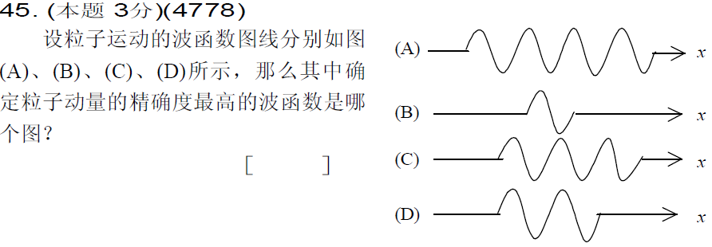
D
C
A

Slide 3



C
D
A

Slide 4

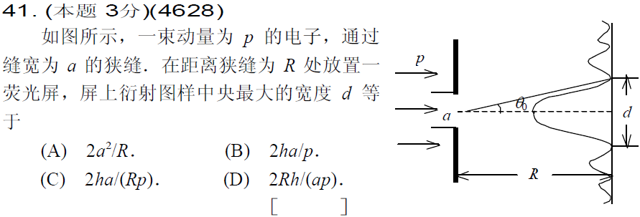
D
D

Slide 5
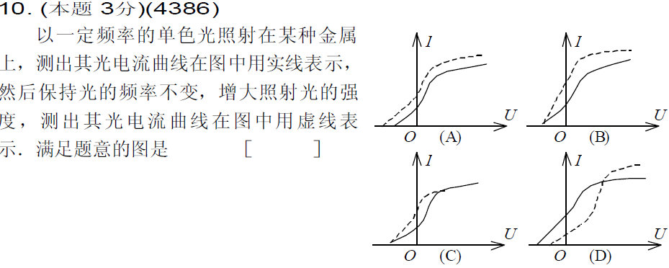


B
A
D

Slide 6



E
C
C

Slide 7
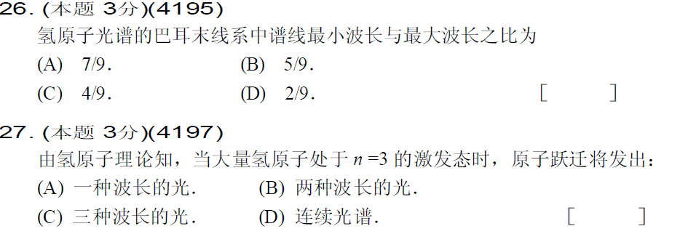

B
C
A

Slide 8

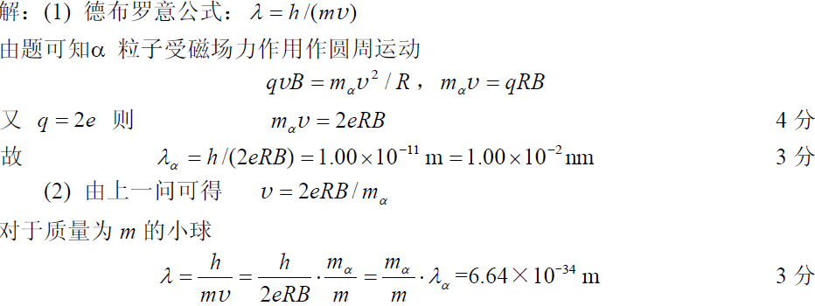

Slide 9

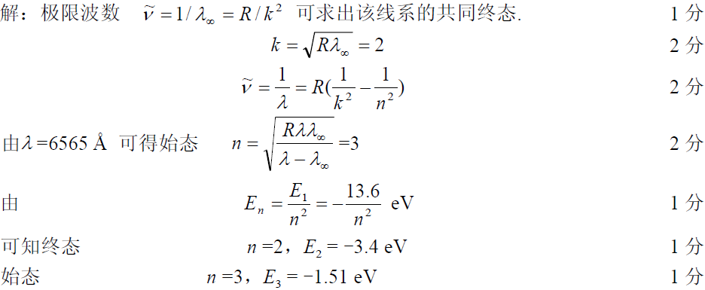

Slide 10



Slide 11

