Slide 1
VE280 Programming and Elementary Data Structures
RC 01

Slide 2
Tips about the course
Please do your project under Linux environment
At least, compile your code in Linux before submission
Submission URL: 202.120.46.219/ve280_summer_2016/
Try to avoid using IDE to write your code.(VS, Xcode)
Small difference, may cause compiling error or wrong answer
Read lecture notes carefully
All the problems in the exam come exactly from the notes
Spend more efforts on the projects
HC violation leads to a serious consequence
Learn to write the proper comments

Slide 3
Simple comments sample
int positive_add(int x, int y){
//Require: x and y to be positive
//Modify: /
//Effect: return the sum of two positive integer x and y
return x+y;
}

Slide 4
Start with the course
Installing a proper Linux system.
directly install on your PC (not recommended)
using a virtual machine;
WIN: VMware workstation, VirtualBox;
MAC: Parallel desktop, VMware fusion;
Installing the compiler – g++
$sudo apt-get install build-essential
Installing a proper editor
Auto completion, Syntax highlight, code folding, etc.
E.g. Sublime, Vim, Atom, Eclipse, Emacs.

Slide 5
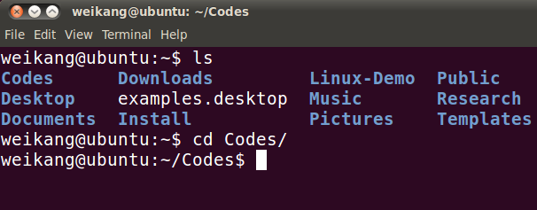
Terminal
Heart of the OS

Slide 6
Root Directory
/
bin/
home/
lib/
...
mary/
peter/
...

Slide 7
Basic Linux command
Change directory: cd path (/ ~ . ..)
List contents of a directory: ls directory (-a, -l, -la)
Create directory: mkdir dir
Delte directory: rmdir dir
Create empty file: touch file
Copy files/directories: cp source dest (-r)
Rename/Move a File: mv source dest
Delete Files/Directories: rm file (-r)
Edit a file nano file
Notes:
cp file1 file2: copy the content of file1 into file2
cp file1 dir: copy file into a directory
cp -r dir1 dir2: If dir2 does not exist, copy dir1 as dir2. If dir2 exists, copy dir1 inside dir2
mv file1 file2: rename file1 as file2
mv file1 dir: move file into a directory
mv dir1 dir2: If dir2 does not exist, then rename dir1 as dir2. If dir2 exists, then move dir1 inside dir2

Slide 8
Other commands
I/O Redirection: input: <
output: >
Compare two files: diff file1 file2
Auto completion: tab button
Help document: man command
Wildcard: *
Compiling the program:
g++ -o program s1.cpp s2.cpp (-w)
Run the program: ./program

Slide 9
Exercise
Write a single command in order to list all .jpg files in your current directory.
Write a single command to learn the usage of command rm.
Write a single command to compile the cpp file ‘test.cpp’ and turn all the warning as well as generating executive file ‘test’.

Slide 10
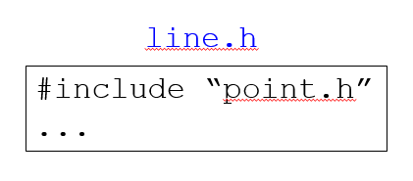
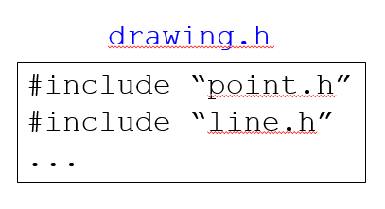
Head file and Header Guard
// add.h #ifndef ADD_H
#define ADD_H
int add(int a, int b); #endif
// add.cpp int add(int a, int b)
{
return a+b;
}

Slide 11
Exercise
Write a header guard for ‘rc.h’

