Slide 1
VE280 RC5

Slide 2
Destructor
Deep Copy
Dynamic Resizing
Linked List

Slide 3
Problem
Problem: Memory leak
Solution: Destructor
bool check(int num){
shoe Adidas(10);
….
cout << “Adidas shoes are on sale.”<<endl;
return true;
};
class shoe{
int* size;
int sizeKind;
int used;
string color;
public:
shoe(int kinds = MAXNUM);
….
};
size
Memory leak!
0
1
2
9

Slide 4
Destructor
Opposite of constructor
Called automatically when a block ends
CONSTRUCTOR:
shoe::shoe(int kinds): size(new int[kinds]), sizeKind(kinds),
used(0),
color(“white”)
{
}
DESTRUCTOR:
shoe:~shoe(){
delete[] size;
}
class shoe{
int* size;
int sizeKind;
int used;
string color;
public:
shoe(int kinds = MAXNUM);
….
~shoe();
};
size
0
1
2
9

Slide 5
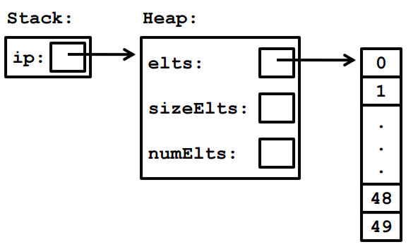
Other case
InSet *ip = new IntSet(50);
delete ip;

Slide 6
Problem
shoe s(4);
shoe x=s;
foo(s);
Shares size array
when x is deleted, s.size dangles
s
size:
sizeKind:
color:
x
size:
sizeKind:
color:
0
1
2
3
Solution: copy constructor & redefine assignment operator

Slide 7
Copy constructor & assignment operator
Copy constructor is called automatically when passing arguments by value to a function
Redefine assignment operator for class shoe
class shoe{
int* size;
int sizeKind;
int used;
string color;
void copyFrom(const shoe &that);
public:
shoe(int kinds = MAXNUM);
shoe(const shoe &that);
shoe &operator= (const shoe &that);
….
~shoe();
};
shoe::shoe(const shoe &that){
size=NULL;
sizeKind=0;
used =0;
color =“white”;
copyFrom(that);
}
shoe &shoe:: operator=(const shoe &that)
{
if(this !=&that)
copyFrom(that);
return *this;
}

Slide 8
void copyFrom(const shoe &that);
void shoe::copyFrom(const shoe &that) {
if (that.sizeKind != this->sizeKind) {
delete[] size;
this->sizeKind = that.sizeKind;
thid->used = that.used;
size = new int[this->sizeKind];
}
for (int i = 0; i < that.sizeKind; i++) {
this->size[i] = that.size[i];
}
this->color = that.color;
}

Slide 9
Problem
Once initializing the class, the length of the size array is fixed(capacity is fixed)
However, one day the producer decides to produce more shoes with different kinds of sizes(we want to dynamically increase the length of size array)
size
size
0
1
2
9
0
1
2
19
Solution: dynamic resizing (a sensible choice is to double the length of the size array each time)

Slide 10
Dynamic resizing
void grow() {
int *tmp = new int[sizeKind * 2];
for (int i = 0; i < used; i++)
{
tmp[i] = size[i];
}
delete[] size;
size = tmp;
sizeKind *= 2;
}
size
0
1
2
9
tmp
0
1
2
19
size

Slide 11
problem
When we want to insert some elements into arrays, it is very complicated
We may need to build a new array and sometimes we may consider the allocation of the length
Time complexity: O(n)
0
1
2
3
4
5
0
1
2
3
4
5

Slide 12
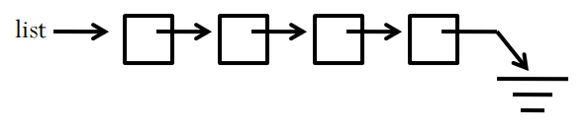
Linked list
Easy to insert but complex to locate the ith element

Slide 13

Implement of linked lists
struct node{
node * next;
int value;
};
class listIsEmpty {};
class IntList{
node * first;
public:
bool isEmpty(); //check if the list is empty
void insertFront(int v); //insert v into the front of the list
int remove(); // is the list is empty, throw listIsEmpty. Otherwise, remove and return the fist element
int getsize(); //return # of element (traverse through the list)
IntList();
IntList(const InstList& that);
~IntList();
IntList &operator= (const IntList & l);
};
NULL

Slide 14
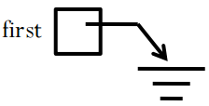
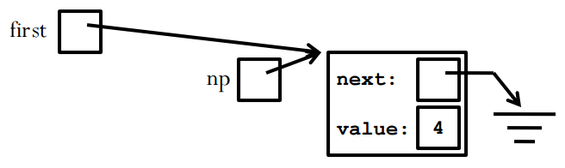
Implement linked list
insertFront
remove
void IntList::insertFront(int v) {
node *np = new node;
np->value = v;
np->next = first;
first = np;
}
int IntList::remove() {
node *victim = first;
int result;
if (isEmpty()) {
listIsEmpty e;
throw e;
}
first = victim->next;
result = victim->value;
delete victim;
return result;
}
victim

Slide 15
Implement linked list
Insert an element v after the jth element
void IntList::insert(int v, int j) {
node *np = new node;
np->value = v;
node *tmp = first;
for (int i=0; i<j-1; i++){
tmp = tmp->next;
}
node* temp = tmp->next;
tmp->next=np;
np->next = temp;
}

Slide 16
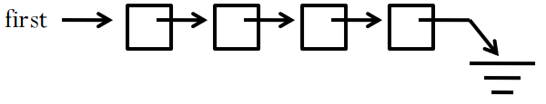
Problem
If we want to insert an element in the end of the list. O(n)
Given a node, we want to know the previous node.

Slide 17
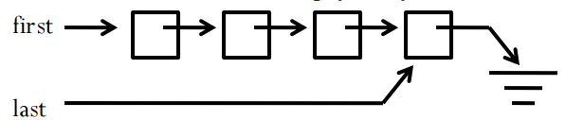
Double-ended list
Doubly linked list

Slide 18
Double-ended list
class IntList {
node *first;
node *last;
public:
…
};
class IntList {
node *first;
public:
…
};

Slide 19
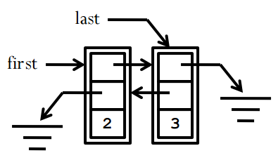
Doubly linked list
struct node{
node *next;
node *prev;
int value;
};
struct node{
node * next;
int value;
};

