Slide 1
Mechanics
Mechanical Overview
Primary mechanic; self-depleting health bar that is replenished on successful hits
Power-ups that grant temporary bonus effects
Basic movement system
Basic combat system centring around a one-hit “slap”
Purchasable upgrades on lose

Slide 2
Mechanics (2)
Power Up Functions
Drop Randomly from hit enemies
Deliberately placed in some levels
Upon picking up an upgrade of the same type as your active one, you receive and upgraded version
Every level up alters the slap in some way
Four Power-Ups are available

Slide 3
Mechanics (3)
Upgrade Shop
The upgrade is only available after the player loses a level
The score earned during the level before they lose can be used to get permanent upgrades to help make the game easier
Upgrades:
An increase to the starting health
Increase to how long a power-up lasts
An upgrade to base run speed
An increase to base slap speed

Slide 4
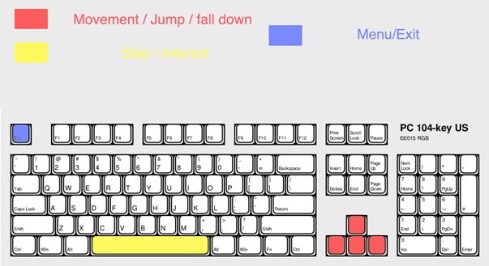
Mechanics (4)
Control Scheme:

