Slide 1
CS428 & CS429: Software Engineering II
Introduction

Slide 2
Course staff
Instructor
Tao Xie (NetID: taoxie)
TAs
Wayne Wu (NetID: yuwu4)
Qing Ye (NetID: qingye3)
Writing graders (cs429)
TBD

Slide 3
Recent past course staff
Instructors
Darko Marinov
Danny Dig
Ralph Johnson
TAs
Yiming Jiang, Wenbo Yu
Zheng (KZ) Kang, Yu Lin, Qi Wang, Jingning Zhang
Cosmin Radoi, Pranav Garg, Sadaf Tayefeh Hosseinlou
Caius Brindescu, Mihai Codoban
Sandro Badame, Yun Young Lee, Jurand Nogiec
Damion Mitchell, Shin Hwei Tan
We’ll be building on their material

Slide 4
Today’s goals
Meet the course staff
Contact info is on Wiki https://wiki.illinois.edu/wiki/display/cs428sp17/Home
What is software engineering?
What is in cs428?
How can you succeed (or fail) in it?
What is in cs429?
Make sure you pass ACP!

Slide 5
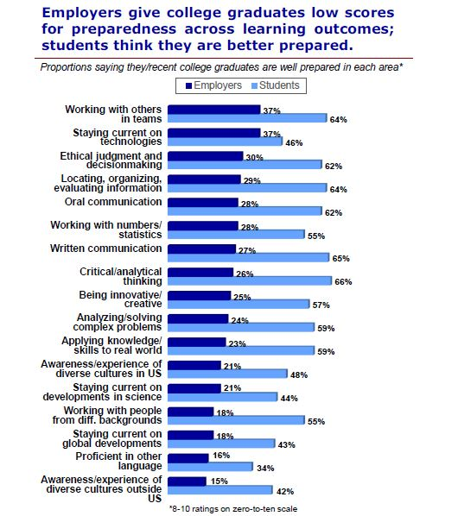
Well-Prepared in Their Own Eyes
https://www.insidehighered.com/news/2015/01/20/study-finds-big-gaps-between-student-and-employer-perceptions

Slide 6
Numbering issue
CS429 = CS428 + ACP
ACP = Advanced Composition
Requires multiple revisions of documents
“Refactoring your writing”
What is refactoring? See cs427
You’ll revise your essays on software development process – more details later
Book we will use for only cs429:
Style: Toward Clarity and Grace by Williams

Slide 7
Reading for 428 and 429
***Optional*** Textbooks
Code Complete, second edition by McConnell
UML Distilled, third edition by Fowler
More required resources will be on Wiki https://wiki.illinois.edu/wiki/display/cs428sp17/Schedule
Lots of easy reading: “broad but shallow”
Assigned required readings will be on EXAM
Some reading even for this lecture

Slide 8
Two-course sequence
427
Configuration management, testing, metrics, debugging, reverse engineering, refactoring, documentation
428
Management, planning, requirements, design, architecture … and more of 427 activities

Slide 9
Existing code
427
Work with an existing medium/large software system
428
Start a new project from scratch
Can reuse some existing code

Slide 10
Project
Team project – typically 8 students per team
Various topics
Opportunity to practice
Process should start with XP
Must document process you use
Must convince us you follow the process you documented

Slide 11
Project lifecycle
Propose project
Pairs due by Thursday, proposal by Tuesday
Form team
Develop
Deliver code, tests, documentation
Graded on process during development + quality of what you deliver = process + product

Slide 12
Project meta-requirements
Automated tests (ideally test first)
Must use UML to document
Consider object-oriented language
Must practice proper configuration management (can use some DVCS, such as Git, besides dept SVN)
Must use continuous integration (Jenkins, Travis CI, or Circle CI, etc.)
Must manage requirements
If project is successful, must have a plan for how to keep it going after the end of the semester

Slide 13
Generic ideas
Engineering Open House project
Web site
Game
Mobile app (smart bus app, mHealth app, etc.)
Lab of Things
Add feature to some open-source code
Whatever (software) that you want!

Slide 14
Project proposal parts
Description
Motivation
Comparison with similar software
Languages, libraries, frameworks, platforms
Risks/challenges
User stories and iterations
Meeting schedule (6+ hours/week of work)
Skill sets
Process
Tools
Related projects, if any

Slide 15
Proposal audience
Must convince staff and fellow students
What do you want to build?
How? What plan to follow?
Is it worth doing? What is the cost? The benefit?
Can you do it? Is the plan reasonable?
What will you get out of it?
Will it be successful?

Slide 16
Project proposal
Can include parts of final documentation
Analysis of problem, users
Architecture, technology
Plan, not reality
Schedule
Risks, and how to deal with them

Slide 17
Project effort
Number of hours per week of work
Plan for at least 6 hours, but some teams get excited and work harder
Proposal meeting times: be flexible so that more people can join you
Semester end: Michael S. Hughes Award in Software Engineering for the top project http://cs.illinois.edu/prospective-students/undergraduates/undergraduate-scholarships-and-awards/michael-s-hughes-award-sof

Slide 18
First homework
In pairs, write project proposals on Wiki
If you care who you pair with, sign up on https://wiki.illinois.edu//wiki/display/cs428sp17/Homework+1+Pairs If you have access problems, email Wayne Wu <yuwu4@illinois.edu>.
If we don’t hear from you by the end of Thursday, we’ll randomly put you into pairs (you don’t lose points for random assignment)
Proposal itself due by the end of Tuesday (Jan 24)

Slide 19
Problems with proposals
Too vague
Can’t tell if task has been done, e.g., “Study x”
Tasks too big
Too much creativity, e.g., focus on art work in game, instead of designing/developing game
Too small
In need of being made bigger (but need to prioritize tasks so scope can be reduced when needed)
Too big (about 8 students and 12 weeks)
Many similar programs exist

Slide 20
Afterwards
We will make list of accepted proposals
You should form teams of about 8 students
We will use CATME to form teams
More details to be disclosed later this week
Team formation goal: a jelled team
Available weekly common meeting/working time
Need to be cohesive but also diverse
We’ll have not only coding but management, testing, requirements, design, documentation…
Your project largely depends on the people!
A jelled team: the whole is more productive than the sum of its parts.

Slide 21
Grading
https://wiki.illinois.edu/wiki/display/cs428sp17/Grading+Policy
For three hours of credit:
Homeworks – 20%
Project – 40%
Final exam – 35%
In-class quizzes – 5%
Piazza participation – up to 1.5%
For 4 hours of credit: Write a book report 25% of the final grade
For 429: If you fail ACP, you get F for 429

Slide 22
Usual campus policies apply
Academic integrity – Code of ethics
Special accommodations (contact the instructor Prof. Tao Xie)

Slide 23
Todos
We already signed up those who enrolled today
If you are not yet on our Piazza CS428/429 course, sign up yourself on Piazza following https://wiki.illinois.edu/wiki/display/cs428sp17/Communicating+with+the+Staff
Sign for HW1 pair by Thursday if you care
Start thinking/writing your proposal
Keep up with assigned reading
Contact us if you have problems with Wiki or Piazza

Slide 24
Group Exercises: Speed “Dating”
Get into four students in a group to share and discuss your directions/proposals of interest for your proposed project
Upon signal, move around and switch to join another group
Requirement: your new group members shouldn’t overlap with your previous group partners.
In this way, you interact with several students (briefly). Feel free to communicate among each other to pair up for HW1.

Slide 25
Class Testimonials
“Looking back, CS 428 was definitely one of the useful classes I took in college and keep using the basic principles (…) almost daily at my job”
Alum 2007, now at Citadel Investment Group
“The biggest thing that CS428 did for me was to give me a sense of the Real World (tm). Much of the work was thought-provoking and exciting. Software Engineering and the Senior Projects both gave a sense of how to work in teams, how to engineer solutions to specific technical challenges. I think having a balance of deep technical issues (most of the classwork) and real-life challenges and approaches is critical to being successful in the field (software development) MOST of us ended up coming out of UIUC.”
Mike Duff – architect Chicago Mercantile Exchange

Slide 26
From 427: What is (not) S.E.?
Not just software programming
Individual vs. team
Not just a process
Field that studies several different processes
IEEE 610: “The application of a systematic, disciplined, quantifiable approach to the development, operation, and maintenance of software.”

Slide 27
Some topics studied in S.E.
Process
Tools
Techniques
Models (of software development)
Modeling (of developed systems)

Slide 28
From 427: Software process
IEEE 1074: “A set of activities performed towards a specific purpose”
Johnson: “The steps a particular group follows to develop software”
All 427 teams followed the same process: (academic) XP (Extreme Programming)

Slide 29
Many software processes
Agile
eXtreme Programming (XP), Scrum…
Theoretical
Waterfall…
Formal
Rational Unified Process (RUP), Cleanroom…
Distributed, open-source
Bazaar…
…

Slide 30
Purpose of 428 differs
Be able to understand and follow your project’s process
Be able to improve your process
Be able to design the right process for your project
427: Learn a particular process (XP) and some steps common to all processes: SCM, testing, refactoring, reverse engineering…
428: Can follow Scrum or other Agile

Slide 31
Default process: XP
Roles
XP: Customer, Developer, Coach
Scrum: Pigs (product owner, dev team [3-9 ppl], Scrum master), Chicken (customers and executive management) (http://en.wikipedia.org/wiki/The_Chicken_and_the_Pig)
Activities
XP: Write stories, planning game, test-first, pair programming, continuous integration, refactoring
Work products
XP: User stories, tests, code

Slide 32
Activities in IEEE 1074 (1)
Project Management – 428 more
Project initiation
Project monitoring and control
Software quality management
Development – 427 and 428
Requirements
Design
Implementation

Slide 33
Activities in IEEE 1074 (2)
Post-development
Installation
Operation and support
Maintenance – 427
Retirement
Integral processes – 427 and 428
Verification and validation
Software configuration management
Documentation development

