Slide 1
CS428: Software Engineering II
Component Design

Slide 2
Abstraction
Abstract 1: disassociated from any specific instance 2: difficult to understand
Abstraction: ignoring unimportant details and focusing on key features
Examples are in “Is abstraction the key to computing” by Jeff Kramer https://www.ics.uci.edu/~andre/informatics223s2007/kramer.pdf

Slide 3
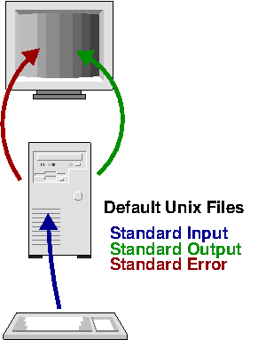
Example of abstraction
Unix file descriptor
Can read, write, and (maybe) seek
File, IO device, pipe
Descriptive Name | File Number | Description
Standard In | 0 | Input from the keyboard
Standard Out | 1 | Output to the console
Standard Error | 2 | Error output to the console
http://www.bottomupcs.com/file_descriptors.html

Slide 4
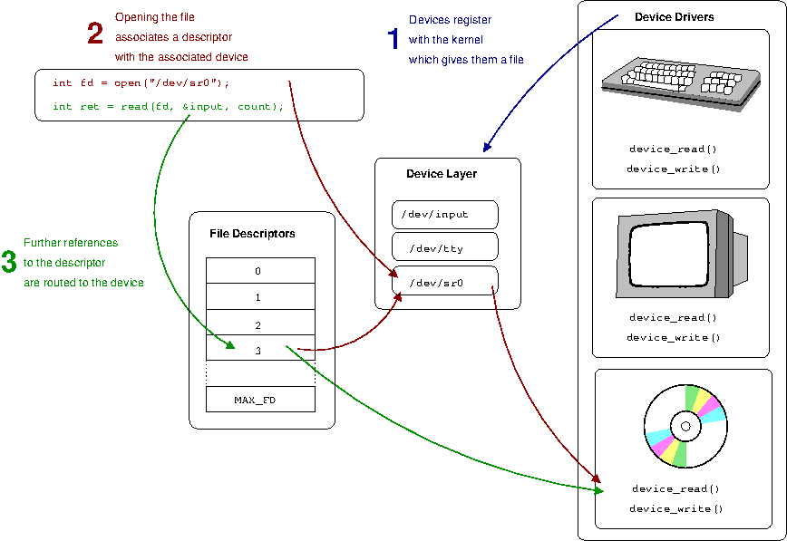
Example of abstraction
http://www.bottomupcs.com/file_descriptors.html

Slide 5
Kinds of abstraction in S.E.
Procedural abstraction
Naming a sequence of instructions
Parameterizing a procedure
Data abstraction
Naming a collection of data
Data type defined by a set of procedures
Control abstraction
W/o specifying all register/binary-level steps
Performance abstraction O(N)

Slide 6
Abstract data types
Complex numbers: +, -, *, real, imaginary
Queue: add, remove, size

Slide 7
Facts about abstraction
Abstractions are powerful
People think about concrete details better than abstractions
People learn abstractions from examples
It takes many examples to invent a good abstraction

Slide 8
How to get good abstractions
Get them from someone else
Read lots of books
Look at lots of code
Generalize from examples
Try them out
Gradually improve them
Look for duplication in your program and eliminate it

Slide 9
Abstractions can fool you
Suppose collection has operation getItemNumbered(int index)
How do you iterate?
for i := 1 to length { getItemNumbered(i) }
But what if collection is a linked list?

Slide 10
High-level view: Architecture
Big picture
Structure(s) that support the system
Early design decisions
Expensive to change
Key to meeting non-functional requirements
Divide the system into modules
Divide the developers into (sub)teams
Subcontract work to other groups
Find packages to reuse

Slide 11
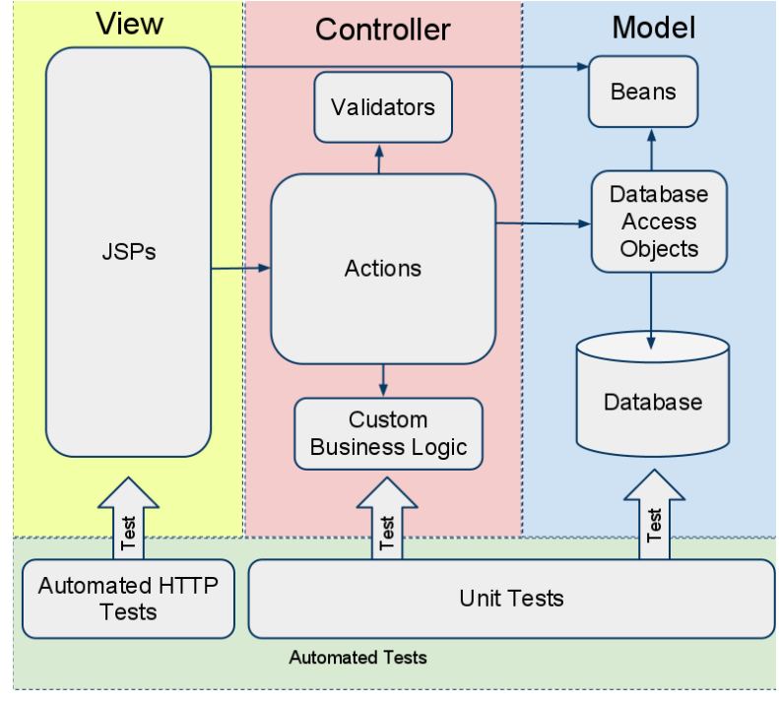
iTrust Architecture
http://bensmith.s3.amazonaws.com/website/papers/sst2011.pdf

Slide 12
Picking an architecture
Many standard architectures
Each has strengths and weaknesses
Each solves some problems & creates others
How do you pick an architectural style?
What is important?
Flexibility/ease of change, efficiency, reliability
More in reading on Wiki (note architectural patterns, including MVC)

Slide 13

MVC Pattern
http://en.wikipedia.org/wiki/Model%E2%80%93view%E2%80%93controller

Slide 14
MVC-View: iTrust View
Little logic; just display info
JSPs
JSP one-to-one mapping to action class (from controller)
A JSP instantiates the mapped Action class
You can browse the iTrust code base at
http://agile.csc.ncsu.edu/iTrust/wiki/doku.php#source_codev210
http://bensmith.s3.amazonaws.com/website/papers/sst2011.pdf

Slide 15
MVC-View: iTrust Model
Logic related to persistent storage
DB system (MySQL)
each DB entity maps to a single DAO and a single Bean
Beans: placeholders for data related to an iTrust entity (e.g., Patient)
minimal functionality (only store data)
Other supporting classes
load beans from database result sets
validate beans based on input
any other custom logic needed.
DAOs (DB Access Objects): Java objects that interact with the DB
reflect contents in the DB
offer to interact with the DB
query and update the DB (e.g., from Action classes)
should not have many branches (assuming incoming data is valid and any exception is handled by the Action classes)
http://bensmith.s3.amazonaws.com/website/papers/sst2011.pdf

Slide 16
MVC-View: iTrust Controller
Handle all logic
validate data
process DB query results
Everything between Action classes and DAO classes
Action classes
exception handling
a method <= 15 lines
Validators
Custom business logic
Action classes delegate responsibilities to other classes
Delegate any input validation to a Validator
Log transactions for auditability
Delegate any custom business logic, such as risk factor calculations
Delegate database interaction
Handle exceptions in a secure manner
http://bensmith.s3.amazonaws.com/website/papers/sst2011.pdf

Slide 17
Modularity
“Modularity is the single attribute of software that allows a program to be intellectually manageable.” (Myers)
Split a larger program into smaller modules
A module can be procedure, class, file, directory, package, service…

Slide 18
Functional independence
What are two terms related to modules?
Cohesion - Each module should do one thing - high cohesion
Coupling - Each module should have a simple interface - low coupling

Slide 19
Coupling
Measure of interconnection among modules
The degree to which one module depends on others
Minimize coupling

Slide 20
Cohesion
Measure of interconnection within a module
The degree to which one part of a module depends on another
Maximize cohesion

Slide 21
Cohesion
Coincidental - grouped by chance
Logical - same idea
Temporal - same time
e.g., placing together all the code used during system start-up or initialization
Procedural - one calls the other
Communicational - shared data
Change together

Slide 22
Turn spaghetti code…

Slide 23
…into a few modules

Slide 24
Information hiding
Each module should hide a design decision from others
Ideally, one design decision per module, but usually design decisions are closely related
D.L. Parnas, "On the Criteria To Be Used in Decomposing Systems Into Modules," CACM, 5(12), December 1972

Slide 25
Design decisions
Representation of data
Use of a particular software package
Use of a particular printer
Use of a particular operating system
Use of a particular algorithm

Slide 26
Other reasons for modularity
Let developers work on system in parallel
Conway’s Law: The architecture of a system is the same as the structure of the group that developed it.
Security - compartmentalization
Reliability - localization of failure
Parallelism – load balance processes
Distributed programming - design modules to reduce communication

Slide 27
Trade-offs
Suppose moving functionality from one module to another will
Decrease coupling between modules
Increase cohesion in one module
Decrease cohesion in another
Should you do it?

Slide 28
XP Simplicity rules
http://c2.com/xp/XpSimplicityRules.html
Runs all the tests
Minimizes coupling
Maximizes cohesion
Says everything “Once and only once”
E.g., avoid “clones”

Slide 29
How to get modularity
Reuse a design with good modularity
Think about design decisions – hide them
Reduce coupling and increase cohesion
E.g., refactor (how many teams refactored?)
Eliminate duplication
Reduce impact of changes
If adding a feature requires changing large part of the system, refactor so change is easy

Slide 30
Modularity summary
Modularity is key to managing complexity
Modularity is about managing dependencies
Modularity should be based on hiding design decisions
No perfect answer
Trade-offs
Iteration

