Slide 1
CS428: Software Engineering II
Low-level Design & MVC

Slide 2
Detailed design
Decision tables
Pseudo code
State machines
Abstract data types (CS421)
…

Slide 3
A good design
Satisfies requirements
Easy to implement
Easy to understand
Easy to change
Easy to check for correctness
Is beautiful

Slide 4
Keep It Simple (S)
“Everything should be as simple as possible, but no simpler.” (Einstein)
“A design is finished not when there is nothing to add, but when there is nothing to take away.” (Saint-Exupery)
“Measuring a program by the number of lines of code in it is like measuring an airplane by how much it weighs.” (Gates)

Slide 5
Keep it simple
Eliminate duplication
Eliminate unnecessary features
Hide information
No surprises (follow standards)

Slide 6
“Design”: Verb
Bounce from high-level to low-level
New requirements come after design is created
Design is created incrementally
As requirements are known
As better design ideas are invented
As design flaws are discovered

Slide 7
Low-level design
Many different techniques
Flow charts
Decision tables
Pseudo-code
State machines

Slide 8
Decision tables
Are used to specify code with complex conditions
Make it easy to see if any cases are missing
Can be implemented with IF statements

Slide 9
Tax code example
The recovery period is 27.5 years for residential real property, 31.5 years for non-residential real property placed in service before May 13, 1993, 39 years for non-residential real property placed in service after May 12, 1993, 50 years for railroad gradings and tunnel bores, except that nonresidential real property on an Indian reservation has a recovery period of 22 years.

Slide 10
Decision table for recovery period
Conditions
1
2
3
4
5
Real property
Residential
Placed before May 13, 1993
Railroad grading or bore
On Indian reservation
27.5 years
31.5 years
39 years
50 years
22 years
T
T
Actions
x

Slide 11
Decision table for recovery period
Conditions
1
2
3
4
5
Real property
Residential
Placed before May 13, 1993
Railroad grading or bore
On Indian reservation
27.5 years
31.5 years
39 years
50 years
22 years
T
T
T
T
T
T
F
F
F
F
T
F
F
F
T
F
F
F
T
Actions
x
x
x
x
x

Slide 12
Pseudo-code
Also called “Program Design Language”
Advantages:
Expressive and compact
Can use any editor
(Sometimes) can compile it
Disadvantages:
Must know the language

Slide 13
Pseudo-code
float computerRecoveryPeriod(property) {
if (isReal(property)) {
if (isResidential(property)) return 27.5;
if (onReservation(property)) return 22;
if (isRailroad(property)) return 50;
if (property.date > “May 13, 1993”)
return 31.5;
else return 39;
}
}

Slide 14
Pseudo-code
Works well with refinement
Write pseudo-code
As comments
With stubs
Gradually implement it all
Execute and test as you go

Slide 15
State Machines (FSM)
Lots of theory (CS373)
How to minimize number of states
How to merge state machines
How to tell whether two state machines are equal
Can generate code directly from state machines
But usually do not

Slide 16
State diagram for stop light
30
2
R/G
R/Y
4
R/R
R/R
4
2
Y/R
G/R
25
Events are time delays, in seconds.

Slide 17
Pseudocode for stop light
Action = Record {integer wait, east, north}
Action: Actions[1 .. 6]
repeat forever
for i = 1 to 6 do
setEast(actions[i].east)
setNorth(actions[i].north)
wait(actions[i].wait)
end for
wait: #seconds
east: east light
north: north light

Slide 18
(More Complicated) Stop Light Requirement
The main light is initially green and the side light is red
When the sensor of the side light FSM detects that the level of incoming traffic exceeds a predefined threshold, it sends a signal (IncomingTraffic) to the side light FSM. In response, the side light FSM sends a SideLight_GetGreen message to the main light requesting a permission to turn green.
If the sensor of the main light does not report any incoming traffic, the message from the side light FSM causes the main light to change to yellow light, and then (after the YellowLightTimeout occurs) to red light. At this point, the main light responds to the side light with a message (MainLight_TurnedRed) indicating that it has turned red. The message makes the side light change from red to green.
A similar sequence of events occurs when the main light determines that it should turn to green when it receives the IncomingTraffic signal from its sensor or when RedLightTimeout occurs
http://citeseerx.ist.psu.edu/viewdoc/download?doi=10.1.1.94.2987&rep=rep1&type=pdf

Slide 19
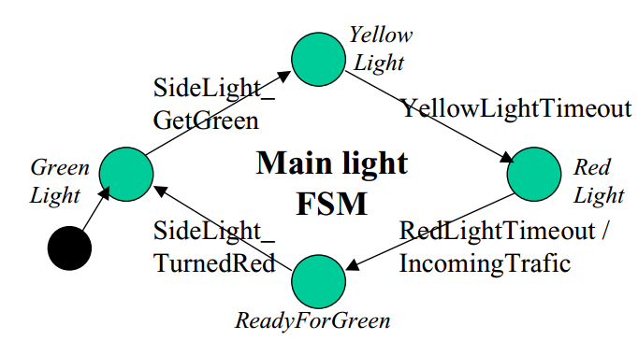
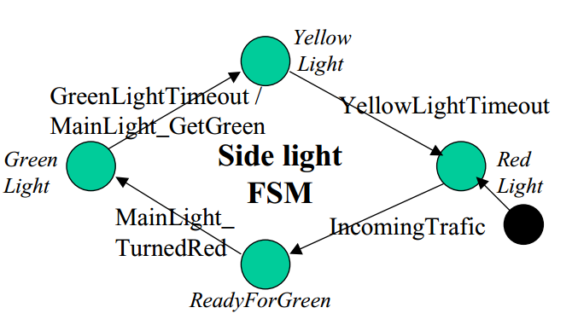
State diagram for stop light
Traffic lights FSMs – main street light and side street light
http://citeseerx.ist.psu.edu/viewdoc/download?doi=10.1.1.94.2987&rep=rep1&type=pdf

Slide 20
State diagram for some sockets
ignore details – the key is complexity
uninitialized
listen()
connect()
passive
active
disconnect()
newconn1()
newconn1()
isconnecting()
qlen!=0
isconnected()
CONNECTING
qlen!=0
isconnected()
isconnected()
accept()
CONNECTED

Slide 21
Implementing socket
Socket is an object
Actions are methods of the socket
State is stored in variable of the object
Each method can use IF statement to make sure socket is in the right state
When IF statements get too complicated, use “State Pattern”

Slide 22
Action with IF statements
class Socket { int state; Object read() { if (state == CONNECTED) { … } else if (state == CONNECTING) { … } else … }
}

Slide 23
State Pattern (Design Pattern)
Socket
SocketState
listen()
connect()
newconn1()
...
ConnectingState
ConnectedState
...
PassiveState

Slide 24
Action with state pattern
class Socket { SocketState state; Object read() { return state.read(); } } class ConnectedState implements SocketState { Object read() { … // actual logic for connected state } }

Slide 25
Detailed design
Lots of different techniques
Most only works in a few places
Pseudocode works most places, but often there is a better technique
Often best to use code and skip detailed design

Slide 26
Good design
Good design is product of many small steps
“Do the right thing”
Each step adds a feature
Do one more thing right
“Do the thing right”
Each step makes design a little simpler
Eliminates one more unnecessary complexity

Slide 27
Model/View/Controller (MVC)
A (good) pattern for UI implementation
Separate UI from application so UI can be reused
Model - application data
View - displays data
Controller - maps user events into changes to the data

Slide 28
One form of MVC
Model
View
Controller

Slide 29
Relationship to design patterns
In original MVC
View is a composite
View is observer of Model
Controller is strategy for handling input

Slide 30
Separating presentation & data
Make it easier to change presentation
Make it easier to change data
Make presentation objects more reusable
Allow people to specialize in data or in presentation
But hard to separate completely
New feature requires change to data and UI
Cross-functional teams - UI and data

Slide 31
MVC in games
If your project is game, check these http://dev.koonsolo.com/9/model-view-controller-for-games/ http://dewitters.koonsolo.com/gameloop.html
Real-time game consists of a game loop
Get input
Update game
Display game
Make “display game” a separate object so that game code is simpler

Slide 32
MVC in games (2)
Put user input in a controller
Controller needs to query view to find location of on-screen objects
Easier to test game code automatically
Whatever your project is, you need to have some (automated!) tests

Slide 33
MVC in games (3)
Controller
Model
View

Slide 34
MVC in web apps
If your project is web app, consider using some framework http://en.wikipedia.org/wiki/Comparison_of_web_application_frameworks
Most already have MVC, many have ORM (Object-relational mapping) http://en.wikipedia.org/wiki/Object-relational_mapping
They help you get more done faster

