Slide 1
CS428: Software Engineering II
Quality Assurance

Slide 2
Last-Time Quiz: Write Parameterized Unit Tests (PUTs)
Let’s copy it to
http://pex4fun.com/default.aspx?language=CSharp&sample=_Template
And Click “Ask Pex”
Class UIntStack {
public UIntStack() {…};
public void Push(int k) { … }
public void Pop() { … }
public int Top() { … }
public bool IsEmpty() { … }
public int MaxSize() { … }
public bool IsMember(int k) { … }
public bool Equals(UIntStack s) { … }
public int GetNumberOfElements() { … }
public bool IsFull() { … }
}
Note that you have to comment earlier written PUTs before you try Pex on your current PUT (Pex4Fun can handle only one PUT at a time)
Write >= 4 PUTs for pop
See the UIntStack.cs that can be downloaded from the course schedule web.

Slide 3
Copy Object Or Not?
[PexMethod]
public static void testPop3(UIntStack e, int k) {
PexAssume.IsTrue(s != null);
PexAssume.IsTrue(e.IsEmpty());
PexAssume.IsTrue(e.IsMember(k));
UIntStack f = e.Copy();
e.Pop();
PexAssert.IsTrue(e.GetNumberOfElements() ==
f.GetNumberOfElements());
PexAssert.IsTrue(!e.IsMember(k));
}

Slide 4
Conditional Or Not?
[PexMethod]
public static bool testPop3(UIntStack e, int k) {
int curNumOfElems = e.GetNumberOfElements();
if (curNumOfElems >= 1)
e.Pop();
if (e.GetNumberOfElements() == (curNumOfElems -1))
return true;
}
return false;
}

Slide 5
Conditional Or Not?
[PexMethod]
public static void testPop3(UIntStack e, int i, int j) {
PexAssume.IsTrue(e.IsEmpty());
e.Push(i);
e.Push(j);
if (i == j) {
e.Pop();
PexAssert.IsTrue(e.Top() == i);
e.Pop();
PexAssert.IsTrue(e.Top() == i);
}
}

Slide 6
Loop Or Not?
[PexMethod]
public static void testPop3(UIntStack e, int k) {
int curNumOfElems = e.GetNumberOfElements();
for (int i = 0; i < curNumOfElems; i++)
e.Pop();
PexAssume.IsTrue(e.IsEmpty());
}

Slide 7
Constant Or Not?
[PexMethod]
public static void testPop3(UIntStack e) {
PexAssume.IsTrue(s.Top() == 1);
e.Push(2);
e.Pop();
PexAssert.IsTrue(e.Top() == 1);
}

Slide 8
Correct Assertion? Same k?
[PexMethod]
public static void testPop3(UIntStack e, int k) {
e.Push(k);
e.Push(k);
e.Pop();
PexAssert.IsTrue(e.NumOfElements() >= 1);
}

Slide 9
Group Discussion: Quality Assurance
Get into group of 2-3 students, derive and document the answers for the following questions:
What is a list of software quality assurance techniques that are adopted in a company that you worked in (e.g., as an intern) [if none of students in your group had such industrial experiences, it is fine; skip this question)?
What is a list of software quality assurance techniques that you are doing or plan to do in your course project?

Slide 10
Software Quality Assurance
How can we tell if software has high quality?
How can we measure the quality of software?
How can we make sure software has high quality?

Slide 11
Perspectives on quality
Customer
System not crashes
System follows documentation
System is logical and easy to use
Developer
System is easy to change
System is easy to understand
System is pleasant to work on

Slide 12
Failure vs. fault
Failure - program didn’t work right
Fault - mistake in the text of the program
Failure analysis - what fault caused this failure?
Fault analysis - what is wrong with our process that allowed this fault to be created and not detected?

Slide 13
Faults, Errors & Failures
Fault : A static defect in the software (i.e., defect, bug)
Infected State: An incorrect internal state that is the manifestation of some fault (often also referred to as error)
Software Failure : External, incorrect behavior with respect to the requirements or other description of the expected behavior

Slide 14
Mistake, Fault, Error, Failure
Programmer makes a mistake.
Fault (defect, bug) appears in the program.
Fault remains undetected during testing (running test inputs).
The program fails (based on test oracles) during execution
i.e. it behaves unexpectedly.
Error: difference between computed, observed, or measured value or condition and true, specified, or theoretically correct value or condition
What does Bug mean in “Bug Report”?

Slide 15
What is fault, error, failure?
Doubling the balance and then plus 10
int calAmount () {
int ret = balance * 3;
ret = ret + 10;
return ret; }
void testCalAmount() { Account a = new Account();
Account.setBalance(0);
int amount = Account.calAmount();
assertTrue(amount == 10);
}
Where is test input? Where is test oracle?

Slide 16
What is fault, error, failure?
Doubling the balance and then plus 10
int calAmount () {
int ret = balance * 3;
ret = ret + 10;
return ret; }
void testCalAmount() { Account a = new Account();
Account.setBalance(1);
int amount = Account.calAmount();
assertTrue(amount == 12);
}
Where is test input? Where is test oracle?

Slide 17
What is fault, error, failure?
Should not allow withdrawal when there is a balance of 100 or less
boolean doWithdraw(int amount) { if (Balance<100) return false; else return wthDraw(amount); }
void testWithDraw() { Account a = new Account();
Account.setBalance(100);
boolean success = Account.doWithdraw(10);
assertTrue(success == false);
}

Slide 18
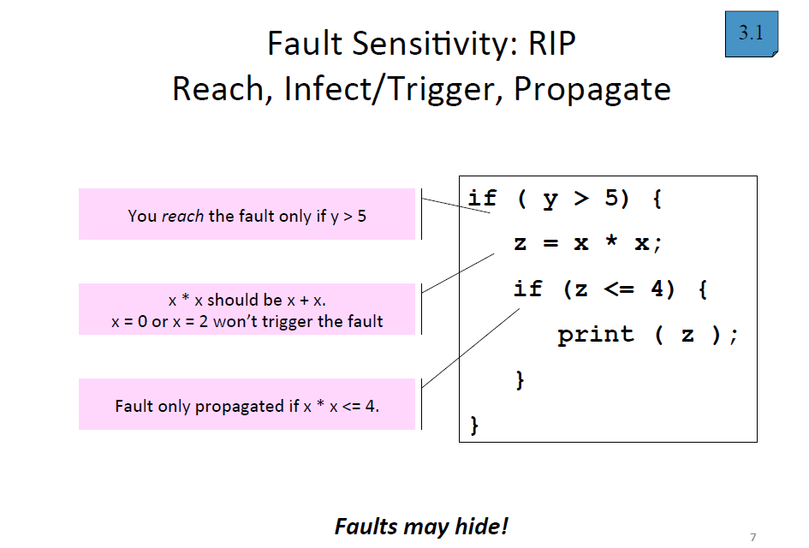

Slide 19
Conversation 1: Tester ⬄ Test Manager
Test Manager: Looks like the code under test is not achieving high statement coverage. Please work hard to achieve high statement coverage.
Tester: Hmm… boss, our goal is to detect faults. I don’t think I need to spend more efforts to achieve high statement coverge.
Test Manager: Well, according to the PIE model, …..[You fill in here]

Slide 20
Conversation 2: Tester ⬄ Test Manager
Tester: Boss, following your command, I work very hard and I have already achieved 100% statement coverage! I would like to take a vacation in Hawaii. Could you approve?
Test Manager: Well, according to the PIE model, …..[You fill in here]

Slide 21
Black-box vs. White-box
White-box - look at code to write test
Tests are based on code
Better for finding crashes, out of bounds failures, file not closed failures
Better at finding faults of extra logic
Black-box - don’t look at code to write test
Tests are based on specifications
Better at telling if program meets spec
Better at finding faults of omission

Slide 22
Black Box vs. White Box
A program needs to be developed so that given an integer value
it outputs 0 when the integer value is 0
it outputs 1 when the integer value > 0
It outputs -1 when the integer value < 0
What would be your black box tests?
How would you generate your white box tests?
Would black box tests alone be good enough to find bugs/faults in the program? Why?
Would white box tests alone be good enough be find bugs/faults in the program? Why?

Slide 23
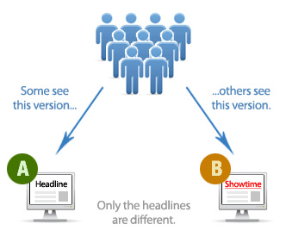
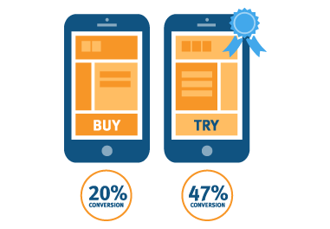
A/B Testing
https://en.wikipedia.org/wiki/A/B_testing
http://www.smartinsights.com/google-analytics/optimisation-google-analytics/ab-testing-in-wordpress-with-google-analytics-site-experiments/
http://talkroute.com/what-is-ab-testing-and-do-i-really-need-it/

Slide 24
Testing & Debugging
Testing : Finding inputs that cause the software to fail
Debugging : The process of finding a fault given a failure

Slide 25
Cost of quality
Cost of quality (COQ) =
Failure cost + Appraisal cost + Prevention cost
Failure cost = cost of diagnosing a failure, making necessary repairs, and getting back into operation
Appraisal cost = cost of evaluating the product to determine its quality level; cost of finding faults, causing failures
Design & code reviews
Testing
Prevention cost = cost associated with identifying the causes of defects and actions taken to prevent them in the future; cost of preventing the injection of faults
Causal analysis, process improvement
Pair programming, test-driven development

Slide 26
Failure costs
Internal
Rework
Repair
Failure analysis
External
Resolving complaints
Returning and replacing product
Help line

Slide 27
Prevention costs
Prevention
Planning
Reviews
Appraisal
Inspection
Testing

Slide 28
Cost of fixing a fault
1000
40-1000
times
30-70
times
100
15-40
times
10
times
10
3-6
times
1
time
1
Req.
Design
Code
Dev.
Test
System
Test
Field
operation

Slide 29
How to improve quality
Measure and compare
Determine root cause of problems
Create ways to eliminate problems

Slide 30
Tracking progress
If you don’t see it, it doesn’t exist
Measure quality over time (metrics)
Display in a public place
Make quality goals, then check to see if you meet them

Slide 31
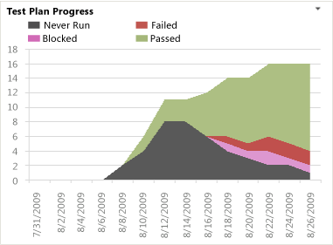
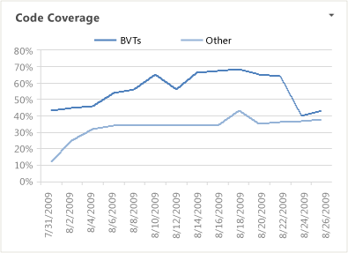
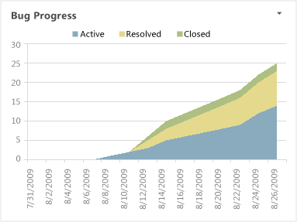
Tracking progress in VS
https://msdn.microsoft.com/en-us/library/dd420562.aspx
build verification tests (BVT)
http://en.wikipedia.org/wiki/Build_verification_test

Slide 32
How to appraise quality
Requirements
Reviews by customers
Prototyping
Analysis and design models
Formal reviews, inspections
Current system
Bug reports
User tests
Surveys
http://www.abodeqa.com/2014/03/22/reviewswalkthrough-and-inspection-in-software-testing/

Slide 33
The story of TeX
A detailed history of all faults in TeX can be found in chapters 10 and 11 of the book “Literate Programming” and in chapter 34 of the book “Digital Typography” by Donald Knuth.
He used the term “error” instead of “fault”
Just for your interest, not on the final exam
http://www-cs-faculty.stanford.edu/~uno/lp.html
http://www-cs-faculty.stanford.edu/~uno/dt.html

Slide 34
Bug tracking
Keep track of
Who reported the bug (the failure)
Description of the failure
Severity
The fault that caused this failure
Who is repairing it
The repair

Slide 35
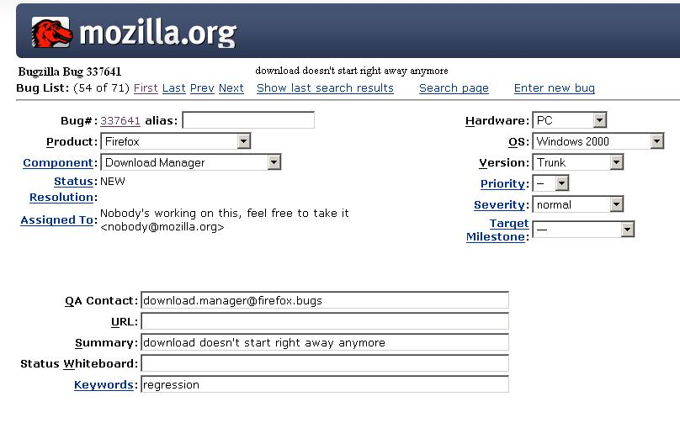
Bugzilla
bill@firefox.org
Adapted from Anvik et al.’s slides

Slide 36
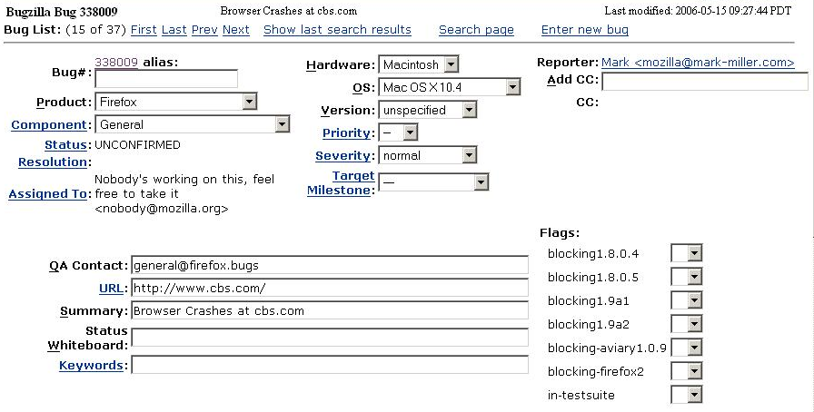
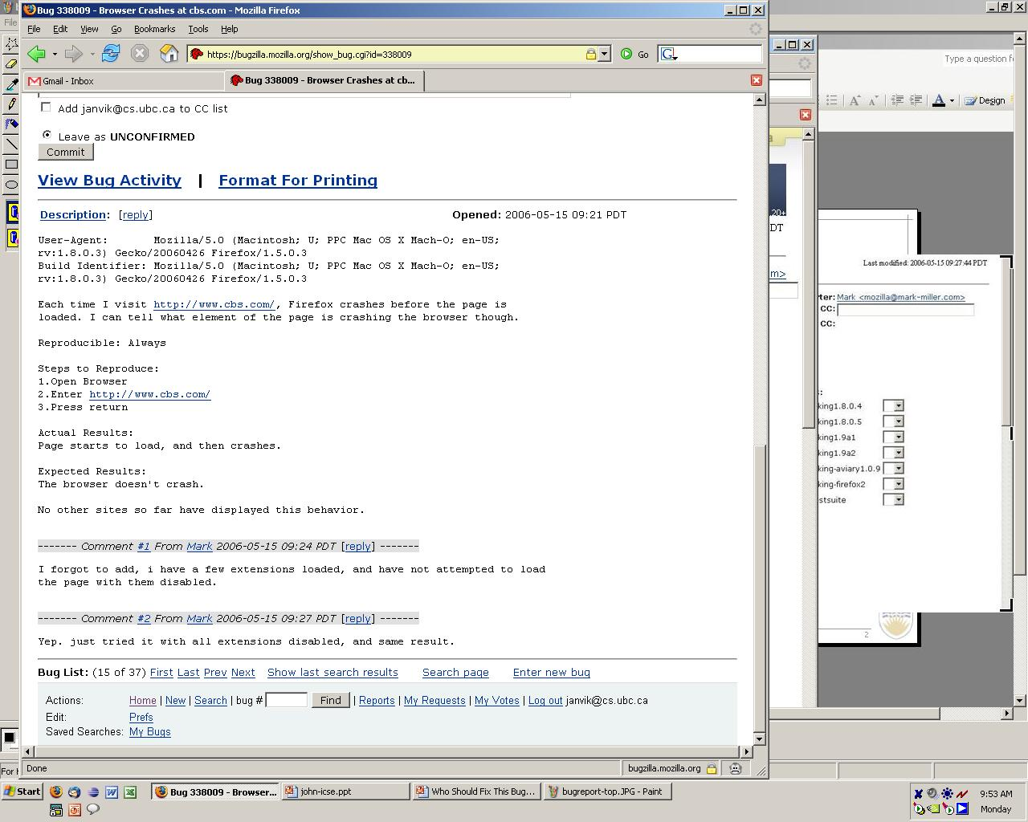
Sample Bugzilla Bug Report
Bug report image
Overlay the triage questions
Assigned To: ?
Duplicate?
Reproducible?
Bugzilla: open source bug tracking tool http://www.bugzilla.org/

Slide 37
Bug tracking
Use information about failures to estimate reliability
Compare
Critical nature of failure
Iteration that the failure discovered
Module that had the fault

Slide 38
Use quality information to make decisions
“Must repair all level 1 failures before shipping”
“Half of all level 1 and 2 failures in the alpha release were in the Call Processing module; we should rewrite it.”
“Half of all level 1 and 2 faults found in the design reviews were in Call Processing; we should rewrite it.”

Slide 39
Bug tracking
Discover the fault (i.e., defect, flaw) that caused each failure (i.e., bug)
Categorize faults
Look at categories with the most faults and improve your process to eliminate them

Slide 40
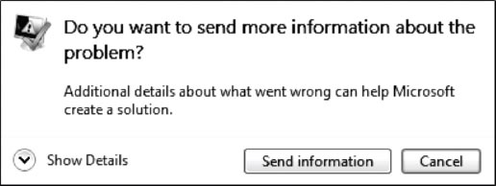
Microsoft Watson aka. Windows Error Reporting System
http://cacm.acm.org/magazines/2011/7/109883-debugging-in-the-very-large/fulltext

Slide 41
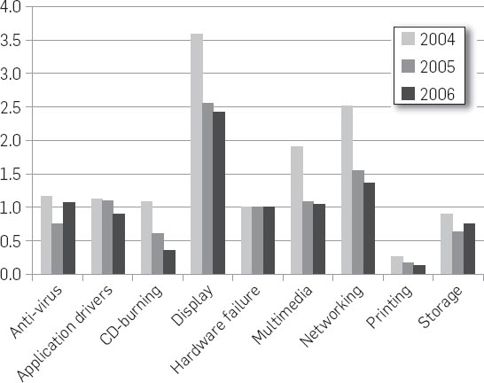
Microsoft Watson aka. Windows Error Reporting System
Crashes by driver class normalized to hardware failures for same period.
http://cacm.acm.org/magazines/2011/7/109883-debugging-in-the-very-large/fulltext

Slide 42
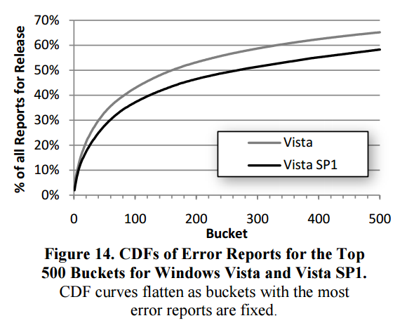
Microsoft Watson aka. Windows Error Reporting System
http://en.wikipedia.org/wiki/Cumulative_distribution_function
http://cacm.acm.org/magazines/2011/7/109883-debugging-in-the-very-large/fulltext

Slide 43
SQA Manager
Responsible for SQA policy
Develops testing plan
Checks that plan is being followed
Develops review process
Trains reviewers
Monitors reviews
Develops customer survey plan
…

Slide 44
Technical Reviews
A way to evaluate the quality of requirements, designs, and software
A way to improve the quality of requirements, designs, and software
A way to educate new developers and ensure that developers are consistent
Proven to be cost-effective!

Slide 45
Main goal: evaluate quality
Produce a report describing
Potential problems
Summary of overall quality
Pass/fail
Evaluated by expert outsiders
Must know enough
Shouldn’t know too much

Slide 46
Secondary goal: improve quality
Find faults
Enforce standards
Improve standards
Provide feedback to management

Slide 47
The Review Team
Leader (moderator)
Recorder/Scribe
Reviewers
Producers of the artifact under review may participate in the review meeting

Slide 48
Leader
Responsible for obtaining a good review - or reporting why a good review wasn’t possible
Good review - one that accurately describes the quality of the product
Make sure that reviewers have all the material they need for the review
Get a time and place for the review

Slide 49
Recorder
Responsible to provide information for an accurate report of the review
At end of review, recorder gives summary and makes sure the team agrees
Recorder helps leader make final report

Slide 50
Reviewers
Study product in advance and take notes
Have a check-list of review criteria
Give both positive and negative comments
Raise issues, don’t resolve them
Must be technically competent

Slide 51
Result of review
Review summary
Who, what, when and the conclusion
Issues list
Can result in more detailed reports
Give priority to issues
Can be disagreement on issues
Most issues are about product, but can also be about process or standards

Slide 52
Walkthrough
Producer guides reviewers through the product
Easier on reviewers
Can cover more material
More reviewers can participate
Good for training the reviewers
Not as good for evaluating and improving the product

Slide 53
Inspection
Confine attention to a few aspects of the product, one at a time
More preparation by leader - must give detailed instructions to reviewers
REVIEWS,WALKTHROUGH AND INSPECTION IN SOFTWARE TESTING:
http://www.abodeqa.com/2014/03/22/reviewswalkthrough-and-inspection-in-software-testing/

Slide 54
Checklist: Java code
Class names make sense
Class comment that defines variables
Classes have member functions and fields in an order
Classes have getters/setters properly defined
Methods
Names should be spelled out in full
Visibility should be as restrictive as possible
Should be properly documented
Should not be too big (less than 30 lines)

Slide 55
Summary
Reviews are a key quality control technique
Pair-programming is a kind of informal review
Use reviews to improve your process, not just your product

Slide 56
More to read
Code Complete 2
Ch. 20 “The Software Quality Landscape”
Ch. 21 “Collaborative Construction”

