Slide 1
CS428: Software Engineering II
Requirements

Slide 2
This week’s goals
How can we document requirements?
What are different ways of writing Use Cases?
When do Use Cases (not) fit for capturing requirements?

Slide 3
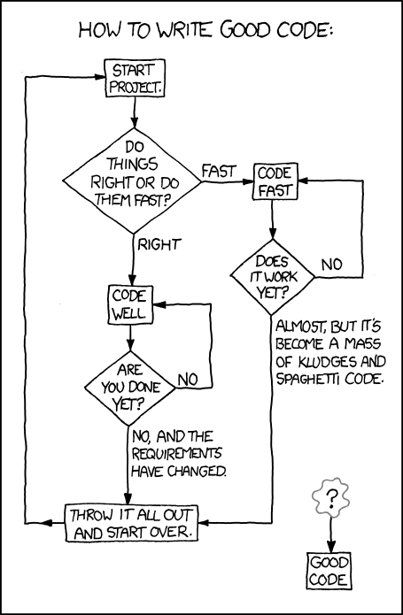
http://xkcd.com/844/

Slide 4
Primary project killers
Requirements mistakes
Wrong requirements
Ever-changing requirements
Ever-increasing requirements (“creep”)
Improper schedule

Slide 5
Requirements in XP
Customer (& developer) writes user stories
Customer interprets user stories
Customer assumed to know requirements
No process for learning requirements

Slide 6
Other people for requirements
Business analyst
analyze an organization or business domain and document its business, processes, or systems, assessing the business model or its integration with tech
Systems engineer
also develop software components, but also specify, build, maintain and support technical infrastructure (e.g., build, test and production environments used to deliver SaaS, and systems for performance monitoring, and as on-call support engineer)
Project lead
Program manager
PM at Microsoft (by Steven Sinofsky): ”do not program nor do they manage”, “working in partnership with expert designers, clever developers, super smart testers, etc. you all work together to define the product AND the responsibilities each of you have.” http://blogs.msdn.com/techtalk/archive/2005/12/16/504872.aspx

Slide 7
What’s in requirements
Example items
Reports to be generated
UI for a game
Behavior of system
Data formats
…
iTrust Example: http://agile.csc.ncsu.edu/iTrust/wiki/doku.php?id=requirements

Slide 8
Requirements
Functional requirements
Inputs, outputs, and the relations between them
Non-functional requirements (-ilities)
Security
Reliability
Efficiency
Usability
Scalability
Maintainability
Portability
…

Slide 9
Functional requirements I
Inputs, outputs, and the relationship between them
Use Cases are one example we’ll look at
Formats, standard interfaces
Business rules and complex formula
iTrust Example: http://agile.csc.ncsu.edu/iTrust/wiki/doku.php?id=requirements

Slide 10
Functional requirements II
Command language
The “get” command will transfer ...
Web pages
Input forms, dynamic pages
Connections to other systems
Files, sockets, XML, …
Reports, displays

Slide 11
Non-functional requirements I
Performance
Must answer a query in 3 seconds
Usability
New user must be able to finish buying a book in 15 minutes
90% of users must say they like interface
Maintainability
New programmers should be able to fix first bug in two weeks on the job

Slide 12
Non-functional requirements II
Technology
Must use Java
Business
Must get it finished in 1 year spending less than $1,000,000

Slide 13
Accuracy
Functional requirements - in theory, can specify completely
Non-functional requirements - hard to specify, can’t specify completely
Requirements should be specific, so you can tell whether you met them
Requirements should be as precise as necessary, but no more

Slide 14
System description
Typical description has two parts
Data
Operations on that data
Three possible descriptions
Requirements
Specification
Design

Slide 15
Many notations
UML
Use cases
Class diagram
State diagram
Finite state machine
Data flow diagram
Pseudocode
Programming language

Slide 16
Many purposes
Communicate to
User
Developers
Boss
Complete - lots of detail
Easy to read - less detail

Slide 17
Cost of change curve
Requirements
Design
Construction
Test
Deployment
Cost of fixing a bug

Slide 18
Requirements analysis

Slide 19
Questions to ask
How do you learn
What the problem is?
What you can change?
What the computer should do?
Whether you were correct?

Slide 20
Discovery techniques
Reading
Interviews
Teams
Creating requirements document
Building models
Building prototypes

Slide 21
Requirement document
List requirements
Name requirements
Categorize requirements by
Source
Feature
Subsystem
Type

Slide 22
Example
Health Claims Processing
System that receives health insurance claims
In the end, determines whether to pay or not
Suppose a legacy system that can process accepted claims
Develop a new system to automate overall processing

Slide 23
Health claims processing I
R1) Receives health claims and supporting documents via many sources: electronically, fax, on paper.
R2) Scanned paper and fax processed by OCR. Documents first subject to form dropout, deskewing, despeckling.
R3) All images are logged to optical disk.

Slide 24
Health claims processing II
R4) Fields with low confidence levels are repaired by hand. Certain types of claims are transmitted to an offshore data entry vendor.
R5) Match the plan and the health care provider.
R6) Existing mainframe system processes accepted claims.

Slide 25
Health claims processing III
R7) Determine if claim can be paid, and how much. If there are inconsistencies, suspend the claim until a human (adjudicator) can look at it.
R8) Adjudicator looks at documents about claim and history of client and can ask for more information, can accept claim, or can reject claim.

Slide 26
Summary of requirements
Getting the right requirements is crucial and hard. Key part of software engineering
Must communicate with users
Models are helpful in analyzing and communicating requirements

Slide 27
Use Cases
One way to express requirements
Invented by Ivar Jacobsen
Popularized by Alistair Cockburn
We used to use his book
Now reading listed on Wiki (consult his book’s draft version http://alistair.cockburn.us/get/2465 if there is unclear place in the reading)

Slide 28
Use case diagram
Shows context - what is in and out of the system
Shows scope and boundaries
Shows actors and use cases
Shows relationships between actors and use cases
Does not show a description of use cases

Slide 29
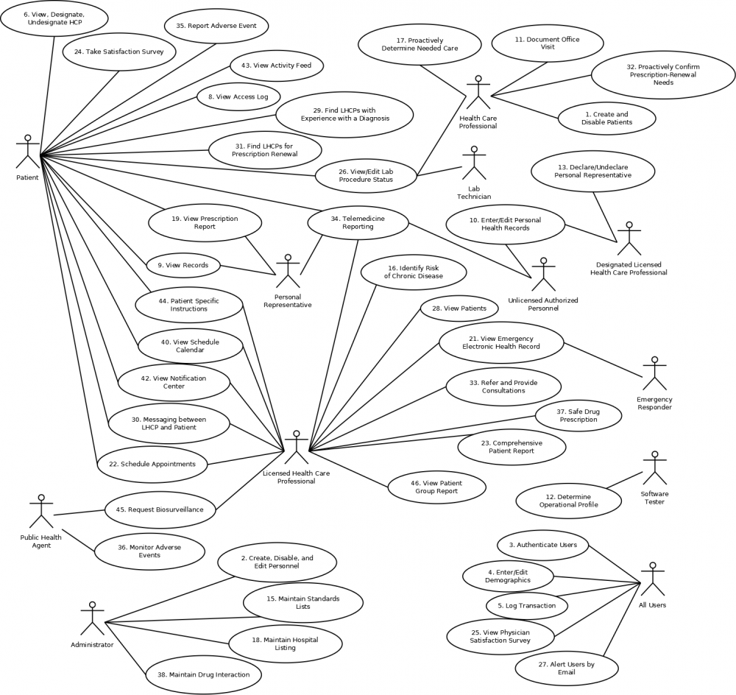
iTrust Spec: Use Case Based
http://agile.csc.ncsu.edu/iTrust/wiki/doku.php?id=requirements

Slide 30
iTrust Spec: Use Case Based

Slide 31
Main entities
Actor: Role of something or someone that interacts with System
Use case: Something that the System does, or that happens to the System. Always involves an actor
System: The thing you are studying

Slide 32
Example Use Case Diagram
Caveat: NOT good naming of use cases
NO need to add arrows on edges except for Include or Extend relationships, see later slides

Slide 33
Use cases
Text - a form of writing
Describes the system’s behavior as it responds to request from a primary actor
Actor wants to achieve some goal
Many kinds of use cases
Brief / detailed
Requirement / specification / design

Slide 34
Use cases are text
Use cases should be easy to read
Keep them short
Tell a story
Write full sentences with active verb phrases
Make the actors visible in each sentence

Slide 35
Use cases are event sequences
Describe the sequence of events that happen when the system responds to a request
Can describe alternatives (note that a scenario doesn’t have alternatives)
Can describe errors

Slide 36
Parts of a use case
Primary actor – who starts it?
Why the use case? Primary actor has goal.
Normal steps
Alternative steps

Slide 37
Four kinds of use cases
Actor-goal list
Use case brief
Casual use cases
“Fully dressed” use cases
Names from “Writing Effective Use Cases” by Alistair Cockburn
How are XP user stories related?

Slide 38
Goals
Primary actor always has a goal
Must pick right level for goal
Use case for Amazon - buy a book
Higher-level goal - learn something, make someone happy
Lower-level goal - provide credit card info

Slide 39
Actor-goal list
Goals should be on the same level
Goal should be from point of view of primary actor
Sort goals by primary actor
Priority to designer of system, not to actors

Slide 40
Actor-goal list
Actor Task-level goal Priority
Provider Submit paper claim 1
Provider Submit fax claim 2
Provider Submit electronic claim 3
Adjudicator Adjudicate problem 2

Slide 41
Including lower-level goals
Lower-level goals can improve readability
To design components
When user has only one goal

Slide 42
Actor-goal list for games
Games have one use case - play game
For use cases to be good requirements document, more detail is needed
Use lower-level goals

Slide 43
Example: Tower game
Actor Task-level goal Priority
User Create towers 1
Tower Shoot monsters 2
Monster Move toward user 2
Horde Create monsters 3

Slide 44
Use case brief
1-6 sentence description of behavior
Mention only most significant behavior and failures
Short enough to put many on a page
Used to
Estimate complexity
Find components to reuse

Slide 45
Use case briefs
Actor
Provider
Provider
Adjudicator
Goal
Submit paper claim
Submit fax claim
Adjudicate failed claim
Brief
Submit claim on paper, which is converted into electronic form, and either paid or sent for adjudication
Submit claim by fax, which is processed by OCR and either paid or sent for adjudication.
Decide whether a questionable claim should be paid by the mainframe payment system or rejected

Slide 46
Identify Use Cases from Video Scenarios
Watch a video clip (you are allowed to write notes when watching!): https://www.youtube.com/watch?v=udr9-CN5mXU
Get into groups of 2-3 students
Competition: enumerate as many use cases as possible in the form of Actor-goal list such as (you can leave priority empty)
Actor Task-level goal Priority
XXX YYY Z
Tower Shoot monsters 2
Monster Move toward user 2
Horde Create monsters 3

Slide 47
Casual & Fully Dressed
Used to tell developers what to build
“Casual” consists of normal paragraphs
“Fully Dressed” has labeled sections
Both should emphasize “main success scenario”
Both should include ways of failing
One per page

Slide 48
Design scope
Actor-Goal list and use case briefs help decide design scope
What is in, what is out
What is a use case, what is not a use case
Casual/fully dressed use case is given to developers so they know what to build

Slide 49
Casual (short) version of Submit Fax Claim
The Provider submits a claim by fax. The claim processing system will log the image to optical disk, apply form dropout, deskewing, despeckling, and then process it using OCR. Knowledge workers will repair any fields that seem to be in error. The claim will then either be paid (using existing mainframe processing system) or sent to adjudication.

Slide 50
Fully dressed
Primary actor
Goal in context - what is the primary actor’s bigger goal?
Scope - system we are designing
Level - user goal, higher-level (summary), lower-level (subfunction)
Stakeholders
Scope or Level options, see Page 3 of http://alistair.cockburn.us/get/2465

Slide 51
Fully dressed
Preconditions: things that must be true before this use case can happen
Guarantees: things that the use case will ensure are always true
Triggers: things that cause the use case to start

Slide 52
Main success scenario
Describe trigger
Give numbered list of actions leading to success
Alternatives left to “extensions”

Slide 53
Extensions
Alternatives to main success scenario
Special cases, failures
Steps have same numbers as in main success scenario, but modified to show they are alternatives
3a instead of 3

Slide 54
Example fully dressed (detailed) version of Submit Fax Claim
Primary Actor: Provider
Goal in context: Pay legitimate claims while rejecting bad ones.
Scope: Business - the overall purchasing mechanism, electronic and non-electronic, as seen by the people in the company.
Level: Summary
Stakeholders and interests:
Provider: Wants to be paid for services rendered.
Company: Wants to cut costs and avoid fraud.
Precondition: none
Minimal guarantees: Pay only certified providers, pay only for services that are covered by plan, do not pay if there are obvious mistakes.
Scope or Level options, see Page 3 of http://alistair.cockburn.us/get/2465

Slide 55
Main success scenario:
Trigger: Claim submitted by fax
1. Provider: submit claim by fax
2. Claim system: drop forms, deskew, despeckle, use OCR to convert to electronic form
3. Claim system: check claim to make sure it is legal
4. Mainframe payment system: pay claim
Extensions:
2a. Some fields have low confidence: Knowledge worker corrects
3a. Claim is not valid: send to adjudication

Slide 56
Writing
Use present tense
Subject should be primary actor, system under design, and secondary actors
Verb should be what actor does to successfully move the use case forward
Avoid GUI: write in terms of goals, not details of the GUI

Slide 57
Team Writing in Practice
Team better for brainstorming, reviewing
Individuals better for writing
Make list in a team
Write use cases in ones or twos
Review as a team

Slide 58
Use cases and requirements
An important part of requirements
You do need more than just use cases
Help manage requirements
Help requirement traceability

Slide 59
Traceability
Traceability - the ability to trace the effect of a requirement and determine who caused it
Why do we have this requirement? Who wrote it?
How is this requirement met?
What requirement caused this design?
Backward (code to requirement) and forward (requirement to code) traceability

Slide 60
Manage requirements
Must agree to change in requirements
Usually increases price
Must be reviewed
Make sure each part of design is due to a requirement
Analyze problems: what was the root cause of this fault/defect?
E.g., Orthogonal Defect Classification (ODC)
http://en.wikipedia.org/wiki/Orthogonal_Defect_Classification

Slide 61
Scenarios and use cases
Scenario is concrete and detailed
Names of people
$ values, particular dates, particular amounts
Scenario is a test case
Use case is a contract, and collects all the scenarios

Slide 62
Goals and use cases
Actor has a goal for the use case
System forms subgoals to carry out its responsibility
Goals can fail
Use case describes a set of ways for carrying out the goal, and several ways of failing

Slide 63
When use cases don’t work
Compilers
One use case - compile a program
Despeckler
One use case - remove speckles
No interaction
…

Slide 64
Use Case Diagram: Stereotypes
Use Case X includes Use Case Y:
X has a multi-step subtask Y. In the course of doing X or a subtask of X, Y will always be completed.
Use Case X extends Use Case Y:
Y performs a sub-task and X is a similar but more specialized way of accomplishing that subtask. X only happens in an exception situation. Y can complete without X ever happening.
©L. Williams

Slide 65
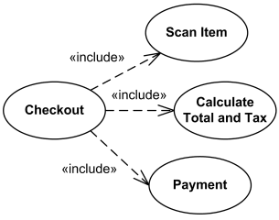
Use Case Diagram: Include
Use Case X includes Use Case Y:
X has a multi-step subtask Y. In the course of doing X or a subtask of X, Y will always be completed.
Arrow direction
“Include relationship between use cases is shown by a dashed arrow with an open arrowhead from the including (base) use case to the included (common part) use case.”
http://www.uml-diagrams.org/use-case-include.html

Slide 66

Use Case Diagram: Extend
Use Case X extends Use Case Y:
Y performs a sub-task and X is a similar but more specialized way of accomplishing that subtask. X only happens in an exception situation. Y can complete without X ever happening.
Arrow direction
“Extend relationship is shown as a dashed line with an open arrowhead directed from the extending use case to the extended (base) use case.”
http://www.uml-diagrams.org/use-case-extend.html

Slide 67
“Executable use cases” Behaviour Driven Development
Cucumber (http://cukes.info/) can execute tests written in structured natural language (as scenarios in use cases)
Example: test for a calculator program Feature: Division Scenario: Regular numbers Given I have entered 3 into the calculator And I have entered 2 into the calculator When I press divide Then the result should be 1.5 on the screen

Slide 68
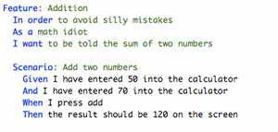
Step 1: Describe behaviour in plain text

Slide 69
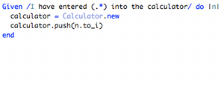
Step 2: Write a step definition in Ruby

Slide 70
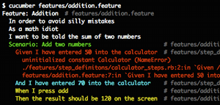
Step 3: Run and watch it fail

Slide 71
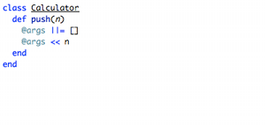
Step 4: Write code to make the step pass

Slide 72
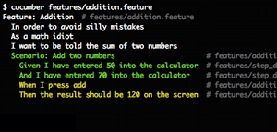
Step 5: Run again and see the step pass

Slide 73
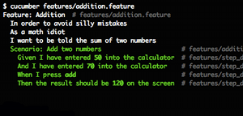
Step 6: Repeat 2-5 until green like a cuke
Step 7. Repeat 1-6 until the money runs out

Slide 74
Summary of use cases
Use cases are useful, but not perfect
Many ways to write use cases
Big projects need big use cases
Use the simplest way you can!

