Slide 1
CS 152 Computer Architecture and Engineering CS252 Graduate Computer Architecture Lecture 17 – RISC-V Vectors
Krste Asanovic
Electrical Engineering and Computer Sciences
University of California at Berkeley
http://www.eecs.berkeley.edu/~krste
http://inst.eecs.berkeley.edu/~cs152
Released Under Creative Commons CC BY-SA 4.0 Licence (see last slide)

Slide 2
Last Time in Lecture 16
GPU architecture
Evolved from graphics-only, to more general-purpose computing
GPUs programmed as attached accelerators, with software required to separate GPU from CPU code, move memory
Many cores, each with many lanes
thousands of lanes on current high-end GPUs
SIMT model has hardware management of conditional execution
code written as scalar code with branches, executed as vector code with predication

Slide 3
New RISC-V “V” Vector Extension
Being added as a standard extension to the RISC-V ISA
An updated form of Cray-style vectors for modern microprocessors
Today, a short tutorial on current draft standard, v0.8/0.9
v0.8 is version supported by tools, v0.9 has some small changes highlighted in red
v0.9 is intended to be close to final version of RISC-V vector extension
Still a work in progress, so details might change before standardization
https://github.com/riscv/riscv-v-spec

Slide 4
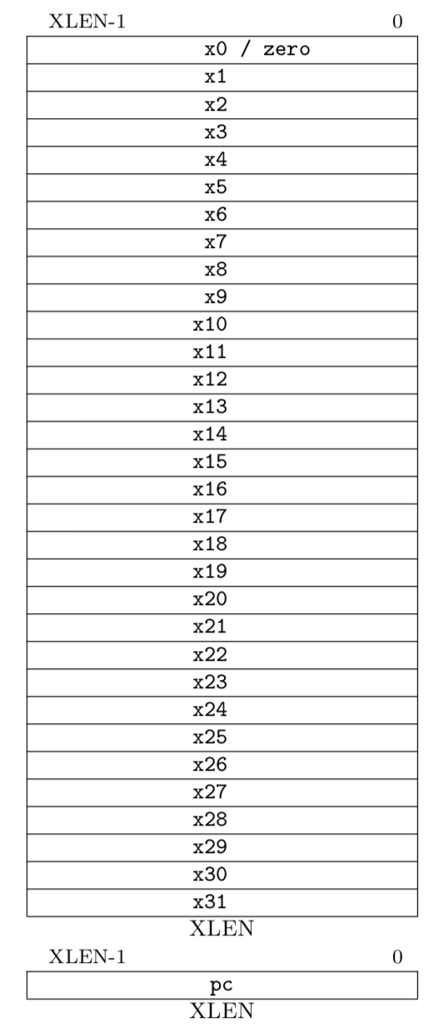
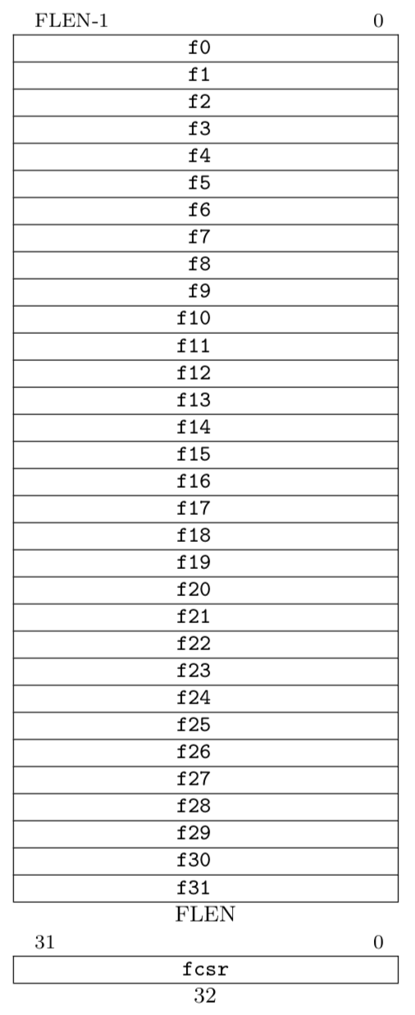
RISC-V Scalar State
Program counter (pc)
32x32/64-bit integer registers (x0-x31)
x0 always contains a 0
Floating-point (FP), adds 32 registers (f0-f31)
each can contain a single- or double-precision FP value (32-bit or 64-bit IEEE FP)
FP status register (fcsr), used for FP rounding mode & exception reporting
ISA string options:
RV32I (XLEN=32, no FP)
RV32IF (XLEN=32, FLEN=32)
RV32ID (XLEN=32, FLEN=64)
RV64I (XLEN=64, no FP)
RV64IF (XLEN=64, FLEN=32)
RV64ID (XLEN=64, FLEN=64)

Slide 5
Vector Extension Additional State
32 vector data registers, v0-v31, each VLEN bits long
Vector length register vl
Vector type register vtype
Other control registers:
vstart
For trap handling
vrm/vxsat
Fixed-point rounding mode/saturation
Also appear in fcsr (0.9: in separate vcsr)
Vector data registers
VLEN bits per vector register, (implementation-dependent)
v0
v31
Vector length register
vl
Vector type register
vtype

Slide 6
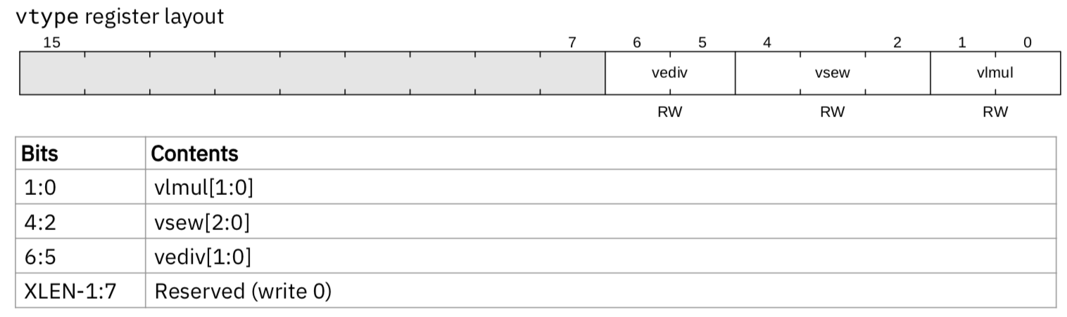
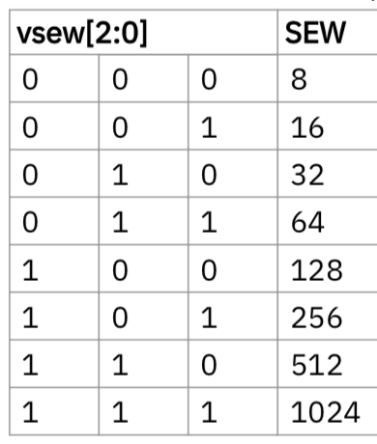
Vector Type Register
Ideally, this info would be instruction encoding, but no space in 32-bit instructions.
Planned 64-bit encoding extension would add these as instruction bits.
vsew[2:0] field encodes standard element width (SEW) in bits of elements in vector register (SEW = 8*2^{vsew} )
vlmul[1:0] encodes vector register length multiplier (LMUL = 2^{vlmul} = 1-8)
(v0.9 adds “fractional LMUL” < 1)
vediv[1:0] encodes how vector elements are divided into equal sub-elements (EDIV = 2^{vediv} = 1-8)

Slide 7
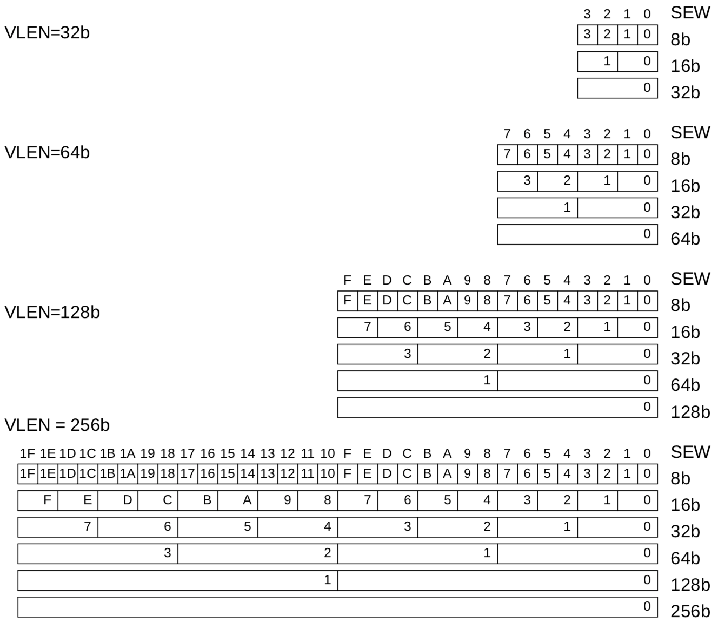
Example Vector Register Data Layouts (LMUL=1)

Slide 8
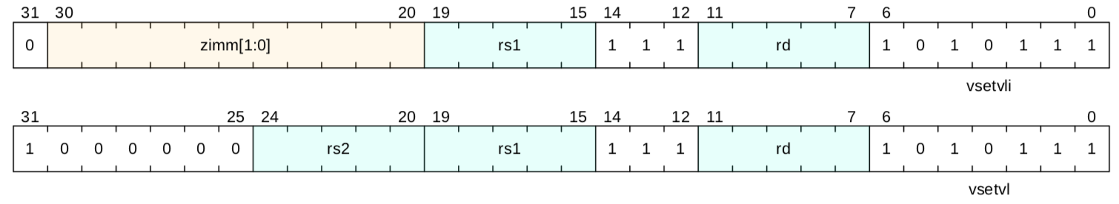
Setting vector configuration, vsetvli/vsetvl
The vsetvl{i} configuration instructions set the vtype register, and also set the vl register, returning the vl value in a scalar register
vsetvli rd, rs1, e8 # Set SEW=8, vl=min(VLEN/SEW,rs1), rd=vl
vtype parameters (SEW,LMUL,EDIV) encoded as immediate in instruction
Resulting machine vector length setting
Requested application vector length
Instruction encoding
Usually use immediate form, vsetvli, to set vtype parameters.
The register version vsetvl is usually used only for context save/restore

Slide 9
vsetvl{i} operation
The first scalar register argument, rs1, is the requested application vector length (AVL)
The type argument (either immediate or second register rs2) indicates how the vector registers should be configured
Configuration includes size of each element, SEW, and LMUL value
The vector length is set to the minimum of requested AVL and the maximum supported vector length (VLMAX) in the new configuration
VLMAX = LMUL*VLEN/SEW
vl = min(AVL, VLMAX)
The value placed in vl is also written to the scalar destination register rd

Slide 10
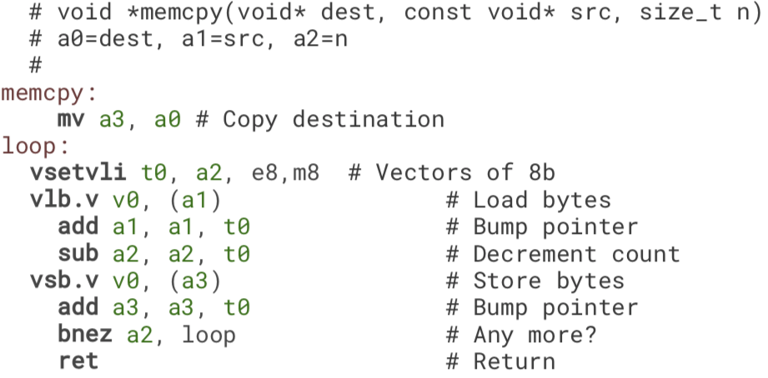
Simple stripmined vector memcpy example
Set configuration, calculate vector strip length
Unit-stride vector load elements (bytes)
e
e
Unit-stride vector store elements (bytes)
Same binary machine code can run on machines with any VLEN!

Slide 11
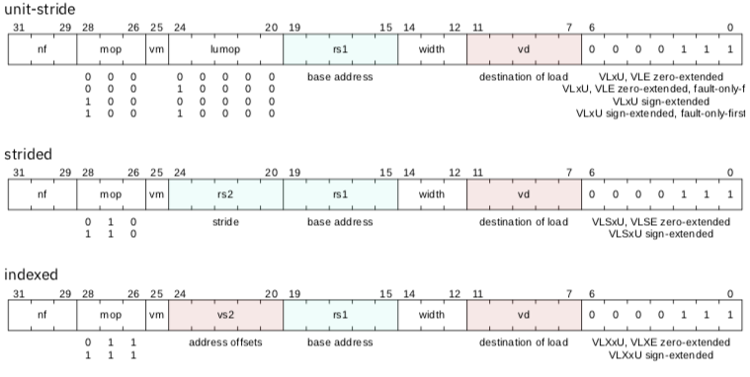
Vector Load Instructions
Vector destination
Scalar stride (bytes)
Vector of offsets (bytes)
Scalar base address

Slide 12
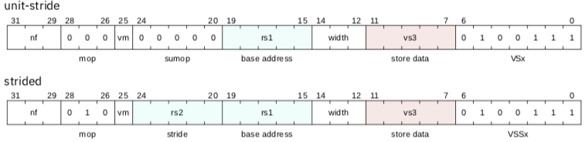
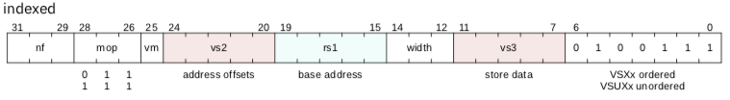
Vector Store Instructions
Vector store data

Slide 13
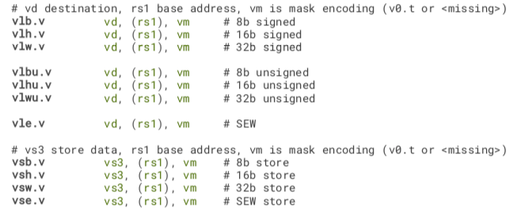
Vector Unit-Stride Loads/Stores
(These other shaded instructions dropped in v0.9)

Slide 14
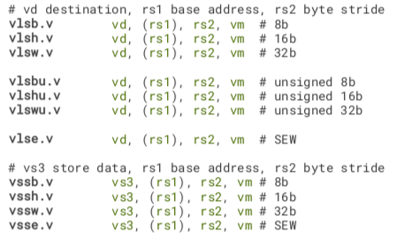
Vector Strided Load/Store Instructions

Slide 15
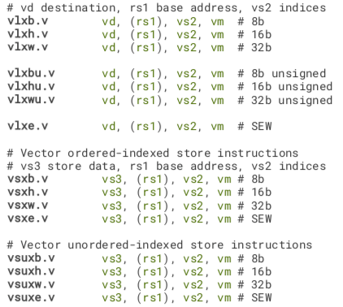
Vector Indexed Loads/Stores

Slide 16

Vector Length Multiplier, LMUL
Gives fewer but longer vector registers
Called “vector register groups” – operate as single vectors
Must use even register names only for LMUL=2 (v0,v2,..), and every fourth register for LMUL=4 (v0,v4, …), etc.
Used for 1) accommodate mixed-width operations, and/or 2) to increase efficiency by using longer vectors when fewer separate registers needed
Set by vlmul[1:0] field in vtype during setvli
LMUL=2

Slide 17
LMUL=8 stripmined vector memcpy example
Combine eight vector registers into group
(v0,v1,…,v7)
Set configuration, calculate vector strip length
Unit-stride vector load bytes
e
e
Unit-stride vector store bytes
Binary machine code can run on machines with any VLEN!

Slide 18
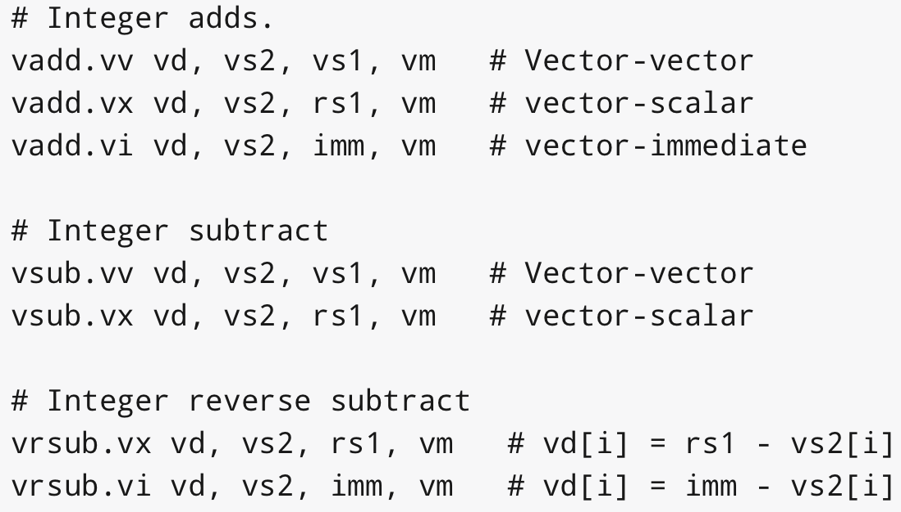
Vector Integer Add Instructions

Slide 19
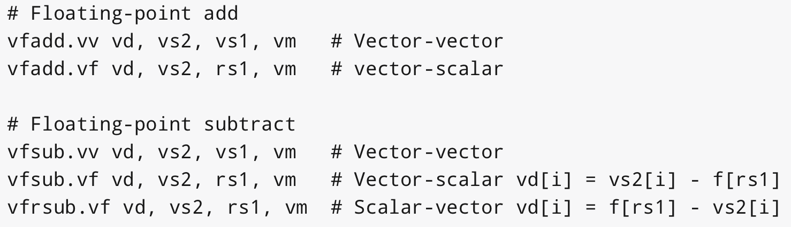
Vector FP Add Instructions
SEW can be 16b, 32b, 64b, 128b for half/single/double/quad FP
Scalar values come from floating-point f registers

Slide 20
CS152 Administrivia
Per campus directions, CS152 will be graded P/NP by default
Instructors will maintain full grading information
Students can request letter grade if required, up to May 6 (RRR week)
PS 4 due Friday April 3
Lab 4 out on Friday April 3
Lab 3 due Monday April 6
Students can request extensions on PS and Labs
Midterm 2 and final format TBD, date unlikely to change
Krste’s office hours now on request (likely 8am-9am)

Slide 21
CS252 Administrivia
Grad students can modify grade to Satisfactory/Unsatisfactory (S/U) until Friday, May 8, 2020.
Dept/College relaxing rulings on course requirements (still TBD)
Next week readings: Cray-1, VLIW & Trace Scheduling

Slide 22
Masking
Nearly all operations can be optionally under a mask (or predicate) held in vector register v0
A single vm bit in instruction encoding selects whether unmasked or under control of v0
Constrained by encoding space in 32-bit instructions
Longer 64-bit encoding extension will support predicate in any register
Integer and FP compare instructions provided to set masks into any vector register
Can perform mask logical operations between any vector registers

Slide 23
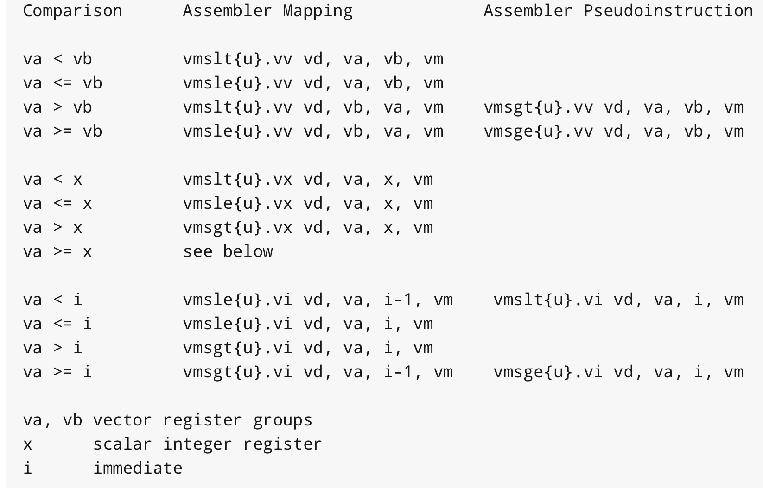
Integer Compare Instructions

Slide 24
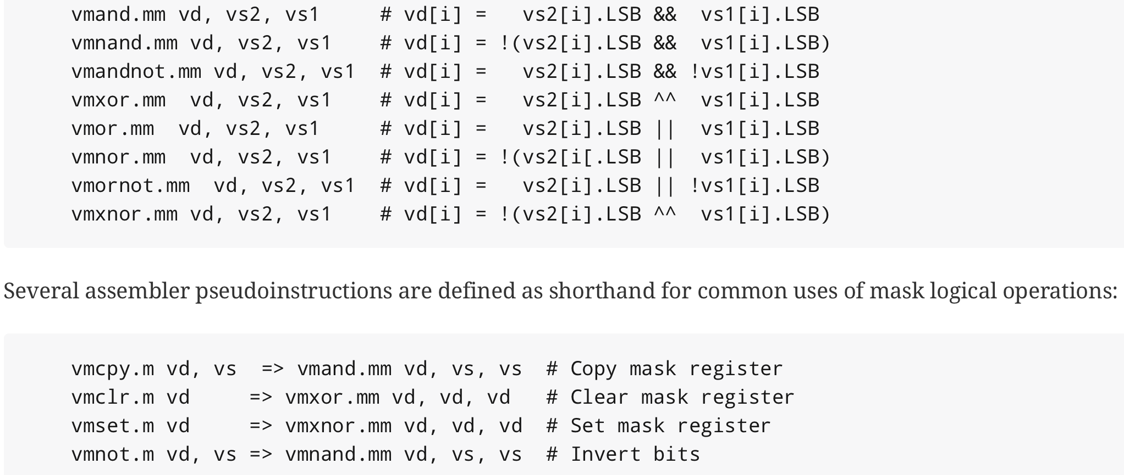
Mask Logical Operations

Slide 25
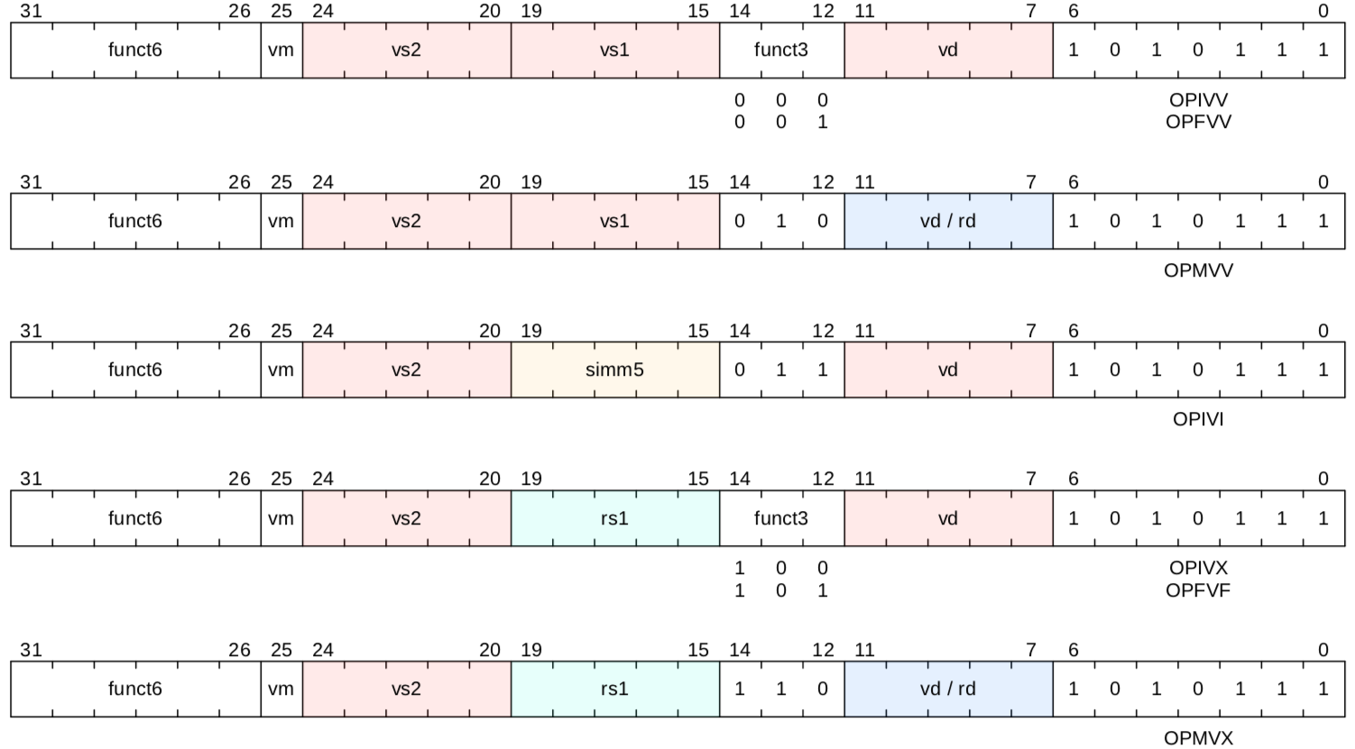
Vector Arithmetic Instruction Encodings

Slide 26
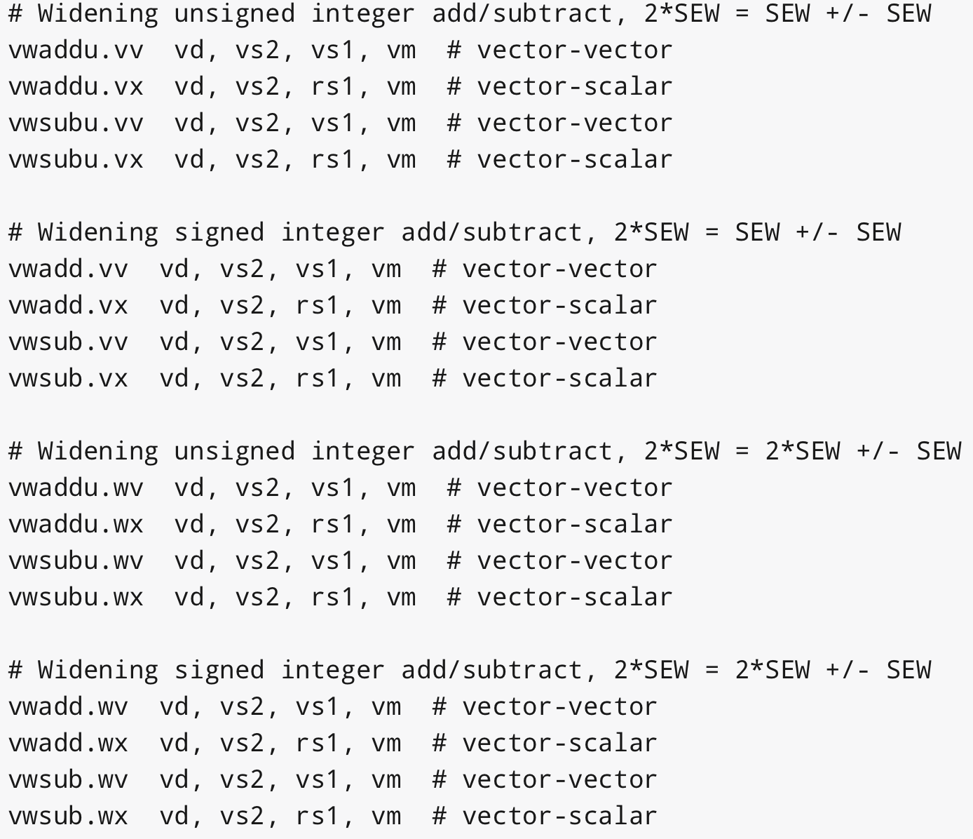
Widening Integer Add Instructions

Slide 27
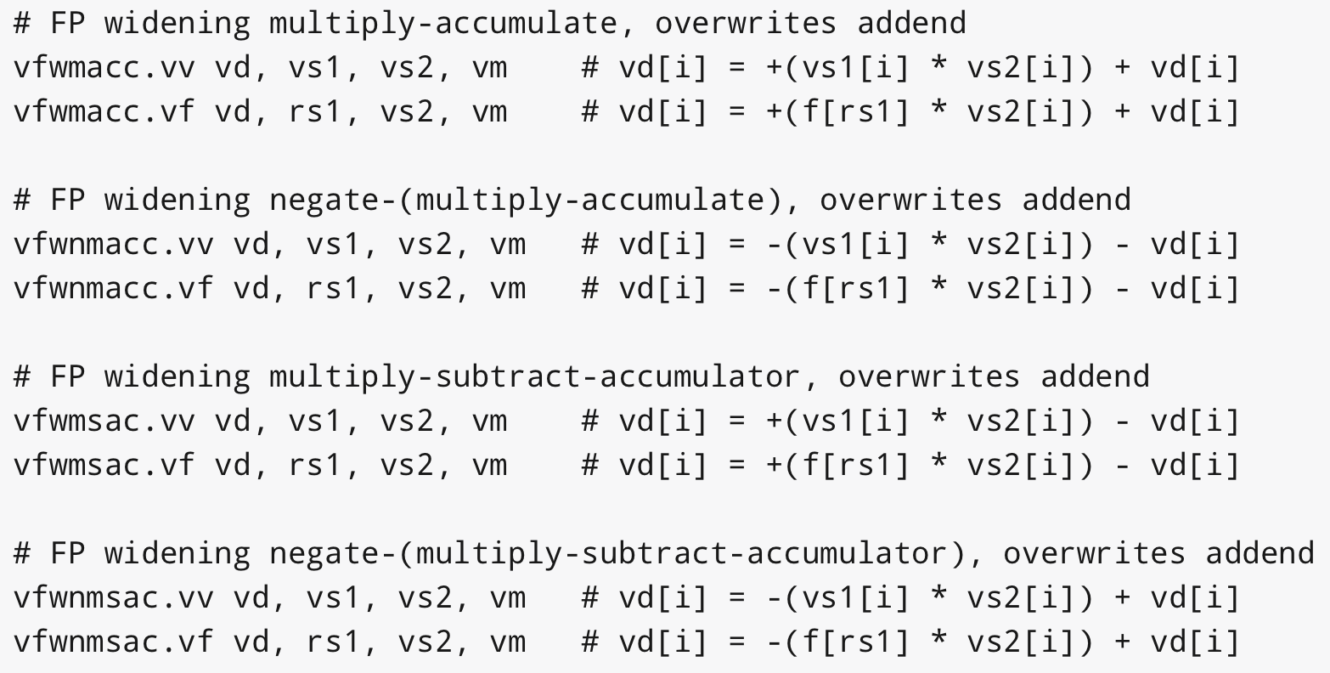
Widening FP Mul-Add

Slide 28
Mixed-Width Loops
Have different element widths in one loop, even in one instruction
e.g., widening multiply, 16b*16b -> 32b product
Want same number of elements in each vector register, even if different bits/element
Solution: Keep SEW/LMUL constant

Slide 29
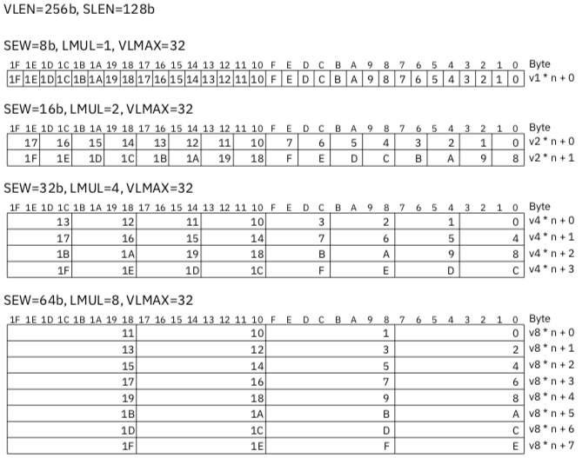
VLEN=128b
VLMAX=16
VLMAX=16
SEW/LMUL=8
VLMAX=16
VLMAX=16

Slide 30
SLEN: Coping with wide datapaths
SLEN is design parameter, so implementers can reduce wiring in their design when SLEN<VLEN
Unless datapath very wide (>128b) will set SLEN=VLEN

Slide 31
Mask Register Layout
Masks always held in a single vector register
All bits written on compare, only LSB considered as mask
Size of each field, MLEN, is SEW/LMUL
E.g.1, SEW=8b, LMUL=8, MLEN=1b
E.g.2, SEW=64b, LMUL=1, MLEN=64b
For mixed-precision loops with constant SEW/LMUL, mask values always ”line up” at each element

Slide 32
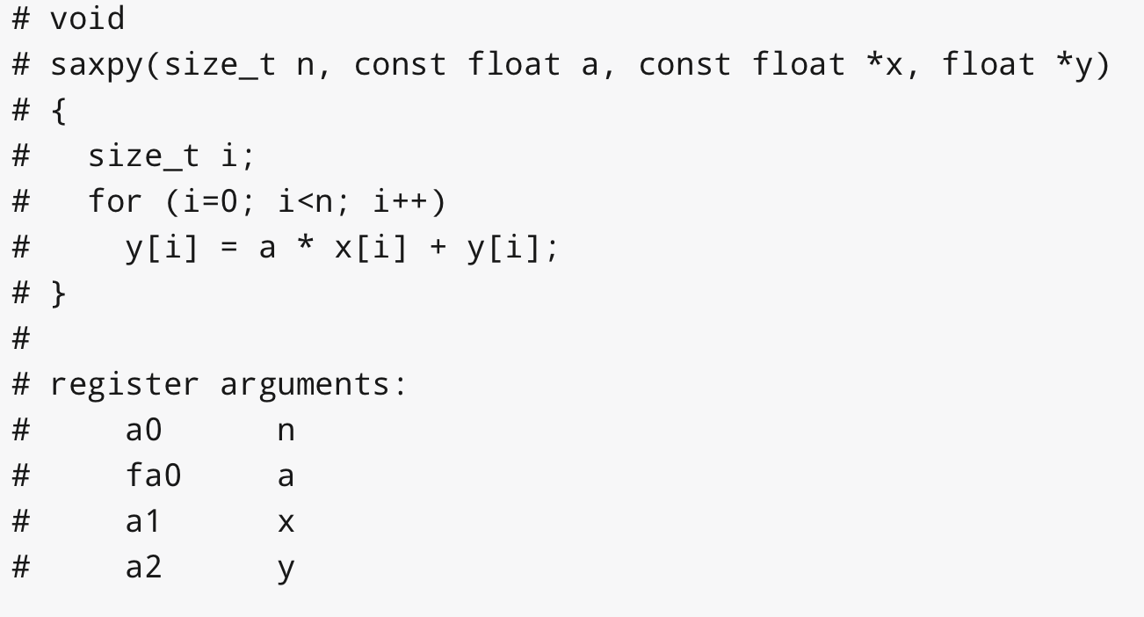
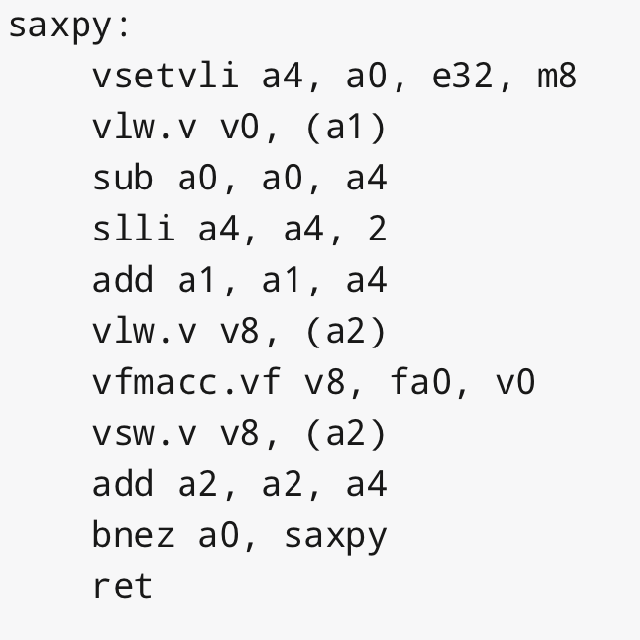
SAXPY Example
e
e
e

Slide 33
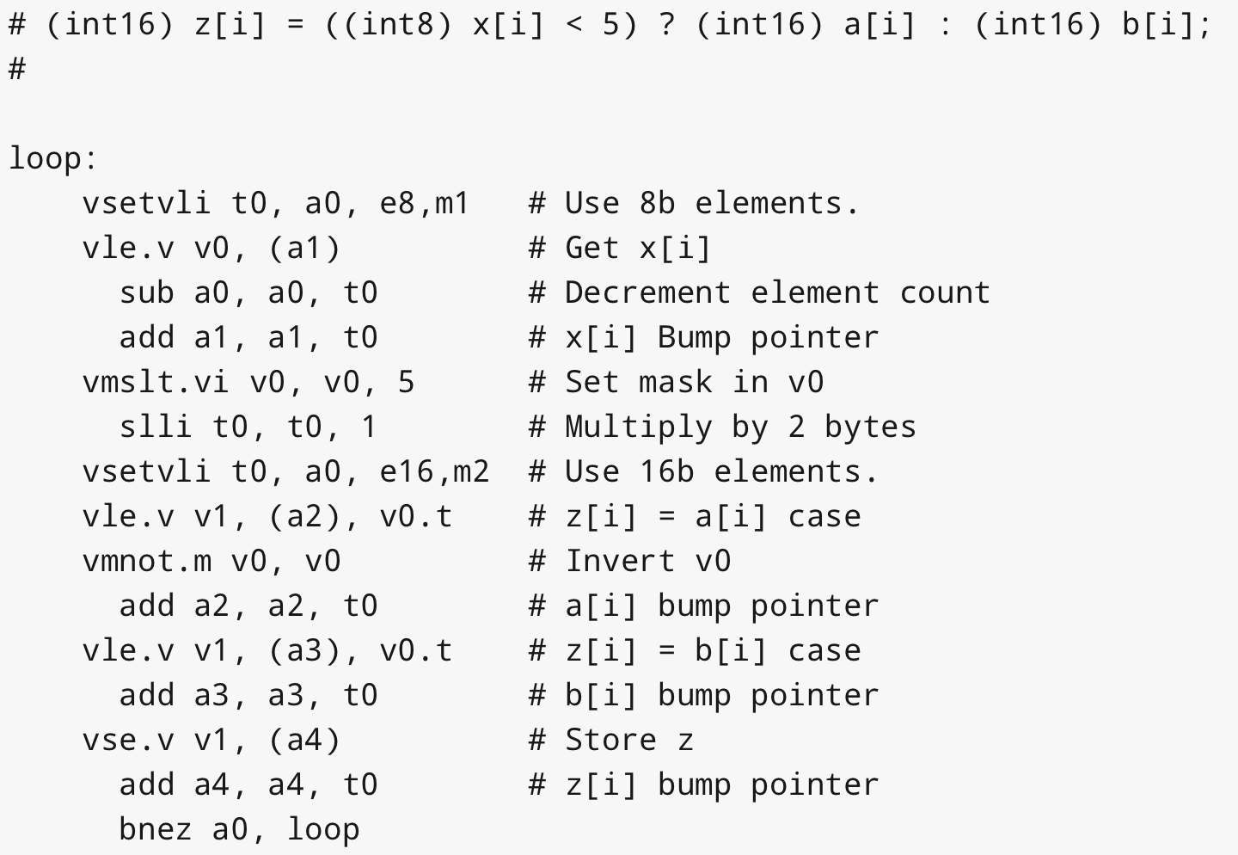
Conditional/Mixed Width Example
e
e
e

Slide 34
Creative Commons Licence
These lecture slides are made available under a CC SY-BA 4.0 license
https://creativecommons.org/licenses/by-sa/4.0/
Attribution Title: “RISC-V Vectors, CS152, Spring 2020”
Attribution Author: Krste Asanovic
Original content link: http://inst.eecs.berkeley.edu/~cs152/sp20/lectures/L17-RISCV-Vectors.pptx

