Slide 1


Human Activity Recognition with IMU data
Getting ready for coding

Slide 2

2
Why Python ?
Python is an easy to use programming language compare to C#, C++…
A wide variety of useful and easy-to-use library :
Numpy: multi-dimensional arrays and matrices. Large collection of mathematical functions
Pandas: data structures, numeric tables and create .csv files
Scikit-learn: machine learning library
Sklearn: deep learning library
The most used programming language in the world for data science

Slide 3
3
Install
Install Anaconda (Environment Manager)
Install Pycharm (Integrated Development Environment (IDE))
Create Python/Anaconda environment
Download GitHub repository (Data and starting code)
Setup Pycharm to use Anaconda environment

Slide 4


4
Install Anaconda
https://www.anaconda.com/products/individual

Slide 5
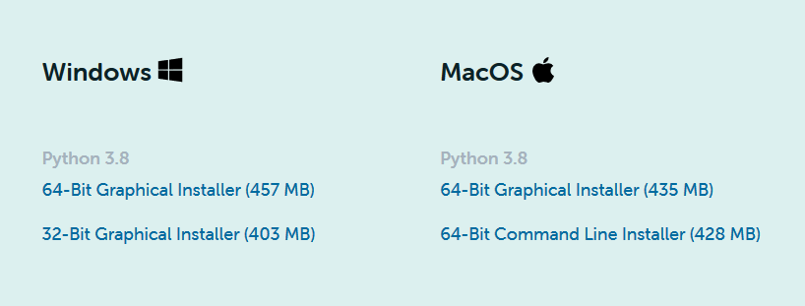
5
Install Anaconda
https://www.anaconda.com/products/individual

Slide 6
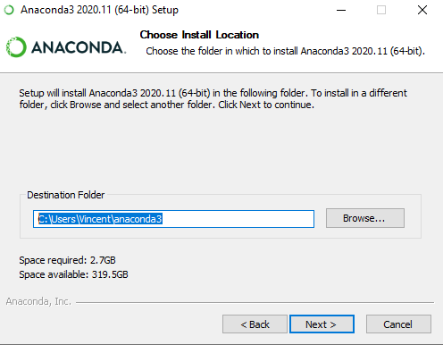
6
Install Anaconda
https://www.anaconda.com/products/individual

Slide 7


7
Install Pycharm
https://www.jetbrains.com/pycharm/

Slide 8
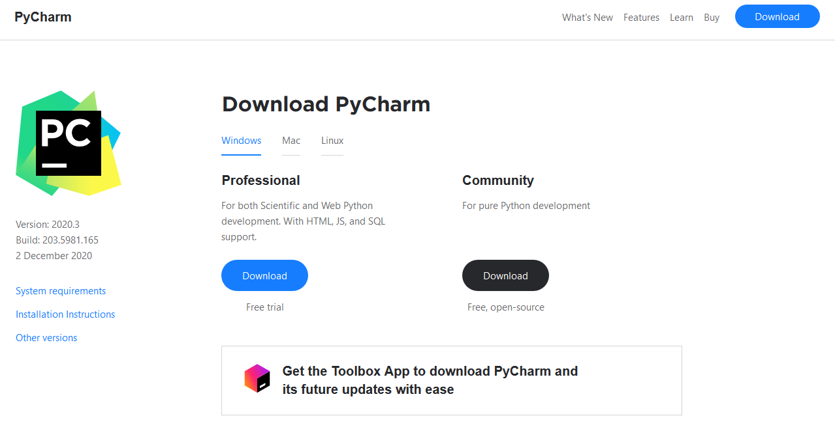
8
Install Pycharm
https://www.jetbrains.com/pycharm/

Slide 9
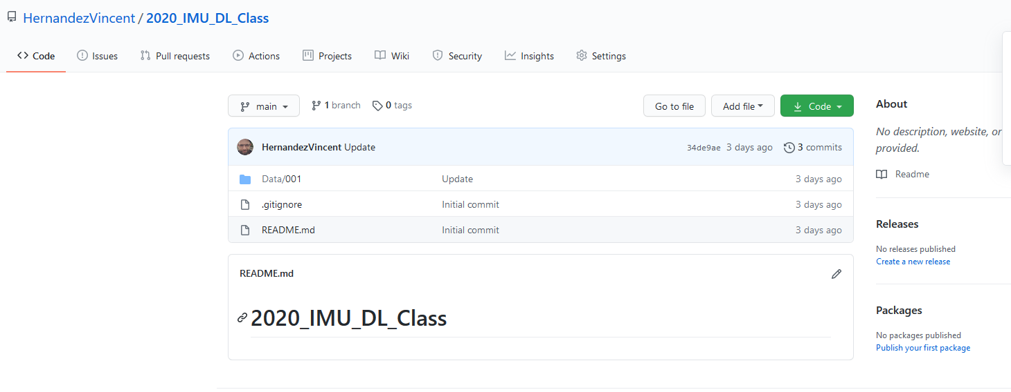

9
Go to the GitHub repository
https://github.com/HernandezVincent/2020_IMU_DL_Class

Slide 10
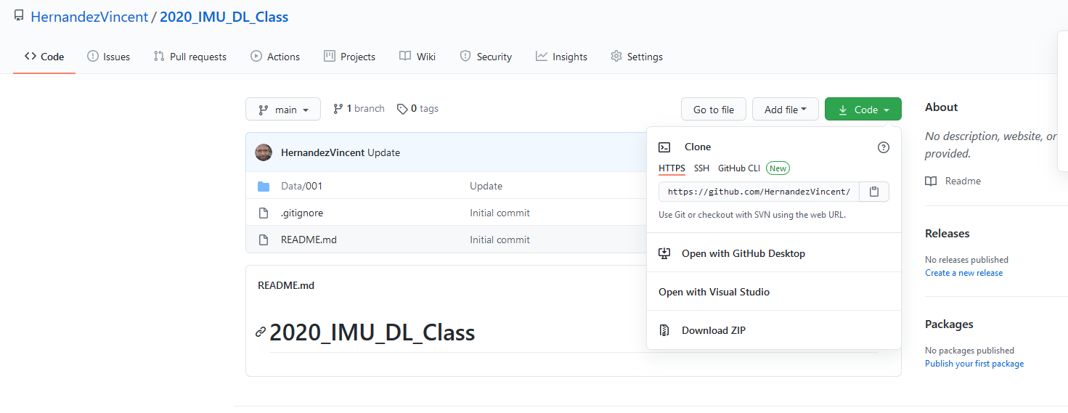
10
Go to the GitHub repository
https://github.com/HernandezVincent/2020_IMU_DL_Class

Slide 11
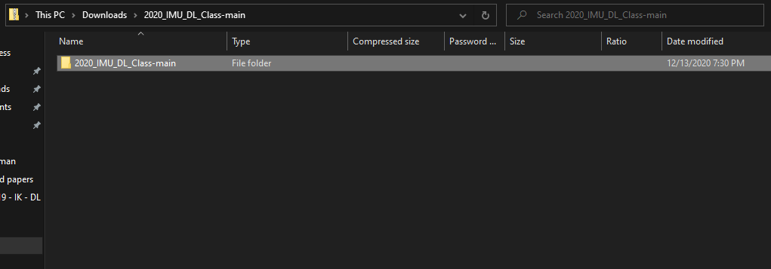
11
Open the .zip the file
Open the .zip file
Place the folder on your desktop

Slide 12
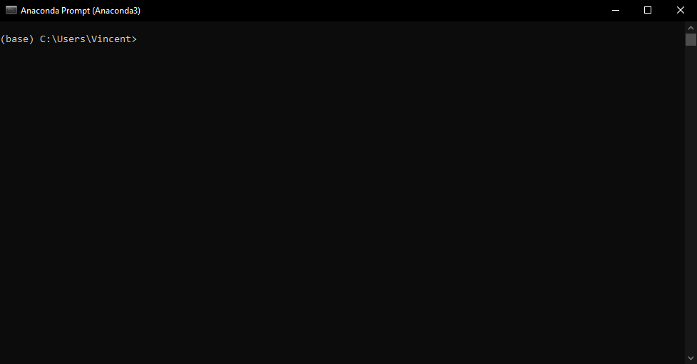
12
Create Anaconda (Python) environnement
Open the “Anaconda Prompt”

Slide 13
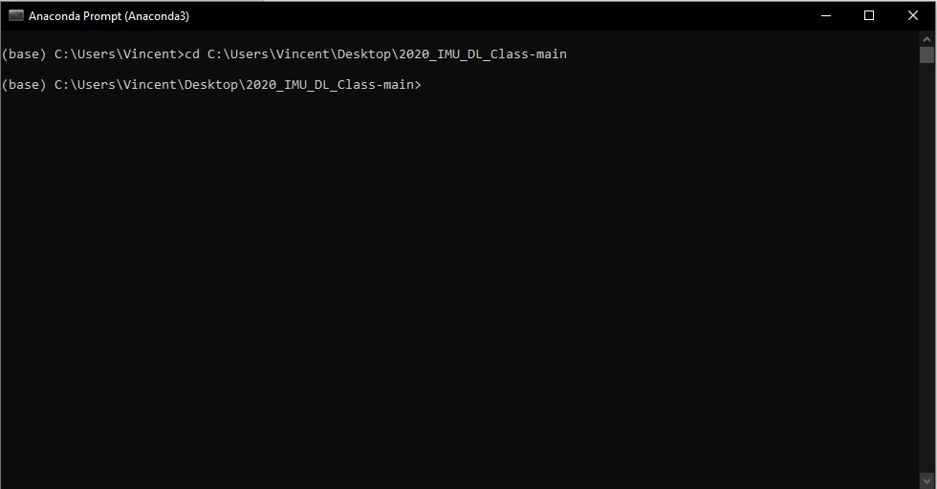
13
Create Anaconda (Python) environnement
Change the directory

Slide 14
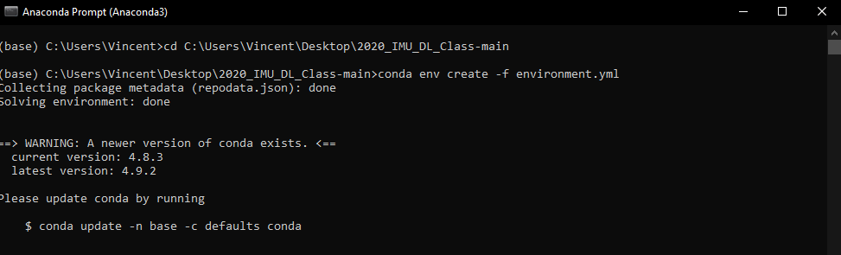
14
Create Anaconda (Python) environnement
conda env create -f environment.yml

Slide 15
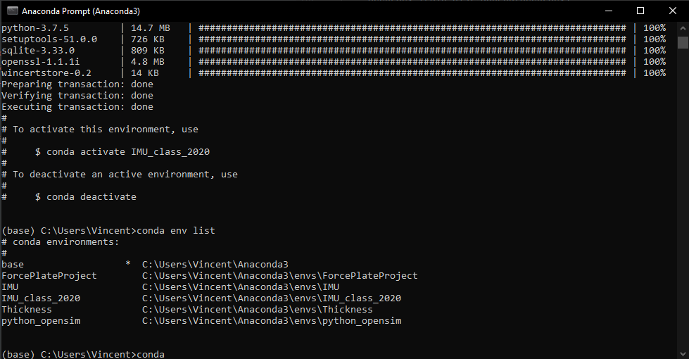
15
Create Anaconda (Python) environnement
conda env list

Slide 16
16
Create Anaconda (Python) environnement
conda env list

Slide 17
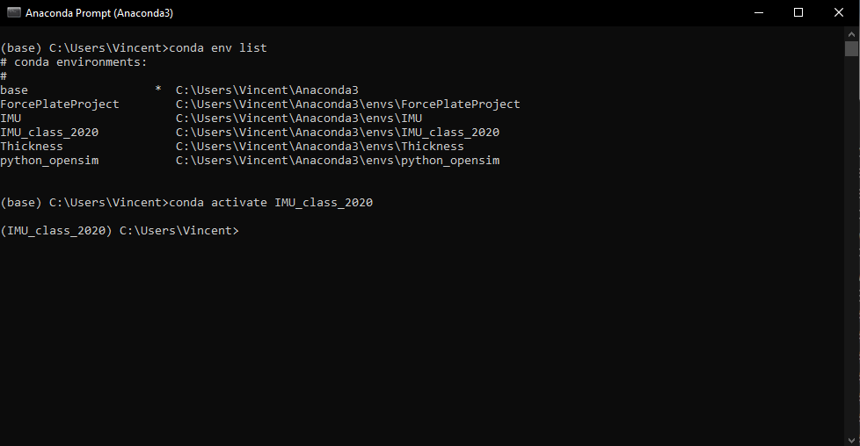
17
Create Anaconda (Python) environnement
conda activate IMU_class_2020

Slide 18
18
Create Anaconda (Python) environnement
conda activate IMU_class_2020

Slide 19
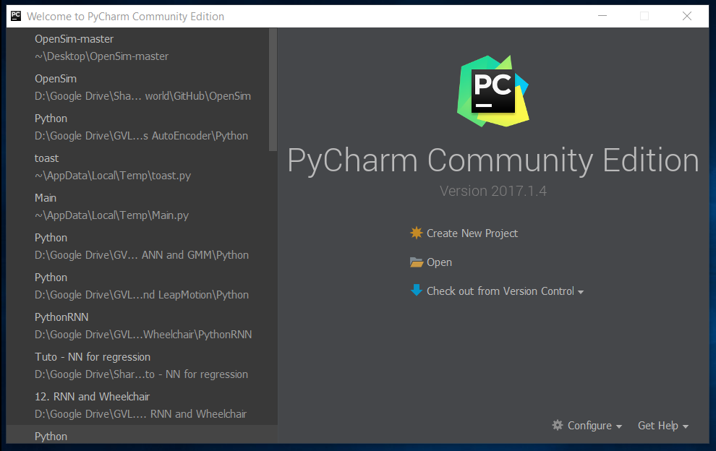
19
Open Pycharm and the project

Slide 20
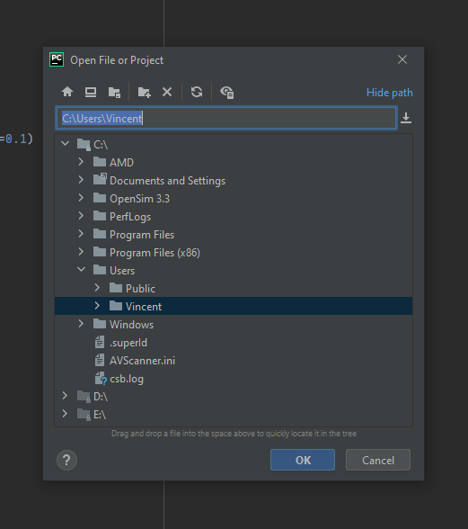
20
Open the project
Click on this icon to have access to your desktop

Slide 21
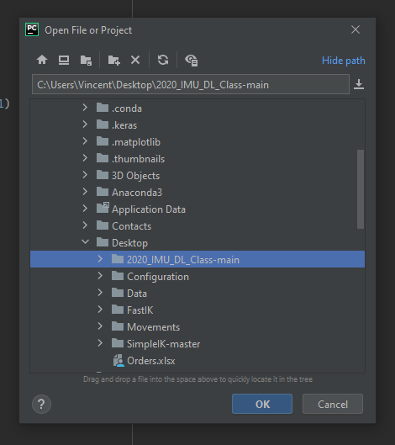
21
Open the project

Slide 22
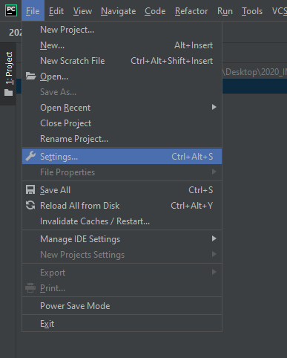
22
Setup Anaconda environment in Pycharm

Slide 23
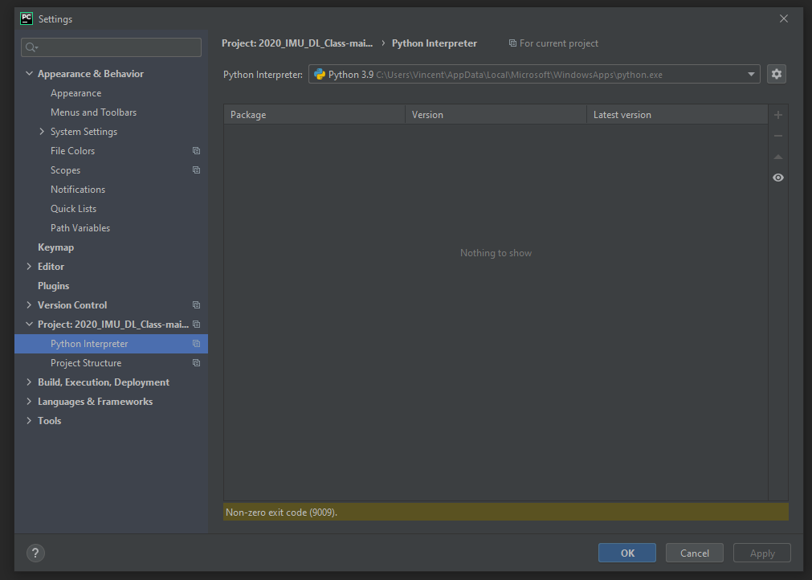
23
Setup Anaconda environment in Pycharm

Slide 24
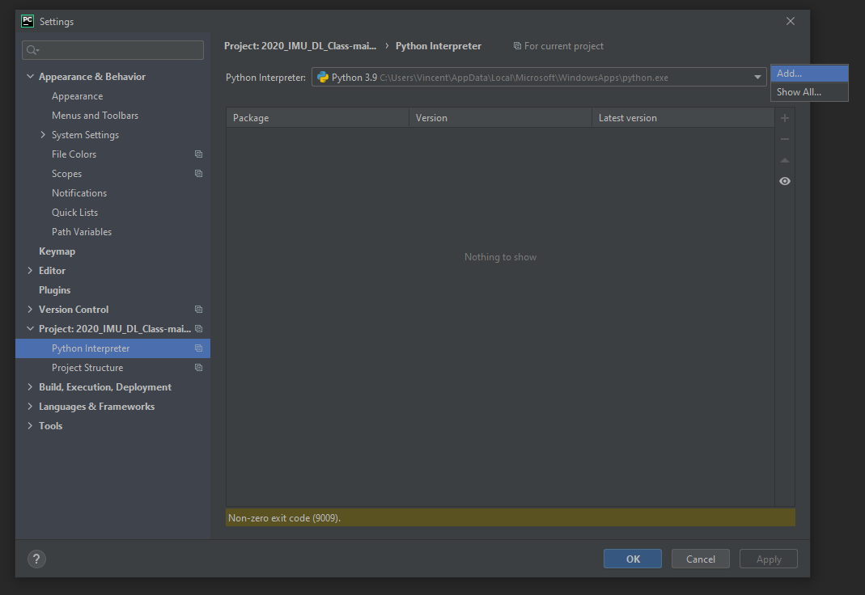
24
Setup Anaconda environment in Pycharm

Slide 25
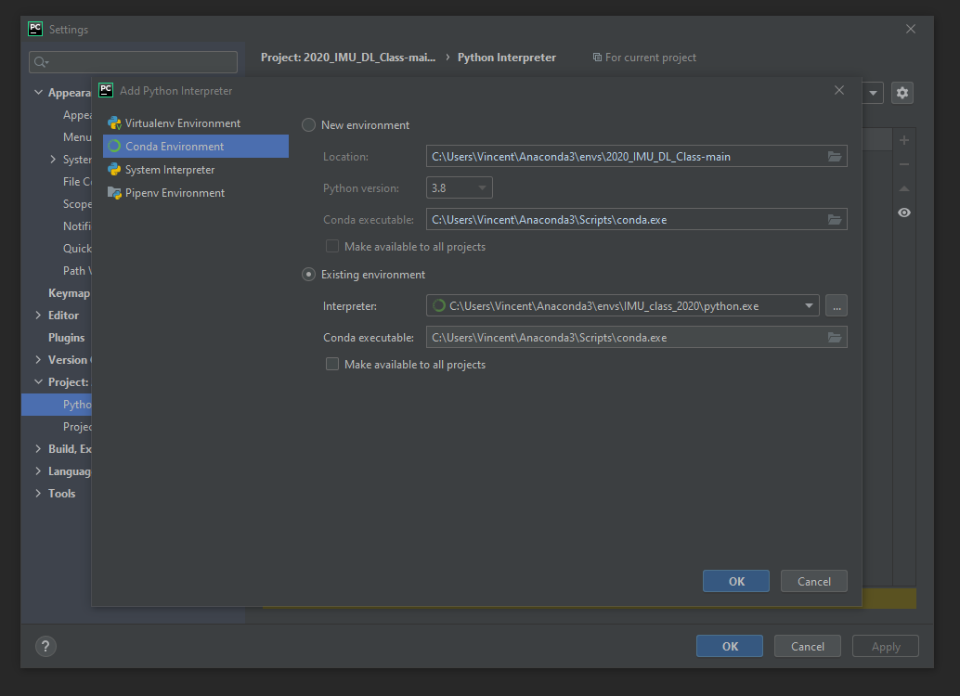
25
Setup Anaconda environment in Pycharm

Slide 26
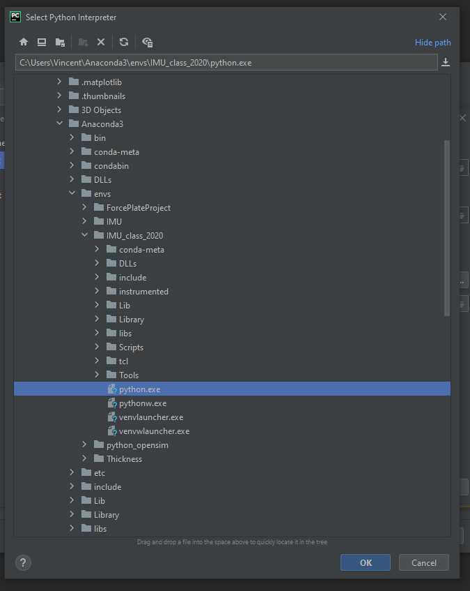
26
Setup Anaconda environment in Pycharm

Slide 27
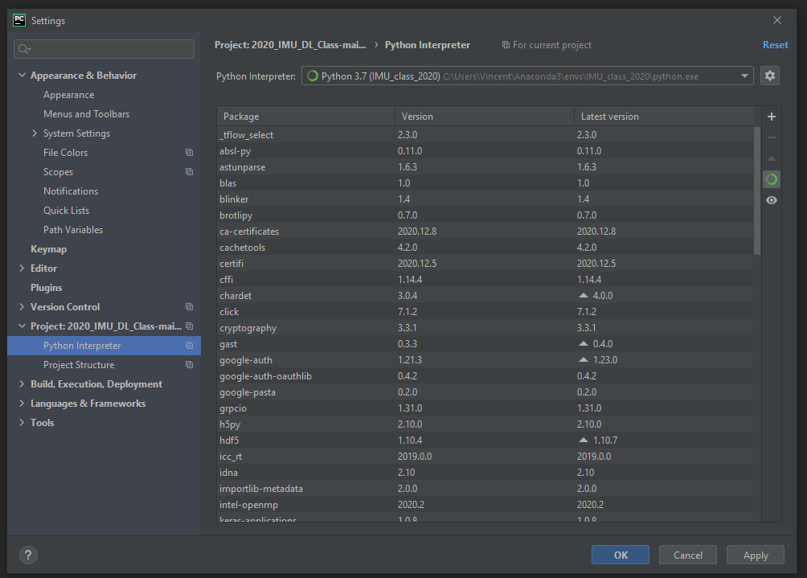
27
Setup Anaconda environment in Pycharm

Slide 28
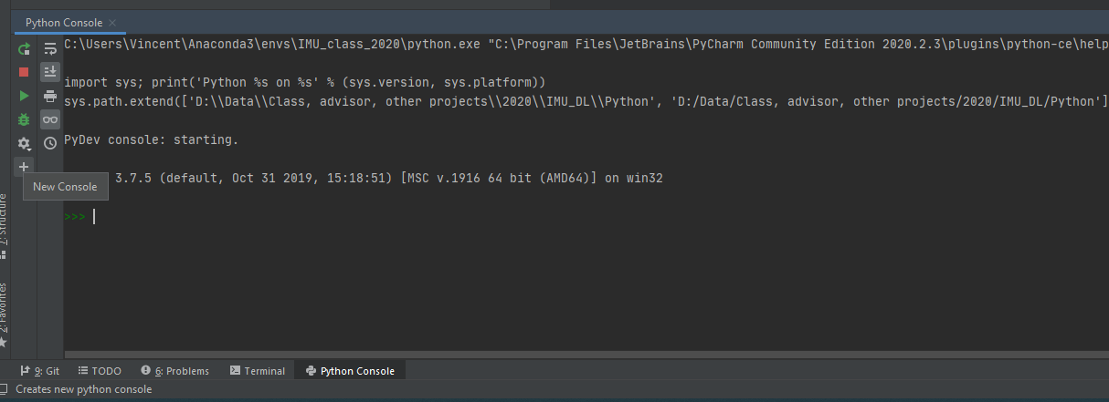
28
Test

Slide 29
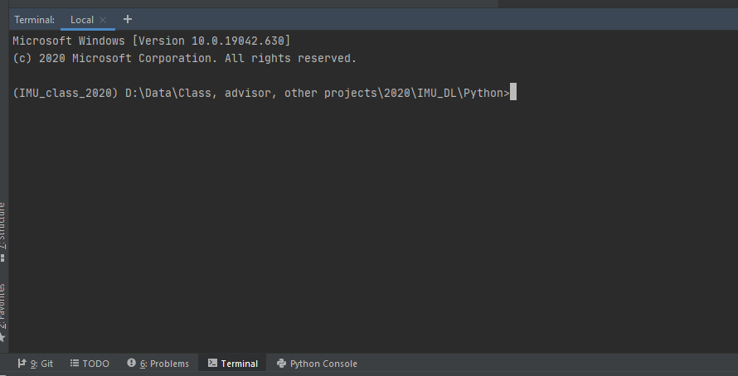
29
Test

