Slide 1

Note: The data and information in this document is reflective of a hypothetical situation and client. This document is to be used for KPMG Virtual Internship purposes only.
Sprocket Central Pty Ltd
Data analytics approach
[Division Name] - [Engagement Manager], [Senior Consultant], [Junior Consultant]

Slide 2
Note: The data and information in this document is reflective of a hypothetical situation and client. This document is to be used for KPMG Virtual Internship purposes only.
Agenda
Introduction
Data Exploration
Model Development
Interpretation

Slide 3
Note: The data and information in this document is reflective of a hypothetical situation and client. This document is to be used for KPMG Virtual Internship purposes only.
Introduction
Customers analyze:
Look into these factors in customers:
Age distributions
Geographical &Wealth distribution
Job industry category.
Brelated purchases

Slide 4
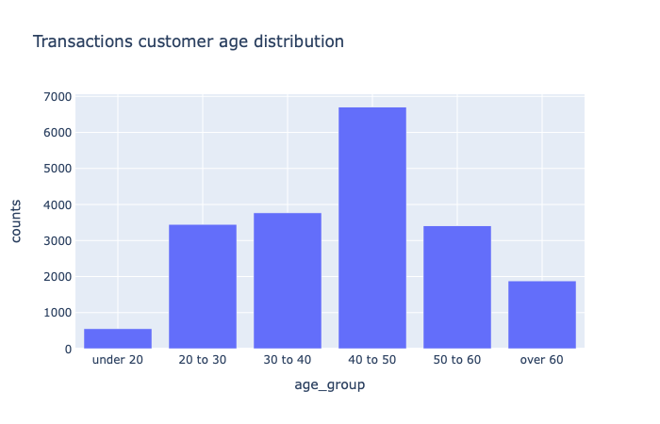
Note: The data and information in this document is reflective of a hypothetical situation and client. This document is to be used for KPMG Virtual Internship purposes only.
Data Exploration
Customers’ age distribution
Most of transactions were made by customers in
age group 40 – 50
The customers’ age is basically normal distributed
The percentages of age group 20 – 30 and 30– 40
are close

Slide 5
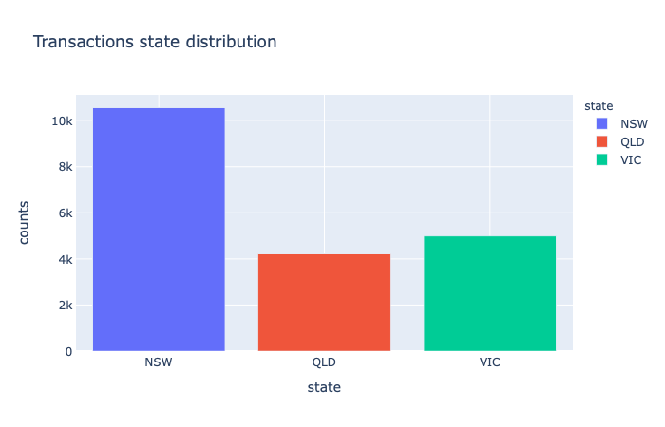
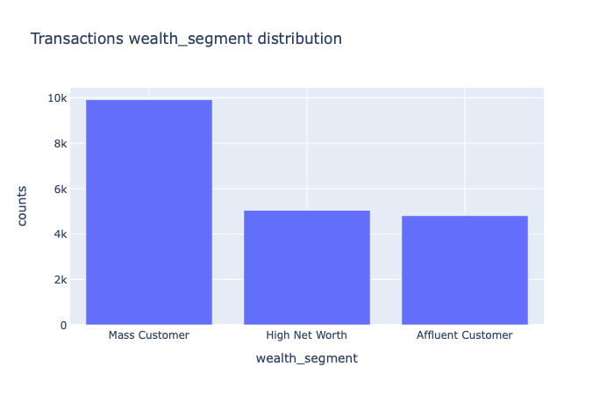
Note: The data and information in this document is reflective of a hypothetical situation and client. This document is to be used for KPMG Virtual Internship purposes only.
Data Exploration
Geographical &Wealth distribution
Most of transactions were made by customers in
New South Wales
Most of transactions were made by customers in
group Mass Customer

Slide 6
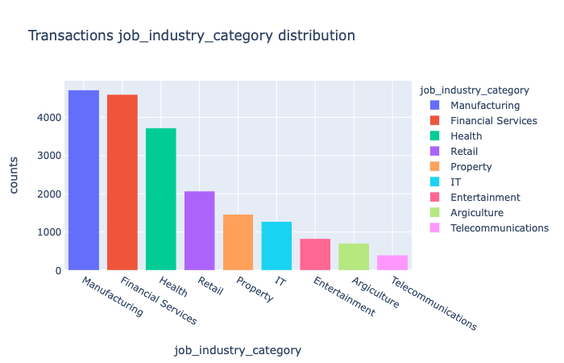
Note: The data and information in this document is reflective of a hypothetical situation and client. This document is to be used for KPMG Virtual Internship purposes only.
Data Exploration
Customers’ job industry distribution
Most of transactions were made by customers in
Manufacturing, Financial Services and Health
The differences among rest of industries is in-
significant

Slide 7
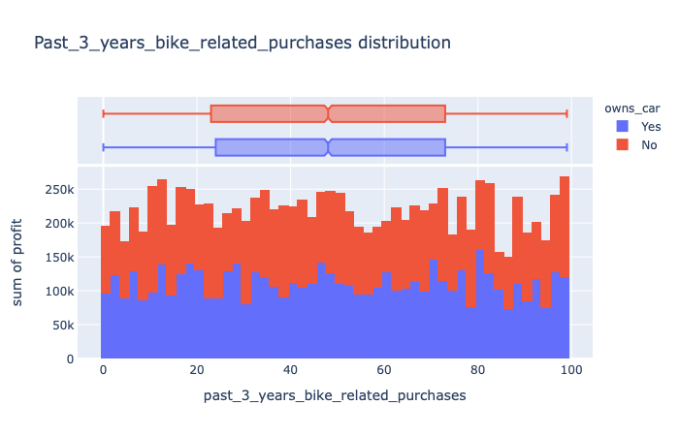
Note: The data and information in this document is reflective of a hypothetical situation and client. This document is to be used for KPMG Virtual Internship purposes only.
Data Exploration
Customers’ bike related purchases
There is a significate relation between profit
and whether the customer owns cars
Cannot see a clear correlation between the profit
and bike related purchases

Slide 8
Note: The data and information in this document is reflective of a hypothetical situation and client. This document is to be used for KPMG Virtual Internship purposes only.
Model Development
Developed Data mining model
Top factors in term of feature importance
past_3_years_bike_related_purchases
age
property_valuation
gender
NSW
Mass Customer

Slide 9
Note: The data and information in this document is reflective of a hypothetical situation and client. This document is to be used for KPMG Virtual Internship purposes only.
Interpretation
Suggestions for marketing strategy towards new customers
Focus on customers who have large amount bike
related porches
Target Male customer whose age between 40 -50
with a high property valuation
Focus on mass customer and the New South Wales area

Slide 10
Note: The data and information in this document is reflective of a hypothetical situation and client. This document is to be used for KPMG Virtual Internship purposes only.
Appendix

