Slide 1
Brno Traffic Accident Data Warehouse
Course: ENA-BIDS
Student: Hero Bala
Supervisor:Ing. Jan Přichystal, Ph.D.
Technologies: PostgreSQL, SQL (ETL), Python, Power BI
🔗 GitHub:
https://github.com/herobala/brno_traffic

Slide 2
Problem Statement & Motivation
Key Points:
Traffic accidents are a major public safety issue
Data comes from multiple heterogeneous sources
Raw data is inconsistent and not analysis-ready
Need for historical, reproducible, analytical solution

Slide 3
Data Sources
Sources Used:
Traffic Accident Data (Brno Open Data)
Vehicle Traffic Intensity Data
Weather Data (Open-Meteo API)
Granularity:
Accident → 1 row per accident
Weather → 1 row per hour
Traffic intensity → 1 row per location per year
These datasets differ in granularity and structure, which makes ETL and correct grain definition critical.

Slide 4
Overall Architecture
CSV Files
↓
Staging Layer
↓
Core Cleaning Views
↓
Dimensions & Facts
↓
BI Views
↓
Power BI
These datasets differ in granularity and structure, which makes ETL and correct grain definition critical.

Slide 5
Enterprise / MS Data Tool–Level Functionality
Implemented in pure SQL:
ETL orchestration (run_pipeline.sql)
Incremental loading (watermark pattern)
Slowly Changing Dimension (Type 2)
Data quality rules
Referential integrity enforcement
Although I used PostgreSQL, all core MS data tool concepts are implemented explicitly in SQL

Slide 6
Staging Layer (Raw Ingestion)
Purpose:
Raw landing zone
No business logic
Incremental-safe ingestion
Key Features:
_loaded_at timestamp
Indexes for performance
Mirrors source CSV structure
_loaded_at TIMESTAMP DEFAULT CURRENT_TIMESTAMP
This is equivalent to the raw landing layer in SSIS

Slide 7
Core Cleaning & Data Quality Handling
Problems Addressed:
Mixed data types
Invalid time values
Dirty numeric fields
Solutions:
Regex-based safe casting
Invalid time detection
Data quality flags (no data loss)
CASE
WHEN time BETWEEN 0 AND 2359 AND (time % 100) < 60
THEN time
END AS time_hhmm
I never delete bad data. I flag it and handle it safely.

Slide 8
Filtering & Validation Logic
Filtering Techniques Used:
Valid HHMM times only
Numeric-only casting
Business-rule validation
WHEN age ~ '^[0-9]+(\.0)?$'
This is equivalent to Data Quality transformations in SSIS.

Slide 9
Dimensional Model (Star Schema)
Dimensions:
Date
Time
Location (SCD Type 2)
Vehicle
Person
Weather
Facts:
Traffic Accident
Weather Hourly
Vehicle Traffic Intensity

Slide 10
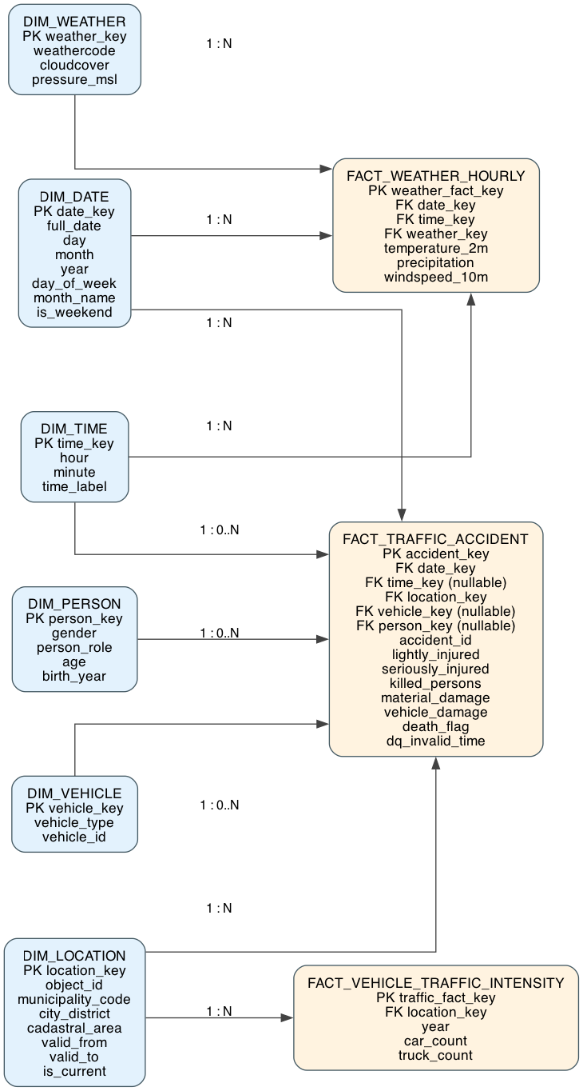
ER Diagram
This model is optimized for analytical queries and BI tools.

Slide 11
Slowly Changing Dimension (SCD Type 2)
Why SCD Type 2?
Location attributes change over time
Historical correctness is required
How implemented:
Detect change via event dates
Close old records
Insert new versions
valid_from / valid_to / is_current
This ensures historical accuracy

Slide 12
Lookup Logic (Dimension Mapping)
Lookups implemented via SQL JOINs:
Accident → Date, Time, Location
Weather → Date, Time, Weather
Intensity → Location
LEFT JOIN dim.dim_location l
ON l.object_id = a.object_id
AND l.is_current = TRUE
This replaces SSIS Lookup components using SQL joins.

Slide 13
UNKNOWN Handling (Star Schema Guarantee)
Problem:
Missing or invalid dimension references
Solution:
UNKNOWN (-1) rows in every dimension
COALESCE in fact loading
COALESCE(t.time_key, -1)
This guarantees referential integrity and prevents Power BI errors.

Slide 14
Incremental Loading
Technique Used:
Unique constraints on grain
ON CONFLICT DO NOTHING
ETL control table
CONSTRAINT uq_fact_accident UNIQUE (accident_id)
This ensures re-runs never duplicate data.

Slide 15
Fact Table Grain Definition
Fact Table | Grain
Traffic Accident | 1 row = 1 accident
Weather Hourly | 1 row = 1 hour
Traffic Intensity | 1 row = location × year
Correct grain definition prevents double counting and analytical errors.

Slide 16
BI Semantic Layer
BI Views:
bi.dim_*
bi.fact_*
bi.fact_traffic_accident_wide
Purpose:
Hide complexity
Simplify Power BI model
Improve performance
This is equivalent to a semantic layer in enterprise BI.

Slide 17
BI Semantic Layer
BI Views:
bi.dim_*
bi.fact_*
bi.fact_traffic_accident_wide
Purpose:
Hide complexity
Simplify Power BI model
Improve performance
This is equivalent to a semantic layer in enterprise BI.

Slide 18
Power BI Dashboards
Dashboards Created:
KPI Overview
Trend & Seasonality
Weather Impact
Spatial Hotspots
All dashboards directly consume BI views, not raw tables.

Slide 19
Sanity Checks & Validation
Checks Implemented:
Referential integrity
Grain violations
Negative values
Temperature plausibility
WHERE temperature_2m < -50 OR temperature_2m > 60
This ensures analytical trustworthiness.

Slide 20
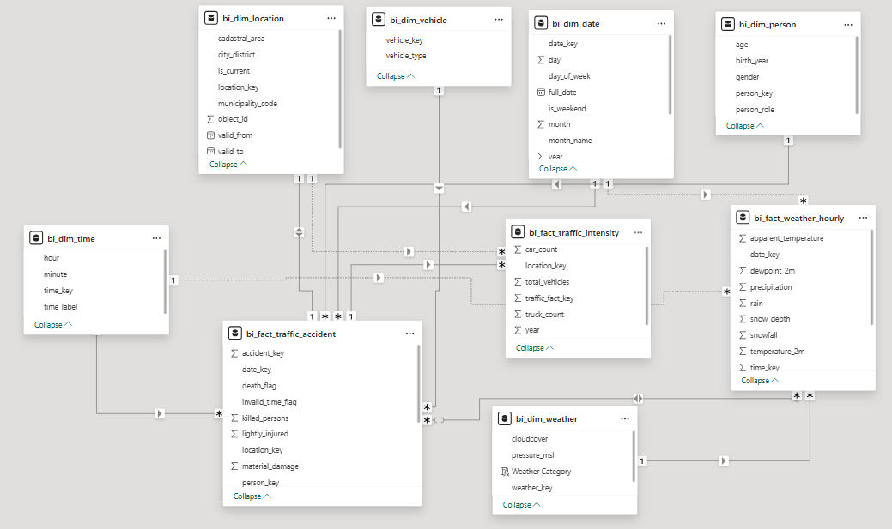
Power BI Data Model

Slide 21
Power BI Dashboards
Dashboards Created:
KPI Overview
Trend & Seasonality
Weather Impact
Spatial Hotspots
All dashboards directly consume BI views, not raw tables.

Slide 22
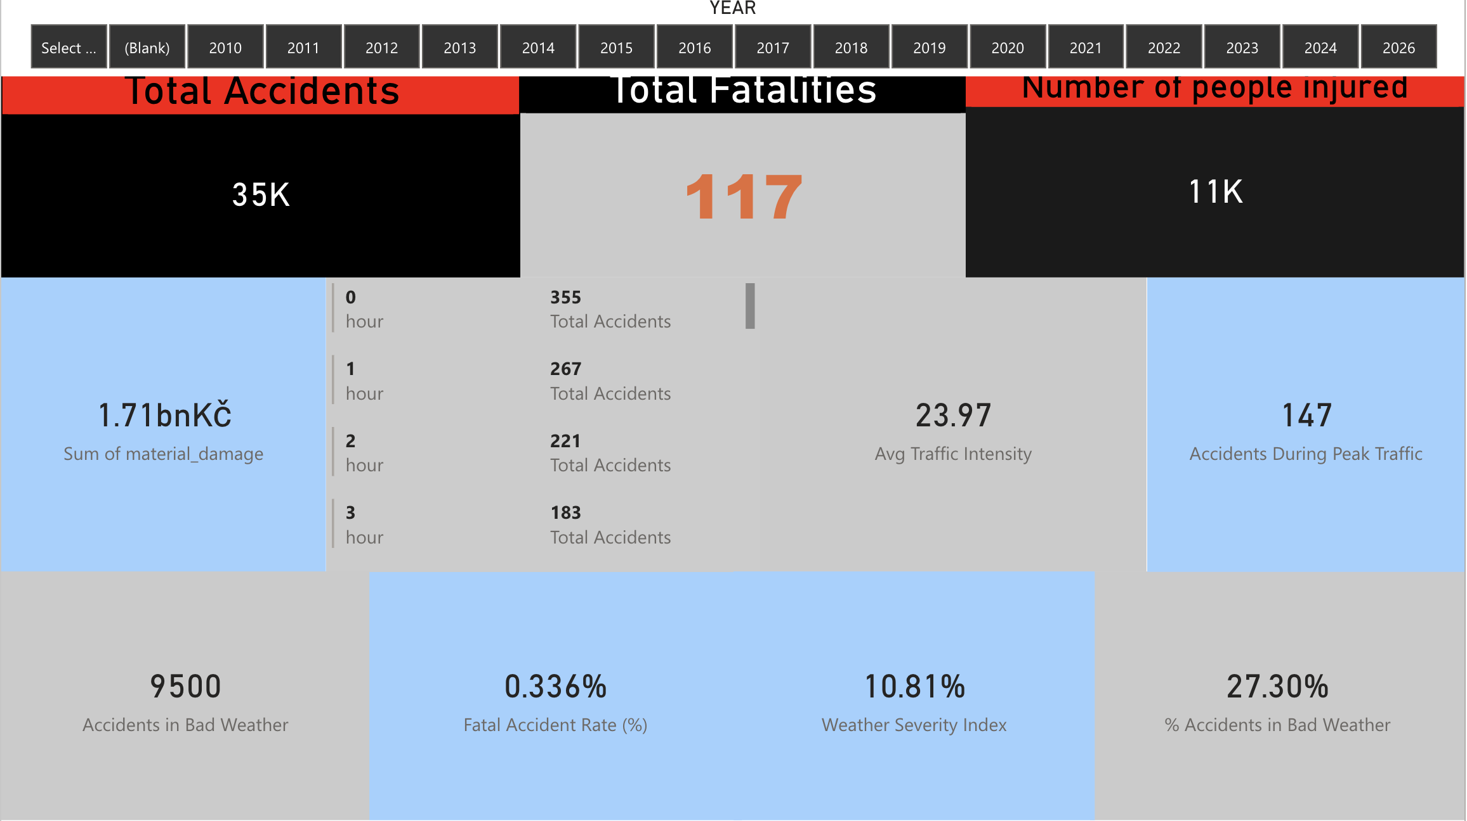
Power BI Dashboards

Slide 23
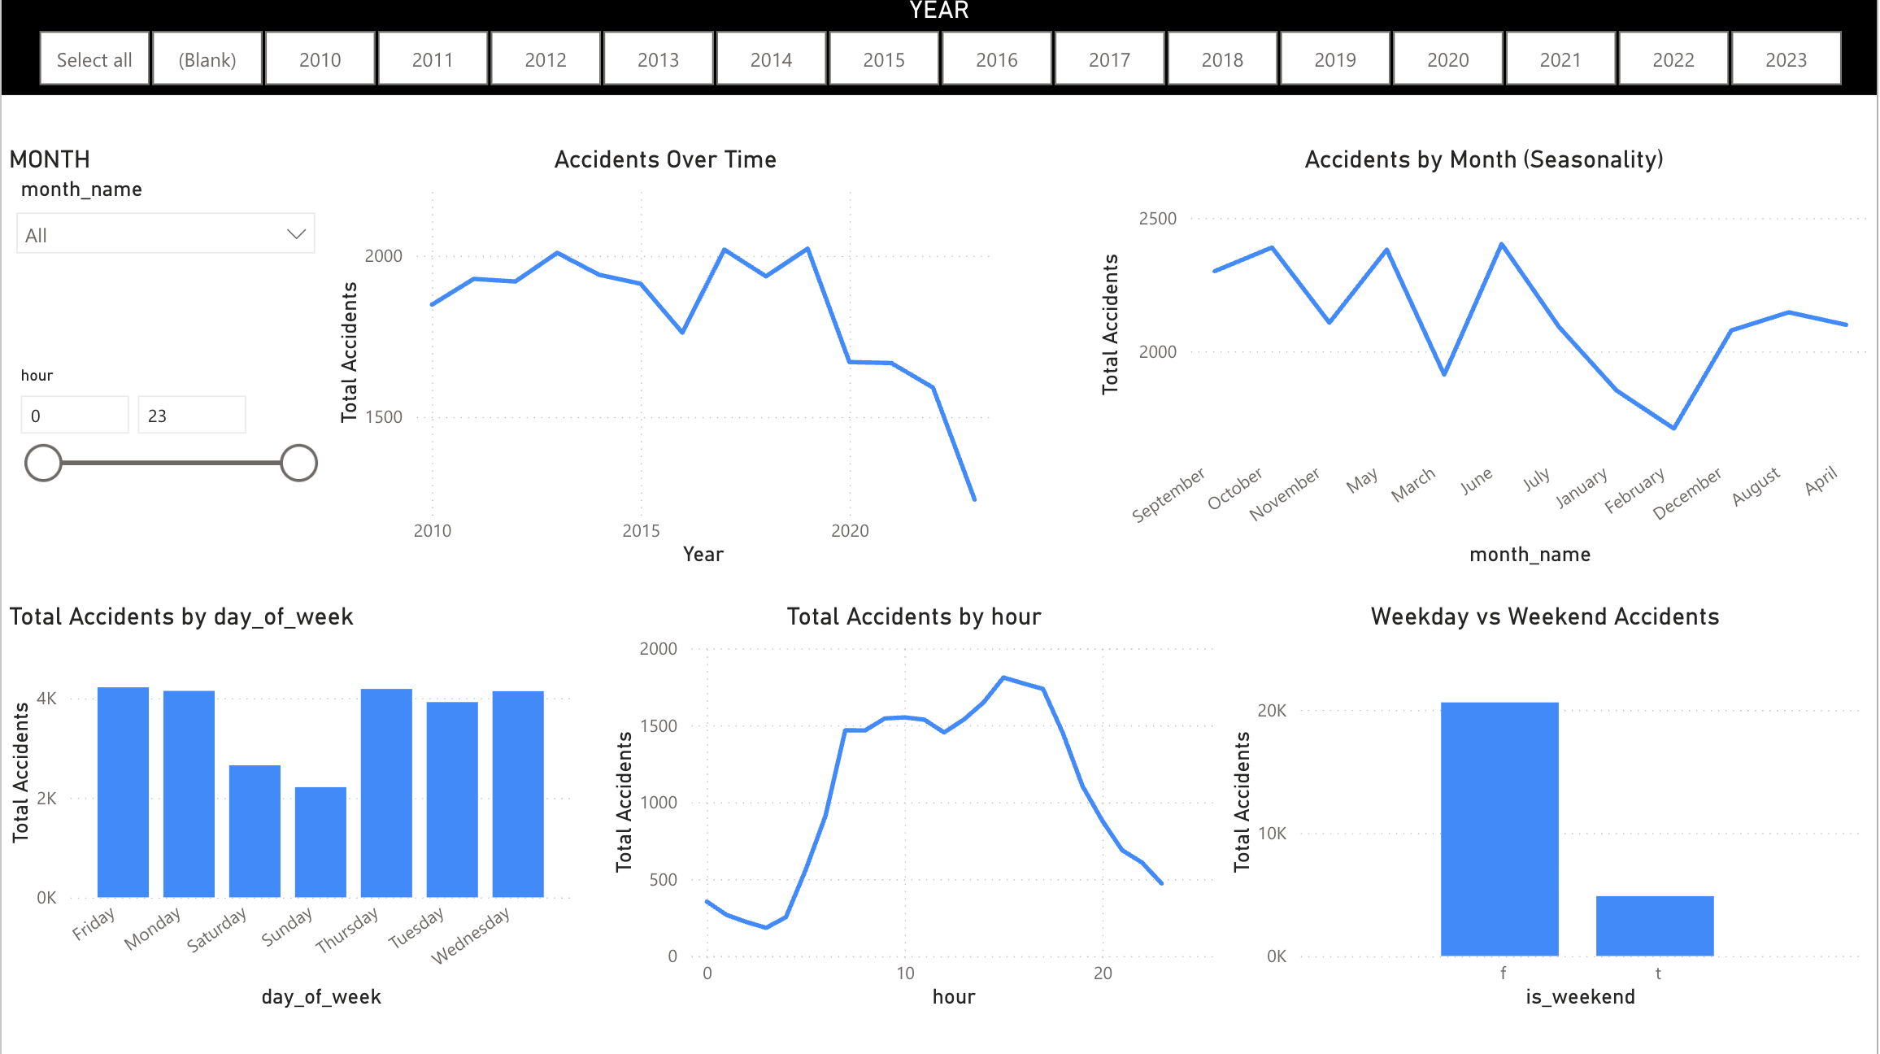

Slide 24
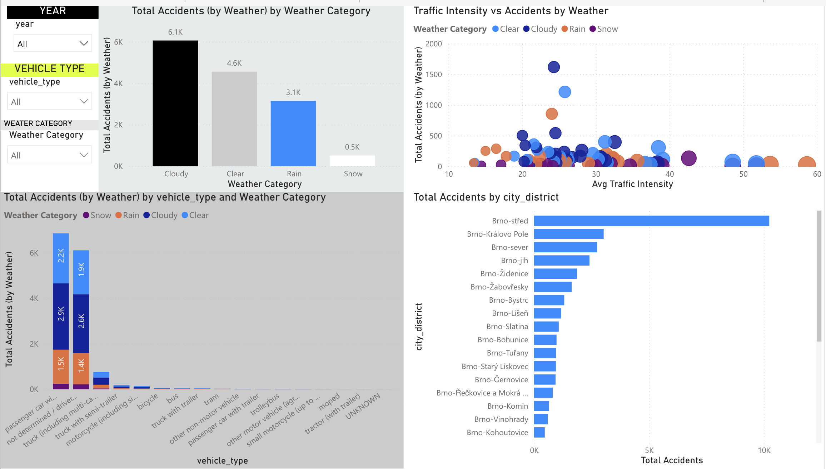

Slide 25
Reproducibility & Automation
Features:
One-command pipeline
Idempotent execution
Incremental-safe
Defense-ready demos
\i sql/run_pipeline.sql
The entire warehouse can be rebuilt from scratch reliably.

Slide 26
Key Learnings
Enterprise DW design
Advanced SQL ETL
Data quality engineering
Historical data handling
BI semantic modeling
All dashboards directly consume BI views, not raw tables.

Slide 27
Conclusion
Summary:
Full DW lifecycle implemented
Enterprise-grade ETL in SQL
Robust BI integration
Scalable and reproducible design
All dashboards directly consume BI views, not raw tables.

Slide 28
Thank you

