Slide 1

Audio Enhancer

Slide 2
Aim
To Design An Audio Enhancement System In Matlab

Slide 3
Audio
Digital audio is a representation of sound recorded in, or converted into, digital form. In digital audio, the sound wave of the audio signal is typically encoded as numerical samples in a continuous sequence.
For example, in CD audio, samples are taken 44,100 times per second, each with 16-bit sample depth. Digital audio is also the name for the entire technology of sound recording and reproduction using audio signals that have been encoded in digital form.

Slide 4
Audio Enhancer
An audio enhancer is designed to help you modify and enhance the music and audio played through speakers and headphones to provide you with a better sound experience.
Audio enhancement is the process of clarifying audio recordings to increase intelligility by reducing the unwanted sounds and increasing the wanted sounds.

Slide 5
Characterisics Of Sound
There Are Five Main Characteristics Of Sound Waves:
Wavelength,
Amplitude,
Frequency,
Time Period, And
Velocity.

Slide 6
Optimisations Involved
Remove Unwanted Noise
Boost Wanted Sound
Amplify Low Amplitude Regions
Equalize The Output
Additional Effects
Quality Improvement

Slide 7
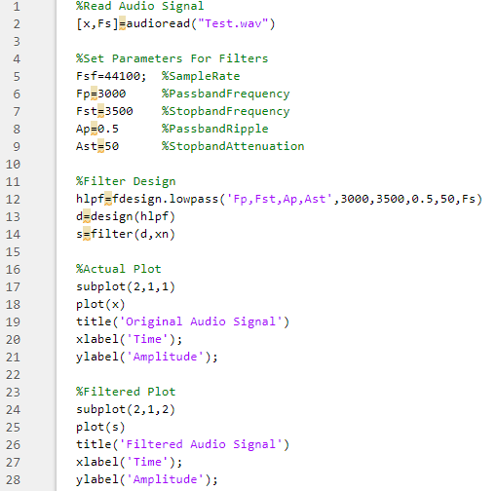

Slide 8
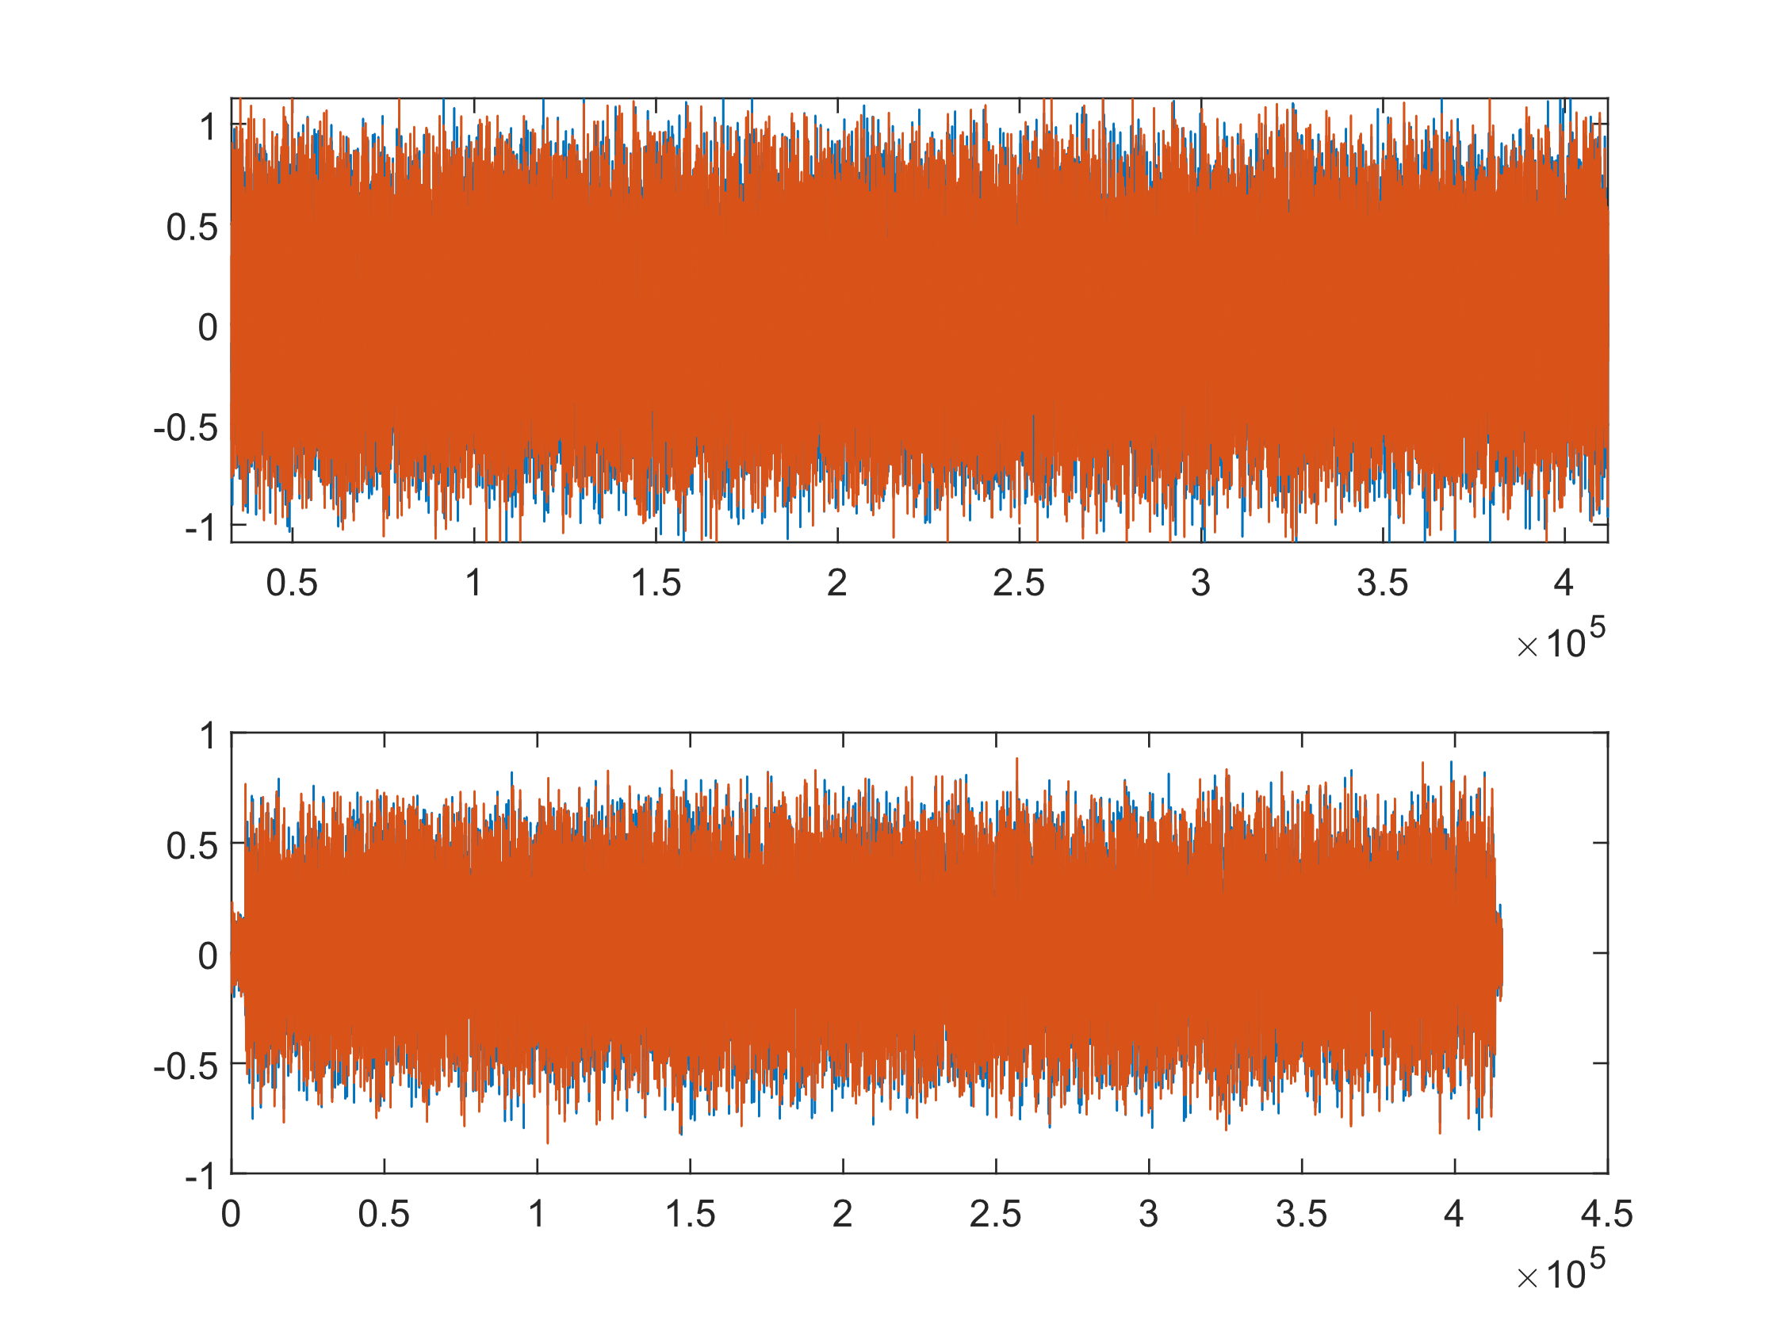
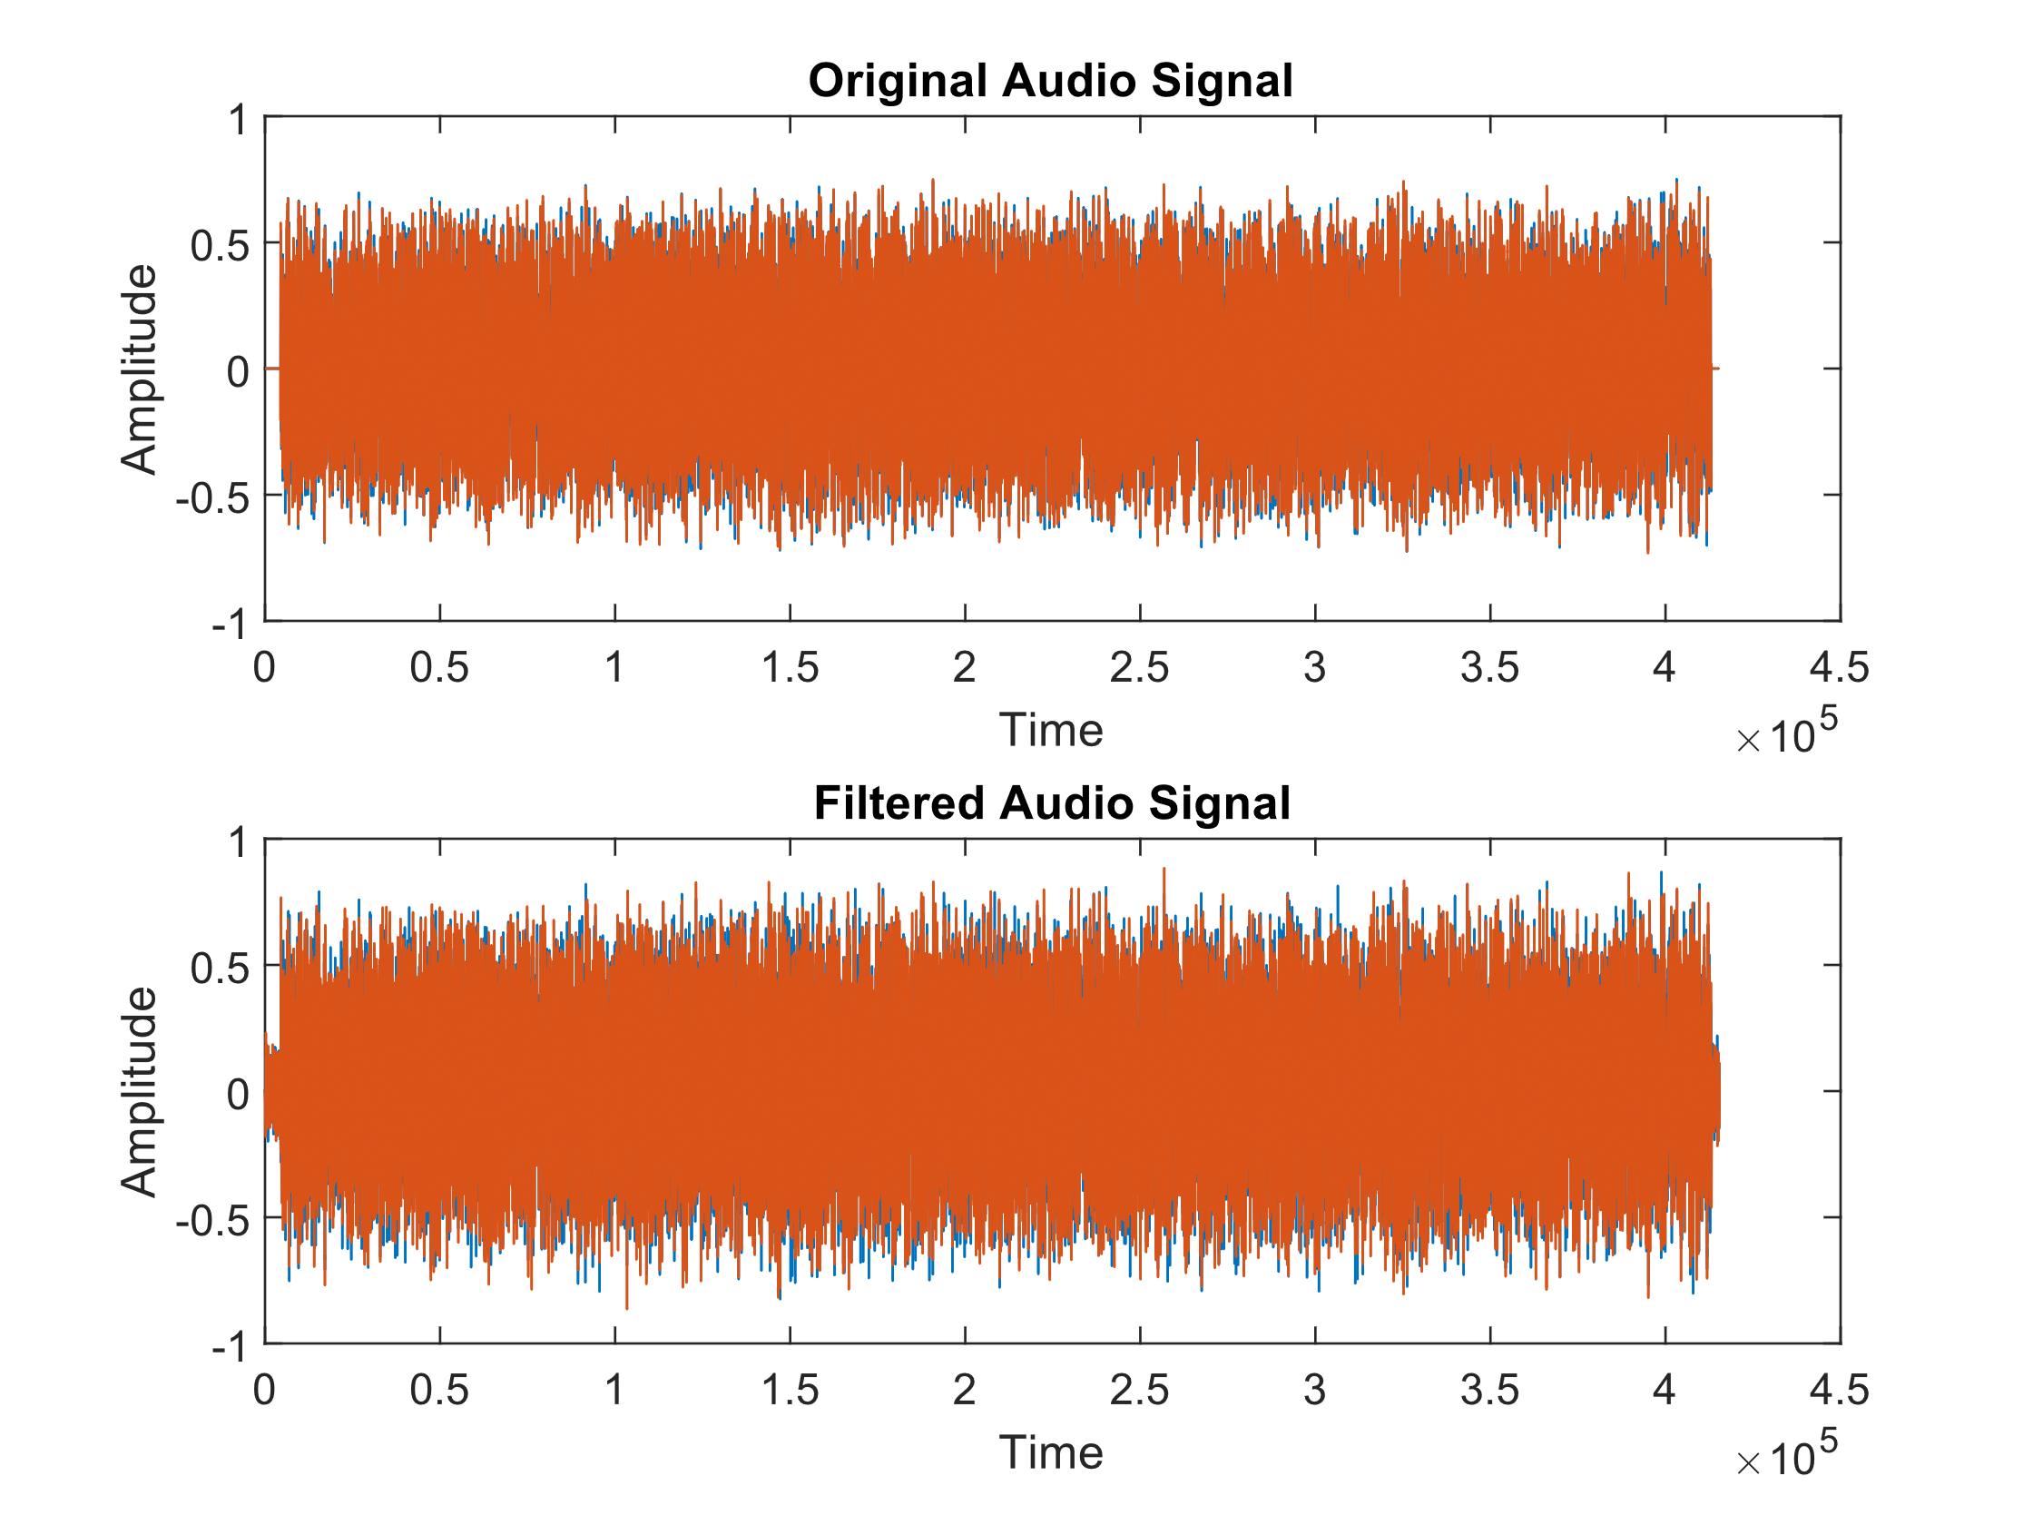

Slide 9
Applications
Smart Phones
Music Systems
Headsets
TVs
Conferences

Slide 10
Thank You

