Slide 1

PROJECT INTRODUCTION
AI Data Quality Agent
Autonomous detection, reasoning & repair of dirty data — powered by LLMs.
Team Project • 2026

Slide 2
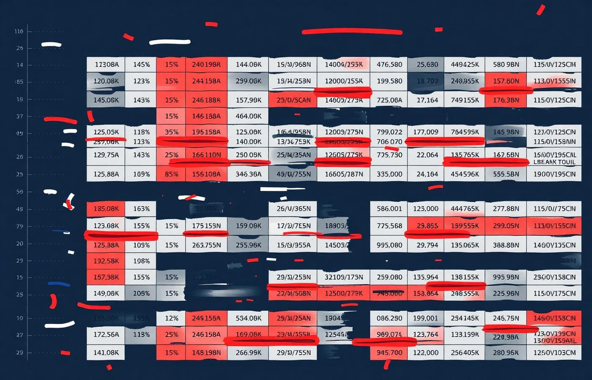
Problem Statement
1
80% of analyst time is wasted on cleaning data, not analyzing it.
2
Missing values, duplicates & wrong types silently corrupt insights.
3
Manual rules break as schemas evolve and datasets grow.
4
Bad data → bad ML models → bad decisions worth millions.
AI Data Quality Agent
02 / 15

Slide 3

Real-World Scenario
A Hospital at 2 A.M.
A nurse exports patient vitals to a CSV. Some BP readings are blank, a patient ID is duplicated, and "age" contains "thirty-two".
Without the Agent
Doctors get wrong dashboards → delayed diagnosis.
With the Agent
Auto-detects, explains, repairs & flags in seconds — clinicians see clean data.
AI Data Quality Agent
03 / 15

Slide 4
Our Idea
An autonomous AI agent that profiles any dataset, reasons about quality issues using LLMs, and proposes or applies repairs — with a human-in-the-loop.
DETECT
REASON
REPAIR
LEARN
Statistical profiling + schema checks find anomalies automatically.
LLM explains why each value is suspicious in plain English.
Suggests or auto-applies fixes with confidence scores.
Improves from analyst feedback over time.
AI Data Quality Agent
04 / 15

Slide 5
Example Dataset — patients.csv
Sample of raw input the agent receives. Cells highlighted in coral are issues automatically detected.
patient_id
name
age
gender
blood_pressure
admit_date
diagnosis
P001
Aarav Sharma
34
M
120/80
2026-01-04
Fever
P002
Priya Patel
∅
F
118/76
2026-01-05
Asthma
P003
Rohan Mehta
thirty-two
M
135/90
01/06/2026
Hypertension
P003
Rohan Mehta
32
M
135/90
2026-01-06
Hypertension
P004
Neha Iyer
29
female
N/A
2026-01-07
Migraine
P005
Aditya Rao
45
M
999/10
2026-01-08
Diabetes
Detected issues: missing value · type mismatch · duplicate ID · inconsistent category · invalid date · outlier
AI Data Quality Agent
05 / 15

Slide 6
Project Workflow
01
02
03
04
05
INGEST
PROFILE
AI REASON
REPAIR
REPORT
CSV / DB / API
Stats + schema
LLM explains
Auto / suggest
Score + audit
A feedback loop sends analyst overrides back to PROFILE — the agent learns dataset-specific rules over time.
AI Data Quality Agent
06 / 15

Slide 7
Technologies Used
Layer
Technology
Purpose
Data Processing
Pandas
CSV loading and analysis
Validation Engine
Python + Regex
Data quality checks
AI Layer
OpenRouter + Nex-AGI N2 Pro
AI-powered diagnosis and recommendations
Frontend
Streamlit
Interactive dashboard
Styling
HTML + CSS
Custom UI design
Data Exchange
JSON
Structured AI responses
Configuration
secrets.toml
Secure API key storage
AI Data Quality Agent
07 / 15

Slide 8
Data Quality Checks
✓
Completeness
✓
Uniqueness
✓
Validity
Missing value detection per column with threshold alerts.
Duplicate row & primary-key collision detection.
Regex, type, range and enumeration validation.
✓
Consistency
✓
Accuracy
✓
Timeliness
Cross-field and cross-table logical checks.
Outlier detection via z-score & isolation forest.
Stale-record and date-format verification.
AI Data Quality Agent
08 / 15

Slide 9

AI Features
Natural-language explanations
“Row 12 is suspicious because age = 220 exceeds 99th percentile.”
Smart imputation
Context-aware fills using similar rows + domain priors.
Anomaly storytelling
Generates plain-English summaries of weekly data health.
Schema inference
Detects implicit types, units, and column relationships.
Few-shot rule learning
Learns custom rules from 2-3 analyst examples.
AI Data Quality Agent
09 / 15

Slide 10
Quality Dimensions — Before vs After
HEALTH SCORE
84
/ 100
▲ +29 pts
vs. raw input
5,420 issues fixed
AI Data Quality Agent
10 / 15

Slide 11
Example Output
AI
Repair Preview
Agent Report — patients.csv
Generated 2026-06-16 · 02:14 UTC
Field
Before
After
Conf
• Found 7 issues across 6 rows (1.2% of dataset).
• Row 3: duplicate patient_id "P003" — merged with row 4.
• Row 3: age "thirty-two" → 32 (NLP normalization, conf 0.98).
• Row 5: blood_pressure "999/10" flagged as physiological
outlier — held for human review.
• Row 5: gender "female" → "F" (category harmonization).
• Recommended adding regex rule for blood_pressure column.
age
thirty-two
32
98%
gender
female
F
99%
date
01/06/2026
2026-01-06
97%
bp
999/10
⚑ review
—
id (dup)
P003
merged
100%
AI Data Quality Agent
11 / 15

Slide 12
Advantages
10×
95%
0
∞
Faster cleaning
Issue coverage
Setup cost
Domains
Minutes instead of days per dataset.
Beyond rules: catches semantic errors too.
Works zero-config on any tabular dataset.
Healthcare, finance, retail, IoT — same agent.
AI Data Quality Agent
12 / 15

Slide 13
Limitations & Future Work
What we don't solve yet
Where we're going
LLM calls add latency on very large datasets (>10M rows).
Streaming mode for Kafka & real-time pipelines.
Requires human review for high-risk medical/financial fixes.
Multi-modal support: images, PDFs, JSON, logs.
Currently optimized for tabular data only.
Local on-device SLM for privacy-sensitive data.
Cost of GPT-4o calls scales with column count.
Auto-generation of dbt tests from learned rules.
AI Data Quality Agent
13 / 15

Slide 14

Conclusion
Clean data is the foundation of every AI system.
Our AI Data Quality Agent turns the hardest, most thankless step of analytics into an autonomous, explainable, always-on service.
✓
Autonomous
✓
Explainable
✓
Domain-agnostic
AI Data Quality Agent
14 / 15

Slide 15
THANK YOU
Questions, feedback, and dirty datasets welcome.
AI Data Quality Agent • 2026

