Slide 1
Molecular Fingerprints
Eric Jin

Slide 2
What is a Molecular Fingerprint?
Method of encoding the structure of a specific molecule (typically in the form of binary digits)
Why fingerprints? Comparing molecules is difficult. Comparing bit strings is easy and efficient
Types of Fingerprints:
Substructure keys-based fingerprints
Topological/Path-based fingerprints
Circular/ECFP Fingerprints
Hybrids
Pharmacophore
2D Fingerprints
3D Fingerprint
Notes:
Hybrids: a combination of structural keys and connective pathway fragments. Can combine structural keys and other bit property descriptors
Pharmacophore (3D): describes structures similar to structural keys but take distance between these features into account. Classifying them into a list of distance ranges

Slide 3
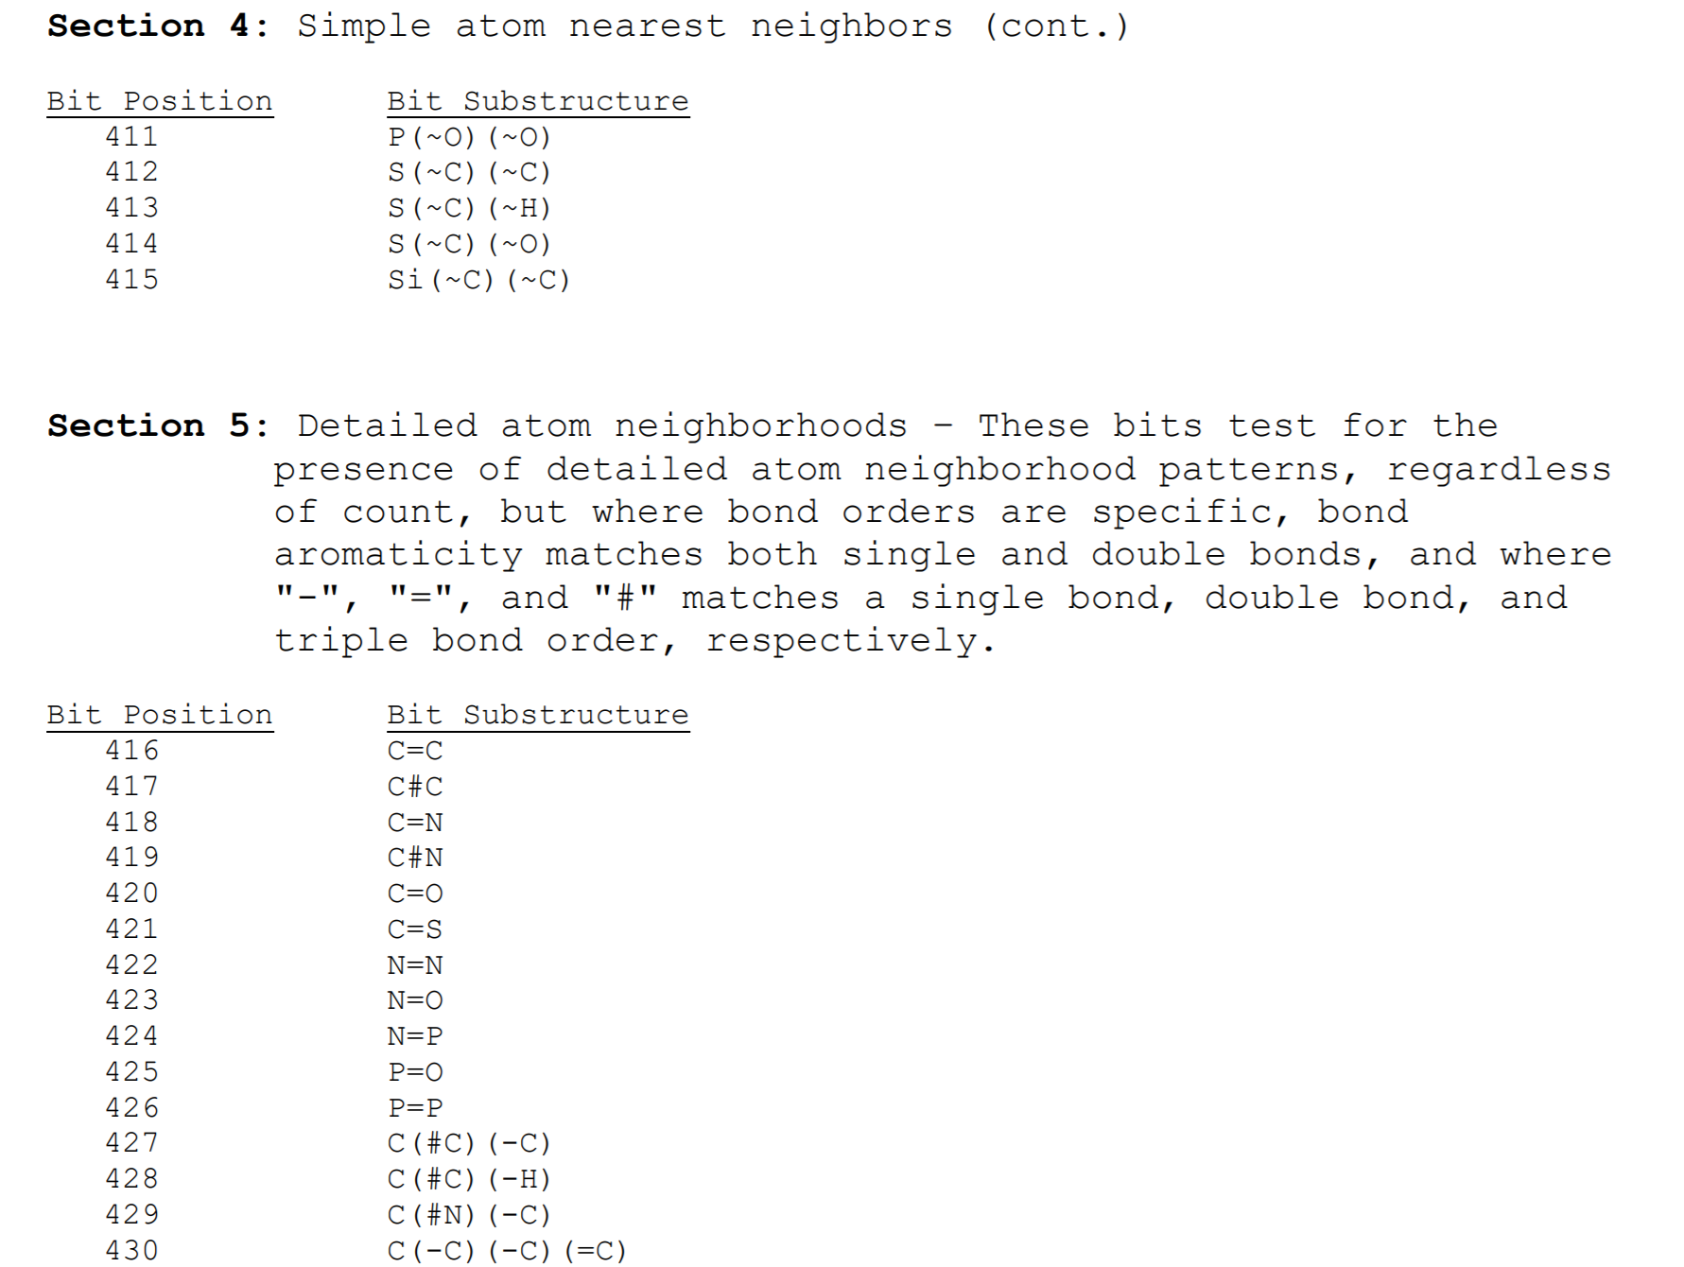
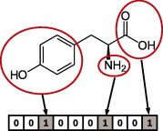
Substructure key-based Fingerprints
Each bit of a bit string is determined by the presence of specific substructure and features (atom pairs, unsaturated/saturated rings, functional groups, etc) of a compound. Substructure and features of compounds are referenced to a list of substructure keys where
Features and substructures not listed in keys will not be represented
MACCS Key: popular 166 bits key
PubChem Key: 881 bits key
(Both are offered in Rcdk kit)

Slide 4
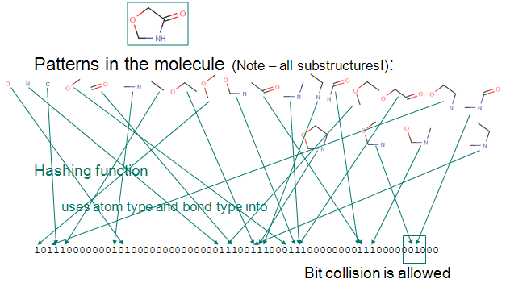
Topological/Path-Based Fingerprints
Given # of bonds, atom type and bond types are detected and analyzed
Topological/Path-based fingerprint: all fragments of compound are analyzed following a (usually linear) path up to a certain number of bonds. These paths are then hashed together into a fingerprint.
Every compound can produce a meaningful fingerprint
Unlike substructure key-base fingerprint, length can be adjusted
Multiple features may lie on one bit. This is acceptable to certain extent. Fingerprint info may be lost with increasing number of bit collisions.
Standard (Rcdk): hashed fingerprints, default length 1024 bits but can be adjusted
Extended (Rcdk): similar to standard but accounts rings and atomic properties into account

Slide 5
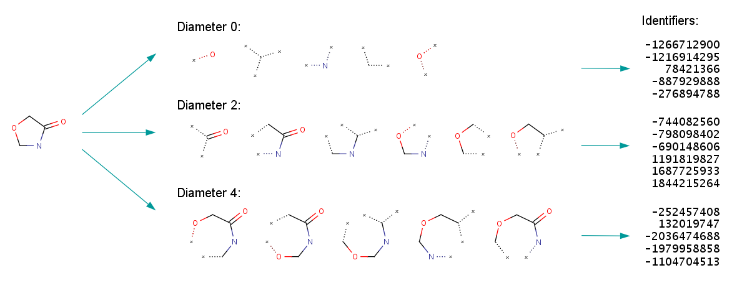
Circular/ Extended Connectivity Finger Print (ECFP
ECFP: generation process systematically record a neighborhood of non-hydrogen atoms in multiple circular layers within a radius/diameter
Each atom-centered substructure is then mapped into integer codes and hashed into a fingerprint
Not good for substructure searching as each fragment has a different environment based on their radius, however, this is optimal for similarity searching.
Circular(Rcdk): implementation of ECFP6 fingerprint

Slide 6
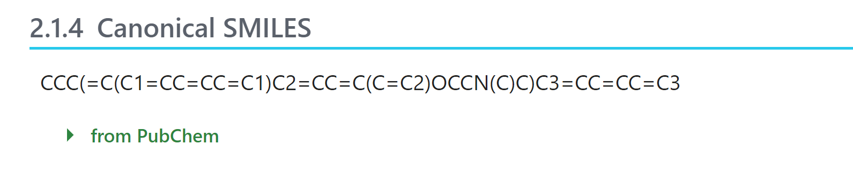
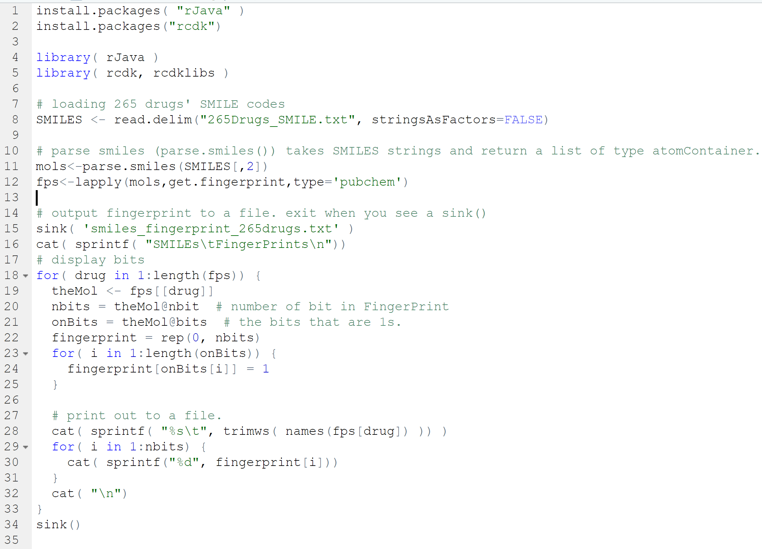
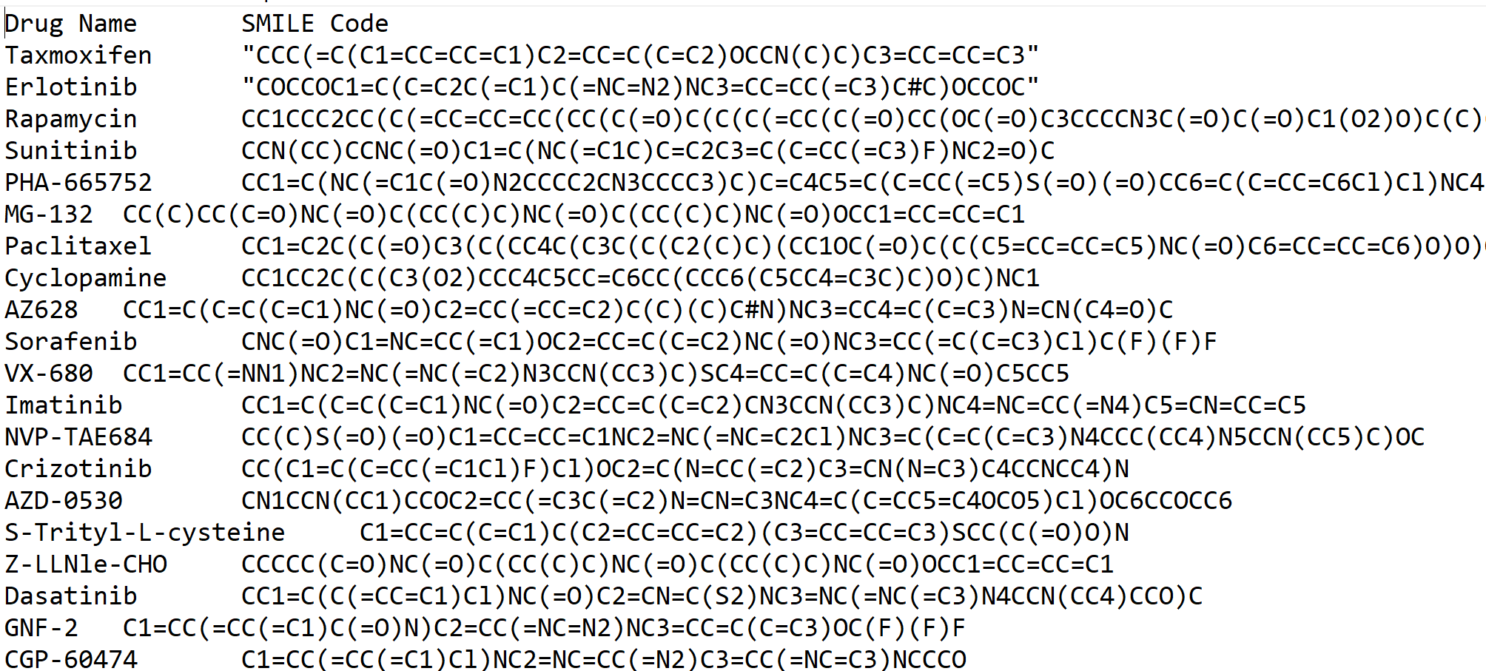
RCDK Approach
Obtain 265 SMILE codes available on PubChem
Notes:
Fingerprint type is interchangeable

Slide 7
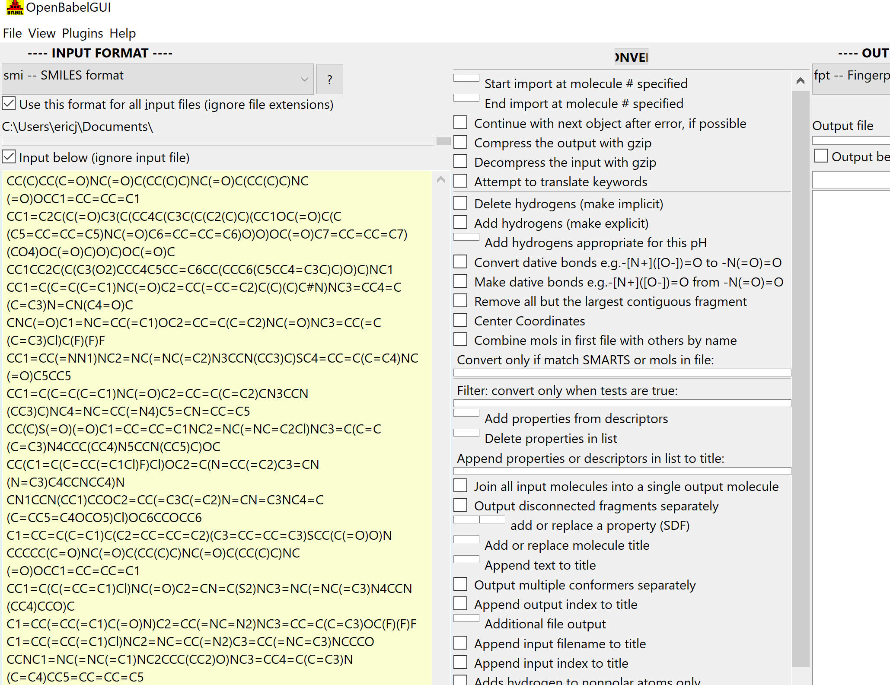
OpenBabel Approach
FP2, FP3, FP4, MACCS key
GUI Interface
Fingerprint generation (hex code format, use Rcdk to convert to binary)
Query molecule similarity searching

Slide 8
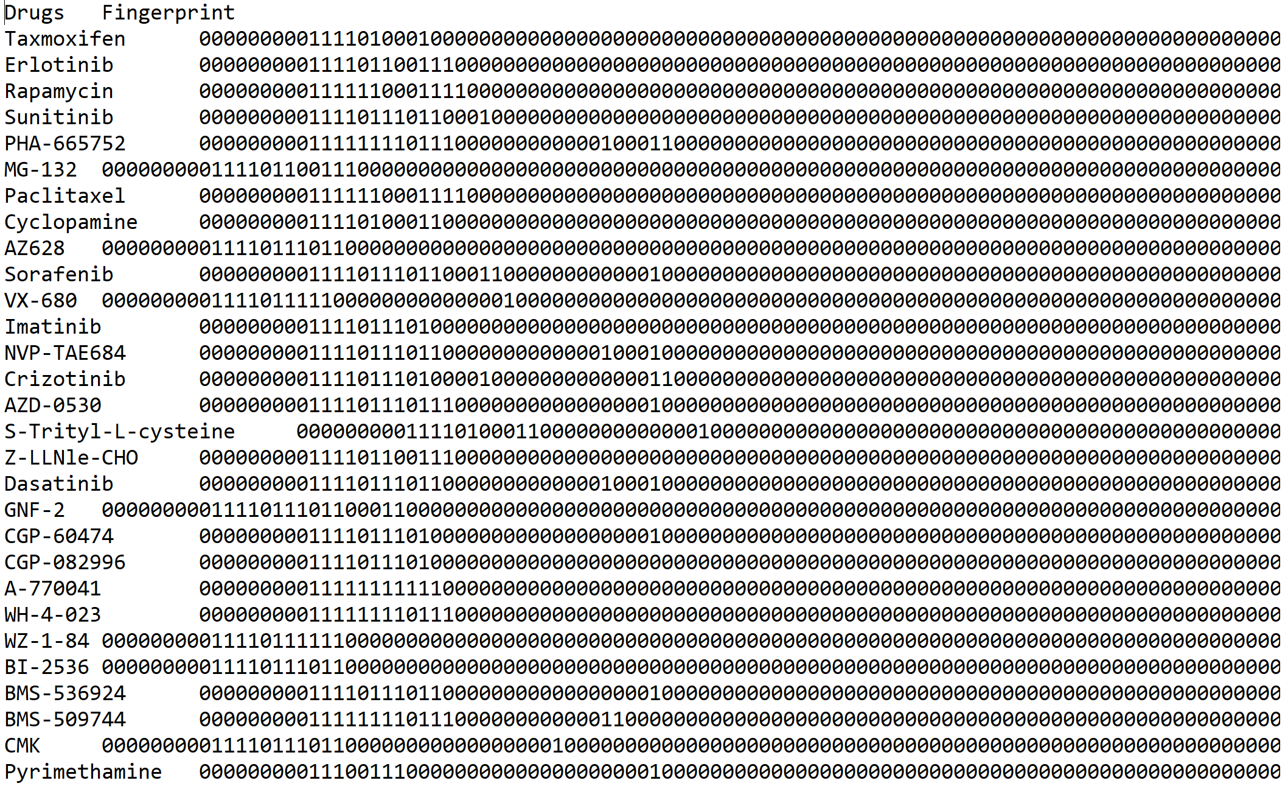
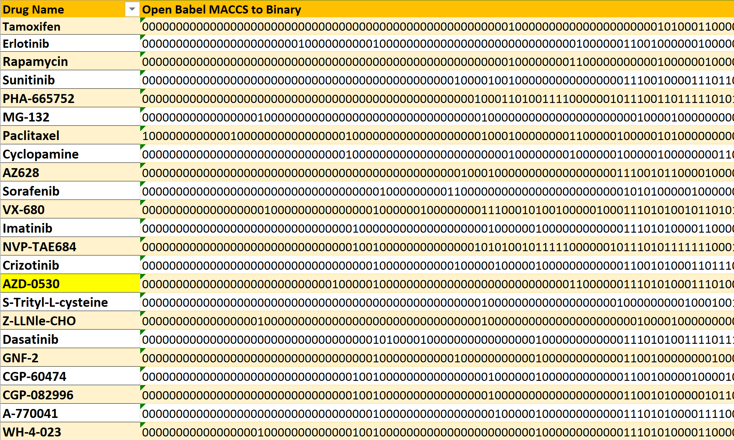
Results
Rcdk Binary Fingerprint
OpenBabel Binary Fingerprint
253/265 drug fingerprint acquired

Slide 9
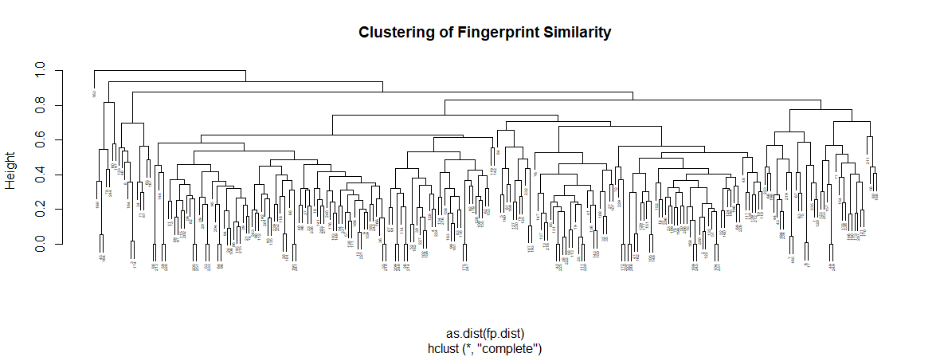
Hierarchical Clustering

Slide 10
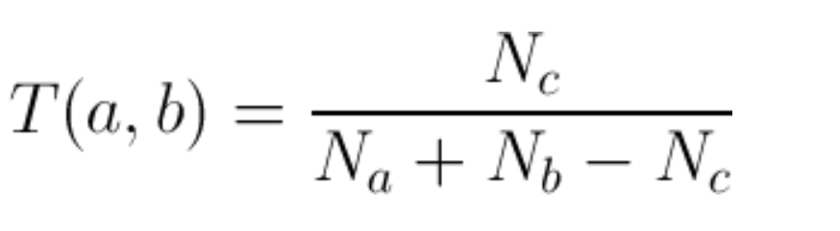
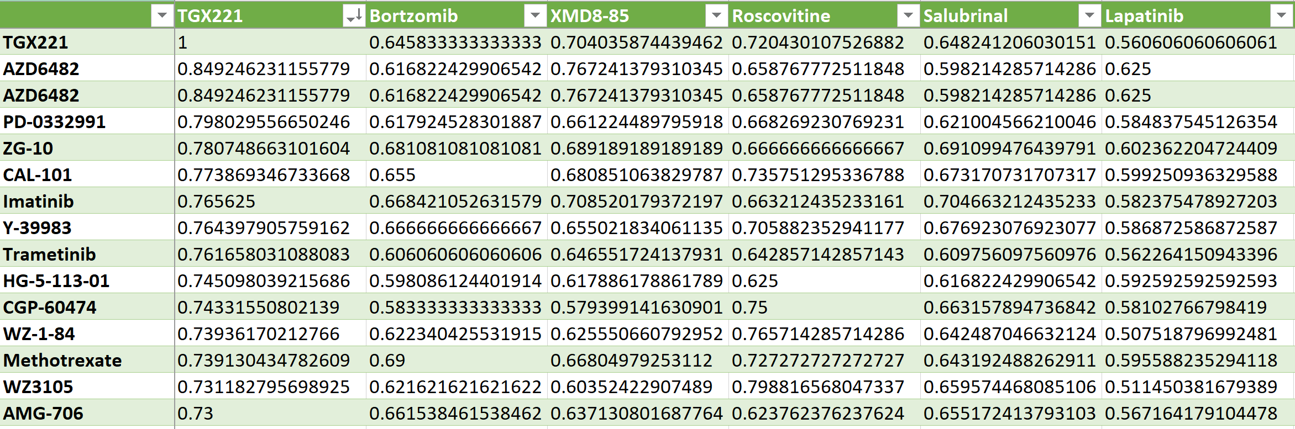
Similarity Searching
Tanimoto/Jacccard Coefficient
N_{a}= number of attributes(bits) a
N_{b}=number of attributes b
N_{c}=number of intersected (shared) attributes of a and b

Slide 11
Prospective Steps
Application of fingerprints to machine/deep learning
Exploration of different fingerprint types
Circular, topological/path-based, hybrids, and 3D fingerprints
Strengths and weaknesses in substructure searching and similarity/distance searching
Bit length
Extent of information stored. More or less?
Use similarity searching (Tanimoto coefficient) to explore FDA approved non-cancer drugs and its effectiveness and comparability to commonly used oncology drugs (ie. Tamoxifen)

Slide 12
References
https://docs.chemaxon.com/display/docs/Extended+Connectivity+Fingerprint+ECFP
https://www.sciencedirect.com/science/article/pii/S1046202314002631
https://cran.r-project.org/web/packages/rcdk/vignettes/using-rcdk.html#fingerprints
https://cran.r-project.org/web/packages/rcdk/rcdk.pdf

