Slide 1
Accurate and Low Complex Cell Histogram Generation By Bypass The Gradient of Pixel Computation
Huy-Hung Ho, Ngoc-Sinh Nguyen, Duy-Hieu Bui, Xuan-Tu Tran
Key Laboratory for Smart Integrated Systems (SISLAB),
VNU University of Engineering and Technology (VNU-UET)
Notes:
Now, don’t let you have to wait long. I will present the our paper: …

Slide 2
Outline
Context and motivation
Cell histogram generation
Hardware implementation
Evaluation

Slide 3
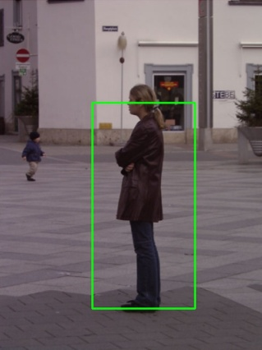
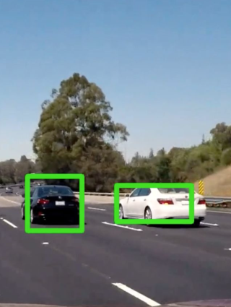
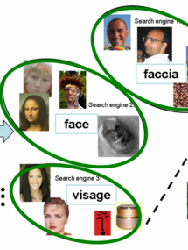
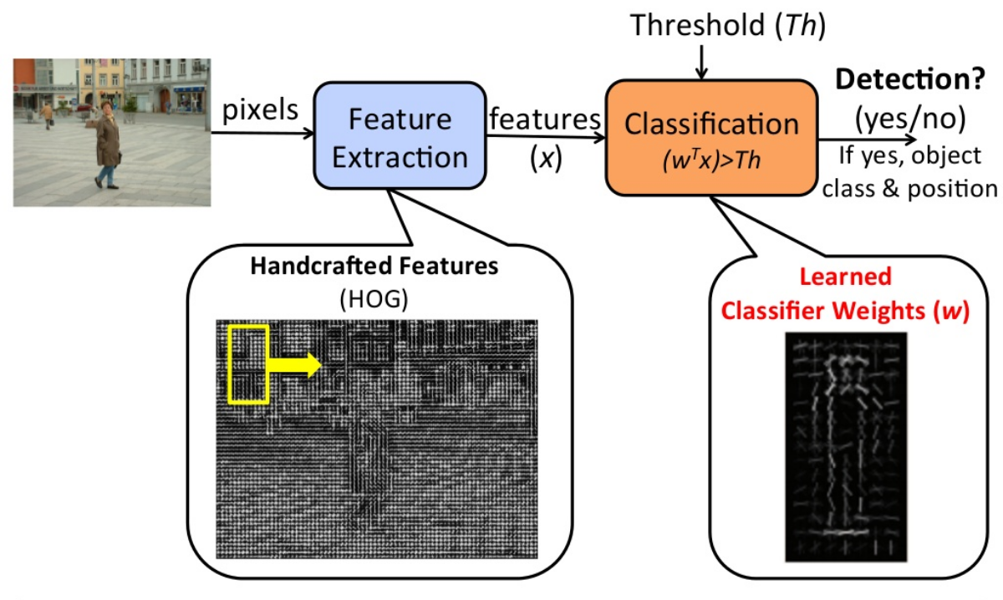
Object detection with HOG
Object detection/recognition
Advanced driver-assistance systems
Unmanned aerial vehicle
AI, robot…
Automotive: pedestrian detection
Automotive:
vehicle detection
Search:
image categorization
Histograms of Oriented Gradients (HOG)
High accuracy: 96.6%
High complex non-linear operation
Notes:
Hệ thống hỗ trợ lái xe nâng cao (ADAS) - Điều khiển tự động trong máy bay không người lái (UAV) -Dây chuyền sản xuất tự động, tương tác người và máy tính, robot…
HOG: pioneered by DALAL and TRIGGS, the most popular methods for feature extraction, based on counting occurrences of gradient orientation in localized portions of an image

Slide 4
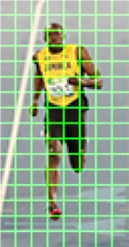
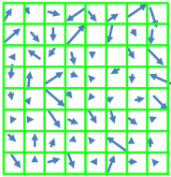
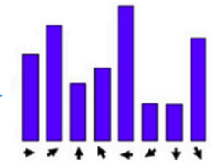
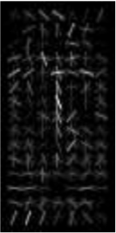
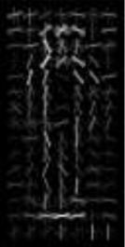

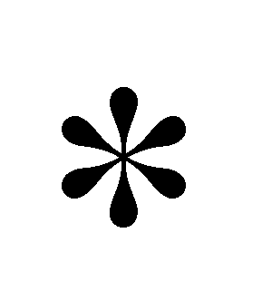
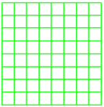
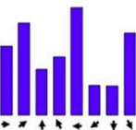
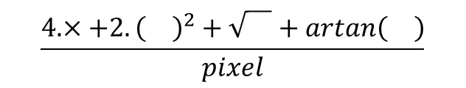
HOG algorithm - 3 phases
Block
(2 x 2 cells)
Cell gradient
Cell histogram
1
HOG features
SVM weights
Cell
(8 x 8 pixels)
Block HOG
Cell histogram generation
Block normalization
SVM classification
$$\frac{4.×+{2.\left(\right)}^{2}+\sqrt{}+artan\left(\right)}{pixel}$$
High cost in Cell histogram generation
[Mizuno 2013]

Slide 5
Outline
Context and motivation
Cell histogram generation
Conventional cell histogram generation
Previous works
Our proposed method
Hardware implementation
Evaluation

Slide 6


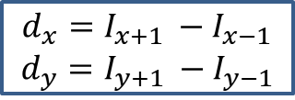












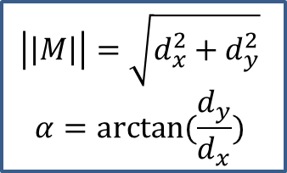







Conventional cell histogram generation
$$y$$
$$\vec{M}$$
$$×\left[1 0 1\right]$$
$$×\left[\begin{aligned}1 \\ 0 \\ 1\end{aligned}\right]$$
$$\vec{B_{2}}$$
$$\vec{d_{y}}$$
Cell
(8 x 8 pixels)
Cell gradient vectors
$$\vec{B_{1}}$$
$$θ_{i+1}$$
$$θ_{i}$$
$$O$$
$$\vec{d_{x}}$$
$$x$$
$$θ$$
$$B_{θ_{i}}=\left|\left|M\right|\right|×\frac{α−θ_{i}}{w}$$
$$B_{θ_{i+1}}=\left|\left|M\right|\right|×\frac{θ_{j+1}−α}{w}$$
$$\left|\left|M\right|\right|=\sqrt{d_{x}^{2}+d_{y}^{2}}$$
$$α=arctan⁡(\frac{d_{y}}{d_{x}})$$
$$θ_{i}<α<θ_{i+1}, θ is constant$$
$$I(x_{i}, y_{i})$$
$\vec{d_{x}},\vec{d_{y}}$
$$\vec{M}(x, y)$$
$$\vec{B_{θ_{i}}}$$
$$d_{x}=I_{x+1 }−I_{x−1}$$
$$d_{y}=I_{y+1 }−I_{y−1}$$
$$\vec{B_{θ_{i+1}}}$$
Difference pixel
Gradient
(magnitude and orientation)
Voting bin

Slide 7
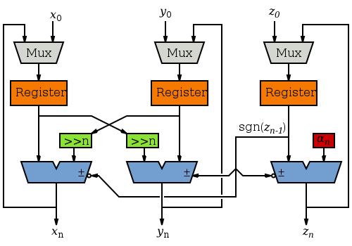

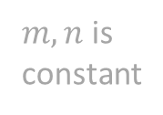

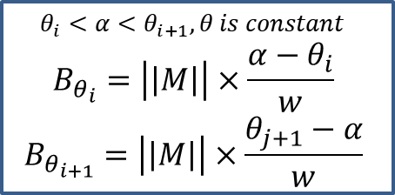








Previous works
Look-up table
$$\left|\left|M\right|\right|≈max((0.875g_{max}+0.5g_{min}),g_{max})$$
$$\left|\left|M\right|\right|≈{|d}_{x}|+{|d}_{y}|$$
$$d_{x}$$
$$M_{xy}$$
$$\left|\left|M\right|\right|≈\left|d_{x}\right|+\left|d_{y}\right| −\frac{g_{min}}{2}$$
L1-Norm
$$d_{y}$$
$$g_{max}=\max\left(\left|d_{x}\right|, \left|d_{y}\right|\right)$$
$$g_{min}=min⁡(\left|d_{x}\right|, \left|d_{y}\right|)$$
Bin’s boundary angles, determinate $θ_{i}, θ_{i+1}$
$$B_{θ_{i}}≈\left|\left|M\right|\right|×m$$
$B_{θ_{i+1}}≈\left|\left|M\right|\right|×n$
$m, n$is constant
Cordict
$$\left|\left|M\right|\right|=\sqrt{d_{x}^{2}+d_{y}^{2}}$$
$$α=arctan⁡(\frac{d_{y}}{d_{x}})$$
$$θ_{i}<α<θ_{i+1}, θ is constant$$
$$B_{θ_{i}}=\left|\left|M\right|\right|×\frac{α−θ_{i}}{w}$$
$$B_{θ_{i+1}}=\left|\left|M\right|\right|×\frac{θ_{j+1}−α}{w}$$
$$d_{x}=I_{x+1 }−I_{x−1}$$
$$d_{y}=I_{y+1 }−I_{y−1}$$
First, gradient magitude calculation: square, square root.
This phase very complex, some researches opmtimized it.

Slide 8
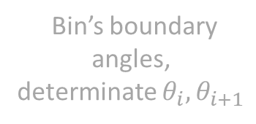



Previous works
Look-up table
Look-up table
$$\left|\left|M\right|\right|≈max((0.875g_{max}+0.5g_{min}),g_{max})$$
$$\left|\left|M\right|\right|≈{|d}_{x}|+{|d}_{y}|$$
$$M_{xy}$$
$$\left|\left|M\right|\right|≈\left|d_{x}\right|+\left|d_{y}\right| −\frac{g_{min}}{2}$$
$$d_{x}$$
$$M_{xy}$$
$$d_{x}$$
L1-Norm
$$d_{y}$$
$$g_{max}=\max\left(\left|d_{x}\right|, \left|d_{y}\right|\right)$$
$$g_{min}=min⁡(\left|d_{x}\right|, \left|d_{y}\right|)$$
$$d_{y}$$
Bin’s boundary angles,
determinate $θ_{i}, θ_{i+1}$
$$B_{θ_{i}}≈\left|\left|M\right|\right|×m$$
$B_{θ_{i+1}}≈\left|\left|M\right|\right|×n$
$m, n$is constant
Cordict
$$\left|\left|M\right|\right|=\sqrt{d_{x}^{2}+d_{y}^{2}}$$
$$α=arctan⁡(\frac{d_{y}}{d_{x}})$$
$$θ_{i}<α<θ_{i+1}, θ is constant$$
$$B_{θ_{i}}=\left|\left|M\right|\right|×\frac{α−θ_{i}}{w}$$
$$B_{θ_{i+1}}=\left|\left|M\right|\right|×\frac{θ_{j+1}−α}{w}$$
$$d_{x}=I_{x+1 }−I_{x−1}$$
$$d_{y}=I_{y+1 }−I_{y−1}$$
Kadota2009, Peker2011 use Look-up table for fast calculation.
But LUT requires very high area cost.

Slide 9

Previous works
Look-up table
$$\left|\left|M\right|\right|≈max((0.875g_{max}+0.5g_{min}),g_{max})$$
$$\left|\left|M\right|\right|≈{|d}_{x}|+{|d}_{y}|$$
$$\left|\left|M\right|\right|≈{|d}_{x}|+{|d}_{y}|$$
$$d_{x}$$
$$M_{xy}$$
$$\left|\left|M\right|\right|≈\left|d_{x}\right|+\left|d_{y}\right| −\frac{g_{min}}{2}$$
L1-Norm
L1-Norm
$$d_{y}$$
$$g_{max}=\max\left(\left|d_{x}\right|, \left|d_{y}\right|\right)$$
$$g_{min}=min⁡(\left|d_{x}\right|, \left|d_{y}\right|)$$
Bin’s boundary angles,
determinate $θ_{i}, θ_{i+1}$
$$B_{θ_{i}}≈\left|\left|M\right|\right|×m$$
$B_{θ_{i+1}}≈\left|\left|M\right|\right|×n$
$m, n$is constant
Cordict
$$\left|\left|M\right|\right|=\sqrt{d_{x}^{2}+d_{y}^{2}}$$
$$α=arctan⁡(\frac{d_{y}}{d_{x}})$$
$$θ_{i}<α<θ_{i+1}, θ is constant$$
$$B_{θ_{i}}=\left|\left|M\right|\right|×\frac{α−θ_{i}}{w}$$
$$B_{θ_{i+1}}=\left|\left|M\right|\right|×\frac{θ_{j+1}−α}{w}$$
$$d_{x}=I_{x+1 }−I_{x−1}$$
$$d_{y}=I_{y+1 }−I_{y−1}$$
Landola2016, Suleiman2016 use L1-norm instead of L2-norm.
This method reduce the accuracy.

Slide 10


Previous works
Look-up table
$$\left|\left|M\right|\right|≈max((0.875g_{max}+0.5g_{min}),g_{max})$$
$$\left|\left|M\right|\right|≈max((0.875g_{max}+0.5g_{min}),g_{max})$$
$$\left|\left|M\right|\right|≈{|d}_{x}|+{|d}_{y}|$$
$$\left|\left|M\right|\right|≈\left|d_{x}\right|+\left|d_{y}\right| −\frac{g_{min}}{2}$$
$$d_{x}$$
$$M_{xy}$$
$$\left|\left|M\right|\right|≈\left|d_{x}\right|+\left|d_{y}\right| −\frac{g_{min}}{2}$$
L1-Norm
$$g_{max}=\max\left(\left|d_{x}\right|, \left|d_{y}\right|\right)$$
$$g_{min}=min⁡(\left|d_{x}\right|, \left|d_{y}\right|)$$
$$d_{y}$$
$$g_{max}=\max\left(\left|d_{x}\right|, \left|d_{y}\right|\right)$$
$$g_{min}=min⁡(\left|d_{x}\right|, \left|d_{y}\right|)$$
Bin’s boundary angles,
determinate $θ_{i}, θ_{i+1}$
$$B_{θ_{i}}≈\left|\left|M\right|\right|×m$$
$B_{θ_{i+1}}≈\left|\left|M\right|\right|×n$
$m, n$is constant
Cordict
$$\left|\left|M\right|\right|=\sqrt{d_{x}^{2}+d_{y}^{2}}$$
$$α=arctan⁡(\frac{d_{y}}{d_{x}})$$
$$θ_{i}<α<θ_{i+1}, θ is constant$$
$$B_{θ_{i}}=\left|\left|M\right|\right|×\frac{α−θ_{i}}{w}$$
$$B_{θ_{i+1}}=\left|\left|M\right|\right|×\frac{θ_{j+1}−α}{w}$$
$$d_{x}=I_{x+1 }−I_{x−1}$$
$$d_{y}=I_{y+1 }−I_{y−1}$$
Chen2014, Hsiao2016 used SRA (Square root approximation technique).
Similary, it also reduce the accuracy level.

Slide 11
Previous works
Look-up table
Look-up table
$$\left|\left|M\right|\right|≈max((0.875g_{max}+0.5g_{min}),g_{max})$$
$$\left|\left|M\right|\right|≈{|d}_{x}|+{|d}_{y}|$$
$$M_{xy}$$
$$\left|\left|M\right|\right|≈\left|d_{x}\right|+\left|d_{y}\right| −\frac{g_{min}}{2}$$
$$d_{x}$$
$$M_{xy}$$
$$d_{x}$$
L1-Norm
$$d_{y}$$
$$g_{max}=\max\left(\left|d_{x}\right|, \left|d_{y}\right|\right)$$
$$g_{min}=min⁡(\left|d_{x}\right|, \left|d_{y}\right|)$$
$$d_{y}$$
Bin’s boundary angles,
determinate $θ_{i}, θ_{i+1}$
$$B_{θ_{i}}≈\left|\left|M\right|\right|×m$$
$B_{θ_{i+1}}≈\left|\left|M\right|\right|×n$
$m, n$is constant
Cordict
$$\left|\left|M\right|\right|=\sqrt{d_{x}^{2}+d_{y}^{2}}$$
$$α=arctan⁡(\frac{d_{y}}{d_{x}})$$
$$θ_{i}<α<θ_{i+1}, θ is constant$$
$$B_{θ_{i}}=\left|\left|M\right|\right|×\frac{α−θ_{i}}{w}$$
$$B_{θ_{i+1}}=\left|\left|M\right|\right|×\frac{θ_{j+1}−α}{w}$$
$$d_{x}=I_{x+1 }−I_{x−1}$$
$$d_{y}=I_{y+1 }−I_{y−1}$$
For gradient orientation, Landola2015 used full LUT
for inverse tangent and consumed 256KB memory.

Slide 12
Previous works
Look-up table
$$\left|\left|M\right|\right|≈max((0.875g_{max}+0.5g_{min}),g_{max})$$
$$\left|\left|M\right|\right|≈{|d}_{x}|+{|d}_{y}|$$
$$d_{x}$$
$$M_{xy}$$
$$\left|\left|M\right|\right|≈\left|d_{x}\right|+\left|d_{y}\right| −\frac{g_{min}}{2}$$
L1-Norm
$$d_{y}$$
$$g_{max}=\max\left(\left|d_{x}\right|, \left|d_{y}\right|\right)$$
$$g_{min}=min⁡(\left|d_{x}\right|, \left|d_{y}\right|)$$
Bin’s boundary angles,
determinate $θ_{i}, θ_{i+1}$
$$B_{θ_{i}}≈\left|\left|M\right|\right|×m$$
$B_{θ_{i+1}}≈\left|\left|M\right|\right|×n$
$m, n$is constant
Cordict
Cordict
$$\left|\left|M\right|\right|=\sqrt{d_{x}^{2}+d_{y}^{2}}$$
$$α=arctan⁡(\frac{d_{y}}{d_{x}})$$
$$θ_{i}<α<θ_{i+1}, θ is constant$$
$$B_{θ_{i}}=\left|\left|M\right|\right|×\frac{α−θ_{i}}{w}$$
$$B_{θ_{i+1}}=\left|\left|M\right|\right|×\frac{θ_{j+1}−α}{w}$$
$$d_{x}=I_{x+1 }−I_{x−1}$$
$$d_{y}=I_{y+1 }−I_{y−1}$$
Takaghi2013 used CORDIC to avoid high memory.
But CORDICT require more time.

Slide 13
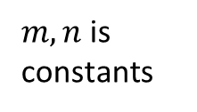


Previous works
Look-up table
$$\left|\left|M\right|\right|≈max((0.875g_{max}+0.5g_{min}),g_{max})$$
$$\left|\left|M\right|\right|≈{|d}_{x}|+{|d}_{y}|$$
$$d_{x}$$
$$M_{xy}$$
$$\left|\left|M\right|\right|≈\left|d_{x}\right|+\left|d_{y}\right| −\frac{g_{min}}{2}$$
L1-Norm
$$d_{y}$$
$$g_{max}=\max\left(\left|d_{x}\right|, \left|d_{y}\right|\right)$$
$$g_{min}=min⁡(\left|d_{x}\right|, \left|d_{y}\right|)$$
Bin’s boundary angles,
determinate $θ_{i}, θ_{i+1}$
$$B_{θ_{i}}≈\left|\left|M\right|\right|×m$$
$B_{θ_{i+1}}≈\left|\left|M\right|\right|×n$
$$B_{θ_{i}}≈\left|\left|M\right|\right|×m$$
$B_{θ_{i+1}}≈\left|\left|M\right|\right|×n$
$m, n$is constant
$m, n$is constants
Cordict
$$\left|\left|M\right|\right|=\sqrt{d_{x}^{2}+d_{y}^{2}}$$
$$α=arctan⁡(\frac{d_{y}}{d_{x}})$$
$$θ_{i}<α<θ_{i+1}, θ is constant$$
$$B_{θ_{i}}=\left|\left|M\right|\right|×\frac{α−θ_{i}}{w}$$
$$B_{θ_{i+1}}=\left|\left|M\right|\right|×\frac{θ_{j+1}−α}{w}$$
$$d_{x}=I_{x+1 }−I_{x−1}$$
$$d_{y}=I_{y+1 }−I_{y−1}$$
All previous papers used fixed weights for voting magnitude.
That leads to the error.

Slide 14






Previous works
Look-up table
$$\left|\left|M\right|\right|≈max((0.875g_{max}+0.5g_{min}),g_{max})$$
$$\left|\left|M\right|\right|≈{|d}_{x}|+{|d}_{y}|$$
$$d_{x}$$
$$M_{xy}$$
$$\left|\left|M\right|\right|≈\left|d_{x}\right|+\left|d_{y}\right| −\frac{g_{min}}{2}$$
L1-Norm
$$d_{y}$$
$$g_{max}=\max\left(\left|d_{x}\right|, \left|d_{y}\right|\right)$$
$$g_{min}=min⁡(\left|d_{x}\right|, \left|d_{y}\right|)$$
Bin’s boundary angles,
determinate $θ_{i}, θ_{i+1}$
Bin’s boundary angles,
determinate $θ_{i}, θ_{i+1}$
$$\tan\left(θ_{i}\right)×d_{x}<dy<tan⁡(θ_{i+1})×dx$$
Constant
Cordict
$$\left|\left|M\right|\right|=\sqrt{d_{x}^{2}+d_{y}^{2}}$$
$$α=arctan⁡(\frac{d_{y}}{d_{x}})$$
$$θ_{i}<α<θ_{i+1}, θ is constant$$
$$B_{θ_{i}}=\left|\left|M\right|\right|×\frac{α−θ_{i}}{w}$$
$$B_{θ_{i+1}}=\left|\left|M\right|\right|×\frac{θ_{j+1}−α}{w}$$
$$d_{x}=I_{x+1 }−I_{x−1}$$
$$d_{y}=I_{y+1 }−I_{y−1}$$
Chen2014, Hsiao2016 determined $θ_{i}, θ_{i+1}$ without $α$.
But this method has the potentially wrong orientation.

Slide 15
Our proposed method
A new method
$$\left|\left|M\right|\right|=\sqrt{d_{x}^{2}+d_{y}^{2}}$$
$$α=arctan⁡(\frac{d_{y}}{d_{x}})$$
$$θ_{i}<α<θ_{i+1}, θ is constant$$
$$B_{θ_{i}}=\left|\left|M\right|\right|×\frac{α−θ_{i}}{w}$$
$$B_{θ_{i+1}}=\left|\left|M\right|\right|×\frac{θ_{j+1}−α}{w}$$
$$d_{x}=I_{x+1 }−I_{x−1}$$
$$d_{y}=I_{y+1 }−I_{y−1}$$
Avoid non-linear operation completely.

Slide 16
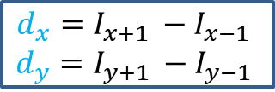






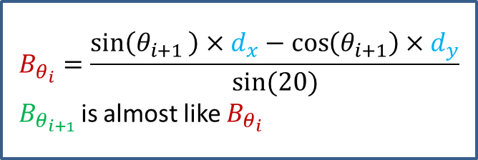

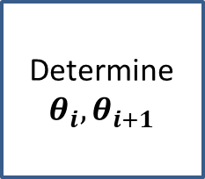



Our proposed method
$$y$$
$$\vec{M}$$
$$\vec{B_{2}}$$
$$\vec{d_{y}}$$
$$\vec{B_{1}}$$
$$θ_{i+1}$$
$$θ_{i}$$
Constant
$$O$$
$$\vec{d_{x}}$$
$$x$$
Determine $θ_{i}, θ_{i+1}$
$$B_{θ_{i}}=\frac{\sin\left(θ_{i+1 }\right)×d_{x}−\cos\left(θ_{i+1}\right)×d_{y}}{sin⁡(20)}$$
$B_{θ_{i+1 }}$is almost like $B_{θ_{i}}$
$$d_{x}=I_{x+1 }−I_{x−1}$$
$$d_{y}=I_{y+1 }−I_{y−1}$$
Determined 2 quantized orientation fast like Chen2013.
But we determine quantized orientation exactly.
We use $d_{x}, d_{y}, θ_{i}, θ_{i+1}$
to calculate gradient magnitude of two bins exactly.
Converting all of multications and division with constant
into form of shifts and additions.

Slide 17
Outline
Context and motivation
Cell histogram generation
Hardware implementation
Evaluation

Slide 18
















Proposed hardware implementation
PIX2BIN
b1,b2 is magnitude * sin (20)
$θ_{1,2}$ is angle, which are encoded to bin position
$$b_{1}=dx×sinθ_{2}−dy×cosθ_{2}$$
$$b_{2}=dy×cosθ_{1}−dx×sinθ_{1}$$
clk
rst
$$\sin{{(θ}_{i})}×dx$$
$$\sin{{(θ}_{1,2})}×dx$$
$$I_{x+1,y}$$
+
+
|dx|
$$A_{i}$$
$×dx$
$$I_{x−1,y}$$
-
dx
clk, rst
sign(dx)
$$\max\left(i\right)$$
$$↔$$
$$θ_{1}, θ_{2}$$
$$B_{i}×dy$$
$$≥A_{i}×dx?$$
$$b_{1}=$$
$$b_{2}=$$
$$I_{x, y+1}$$
$$B_{i}$$
$×dy$
+
|dy|
$$θ_{1}=$$
$$θ_{2}=$$
$$I_{x, y −1}$$
+
dy
-
sign(dy)
$$\cos\left(θ_{i}\right)×dy$$
$$\cos{{(θ}_{1,2})}×dy$$
Proposed cell histogram generation include 4 states.
It usages 30 shifts and 40 additions.

Slide 19
Outline
Context and motivation
Cell histogram generation
Hardware implementation
Evaluation

Slide 20
Evaluation
 |  | Memory | Timming | Accurate
Basic cell hisogram generation |  | - | - | 100%
Previous works | Lookup table – Kadota2009, Peker2011 | - - | + + | - -
 | Magnitude approximations – Chen2013, Hsiao2016, Patent2015 | + |  | --
 | L1-norm instead of L2-norm – Landola2016, Suleman2016 | + |  | -
 | CORDIC - Takagi2013 |  | -
 | Bin’s boundary angles – Chen2013, Hsiao2016 |  |  | < 98%
Our Proposed |  | + | + | 98%

Slide 21
Evaluation
Complexity: 30 additions + 40 shifts
Area: 3.57 KGEs (in NanGate 45nm)
Throughput: 0.4×10^6 pixel/s
Max frequency: 400 MHz
Error: < 2%
Error compare to absolute floating point
References | Approach | Areas (KGates) | Frequency
Chen2014 | Square root approx Bin’s boundary angles | 85.5 | 167 MHz (all HOG)
Hsiao2016 | Square root approx Bin’s boundary angles | 29.1 | N/A
Munteanu2016 (patent) | Square root approx Bin’s boundary angles | 20 | Max. 400 MHz
Our proposed | Bypass gradient of pixel calculation Improved bin’s boundary angles | 3.57 | Max. 400 MHz

Slide 22
Thank you for your attention

Slide 23
Backup slides

Slide 24
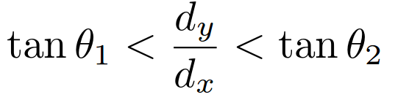
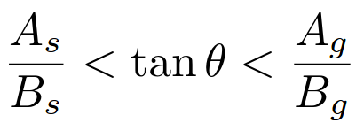
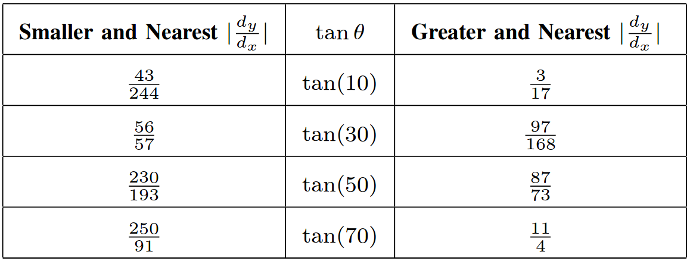










Determining 2 quantized orientation
$$y$$
$$\vec{M}$$
$$\vec{B_{2}}$$
$$\vec{d_{y}}$$
$$\vec{B_{1}}$$
$$θ_{i+1}$$
$$θ_{i}$$
Use shift and comparator
$$O$$
$$\vec{d_{x}}$$
$$x$$
Symmetry about angle
$$θ_{i}, θ_{i+1}$$

Slide 25




$$d_{x}$$
$$M_{xy}$$
$$d_{y}$$
$$d_{x}$$
$$M_{xy}$$
$$d_{y}$$

Slide 26

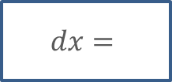
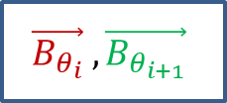



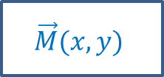


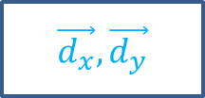

Conventional cell histogram generation
$$y$$
$$\vec{M}$$
$$×\left[1 0 1\right]$$
$$×\left[\begin{aligned}1 \\ 0 \\ 1\end{aligned}\right]$$
$$\vec{B_{2}}$$
$$\vec{d_{y}}$$
Cell
(8 x 8 pixels)
Cell gradient vectors
$$\vec{B_{1}}$$
$$θ_{i+1}$$
$$θ_{i}$$
$\vec{d_{x}},\vec{d_{y}}$
$$O$$
$$\vec{d_{x}}$$
$$x$$
$$\vec{M}(x, y)$$
$$\vec{B_{θ_{i}}} , \vec{B_{θ_{i+1}}}$$
$$\left\{I(x_{i}, y_{i})\right\}$$
$$dx=$$
$\vec{d_{x}},\vec{d_{y}}$
$$\vec{M}(x, y)$$
$$\vec{B_{θ_{i}}} , \vec{B_{θ_{i+1}}}$$
Difference pixel
Gradient (magnitude and angle)
Voting bin

Slide 27

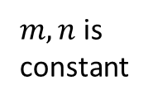




Previous works
This phase very complex, some researches opmtimized it.
Look-up table
$$\left|\left|M\right|\right|≈max((0.875g_{max}+0.5g_{min}),g_{max})$$
$$\left|\left|M\right|\right|≈{|d}_{x}|+{|d}_{y}|$$
$$d_{x}$$
$$M_{xy}$$
$$\left|\left|M\right|\right|≈\left|d_{x}\right|+\left|d_{y}\right| −\frac{g_{min}}{2}$$
First, gradient magitude calculation: square, square root.
L1-Norm
$$d_{y}$$
$$g_{max}=\max\left(\left|d_{x}\right|, \left|d_{y}\right|\right)$$
$$g_{min}=min⁡(\left|d_{x}\right|, \left|d_{y}\right|)$$
Kadota2009, Peker2011 use Look-up table for fast calculation.
But LUT requires very high areas cost.
Bin’s boundary angles, determinate $θ_{i}, θ_{i+1}$
Landola2016, Suleiman2016 use L1-norm instead of L2-norm.
$$B_{θ_{i}}≈\left|\left|M\right|\right|×m$$
$B_{θ_{i+1}}≈\left|\left|M\right|\right|×n$
$m, n$is constant
Chen2013, Hsiao2016 used SRA (Square root approximation technique).
However, this model reduce the accuracy level.
Cordict
$$\left|\left|M\right|\right|=\sqrt{d_{x}^{2}+d_{y}^{2}}$$
$$α=arctan⁡(\frac{d_{y}}{d_{x}})$$
$$θ_{i}<α<θ_{i+1}, θ is constant$$
$$B_{θ_{i}}=\left|\left|M\right|\right|×\frac{α−θ_{i}}{w}$$
$$B_{θ_{i+1}}=\left|\left|M\right|\right|×\frac{θ_{j+1}−α}{w}$$
$$d_{x}=I_{x+1 }−I_{x−1}$$
$$d_{y}=I_{y+1 }−I_{y−1}$$
For gradient orientation, Peker2011 use combined the LUT and piece-wise approximations.
Takaghi2013 used CORDIC to avoid high memory.
But CORDICT require more time.
Fixed weight for voting: reduce accuracy.

Slide 28









Approximate Computing
$$\left|\left|M\right|\right|=\sqrt{d_{x}^{2}+d_{y}^{2}}$$
Look-up table
$$\left|\left|M\right|\right|≈{|d}_{x}|+{|d}_{y}|$$
$$d_{x}$$
$$M_{xy}$$
L1-Norm
$$d_{y}$$
$$\left|\left|M\right|\right|≈max((0.875g_{max}+0.5g_{min}),g_{max})$$
$$α=\arctan\left(\frac{d_{y}}{d_{x}}\right)$$
$$θ_{i}<α<θ_{i+1}$$
$$θ is quantized angle$$
$$\left|\left|M\right|\right|≈\left|d_{x}\right|+\left|d_{y}\right| −\frac{g_{min}}{2}$$
$$g_{max}=\max\left(\left|d_{x}\right|, \left|d_{y}\right|\right)$$
$$g_{min}=min⁡(\left|d_{x}\right|, \left|d_{y}\right|)$$
Cordict
$$B_{θ_{i}}=\left|\left|M\right|\right|×\frac{α−θ_{i}}{w}$$
$$B_{θ_{i+1}}=\left|\left|M\right|\right|×\frac{θ_{j+1}−α}{w}$$
Bin’s boundary angles, determinate $θ_{i}, θ_{i+1}$
$$B_{θ_{i}}≈\left|\left|M\right|\right|×m$$
$B_{θ_{i+1}}≈\left|\left|M\right|\right|×n$
$m, n$is constant

