Slide 1
Accurate and Low Complex Cell Histogram Generation By Bypass The Gradient of Pixel Computation
NAFOSTED Conference on Information and Computer Science (NICS)
Huy-Hung Ho, Ngoc-Sinh Nguyen, Duy-Hieu Bui, Xuan-Tu Tran
Key Laboratory for Smart Integrated Systems (SISLAB),
VNU University of Engineering and Technology (VNU-UET)

Slide 2
Outline
Context and motivation
Cell histogram generation
Proposed cell histogram generation
Hardware implementation & evaluation
Conclusion

Slide 3
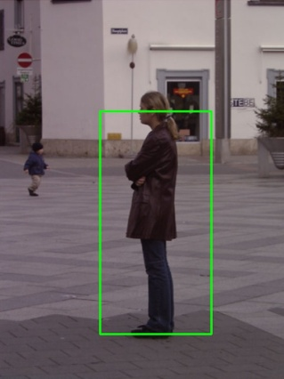
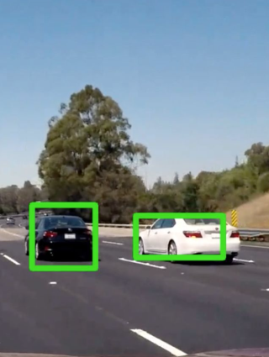
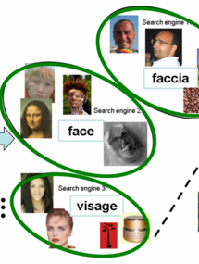
Object detection with HOG
Object detection/recognition
Advanced driver-assistance systems
Unmanned aerial vehicle
AI, robot…
Automotive: pedestrian detection
Automotive:
vehicle detection
Search:
image categorization
Histograms of Oriented Gradients (HOG)
High accuracy: 96.6%
High complex non-linear operation
HOG Features

Slide 4
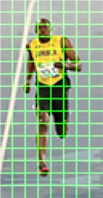
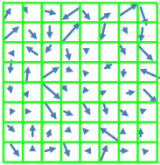
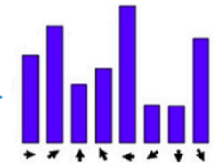
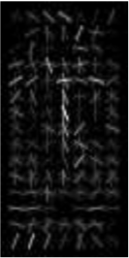
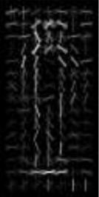


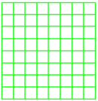
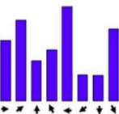
HOG algorithm - 3 phases
Block
(2 x 2 cells)
Cell gradient
Cell histogram
1
HOG features
SVM weights
Cell
(8 x 8 pixels)
Block HOG
Cell histogram generation
Block normalization
SVM classification
High cost in Cell histogram generation
[Mizuno-2013]

Slide 5
Outline
Context and motivation
Cell histogram generation
Conventional cell histogram generation
Approximate models
Proposed cell histogram generation
Hardware implementation & evaluation
Conclusion

Slide 6
Outline
Context and motivation
Cell histogram generation
Conventional cell histogram generation
Approximate models
Proposed cell histogram generation
Hardware implementation & evaluation
Conclusion

Slide 7
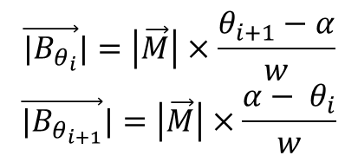
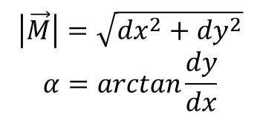
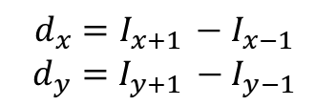
Conventional Cell Histogram Generation Process
Horizontal Gradient
Gradient M
Image
Voting
Vertical Gradient
Magnitude
Angle
$$\left|\vec{M}\right|=\sqrt{dx^{2}+dy^{2}}$$
$$α=\arctan{\frac{dy}{dx}}$$
$$\vec{{|B}_{θ_{i}}}|=\left|\vec{M}\right|×\frac{θ_{i+1}−α}{w}$$
$$\vec{{|B}_{θ_{i+1}}}|=\left|\vec{M}\right|×\frac{α− θ_{i}}{w}$$
$$d_{x}=I_{x+1 }−I_{x−1}$$
$$d_{y}=I_{y+1 }−I_{y−1}$$

Slide 8
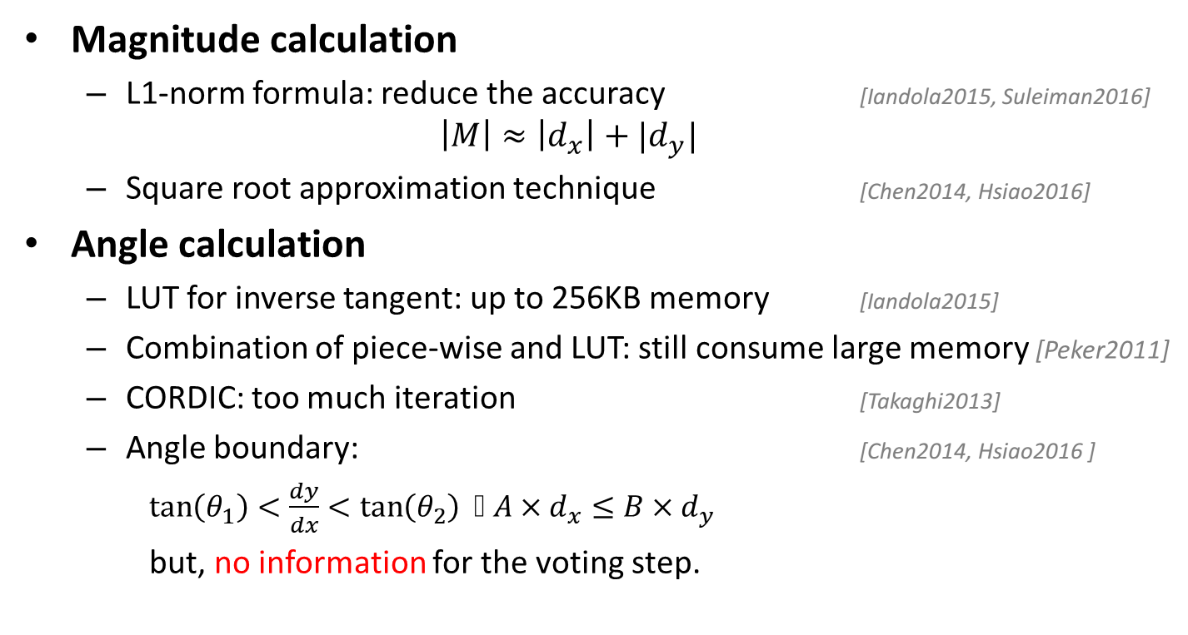
Gradient approximations
Horizontal Gradient
Gradient M
Image
Voting
Vertical Gradient
Magnitude
Angle
Magnitude calculation
L1-norm formula: reduce the accuracy [Iandola2015, Suleiman2016]
$$\left|M\right|≈\left|d_{x}\right|+|d_{y}|$$
Square root approximation technique [Chen2014, Hsiao2016]
Angle calculation
LUT for inverse tangent: up to 256KB memory [Iandola2015]
Combination of piece-wise and LUT: still consume large memory [Peker2011]
CORDIC: too much iteration [Takaghi2013]
Angle boundary: [Chen2014, Hsiao2016 ]
$\tan\left(θ_{1}\right)<\frac{dy}{dx}<\tan\left(θ_{2}\right)$ ⬄ $A×d_{x}≤B×d_{y}$
but, no information for the voting step.

Slide 9
Outline
Context and motivation
Cell histogram generation
Proposed cell histogram generation
Hardware implementation & evaluation
Conclusion

Slide 10
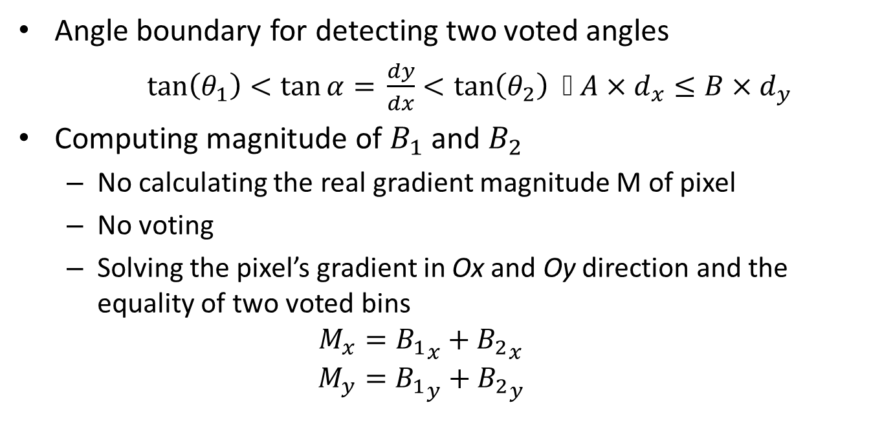
Ideas
Horizontal Gradient
Gradient M
Image
Voting
Vertical Gradient
Magnitude
Angle
Angle boundary
Computing magnitude
Angle boundary for detecting two voted angles
$\tan\left(θ_{1}\right)<\tan{α= }\frac{dy}{dx}<\tan\left(θ_{2}\right)$ ⬄ $A×d_{x}≤B×d_{y}$
Computing magnitude of $B_{1}$ and $B_{2}$
No calculating the real gradient magnitude M of pixel
No voting
Solving the pixel’s gradient in Ox and Oy direction and the equality of two voted bins
$$M_{x}={B_{1}}_{x}+{B_{2}}_{x}$$
$$M_{y}={B_{1}}_{y}+{B_{2}}_{y}$$

Slide 11
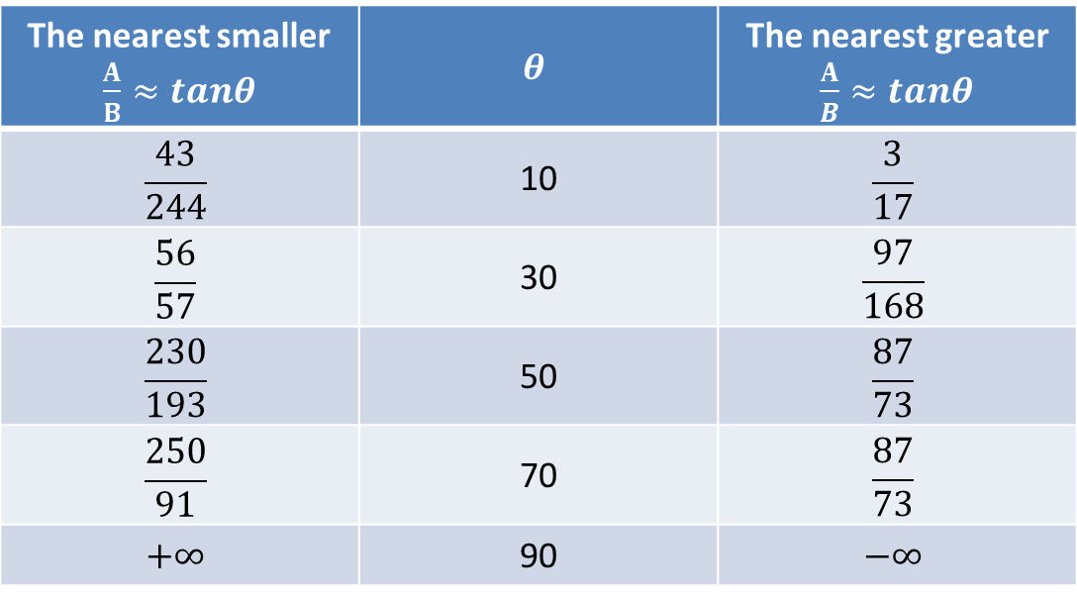
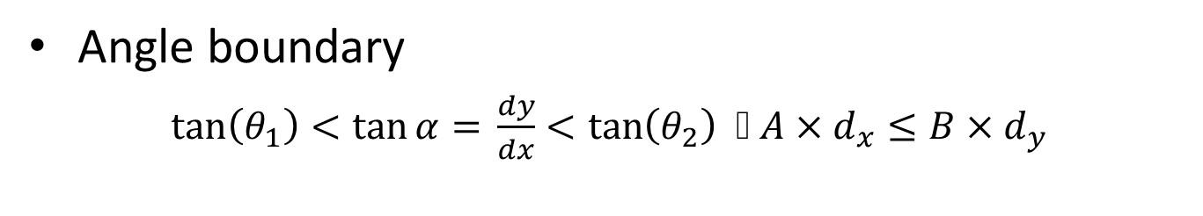
Detecting angle of two voted bins
Angle boundary
$\tan\left(θ_{1}\right)<\tan{α= }\frac{dy}{dx}<\tan\left(θ_{2}\right)$ ⬄ $A×d_{x}≤B×d_{y}$
The nearest smaller $\frac{A}{B}≈tanθ$ | $$θ$$ | The nearest greater $\frac{A}{B}≈tanθ$
$$\frac{43}{244}$$ | 10 | $$\frac{3}{17}$$
$$\frac{56}{57}$$ | 30 | $$\frac{97}{168}$$
$$\frac{230}{193}$$ | 50 | $$\frac{87}{73}$$
$$\frac{250}{91}$$ | 70 | $$\frac{87}{73}$$
$$+∞$$ | 90 | $$−∞$$

Slide 12
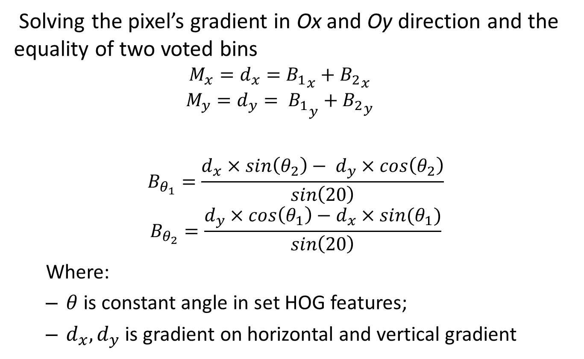
Calculating magnitude of two voted bin
Solving the pixel’s gradient in Ox and Oy direction and the equality of two voted bins
$$M_{x}=d_{x}={B_{1}}_{x}+{B_{2}}_{x}$$
$$M_{y}={d_{y}= B_{1}}_{y}+{B_{2}}_{y}$$
$$B_{θ_{1}}=\frac{d_{x}×\sin\left(θ_{2}\right)− d_{y}×\cos\left(θ_{2}\right)}{\sin\left(20\right)}$$
$$B_{θ_{2}}=\frac{d_{y}×\cos\left(θ_{1}\right)−d_{x}×sin{(θ}_{1})}{\sin\left(20\right)}$$
Where:
$θ$ is constant angle in set HOG features;
$d_{x},d_{y}$ is gradient on horizontal and vertical gradient

Slide 13
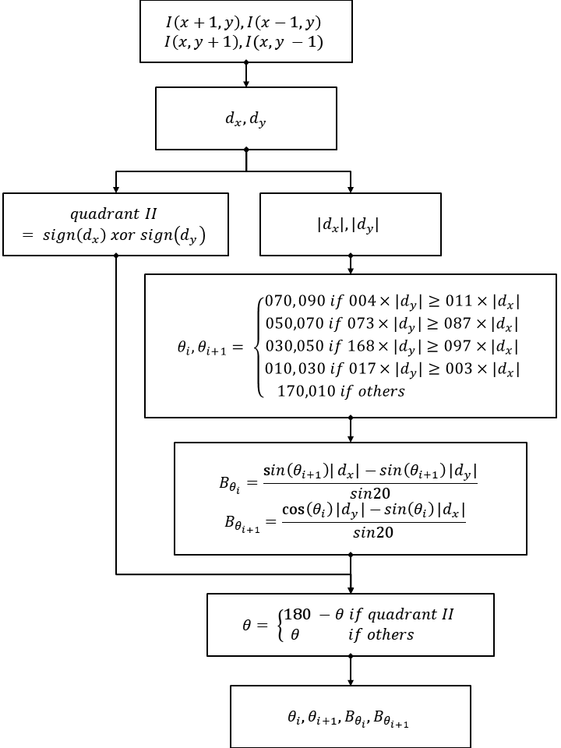
Dataflow of proposed method
Computing horizontal, vertical gradient
Detecting angle range or angles of two voted bins
Calculating magnitudes of two voted bins
Converting angle into left side of Oy

Slide 14
Outline
Context and motivation
Cell histogram generation
Proposed cell histogram generation
Hardware implementation & evaluation
Conclusion

Slide 15


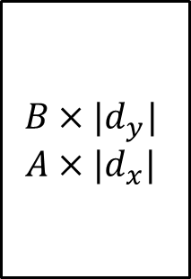







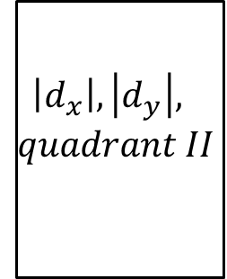

Hardware Implementation
clk
rst
4
/
$$θ_{1}$$
$d_{x}, d_{y}$
$$\left|d_{x}\right|, \left|d_{y}\right|,$$
$$quadrant II$$
$$B×{|d}_{y}|$$
$$A×{|d}_{x}|$$
Angle and Magnitude Calculation
$$4$$
/
$$θ_{2}$$
$$I(x+1,y)$$
8
/
$$I(x−1,y)$$
8
/
17
/
$$B_{1}$$
$$I(x,y+1)$$
8
/
17
/
$$B_{2}$$
$$I(x,y−1)$$
8
/
Step 1
Step 2
Step 3
Step 4
Inputs: 4 pixels with 8-bit length
Output: 2 bins with 8-bit fractional part

Slide 16
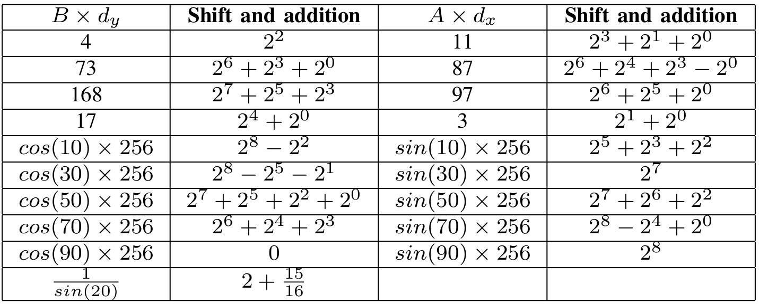










Hardware Implementation (cont)
clk
4
/
$$θ_{1}$$
rst
$d_{x}, d_{y}$
$$\left|d_{x}\right|, \left|d_{y}\right|,$$
$$quadrant II$$
$$B×{|d}_{y}|$$
$$A×{|d}_{x}|$$
Angle and Magnitude Calculation
$$4$$
/
$$θ_{2}$$
$$I(x+1,y)$$
8
/
$$I(x−1,y)$$
8
/
17
/
$$B_{1}$$
$$I(x,y+1)$$
8
/
17
/
$$B_{2}$$
$$I(x,y−1)$$
8
/
Step 1
Step 2
Step 3
Step 4

Slide 17
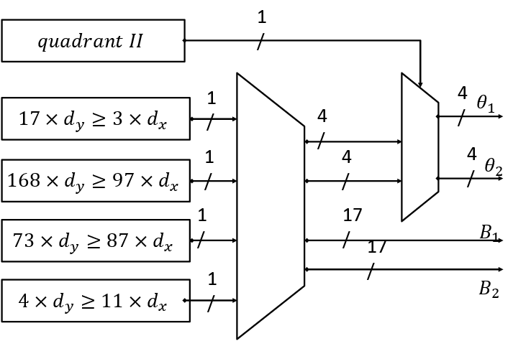








Angle and Magnitude Calculation
clk
4
/
$$θ_{1}$$
rst
$d_{x}, d_{y}$
$$\left|d_{x}\right|, \left|d_{y}\right|,$$
$$quadrant II$$
$$B×{|d}_{y}|$$
$$A×{|d}_{x}|$$
Angle and Magnitude Calculation
$$4$$
/
$$θ_{2}$$
$$I(x+1,y)$$
8
/
$$I(x−1,y)$$
8
/
17
/
$$B_{1}$$
$$I(x,y+1)$$
8
/
17
/
$$B_{2}$$
$$I(x,y−1)$$
8
/
Step 1
Step 2
Step 3
Step 4
4
/
$$θ_{1}$$
$$4$$
/
$$θ_{2}$$
$$\frac{d_{x}×\sin\left(θ_{2}\right)− d_{y}×\cos\left(θ_{2}\right)}{\sin\left(20\right)}$$
17
/
$$B_{1}$$
$$\frac{d_{y}×\cos\left(θ_{1}\right)−d_{x}×sin{(θ}_{1})}{\sin\left(20\right)}$$
17
/
$$B_{2}$$

Slide 18

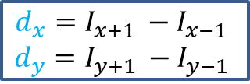






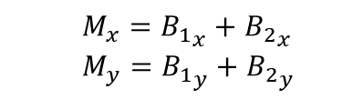




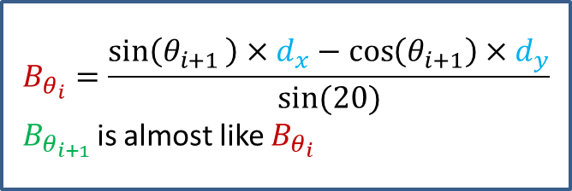

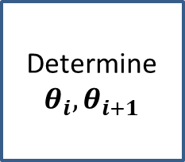





Our proposed method
$$y$$
$$y$$
$$\vec{M}$$
$$M_{x}={B_{1}}_{x}+{B_{2}}_{x}$$
$$M_{y}={B_{1}}_{y}+{B_{2}}_{y}$$
$$\vec{B_{2}}$$
$$\vec{d_{y}}$$
$$\vec{d_{y}}$$
$$θ_{i+1}$$
$$θ_{i+1}$$
$$\vec{B_{1}}$$
$$θ_{i}$$
$$θ_{i}$$
$$O$$
$$\vec{d_{x}}$$
$$x$$
$$O$$
$$\vec{d_{x}}$$
$$x$$
Constant
Determine $θ_{i}, θ_{i+1}$
$$B_{θ_{i}}=\frac{\sin\left(θ_{i+1 }\right)×d_{x}−\cos\left(θ_{i+1}\right)×d_{y}}{sin⁡(20)}$$
$B_{θ_{i+1 }}$is almost like $B_{θ_{i}}$
$$d_{x}=I_{x+1 }−I_{x−1}$$
$$d_{y}=I_{y+1 }−I_{y−1}$$
Solving the equality of two voted bins and the pixel’s gradient
in Ox and Oy direction.
Converting all of multications and division with constant
into form of shifts and additions.
Determined 2 quantized orientation like Chen2013.
But we determine quantized orientation exactly.

Slide 19
Evaluation Methodology
Software simulation
C++
Hardware simulation
VHDL
Hardware implementation
NanGate 45nm Synopsys tool

Slide 20
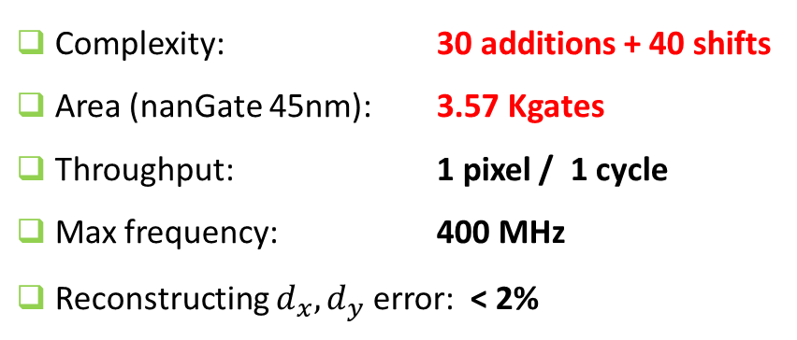
Evaluation
Complexity: 30 additions + 40 shifts
Area (nanGate 45nm): 3.57 Kgates
Throughput: 1 pixel / 1 cycle
Max frequency: 400 MHz
Reconstructing $d_{x},d_{y}$ error: < 2%
48 fps with 4K UHD resolution
References | Approach | Areas (Kgates) | Frequency
Chen2014 | Square root approx Boundary angles | 85.5 | 167 MHz (all HOG)
Hsiao2016 | Square root approx Boundary angles | 29.1 | N/A
Munteanu2016 | Square root approx Boundary angles | 20 | Max. 400 MHz
Our proposed | Boundary angles Bypass gradient magnitude | 3.57 | Max. 400 MHz

Slide 21
Conclusion
Contribution
Proposed a new methodology to calculate two bins of a pixel
No non-linear operation
High accuracy
Hardware implementation
Reduce the area by 81.2% compare to state-of-the-art
Future work
Applied full HOG for human detection devices

Slide 22
References
K. Takagi, K. Mizuno, S. Izumi, H. Kawaguchi, and M. Yoshimoto, “A sub-100-milliwatt dual-core HOG accelerator VLSI for real-time multiple object detection,” in 2013 IEEE International Conference on Acoustics, Speech and Signal Processing.
K. Mizuno, Y. Terachi, K. Takagi, S. Izumi, H. Kawaguchi, and. Yoshimoto, “Architectural Study of HOG Feature Extraction Processor for Real-Time Object Detection,” in 2012 IEEE Workshop on Signal Processing Systems.
R. Kadota, H. Sugano, M. Hiromoto, H. Ochi, R. Miyamoto, and Y. Nakamura, “Hardware Architecture for HOG Feature Extraction.”
F. N. Iandola, M. W. Moskewicz, and K. Keutzer, “libHOG: Energy- Efficient Histogram of Oriented Gradient Computation,” in IEEE 18th International Conference on Intelligent Transportation Systems
A. Suleiman and V. Sze, “An Energy-Efficient Hardware Implementation of HOG-Based Object Detection at 1080HD 60 fps with Multi-Scale Support,”
S.-F. Hsiao, J.-M. Chan, and C.-H. Wang, “Hardware design of histograms of oriented gradients based on local binary pattern and binarization,” in 2016 IEEE Asia Pacific Conference on Circuits and Systems (APCCAS)
P.-Y. Chen, Chien-Chuan Huang, Chih-Yuan Lien, and Yu-Hsien Tsai, “An Efficient Hardware Implementation of HOG Feature Extraction forHuman Detection,”
Munteanu, “A Method for producing a histogram of oriented gradients,” Patent Patent No. WO2 016 083 002.
M. Peker, H. Altun, and F. Karakaya, “Hardware emulation of HOG and AMDF based scale and rotation invariant robust shape detection,” in 2012 International Conference on Engineering and Technology (ICET)

Slide 23
Thank you for your attention

Slide 24
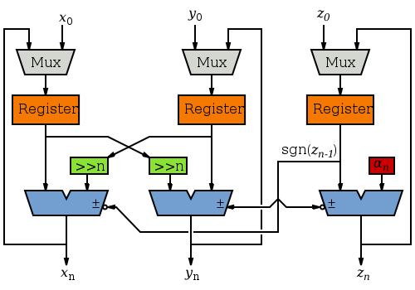


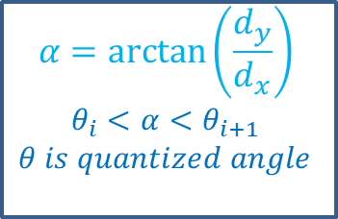

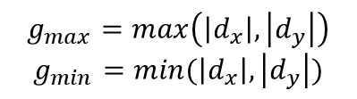
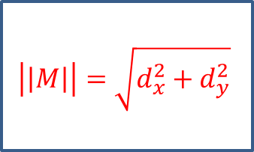


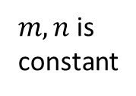
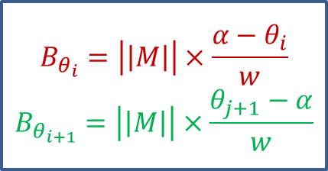


Approximate Computing
$$\left|\left|M\right|\right|=\sqrt{d_{x}^{2}+d_{y}^{2}}$$
Look-up table
$$\left|\left|M\right|\right|≈{|d}_{x}|+{|d}_{y}|$$
$$d_{x}$$
$$M_{xy}$$
L1-Norm
$$d_{y}$$
$$\left|\left|M\right|\right|≈max((0.875g_{max}+0.5g_{min}),g_{max})$$
$$α=\arctan\left(\frac{d_{y}}{d_{x}}\right)$$
$$θ_{i}<α<θ_{i+1}$$
$$θ is quantized angle$$
$$\left|\left|M\right|\right|≈\left|d_{x}\right|+\left|d_{y}\right| −\frac{g_{min}}{2}$$
$$g_{max}=\max\left(\left|d_{x}\right|, \left|d_{y}\right|\right)$$
$$g_{min}=min⁡(\left|d_{x}\right|, \left|d_{y}\right|)$$
Cordict
$$B_{θ_{i}}=\left|\left|M\right|\right|×\frac{α−θ_{i}}{w}$$
$$B_{θ_{i+1}}=\left|\left|M\right|\right|×\frac{θ_{j+1}−α}{w}$$
Bin’s boundary angles, determinate $θ_{i}, θ_{i+1}$
$$B_{θ_{i}}≈\left|\left|M\right|\right|×m$$
$B_{θ_{i+1}}≈\left|\left|M\right|\right|×n$
$m, n$is constant

