Slide 1
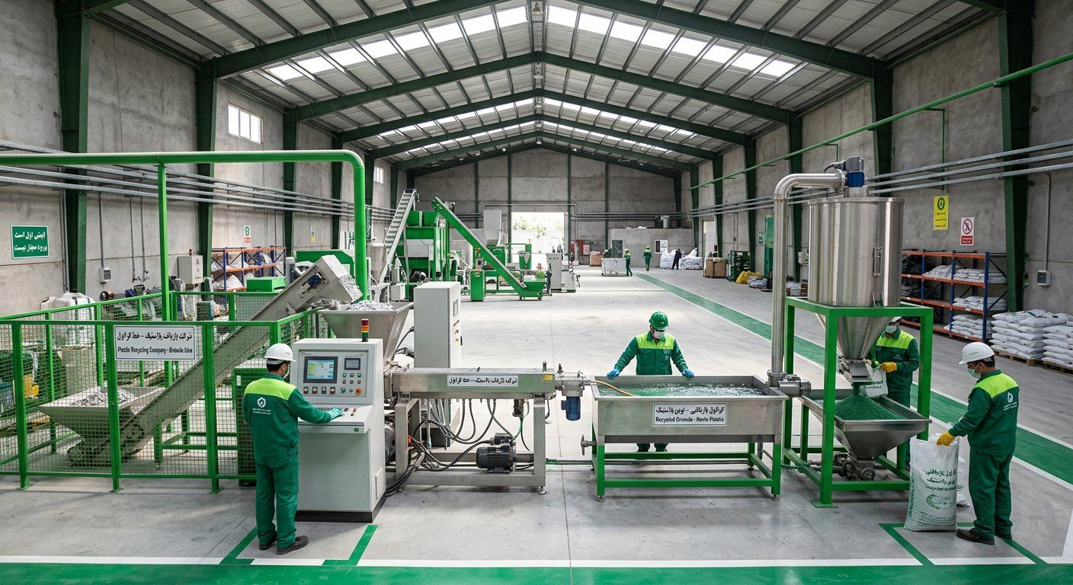
GreenPars Recycling
Granule that helps Iranian pipe and bag makers cut raw-material cost by 20% — made from city plastic waste with hot washing and melt filtration.
Ask: 31 bn Toman (≈ $132K) for the Mashhad pilot plant

Slide 2
A two-sided problem
A Mashhad waste picker sells plastic cheaply by the kilo; a pipe factory buys the same polymer as virgin material at several times the price.
 | Supply side: collectors and city | Demand side: factories
Pain | Unstable price, irregular buyers, costly landfill | Virgin polymer expensive and FX-linked
Today | ~20,000 t/day dumped | Recycled granule of variable quality
We give | Regular buying at a fixed price | Certified granule 20% cheaper
GreenPars Recycling • 2

Slide 3
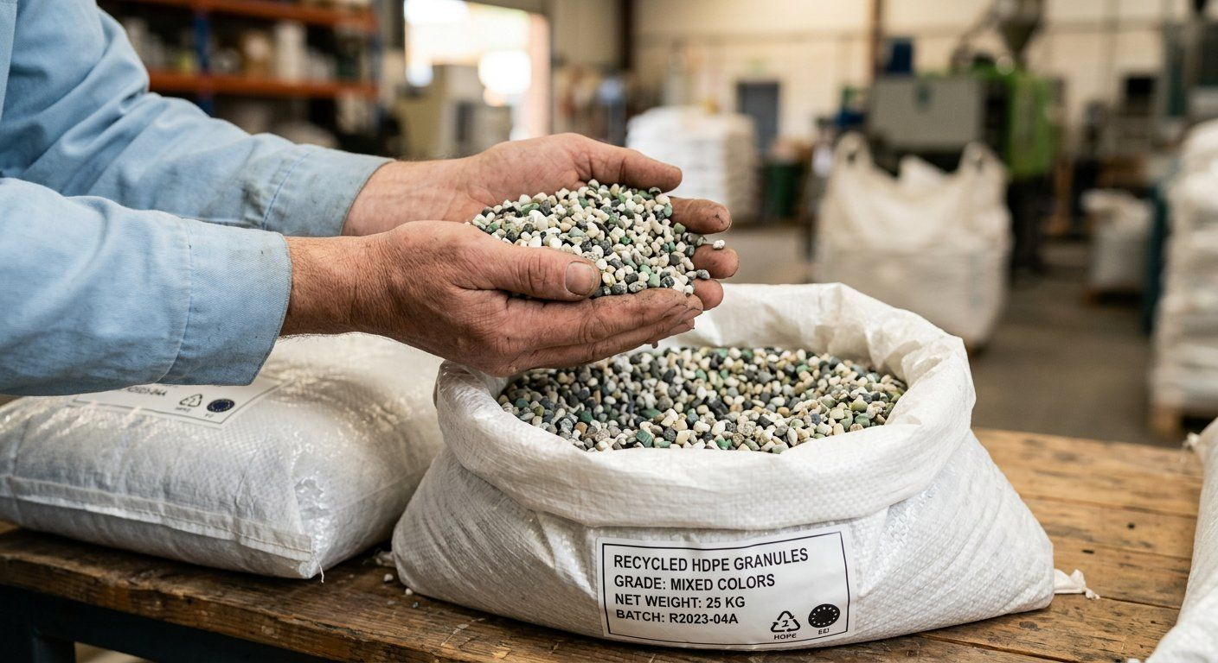
Solution
Washed, melt-filtered granule with consistent quality and a lab certificate per batch.
Sort → shred → hot wash → dry → extrude + melt filter → granule
20% cheaper than virgin
Reliable delivery on 6-month contracts
GreenPars Recycling • 3

Slide 4
Why now?
New law, an active fund and expensive virgin polymer — the window is open.
• Waste law bylaw: Art. 17 maximum facilities, Art. 12 recyclers' share of levies
• National Environment Fund has opened recycling loans (iranemp.ir)
• Sanctions make imports harder; local equipment and materials are now an advantage
GreenPars Recycling • 4

Slide 5
Market
Demand isn't the limit; clean waste supply is — we solve it with municipal contracts.
Layer | Volume | Meaning
National plastic waste | ~20,000 t/day | TAM
10 target cities | ~92 t/day | SAM
Mashhad pilot | ~4 t/day input | SOM
GreenPars Recycling • 5

Slide 6
Business model
Per kg: buy waste at 45k → sell granule at 100–135k Toman.
Scenario | Granule/waste (k Toman) | Payback
Pessimistic | 85 / 45 | Loss
Base | 100 / 45 | 5.3 yrs
Target | 110 / 35 | 2.1 yrs
Optimistic | 115 / 45 | 2.5 yrs
We don't hide the risk: a 15% granule price drop means a loss — so pre-sales and a waste contract are start conditions.
GreenPars Recycling • 6

Slide 7
Traction so far
Before the money, we have de-risked — and planned the next 90 days with measurable outputs.
Item | Status
Technical partner & realistic financial model | ✓ Done
7 formal letters (fund, bank, city, buyers) | ✓ Ready to send
Written Pendar quote | Month 1
3 purchase letters of intent | Month 2
Mashhad waste agency MoU | Month 3
GreenPars Recycling • 7

Slide 8
Go-to-market
30 target buyers → 15 samples → 6 production trials → 3 contracts = 80% of year-1 sales.
Channel | Supply (waste) | Demand (granule)
Primary | Mashhad waste agency MoU | Direct sales to factories within 500 km
Secondary | 10 scrap dealers + 5 factories with scrap | Pendar Polymer network (buy-back)
Cost | Buying stations: low | ~2% of sales: samples, fairs
GreenPars Recycling • 8

Slide 9
Peter Thiel's 7 questions — self-check
Big share of a small market first: Mashhad; then expand.
Question | Our answer | Strength
Engineering | Incremental, not breakthrough (melt filter + lab) | ●○○
Timing | Law, fund, costly virgin polymer | ●●●
Monopoly | Big share of Mashhad clean waste via city contract | ●●○
People | Strong tech partner; production & sales hires pending | ●○○
Distribution | Direct B2B + Pendar buy-back | ●●○
Durability | Station network and long-term contracts | ●●○
Secret | Profit is in waste sourcing, not machinery | ●●○
GreenPars Recycling • 9

Slide 10
Competition
Unlike informal workshops, we give certified quality; unlike virgin polymer, we are 20% cheaper with no FX exposure.
 | Quality | Price | Supply reliability
Informal workshop | Low | Cheap | Low
Virgin polymer | High | Expensive | Medium (FX)
GreenPars | High ✓ | 20% cheaper ✓ | Municipal contract ✓
GreenPars Recycling • 10

Slide 11
Financial projection
Break-even in year 2; payback 5.3 yrs base, 2.1 yrs target.
GreenPars Recycling • 11

Slide 12
Staged growth path
Each phase starts only after passing a decision gate.
Phase | Capex | Payback | Jobs
Mashhad pilot | $132K | 2.1–5.3 yrs | ~20
10 cities | $3.0M | 2.3–4.7 | 211
Half of cities | $24.9M | 3.2–7.5 | 2,890
Gate: waste ≤40k, granule ≥105k Toman, 6 consecutive profitable months.
GreenPars Recycling • 12

Slide 13
Team
Founding team + a technical partner with 20 years' experience; two key hires with this round.
Role | Name | Background
CEO / founder | [ ] | [ ]
Technical partner | Hamidreza Panahandeh — Pendar Polymer | ~25 workshops built
Production manager (hire) | — | Month 2
Sales manager (hire) | — | Month 3
GreenPars Recycling • 13

Slide 14
The ask and use of funds
31 bn Toman → one running plant, ~1,100 t granule/yr, ~20 jobs.
Sources:
• Founders 31%
• Pendar instalments 21%
• Environment Fund 32%
• Crowdfunding 16%
For an investor: 5 bn Toman = 15–20% equity
GreenPars Recycling • 14

Slide 15
Risks — stated openly
Three big risks and our answer to each.
Risk | Response
Granule price | 6-month pre-sales with 3 buyers
Waste supply | Municipal MoU + buying stations
Sanctions and banking | 100% domestic model; foreign partner only as buyer/barter
GreenPars Recycling • 15

Slide 16
Next step
A 30-minute meeting + a visit to Pendar Polymer's workshop.
[Name] • [Phone / WhatsApp] • [Email]
Appendix: business plan, feasibility, financial model, game-theory analysis and 12 more reports (FA / EN / TR)
Rate: 1 USD = 235,000 Toman (28 Sep 2026) — figures are estimates.
GreenPars Recycling • 16

