Slide 1
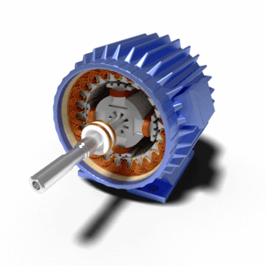



p_{mechanical}
+
$$\frac{k_{inertia}}{s}$$
f_{rotor}
_
Electrical model
_
p_{electrical}
$$HPF$$
$$k_{damp}$$
i_{ref}[a]
r_{d}
~
i_{ref}
C_{x}
Mechanical model
C_{d}
~
~
i_{ref}[b]
Circuit controls
i_{ref}[c]

Slide 2


Mechanical model
Electrical model
p_{mechanical}
+
$$\frac{k_{inertia}}{s}$$
f_{rotor}
_
i_{ref}[a]
_
p_{electrical}
~
$$k_{damp}$$
~
~
i_{ref}[b]
i_{ref}[c]
i_{machine}
i_{ref}
~
i_{excess}
r_{d}
Current-limiting
i_{ref}
C_{x}
C_{d}
Circuit controls

Slide 3
L_{s}
r_{s}
~
r_{N}
N
i_{machine}
i_{ref}
~
~
~
L_{s}
r_{s}
i_{excess}
L_{s}
r_{s}
r_{d}
i_{ref}
C_{x}
C_{d}

Slide 4
i_{limited}
hard limit
soft limit
i_{pre-limit}
-soft limit
-hard limit

Slide 5
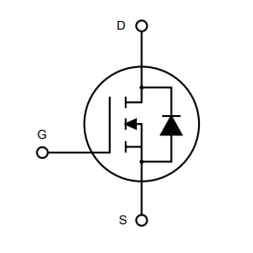
inverter
r_{d}
i_{ref}
C_{x}
C_{x}
C_{d}
PI
+
i_{ref}
+
r-c damper

Slide 6
L_{equ}
r_{d}
~
i_{ref}
C_{x}
C_{d}

Slide 7
Traditional generation
Inverter-connected renewables
Transmission system
=
G
~
Distribution feeder
Distribution feeder

Slide 8
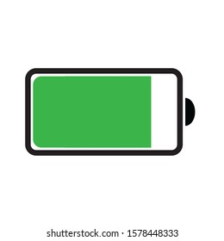
=
~
=
~
=
~
=
X: 0.04-0.07
~
X: 0.10-0.25
=
GSU
~
POI

Slide 9
=
X: 0.04-0.07
~
=
X: 0.04-0.07
~
GSU
=
X: 0.04-0.07
X: 0.10-0.25
~
Xeq: (0.10-0.25) * (1-1/n)
X: 0.04-0.07
During partial outage, equivalent GSU impedance drops relative to inverter capacity remaining on-line
=
~
Faulted or down for service

Slide 10
L_{s}
r_{s}
v_{inverter}
L_{equ}
0.15 pu - ∞
~
r_{d}
V_{grid}
V_{emf}
C_{x}
C_{d}

Slide 11
Clipping during sub-transient
Impedance controls initial ac amplitude
RMS limiting during extended transient

Slide 12
X_{s}
X_{line}
Amplified X_{s}
X_{line}
~
V_{s}
~
r_{fault}
V_{s}
r_{fault}
X_{line}
θ_{V}
PLL & phase detection
+
θ_{desired}
I_{limit}
r_{fault}
+
θ_{I}
+
+
θ_{Z}
Phase ‘tailspin’ due to mismatch

Slide 13
g_{droop}= k_{droop}
L_{equ} = (X_{s}+X_{g})/(2πV_{nom}²)
f_{rotor}
+
_
g = k_{damp}
+
_
F_{ref}
C_{rotor}
=1/k_{inertia}
F_{grid}
Circuit equivalent with voltage representing frequency, current representing power flow

Slide 14





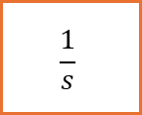




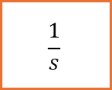


$$k_{damp}$$
$${df}_{HPF}$$
$$F_{ref}$$
+
_
+
_
+
+
$${df}_{LPF}$$
LPF
$$p_{mech}$$
Slow droop path is time-scale separated from resonance/damping dynamics
$$k_{droop}$$
+
$k_{inertia}$ $=\frac{F_{nom}}{2∙H}$
$$\frac{1}{s}$$
_
$$f_{rotor}$$
$$p_{elec}$$
Natural resonance mode
+
$$\frac{1}{s}$$
_
$$F_{grid}$$
$k_{transfer}$ $=\frac{2∙π}{X_{plant}+X_{grid}}$

Slide 15
i_{machine}
i_{ref}
~
Power limiting “virtual load”
i_{excess}
i_{machine}
i_{GFL}
i_{ref}
~
Machine model
Current source
i_{excess}

Slide 16
X_{s}
r_{s}
Grid transient
~
Large point-on-wave reaction
~
V_{emf}

Slide 17
=
X = 0.33 pu
~
~
GSU
SCR of 3.0
POI

Slide 18
G
G
Frequency
Net load
Grid power
BESS power
Load
Fault (sub-cycle) | Voltage recovery (1-2 cycles) | Inertial dynamic (< 0.5 seconds) | Droop & load shed | Redispatch
Provide coherent signature
Absorb disturbance and prevent cascading
Requires overload capability
Maintain stable response
Load
PV
Battery

Slide 19
Legend
Plant Controller
Grid-forming essentials
(must harmonize)
Inverter controller
Companion algorithm
(valuable to harmonize)
Controls Interface
Design-specific
(highly custom)
Dc Voltage Control
Ac Checks
Diagnostics Interface
Machine Model
Current Source
Power Limiter
Grid-interactive controls layer
Current Limiting
Ac Monitor
Modes and protection
Circuit Controls
Hardware Protection
Circuit controls layer

Slide 20
i_{machine}
i_{GFL}
i_{ref}
Grid-interactive controls layer
~
Open-source
Machine model
Current source
i_{excess}
Circuit controls and virtual damping
i_{ref}
r_{d}
C_{x}
C_{d}
Proprietary & vendor-specific
Converter hardware

Slide 21
=
C_{in}
~
i_{in}
v_{in}
+
_
Low-pass filter
MPPT
P_{request}
Dc Voltage Controller

Slide 22
=
=
C_{bus}
=
~
i_{in}
v_{pv}
v_{dc}
+
_
+
_
Low-pass filter
MPPT
V_{dc_ref}
P_{request}
Input Voltage Controller
Dc Voltage Controller

Slide 23
=
~
Supercap

Slide 24
i_{machine}
i_{ref}
i_{machine}
i_{ref}
Machine-model with reduced rating
~
i_{GFL}
i_{GFL}
Current Source Controls
~
Machine-model
(Virtual Synchronous Condensor)
Current Source Controls

Slide 25
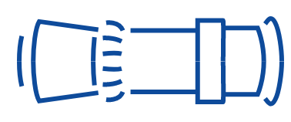



Traditional architecture
800Vdc architecture with SST-based rectifiers
GSU
Transfer switch
GSU
Gas turbine
13-35kV
35kV
5-30 minute
UPS
MVTs
~
=
~
=
~
=
SST rectifiers
~
~
~
~
~
=
=
=
=
=
~
~
~
800Vdc
800Vdc
=
=
Battery-backup units
On-site generation
=
=
=
~
~
~
=
=
=
=
=
=
=
=
=
=
=

Slide 26

Conventional architecture with ac-distribution
800Vdc architecture with SST-based converters
GSU
13.8-34.5kV
GSU
MVTs
34.5kV
Transfer switch
Transfer switch
Diesel backup
480Vac
~
~
~
~
~
=
=
=
=
=
SST converters
~
~
=
=
On-site renewable generation & backup
(conventional and/or SST inverter)
5-30
minute UPS
Battery-backup units
415Vac
~
~
=
=
=
=
=
=
=
=
=
=
800Vdc compute rack
48Vdc compute racks

Slide 27
Phase A
Phase B
Phase C
=
=
=
=
=
=
=
~
=
~
=
~
=
=
=
=
=
=
=
~
=
~
=
~
.. .
.. .
.. .
Series-connected ac-ports
Parallel-connected dc-ports
=
=
=
=
=
=
=
~
=
~
=
~
800Vdc
To GPU racks

Slide 28
I
I
=
G
~
V
V
Battery
Relay 1
Relay 2

Slide 29
I_{L}
I_{R}
=
G
~
Battery
Relay 1
Relay 2
Communication scheme
Zone 1: underreaching
Zone 2: overreaching
Zone 3: backup
=
G
~
Battery
Relay 1

Slide 30
I_{L}
=
G
~
Battery
Forward fault
Relay 1
I_{L}
=
G
~
Battery
Reverse fault
Relay 1

Slide 31
Z_{stator}
Z_{gsu}
Z_{grid}
Z_{stator}
Z_{gsu}
Z_{grid}
~
Z_{fault}
~
~
High power
~
Spinout occurs during fault because of the drop of electrical power while ‘mechanical’ power still fed in
Spinout occurs when power angle approaches 90 degrees

Slide 32
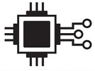

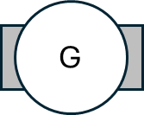
N
S
S
N
G

