Slide 1
6. Development of a secure Web Application
Barnabas Steiner

Slide 2
Agenda
🔑 Keycloak
🗄️ MariaDB Least Privilege DB-User
🛡️ server.js AuthN/AuthZ für Dashboard & Controller
⚙️ controller.py AuthN/AuthZ mit Keycloak
🖥️ Web-Dashboard
🏁 Fazit

Slide 3
🔑 Keycloak
Container Externals
Client
(Produktion Netz)
Docker-Bridge
'sensor-net'
HTTPS:443
(AuthN, AuthZ, RESTful API)
Backend Server
HTTPS:8443
AuthZ
HTTPS:8443
AuthN
keyCloak
(AuthN/AuthZ))
MariaDB
(Database)
server.js
(node.js)
nginx
(Reverse Proxy)
SQL & TLS :3306
HTTPS:3443

Slide 4
docker-compose.yml > keycloak_web Service + keycloak_data Volume
docker-compose.yml (before — nicht vorhanden)
docker-compose.yml (after)
① Neuer Service: keycloak_web (Keycloak IAM — OIDC Provider)
② Neues Named Volume: keycloak_data (persistente Keycloak-Daten)
106 volumes:
107 mariadb-data:
① Neuer Service: keycloak_web (Keycloak IAM — OIDC Provider)
88+ keycloak_web:
89+ image: quay.io/keycloak/keycloak:23.0.7
90+ container_name: keycloak_web
91+ environment:
93+ KC_HOSTNAME_PORT: 8443
94+ KC_HOSTNAME_STRICT: "false"
95+ KC_HOSTNAME_STRICT_HTTPS: "false"
96+ KC_PROXY: edge
97+ KC_LOG_LEVEL: info
98+ KC_METRICS_ENABLED: "true"
99+ KC_HEALTH_ENABLED: "true"
100+ KEYCLOAK_ADMIN: admin
101+ KEYCLOAK_ADMIN_PASSWORD: admin
102+ KC_HTTP_RELATIVE_PATH: /auth
103+ volumes:
104+ - keycloak_data:/opt/keycloak/data
105+ - ./keycloak/iot-realm.json:/opt/keycloak/data/import/iot-realm.json:ro
106+ command: start-dev --http-port 8080 --import-realm
107+ healthcheck:
109+ test: ["CMD-SHELL", "exec 3<>/dev/tcp/127.0.0.1/8080 && echo …"]
110+ timeout: 10s retries: 5 start_period: 40s
113+ ports:
114+ - "8443:8080"
115+ networks:
116+ - app-network
② Neues Named Volume: keycloak_data (persistente Keycloak-Daten)
137 volumes:
138 mariadb-data:
139+ keycloak_data: # Keycloak persistente Daten
Keycloak IAM · OIDC Authorization Code Flow · Port 8443:8080 · Realm-Import: iot-realm.json

Slide 5
Keycloak > iot-realm.json > Realm-Konfiguration
// Realm Grundeinstellungen
1 {
2 "realm": "iot",
3 "enabled": true,
4 "sslRequired": "all",
5 "registrationAllowed": false,
// Rollen-Definition
6 "roles": {
7 "realm": [
8 { "name": "dashboard-user" },
9 { "name": "admin-user" },
10 { "name": "controller-ingest" }
11 ]
12 },
// Rolle → Berechtigung (Zuordnung)
dashboard-user → Dashboard lesen (GET /api/sensordata)
admin-user → Admin-Funktionen (Verwaltung)
controller-ingest → Sensordaten schreiben (POST /api/internal/sensordata)
Realm-Name
Realm aktiv
SSL für alle Verbindungen
Selbstregistrierung deaktiviert
Lese-Zugriff Dashboard
Admin-Zugriff
Sensor-Daten schreiben
dashboard-user → lesen · admin-user → Admin · controller-ingest → schreiben

Slide 6
Keycloak > iot-realm.json > Benutzer-Konfiguration
// Benutzer 1: iotuser01 (Mensch — Dashboard-Zugriff)
13 "users": [ {
15 "username": "iotuser01",
16 "enabled": true,
17 "emailVerified": true,
18 "firstName": "James",
19 "lastName": "Cookie",
20 "credentials": [{
22 "type": "password",
23 "value": "password",
24 "temporary": false
26 }],
27 "realmRoles": ["dashboard-user", "admin-user"]
28 },
// Benutzer 2: service-account-controller-client (Maschine — Controller)
29 {
30 "username": "service-account-controller-client",
31 "enabled": true,
32 "serviceAccountClientId": "controller-client",
33 "realmRoles": ["controller-ingest"]
34 }
35 ],
Login-Name
⚠ Nur für Entwicklung!
Benutzerrollen
Service-Account (kein Mensch)
Verknüpft mit Client
Nur Schreib-Rolle
iotuser01: dashboard-user + admin-user · service-account: controller-ingest

Slide 7
Keycloak > iot-realm.json > Client-Konfiguration
// Client 1: dashboard-client (Browser → OIDC Authorization Code Flow)
36 "clients": [ {
38 "clientId": "dashboard-client",
39 "enabled": true,
40 "protocol": "openid-connect",
41 "publicClient": true,
42 "standardFlowEnabled": true,
43 "directAccessGrantsEnabled": false,
44 "serviceAccountsEnabled": false,
45 "redirectUris": [
46 "https://www.lab.local/*"
47 ]
48 },
// Client 2: controller-client (Maschine → Client Credentials Flow)
49 {
50 "clientId": "controller-client",
51 "enabled": true,
52 "protocol": "openid-connect",
53 "publicClient": false,
54 "standardFlowEnabled": false,
55 "directAccessGrantsEnabled": false,
56 "serviceAccountsEnabled": true,
57 "secret": "change-me-please"
58 }
59 ]
Frontend-Client
Kein Secret (Browser-App)
Auth-Code Flow (PKCE)
Erlaubte Redirect-URL
IoT Controller (Backend)
Confidential Client (hat Secret)
Kein Auth-Code Flow
Client-Credentials Flow aktiv
⚠ In Produktion ersetzen!
dashboard-client: Auth-Code Flow (PKCE) · controller-client: Client-Credentials Flow

Slide 8
🗄️ MariaDB Least Privilege DB-User
server.js
Write API
Controller.py
Read API
DB-Login db_write_user [INSERT, UPDATE]
DB-Login db_read_user [SELECT]
MariaDB

Slide 9
docker-compose.yml > Separate DB-Credentials + Keycloak Dependency
docker-compose.yml (before)
docker-compose.yml (after)
① webapp: environment — Split single credential → separate read/write credentials
6 environment:
7 - DB_HOST=mariadb
8- - DB_USER=websrv_write
9- - DB_PASSWORD=pass-0123-iot
10 - DB_NAME=myapp
11 - PORT=3000
12 - API_KEY=api_key
② webapp: depends_on — Add keycloak_web health check dependency
13 depends_on:
14 db:
15 condition: service_healthy
③ db: volumes — Named volume + consolidated init scripts mount
29 volumes:
31 - /mariadb/db:/var/lib/mysql
32- - /mariadb/01_config.sql:/docker-entrypoint-initdb.d/1.sql:ro
33- - /mariadb/02_archive_job.sql:/docker-entrypoint-initdb.d/2.sql:ro
34- - /mariadb/03_user.sql:/docker-entrypoint-initdb.d/3.sql:ro
35- - /mariadb/04_training_data.sql:/docker-entrypoint-initdb.d/4.sql:ro
36- - /mariadb/05_training_data_privileges.sql:/docker-entrypoint-initdb.d/…
Removed Added Split DB credentials · Add Keycloak dependency · Named volume + consolidated init mount
① webapp: environment — Split single credential → separate read/write credentials
6 environment:
7 - DB_HOST=mariadb
8+ - DB_WRITE_USER=websrv_write
9+ - DB_WRITE_PASSWORD=pass-0123-iot
11+ - DB_READ_PASSWORD=pass-0123-client
12 - DB_NAME=myapp
13 - PORT=3000
14 - API_KEY=api_key
15+ - PUBLIC_DIR=app_net/public
② webapp: depends_on — Add keycloak_web health check dependency
16 depends_on:
17 db:
18 condition: service_healthy
19+ keycloak_web:
20+ condition: service_healthy
③ db: volumes — Named volume + consolidated init scripts mount
34 volumes:
36 - mariadb-data:/var/lib/mysql
37+ - ./mariadb:/docker-entrypoint-initdb.d
Split DB credentials · Add Keycloak dependency · Named volume + consolidated init mount

Slide 10
mariadb > 06_db_read_user > ...
06_db_read_user (neu)
1 CREATE OR REPLACE USER 'websrv_read'@'%'
2 IDENTIFIED BY 'pass-0123-client';
3 GRANT SELECT ON myapp.sensor_data
4 TO 'websrv_read'@'%';
5 FLUSH PRIVILEGES;
Write ops use getWritePool() · Read ops use getReadPool() · Principle of least privilege

Slide 11
app-net > config > js database.js > ...
database.js (before)
database.js (after)
1 require('dotenv').config(); // use .env file
2- const HOST = process.env.PORT || 3000;
3 const DB_HOST = process.env.DB_HOST
4- const DB_USER = process.env.DB_USER
5- const DB_PASSWORD = process.env.DB_PASSWORD
6 const DB_NAME = process.env.DB_NAME
7- let pool;
9- async function getPool() {
10- if (!pool) {
11 const mariadb = await import('mariadb');
12- pool = mariadb.createPool({
13 host: DB_HOST,
14- user: DB_USER,
15- password: DB_PASSWORD,
16 database: DB_NAME,
17 connectionLimit: 5
18 });
19 }
20- return pool;
21 }
1 require('dotenv').config(); // use .env file
2 const DB_HOST = process.env.DB_HOST
3+ const DB_WRITE_USER = process.env.DB_WRITE_USER
4+ const DB_WRITE_PASSWORD = process.env.DB_WRITE_PASSWORD
5+ const DB_READ_USER = process.env.DB_READ_USER
6+ const DB_READ_PASSWORD = process.env.DB_READ_PASSWORD
7 const DB_NAME = process.env.DB_NAME
8+ let readPool;
9+ let writePool;
11+ async function getWritePool() {
12+ if (!writePool) {
13+ const mariadb = await import('mariadb');
14+ writePool = mariadb.createPool({
15+ host: DB_HOST,
16+ user: DB_WRITE_USER,
17+ password: DB_WRITE_PASSWORD,
18+ database: DB_NAME,
19+ connectionLimit: 5
20+ });
21+ }
22+ return writePool;
23+ }
Refactor: single pool → separate read/write pools (principle of least privilege)

Slide 12
app-net > config > js database.js > ...
database.js (before)
database.js (after)
23- module.exports = { getPool };
25+ async function getReadPool() {
26+ if (!readPool) {
27 const mariadb = await import('mariadb');
28+ readPool = mariadb.createPool({
29 host: DB_HOST,
30+ user: DB_READ_USER,
31+ password: DB_READ_PASSWORD,
32 database: DB_NAME,
33 connectionLimit: 5
34 });
35 }
36+ return readPool;
37 }
39+ module.exports = { getWritePool, getReadPool };
Refactor: single pool → separate read/write pools (principle of least privilege)

Slide 13
app-net > server.js > ...
server.js (before)
server.js (after)
① Import: destructured pool functions
1 require('dotenv').config(); // use .env file
2 const express = require('express');
4- const {getPool} = require('./config/database');
5 const PORT = process.env.PORT || 3000;
② POST /api/internal/sensordata — write operation → getWritePool()
44 if (!temperature) throw Error("Denied: ")
46- const pool = await getPool();
47 conn = await pool.getConnection();
③ POST /api/internal/trainingdata — write operation → getWritePool()
72 if (!temperature) throw Error("Denied: ")
73- const pool = await getPool();
74 conn = await pool.getConnection();
④ GET /api/internal/sensordata/latest — read operation → getReadPool()
95 try {
96- const pool = await getPool();
99 conn = await pool.getConnection();
100 const sql = "SELECT * FROM sensor_data ORDER BY timestamp…"
① Import: destructured pool functions
1 require('dotenv').config(); // use .env file
2 const express = require('express');
4+ const {getReadPool, getWritePool} = require('./config/database');
5 const PORT = process.env.PORT || 3000;
② POST /api/internal/sensordata — write operation → getWritePool()
44 if (!temperature) throw Error("Denied: ")
45+ const pool = await getWritePool();
46 conn = await pool.getConnection();
③ POST /api/internal/trainingdata — write operation → getWritePool()
71 if (!temperature) throw Error("Denied: ")
72+ const pool = await getWritePool();
73 conn = await pool.getConnection();
④ GET /api/internal/sensordata/latest — read operation → getReadPool()
94 try {
95+ const pool = await getReadPool();
98 conn = await pool.getConnection();
99 const sql = "SELECT * FROM sensor_data ORDER BY timestamp DESC LIMIT 1"
Write ops use getWritePool() · Read ops use getReadPool() · Principle of least privilege

Slide 14
🛡️ server.js AuthN/AuthZ
Container Externals
Client
(Produktion Netz)
Docker-Bridge
'sensor-net'
HTTPS:443
(AuthN, AuthZ, RESTful API)
Backend Server
HTTPS:8443
AuthZ
HTTPS:8443
AuthN
keyCloak
(AuthN/AuthZ))
MariaDB
(Database)
server.js
(node.js)
nginx
(Reverse Proxy)
SQL & TLS :3306
HTTPS:3443

Slide 15
app-net > server.js > JWKS-Client [Teil 1/2]
server.js (before)
after
① Imports — https + jwks-rsa + jsonwebtoken + KC_JWKS_URI / KC_BASE_URL
4 const {getReadPool, getWritePool} = require('./config/database');
5 const PORT = process.env.PORT || 3000;
② JWKS-Client — Signing-Key von Keycloak via jwks-rsa abrufen
① Imports — https + jwks-rsa + jsonwebtoken + KC_JWKS_URI / KC_BASE_URL
4 const {getReadPool, getWritePool} = require('./config/database');
5 const PORT = process.env.PORT || 3000;
6+ const https = require('https');
11+ const jwksClient = require('jwks-rsa');
12+ const jwt = require('jsonwebtoken');
14+ const KC_JWKS_URI = process.env.KC_JWKS_URI;
② JWKS-Client — Signing-Key von Keycloak via jwks-rsa abrufen
17+ const client = jwksClient({
18+ jwksUri: KC_JWKS_URI,
19+ requestAgent: new https.Agent({ ca: undefined, rejectUnauthorized: true }),
23+ });
25+ const getKey = (header, callback) => {
26+ client.getSigningKey(header.kid, (err, key) => {
30+ const signingKey = key.getPublicKey(); callback(null, signingKey);
33+ }); // end getKey
JWKS-Client · authenticateToken Middleware · JWT-Verify · Audience + Rollen-Check

Slide 16
app-net > server.js > authenticateToken-Middleware (JWT AuthZ) [Teil 2/2]
server.js (before)
③ Neue Middleware authenticateToken — Bearer-Check → JWT-Verify → Audience → Rolle
after
③ Neue Middleware authenticateToken — Bearer-Check → JWT-Verify → Audience → Rolle
36+ const authenticateToken = (req, res, next) => {
37+ const authHeader = req.headers.authorization || "";
39+ if (!authHeader.startsWith("Bearer ")) return res.sendStatus(401);
51+ const token = authHeader.split(" ")[1];
56+ jwt.verify(token, getKey, validationOptions, (err, decodedPayload) => {
58+ if (err) return res.status(403).json({ error: "Forbidden",
62+ message: "Token verification failed (signature, expiration or issuer invalid)." });
67+ const expectedAudience = 'dashboard-client';
73+ const audienceOk = (azp === expectedAudience) || (aud === expectedAudience) || Array.isArray(aud)…;
79+ if (!audienceOk) return res.status(403).json({ error: `Audience '${expectedAudience}' missing` });
85+ const requiredRole = 'dashboard-user';
87+ const roles = decodedPayload.realm_access?.roles || [];
89+ if (requiredRole && !roles.includes(requiredRole)) return res.status(403).json({…});
96+ req.user = decodedPayload; next();
99+ }); // end jwt.verify
100+ }; // end authenticateToken
JWKS-Client · authenticateToken Middleware · JWT-Verify · Audience + Rollen-Check

Slide 17
app-net > server.js > GET /api/sensordata mit authenticateToken für Dashboard-Chart
server.js (before)
after
① Neuer Endpoint GET /api/sensordata — authenticateToken (JWT) statt authenticateApiKey
② Vergleich: welcher Endpoint nutzt welche Auth-Middleware
POST /api/internal/sensordata authenticateApiKey // API-Key (x-api-key) — Controller schreibt
POST /api/internal/trainingdata authenticateApiKey // API-Key (x-api-key) — Controller schreibt
GET /api/internal/sensordata/latest authenticateApiKey // API-Key (x-api-key) — Controller liest
① Neuer Endpoint GET /api/sensordata — authenticateToken (JWT) statt authenticateApiKey
206+ // For Dashboard chart
207+ app.get('/api/sensordata', authenticateToken, async (req, res) => {
209+ try {
210+ const pool = await getReadPool();
211+ conn = await pool.getConnection();
214+ const sql = "SELECT * FROM sensor_data ORDER BY timestamp DESC";
215+ const rows = await conn.query(sql);
217+ if (rows.length === 0) return res.status(200).json({message: "No data available."});
220+ res.status(200).json(rows[0]);
221+ } catch (err) { res.status(500).json({error: err.message});
223+ } finally { if (conn) conn.release(); }
226+ });
② Vergleich: welcher Endpoint nutzt welche Auth-Middleware
POST /api/internal/sensordata
POST /api/internal/trainingdata
GET /api/internal/sensordata/latest
GET /api/sensordata
GET /api/sensordata · authenticateToken (JWT) statt authenticateApiKey

Slide 18
⚙️ controller.py AuthN/AuthZ mit Keycloak
Docker-Bridge 'sensor-net'
Controller.py
HTTPS:443
(AuthN, AuthZ, RESTful API)
Backend Server
keyCloak
(AuthN/AuthZ))
MariaDB
(Database)
HTTPS:8443
AuthN
HTTPS:8443
AuthZ
nginx
(Reverse Proxy)
server.js
(node.js)
SQL & TLS :3306
HTTPS:3443

Slide 19
sensor-net > http_client.py > Inline-Header → _build_headers() · verify=False → CA_CERT_PATH
http_client.py (before)
after
① Imports: tensorflow entfernt, keycloak_auth + CA_CERT_PATH neu
3 import requests
4- from tensorflow…tag_constants import TRAINING
6- from config import BACKEND_URL, API_KEY, HTTP_TIMEOUT, log, TRAININGURL
② Neue Funktion _build_headers() — zentraler Header mit API-Key + Bearer-Token
③ forward_to_backend() inline headers → _build_headers() · verify=False → CA_CERT_PATH
18- headers = {"Content-Type": "application/json", "x-api-key": API_KEY}
26- headers=headers,
28- verify=False, # Until nginx Certificate can be verified
58- headers = {"Content-Type": "application/json", "x-api-key": API_KEY }
66- headers=headers,
68- verify=False,
① Imports: tensorflow entfernt, keycloak_auth + CA_CERT_PATH neu
3 import requests
5+ from config import BACKEND_URL, API_KEY, HTTP_TIMEOUT, CA_CERT_PATH, log
6+ from keycloak_auth import auth_header
9+ def _build_headers() -> dict:
10+ """Erstellt die HTTP-Header mit API-Key und Bearer-Token."""
② Neue Funktion _build_headers() — zentraler Header mit API-Key + Bearer-Token
11+ headers = {
12+ "Content-Type": "application/json",
13+ "x-api-key": API_KEY,
15+ headers.update(auth_header())
16+ return headers
③ forward_to_backend() · inline headers → _build_headers() · verify=False → CA_CERT_PATH
32+ headers=_build_headers(),
34+ verify=CA_CERT_PATH,
68+ headers=_build_headers(),
70+ verify=CA_CERT_PATH,
Imports: tensorflow entfernt, keycloak_auth + CA_CERT_PATH neu · _build_headers() · verify=CA_CERT_PATH

Slide 20
Sensor-net > keycloak_auth.py > Client-Credentials-Flow, Token-Cache, Rollenprüfung [Teil 1/2]
keycloak_auth.py (before)
Komplett neue Datei — Keycloak Client-Credentials-Flow für den Controller
① Token-Cache — Module-level globals für Access-Token und Ablaufzeit
② request_token() — POST Client-Credentials → Keycloak, Access-Token cachen (−30s Puffer)
after
Komplett neue Datei — Keycloak Client-Credentials-Flow für den Controller
1+ """Keycloak Client-Credentials-Flow: Token holen, cachen, Rolle prüfen."""
3+ import base64, json, time
7+ import requests
9+ from config import KC_TOKEN_URL, KC_CLIENT_ID, KC_CLIENT_SECRET, KC_REQUIRED_ROLE, CA_CERT_PATH, …
14+ _cached_token: str | None = None
15+ _token_expires_at: float = 0.0
② request_token() — POST Client-Credentials → Keycloak, Access-Token cachen (−30s Puffer)
26+ def request_token() -> str:
28+ data = {"grant_type": "client_credentials", "client_id": KC_CLIENT_ID, …}
33+ resp = requests.post(KC_TOKEN_URL, data=data, timeout=HTTP_TIMEOUT, verify=CA_CERT_PATH)
43+ _cached_token = body["access_token"]
45+ _token_expires_at = time.time() + body.get("expires_in", 300) - 30 # 30s Puffer
Token-Cache · request_token() · get_token() / verify_role() / auth_header()

Slide 21
Sensor-net > keycloak_auth.py > Client-Credentials-Flow, Token-Cache, Rollenprüfung [Teil 2/2]
keycloak_auth.py (before)
after
Komplett neue Datei — Keycloak Client-Credentials-Flow für den Controller
③ get_token() — Cache-Check · verify_role() — Rollenprüfung · auth_header() — Bearer-Header
③ get_token() — Cache-Check · verify_role() — Rollenprüfung · auth_header() — Bearer-Header
51+ def get_token() -> str: # cached oder frisch
53+ if _cached_token and time.time() < _token_expires_at: return _cached_token
58+ def verify_role() -> None: # RuntimeError wenn Rolle fehlt
65+ roles = payload.get("realm_access", {}).get("roles", [])
66+ if KC_REQUIRED_ROLE not in roles: raise RuntimeError(…)
76+ def auth_header() -> dict: # {"Authorization": "Bearer <token>"}
Token-Cache · request_token() · get_token() / verify_role() / auth_header()

Slide 22
Sensor-net > controller.py > Keycloak-Integration
controller.py (before)
after
① Import: CA_CERT_PATH + verify_role / auth_header aus keycloak_auth
21- MQTT_KEEPALIVE, API_KEY, BACKEND_URL, HTTP_TIMEOUT, log,
② warmstart() — auth_header() zu bestehenden Headers hinzufügen · verify=CA_CERT_PATH
35 headers = {"Content-Type": "application/json", "x-api-key": API_KEY}
41- url, headers=headers, timeout=HTTP_TIMEOUT, verify=False
③ main() — Keycloak AuthN/AuthZ: verify_role() vor warmstart()
75 if not os.path.isfile(os.getenv("MQTT_CA_FILE", "")): …
① Import: CA_CERT_PATH + verify_role / auth_header aus keycloak_auth
21+ MQTT_KEEPALIVE, API_KEY, BACKEND_URL, HTTP_TIMEOUT,
22+ CA_CERT_PATH, log,
24+ from keycloak_auth import verify_role, auth_header
② warmstart() — auth_header() zu bestehenden Headers hinzufügen · verify=CA_CERT_PATH
38 headers = {"Content-Type": "application/json", "x-api-key": API_KEY}
44+ url, headers=headers, timeout=HTTP_TIMEOUT, verify=CA_CERT_PATH
③ main() — Keycloak AuthN/AuthZ: verify_role() vor warmstart()
78 if not os.path.isfile(os.getenv("MQTT_CA_FILE", "")): …
81+ # Keycloak AuthN/AuthZ: Token holen und Rolle prüfen
82+ try:
83+ verify_role()
84+ except Exception as exc:
85+ log.error("Keycloak-Authentifizierung fehlgeschlagen: %s", exc)
86+ sys.exit(1)
verify_role() vor warmstart() · CA_CERT_PATH + KC_* Variablen · Dockerfile ENV-Defaults

Slide 23
Client (Produktion Netz)
🖥️ Web-Dashboard
frontend.js
(chart.js)
Webbrowser
(index.html)
HTTPS:443
(AuthN, AuthZ, RESTful API)
Backend Server
HTTPS:8443
AuthN
keyCloak
(AuthN/AuthZ))
MariaDB
(Database)
HTTPS:8443
AuthZ
server.js
(node.js)
nginx
(Reverse Proxy)
SQL & TLS :3306
HTTPS:3443

Slide 24
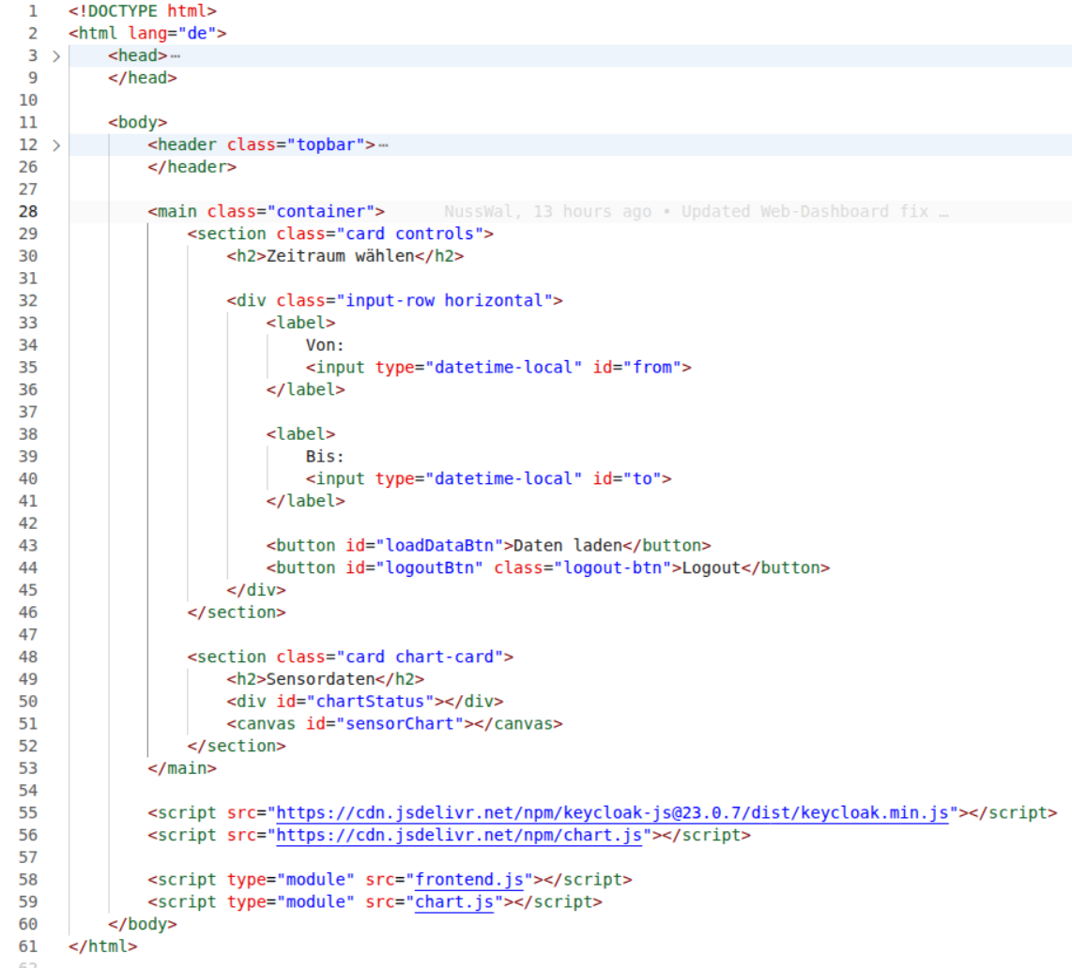

Slide 25
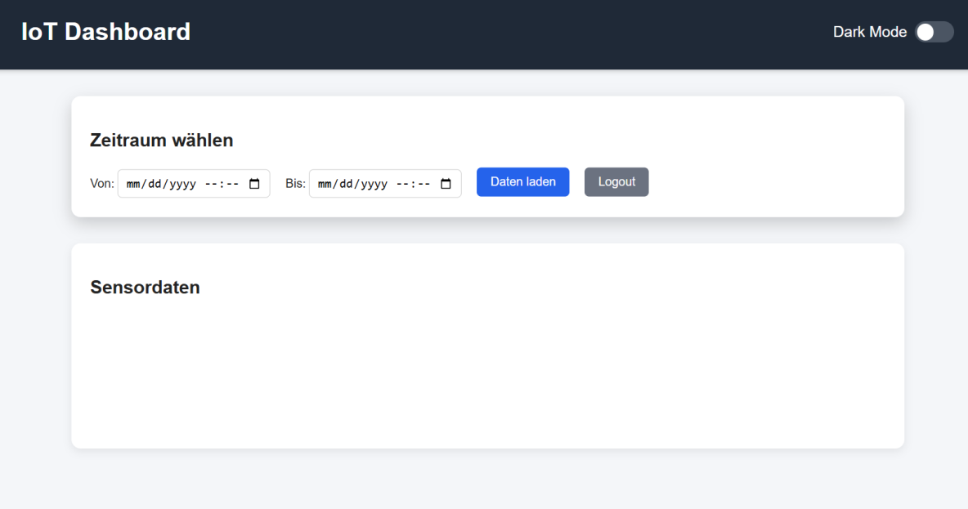

Slide 26
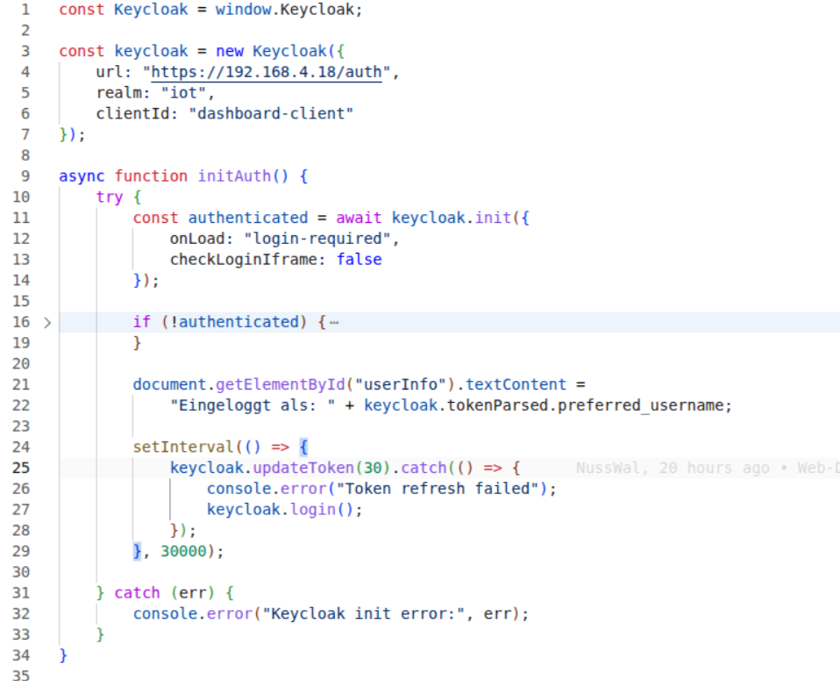
webapp > frontend.js [Teil 1/2 ]

Slide 27
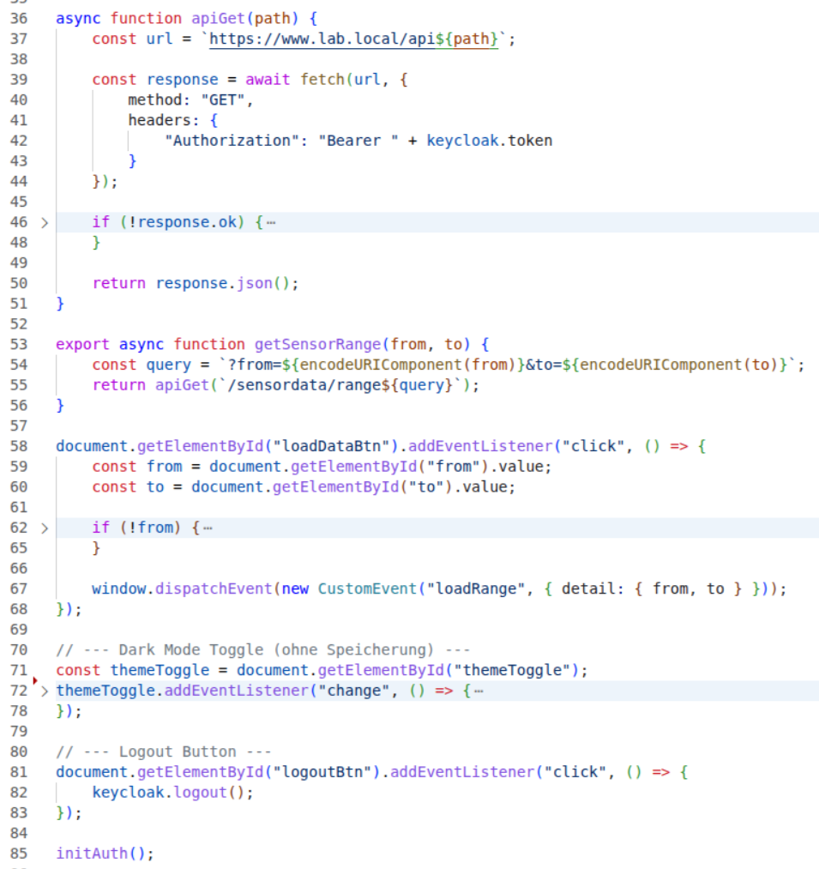

Slide 28
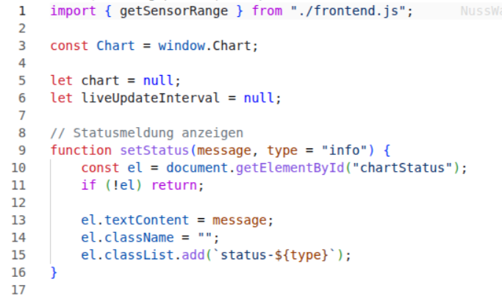
webapp > chart.js [Teil 1/3 ]

Slide 29
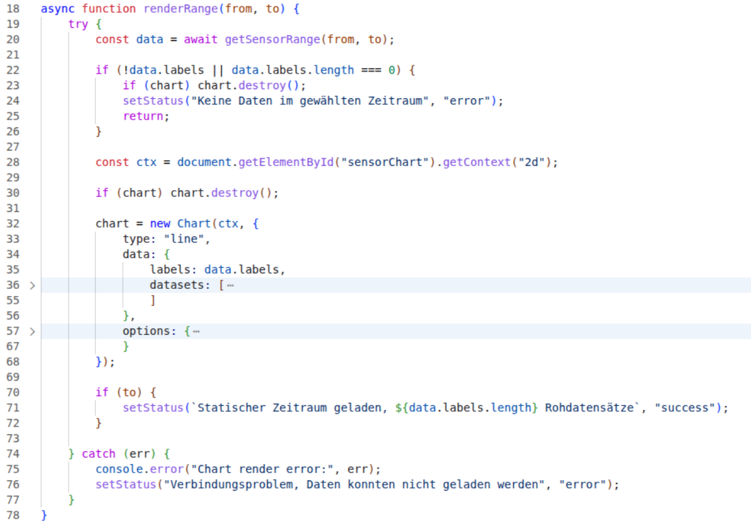

Slide 30
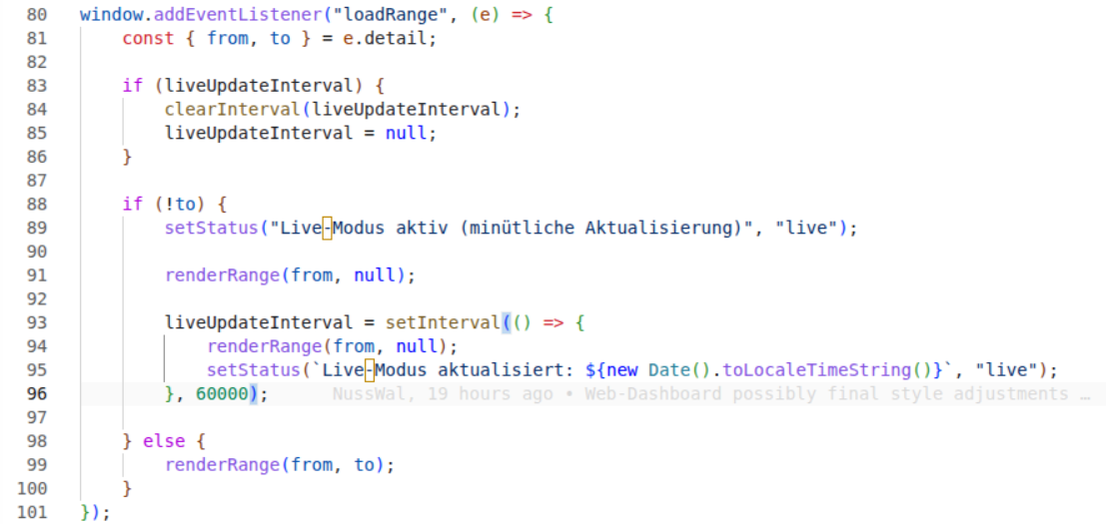

Slide 31
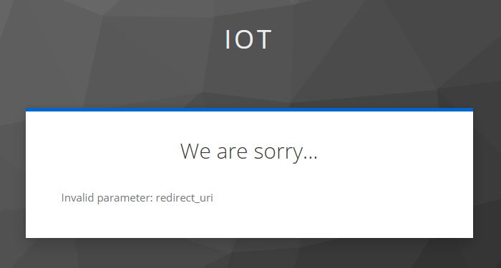

Slide 32
🏁 Fazit
Verschlüsselung zu MQTT: funktioniert ✓
Reverse Proxy (nginx): HTTPS → HTTP — Problem mit Zertifikaten
Routing und Keycloak Authentifikation → Problem im Browser

