Slide 1
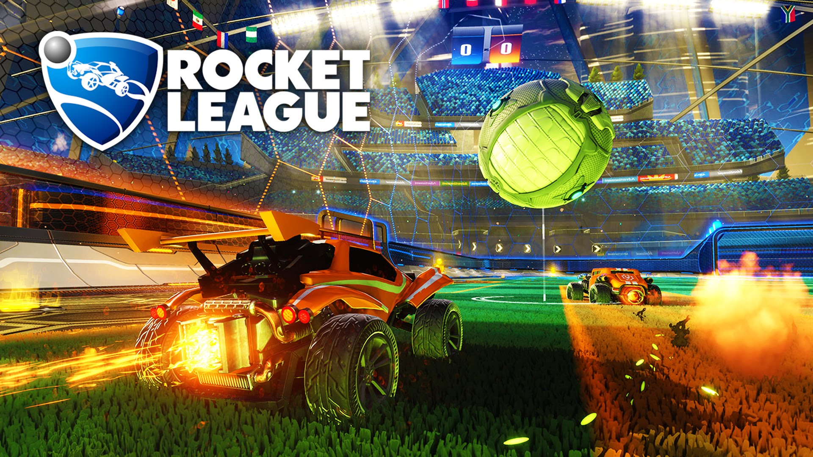

Project Proposal
Diogo Silva
Jorge Brown
Tiago Melo
AASMA - IST – 2020/2021

Slide 2
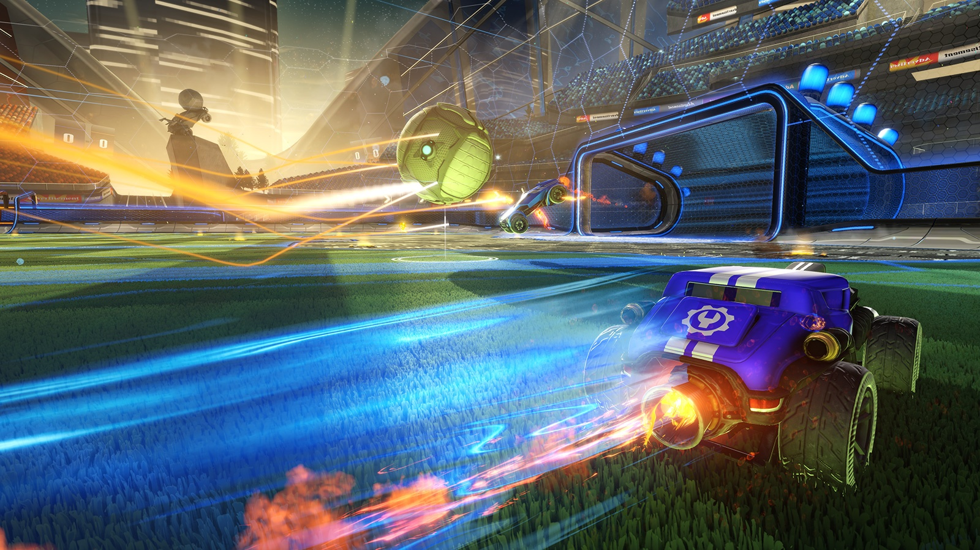
The Game
AASMA - IST – 2020/2021

Slide 3
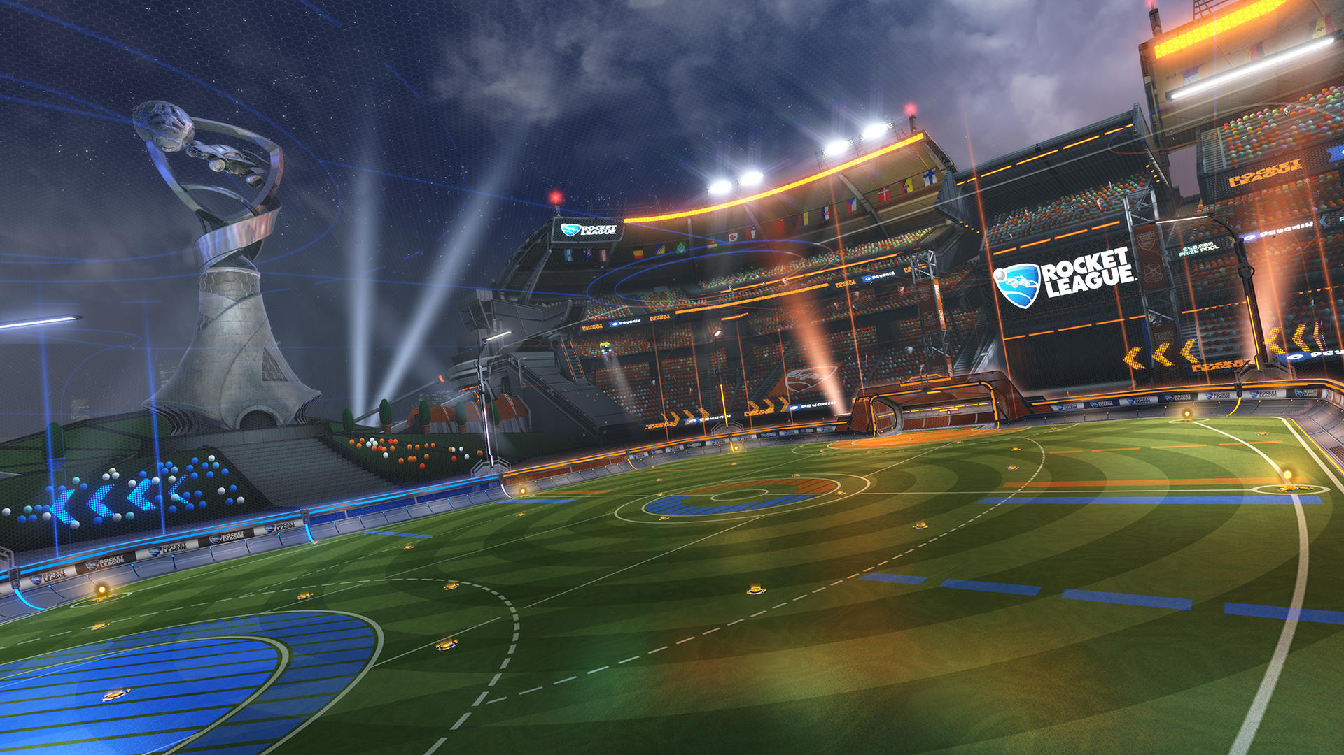
The Environment
Multi-Agent
Stochastic
Sequential
- 3 vs 3 Team game
- Semi-Realistic Physics
- A lot of unpredictability
- Current decisions impact future outcomes
- Reset only after goals
Dynamic
Continuous
Partially Obs.
- State of the world in constant change
- Factors (speed, etc.) vary in range of continuous values
- No access to factors such as opponent’s strats or precise velocity
AASMA - IST – 2020/2021

Slide 4

RLBot
AASMA - IST – 2020/2021

