Slide 1





Traffic Sign identification
The German Traffic Sign Benchmark (GTSB)
By: Diogo silva, 89348 & pedro oliveira, 89156
TAA, Universidade de Aveiro, 2020

Slide 2
Index
Contextualization
The Dataset
Deep Neural Network
Initial configurations and preparations
Image pre-processing
Hyper-parameter adjustment
Conclusions

Slide 3

Contextualization
“The German Traffic Sign Detection Benchmark is a single-image detection assessment for researchers with interest in the field of computer vision, pattern recognition and image-based driver assistance.”
- http://benchmark.ini.rub.de/?section=gtsdb&subsection=dataset

Slide 4
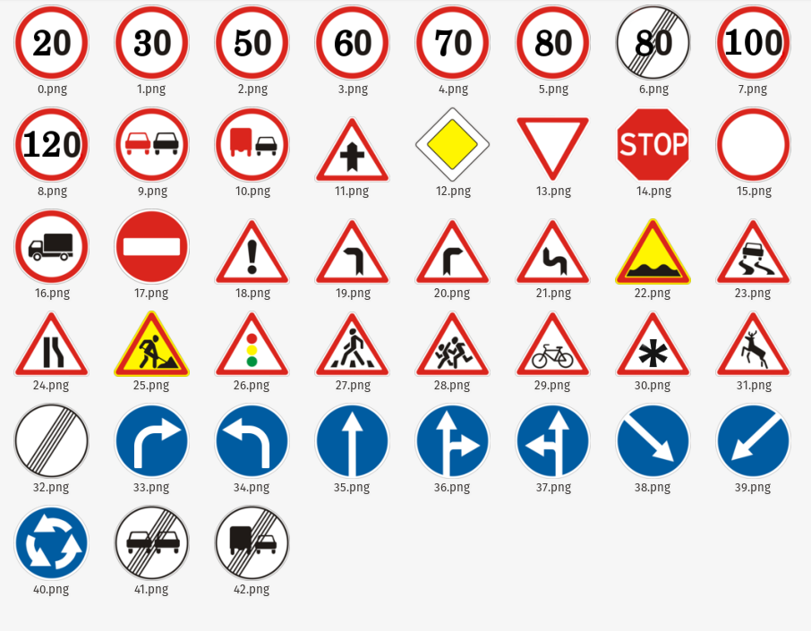
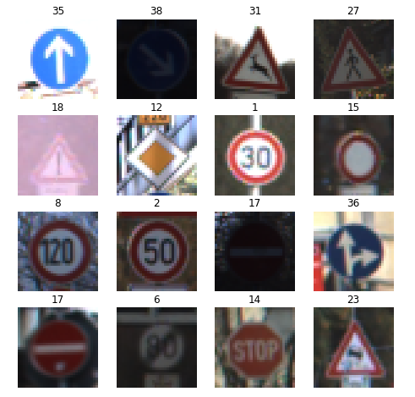
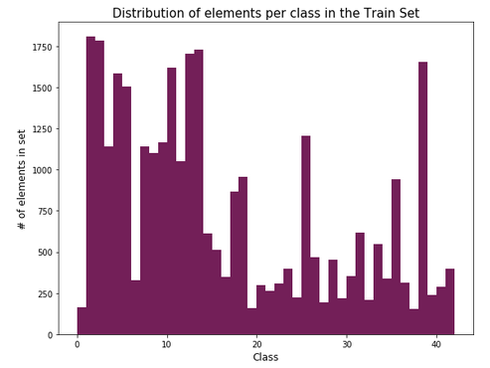
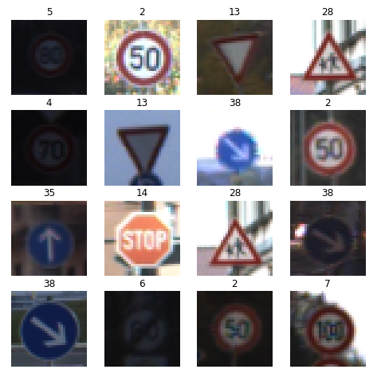
The Dataset
3 Sets
META
TRAIN
TEST
Over 50,000 images
43 different traffic signs
Varying quality and dimensions
Different number of images per class

Slide 5
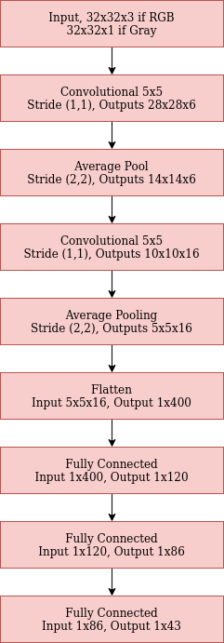
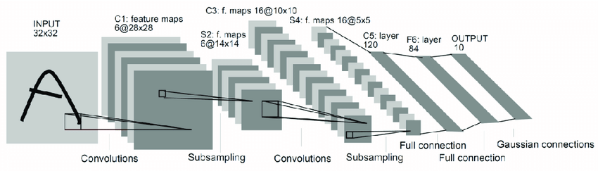

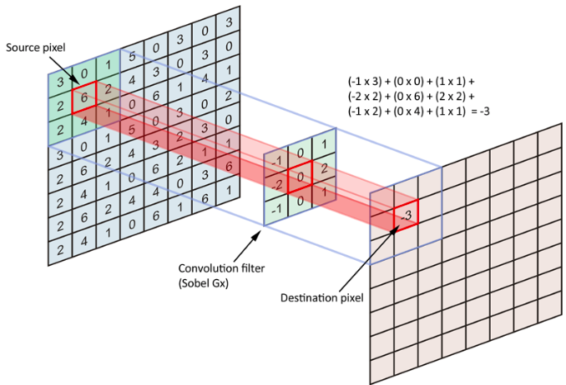

Deep Neural Network
Deep Convolutional Neural Network
LeNet 5
Convolutional Block
Convolutional Layer
Average Pool Layer
Flattening Convolutional Layer
Fully Connected Layer
Softmax Layer

Slide 6
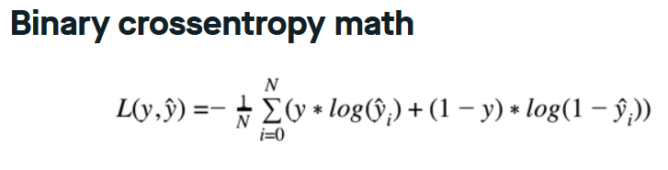
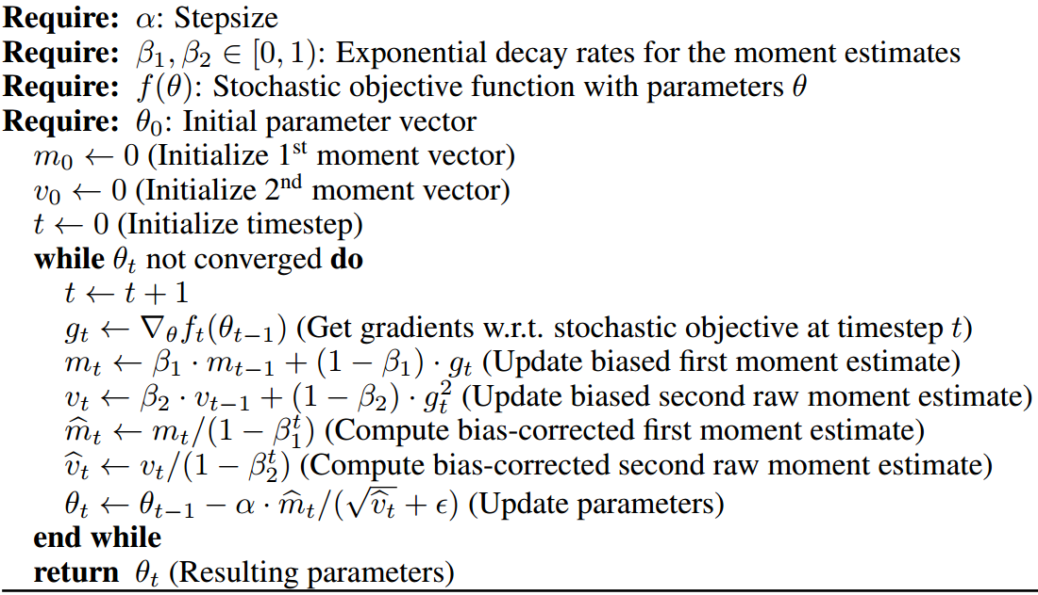


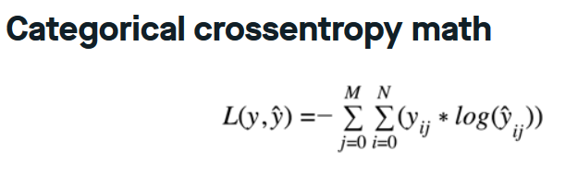
Initial Configurations and preparations
Loss Function
Categorical Cross-Entropy
Activation Function
RELU
Optimizing Function
ADAM
Learning Rate
0.002
Epochs
50
Batch Size
200

Slide 7

Initial Configurations and preparations
Cross-Validation Set
3-Fold
20% random images from the Train Set
Random Shuffling
Resize images to 32x32
Normalization

Slide 8
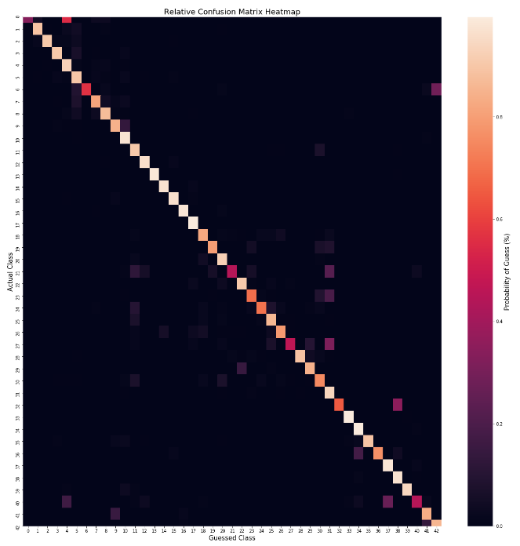
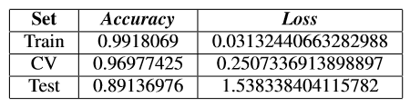
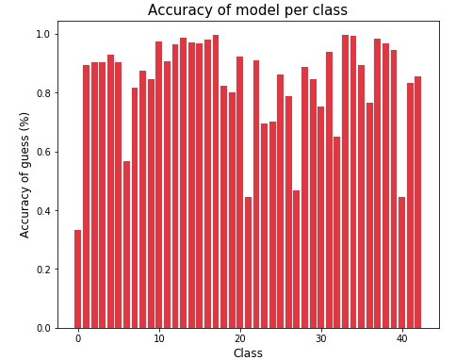
First Results

Slide 9
Image Pre-processing and Data Augmentation
Cross Validation Set Improvement
Grayscale
Equalization
Normalization Improvement
Dataset Augmentation

Slide 10
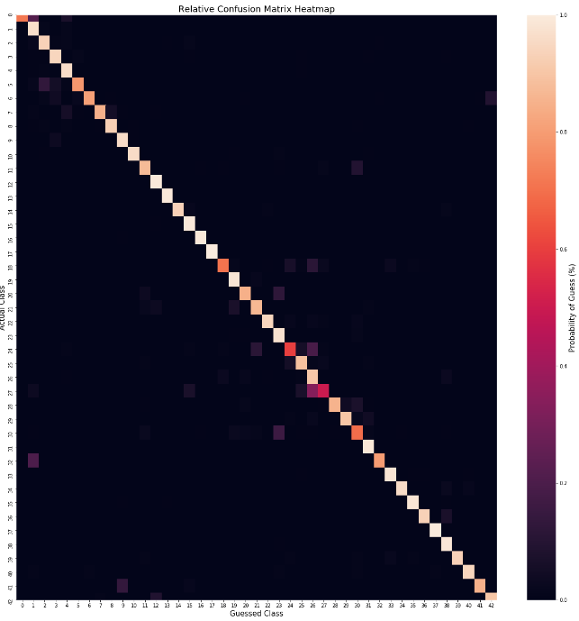
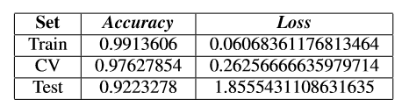
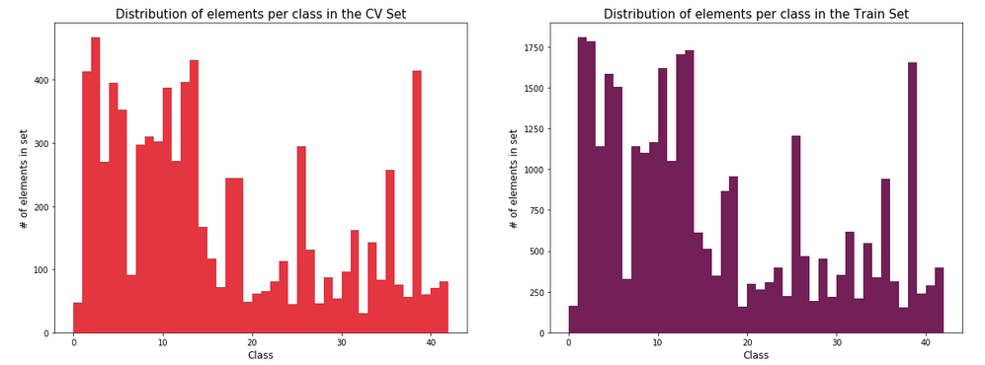
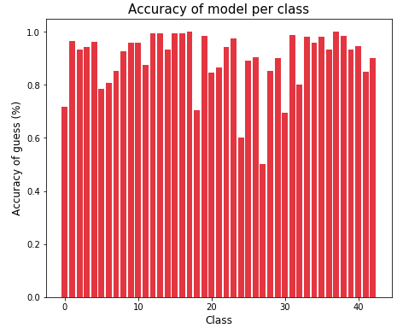
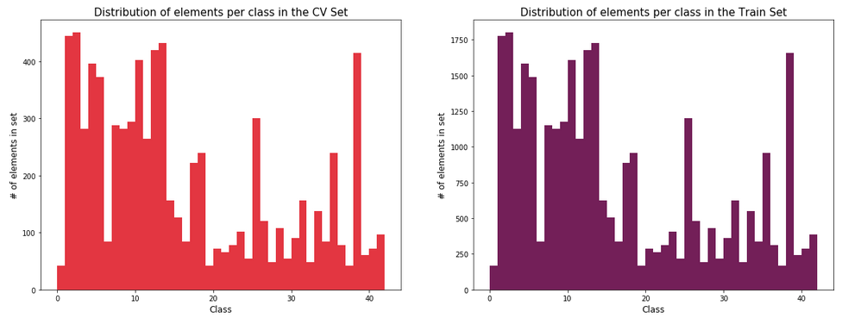
Cross Validation Set

Slide 11
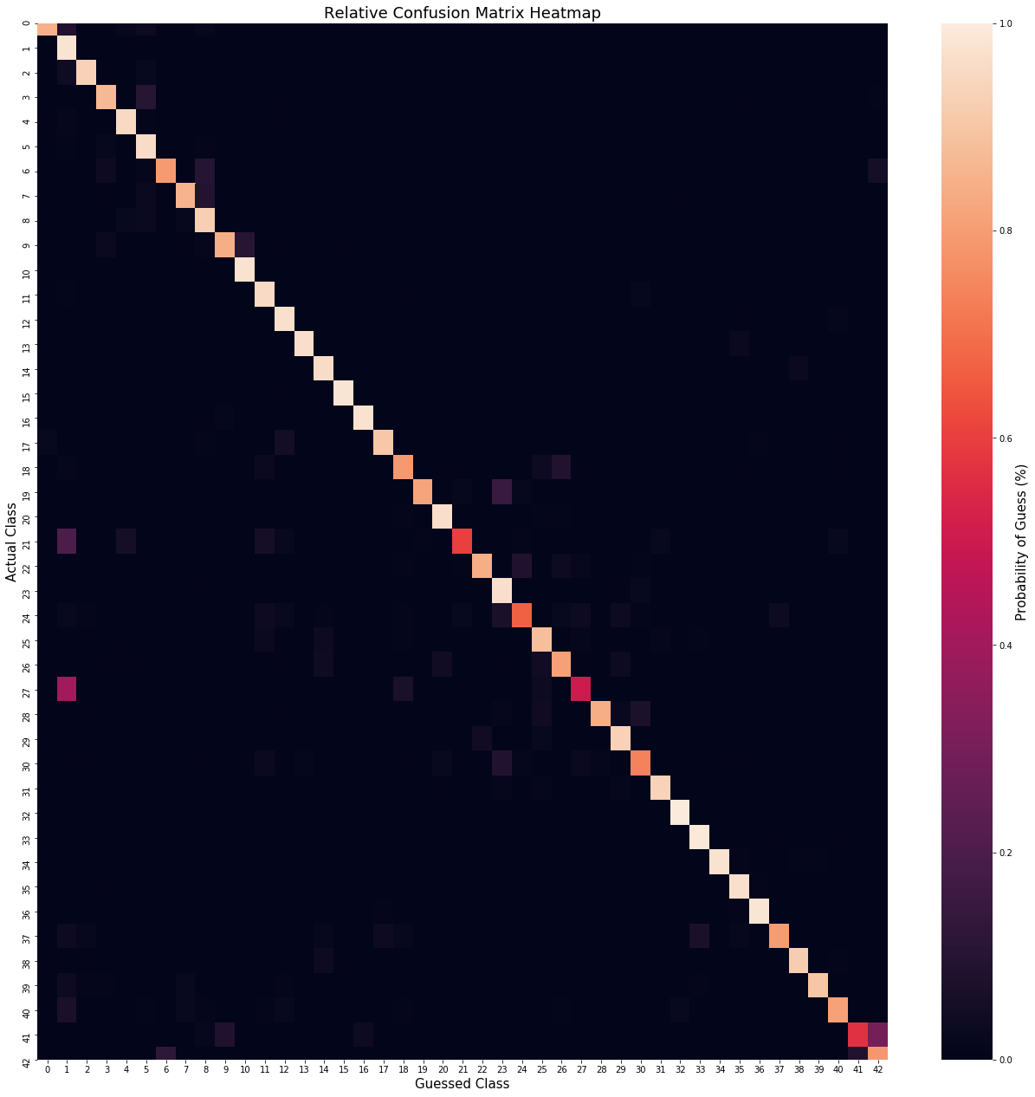
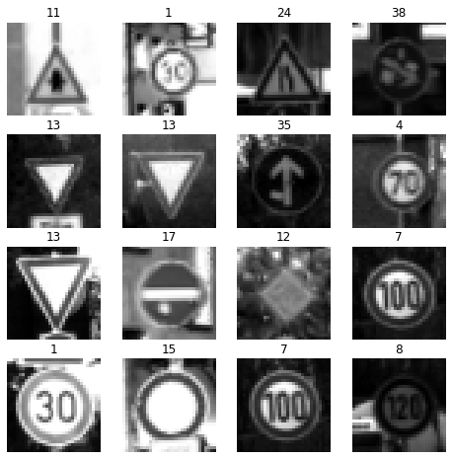
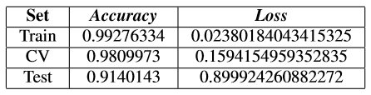
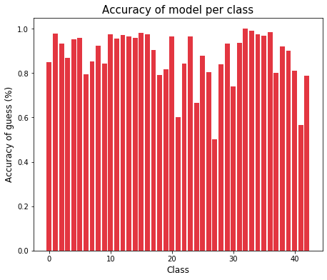
Grayscale

Slide 12

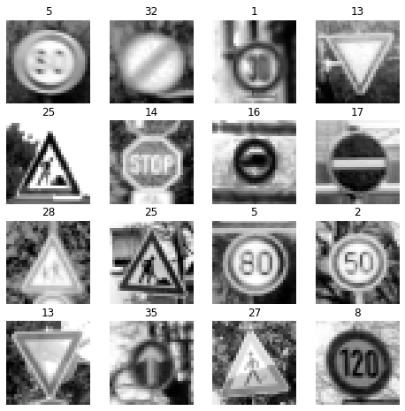
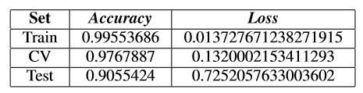
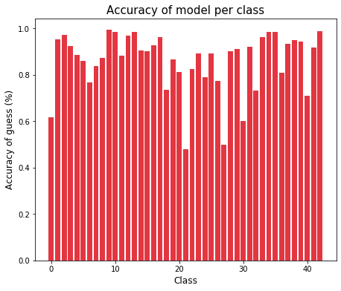
Histogram Equalization

Slide 13
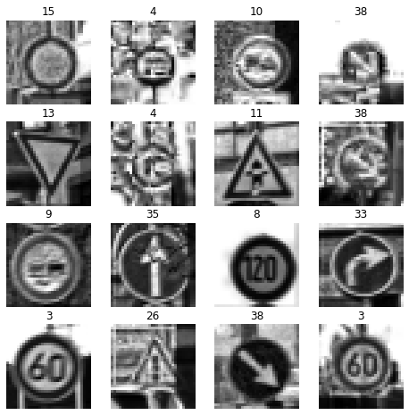

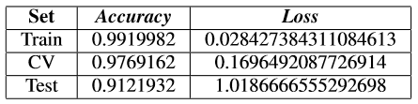
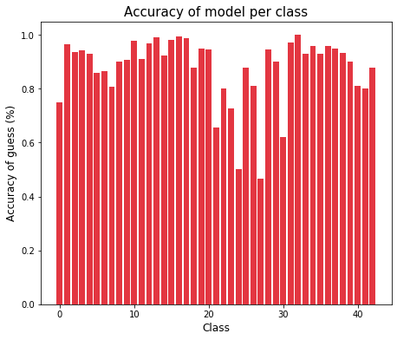
Contrast Lim. Adap. Hist. Eq.

Slide 14

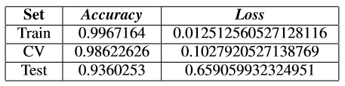
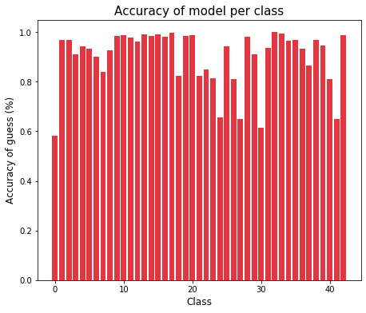
OpenCV Normalization

Slide 15

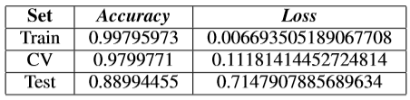
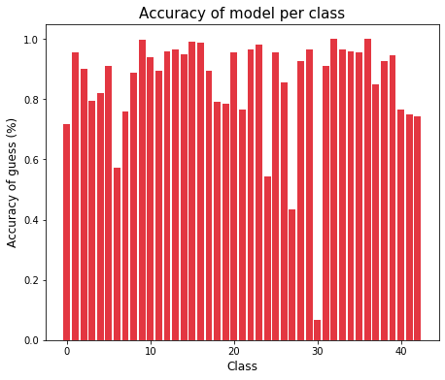
Contrast Modification

Slide 16

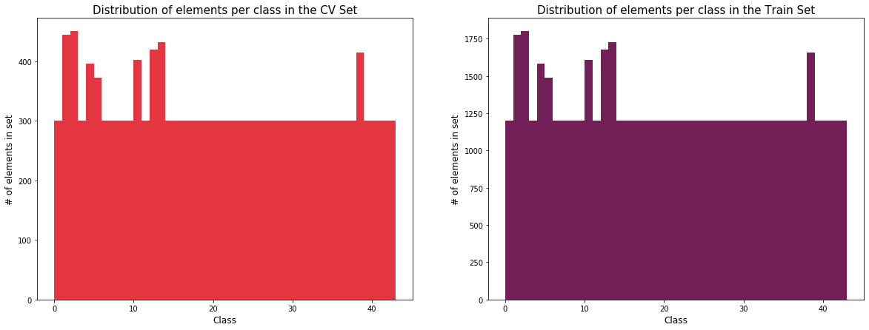
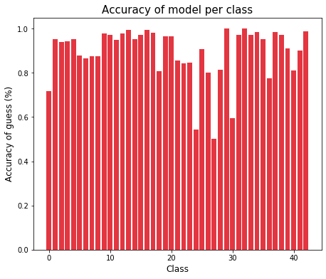
Data Augmentation 1

Slide 17

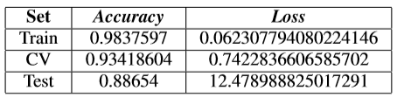
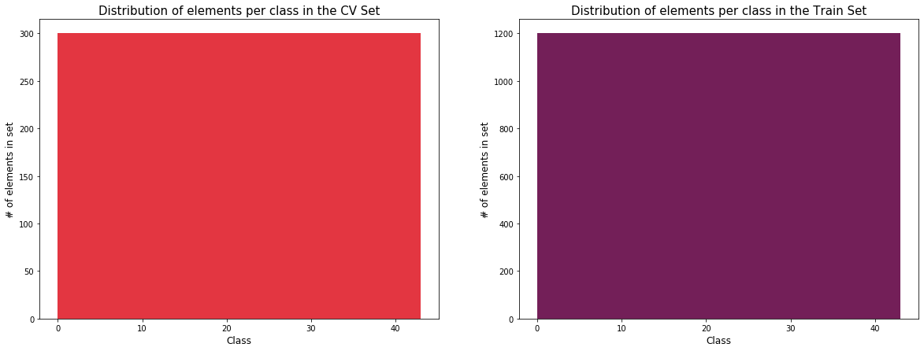
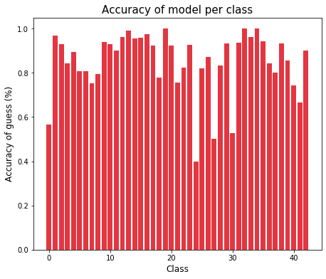
Data Augmentation 2

Slide 18
Hyper-parameter adjustment
Epochs
Changes in the Neural Network Structure
Learning Rate
Dropout
MaxPooling
Regularization

Slide 19
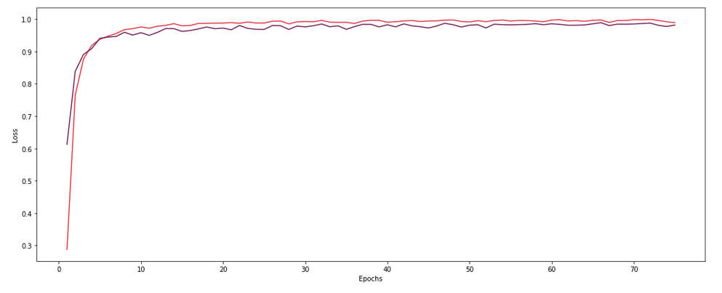
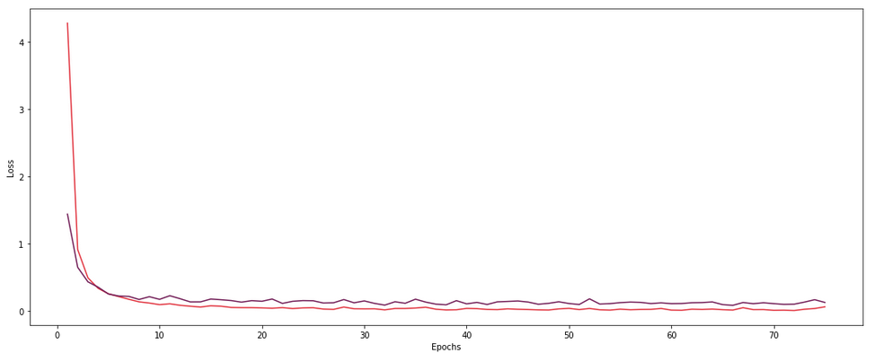
Epochs
CV
CV
Train
Train
Accuracy

Slide 20
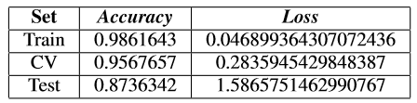
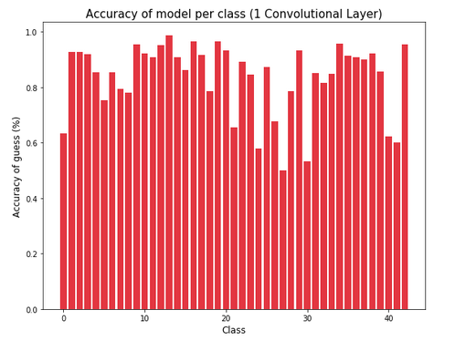
1 Convolutional Layer

Slide 21
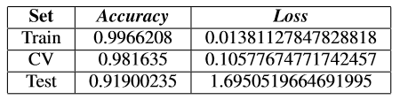
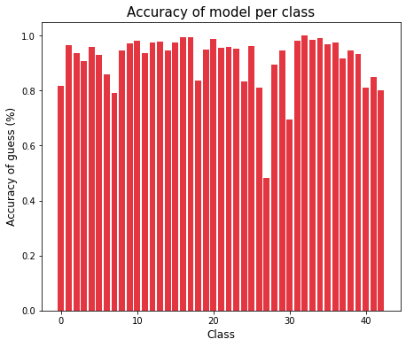
1 Fully Connected Layer

Slide 22

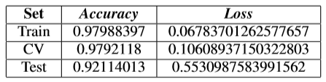
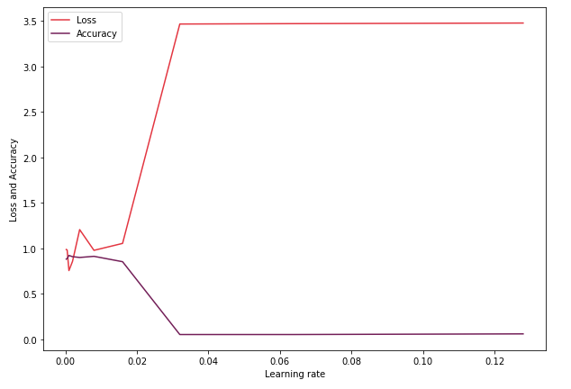
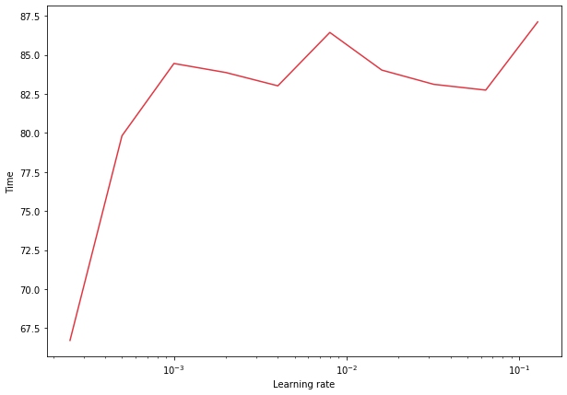

Learning Rate

Slide 23
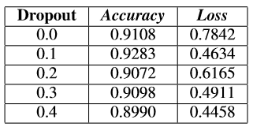
Dropout on Convolutional Blocks

Slide 24

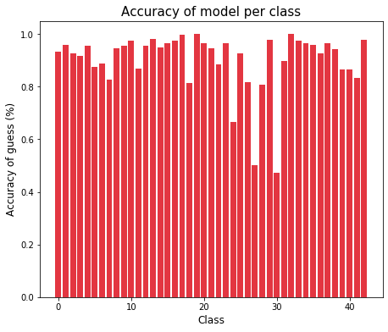
Dropout 0.1 at Convolutional Layer

Slide 25
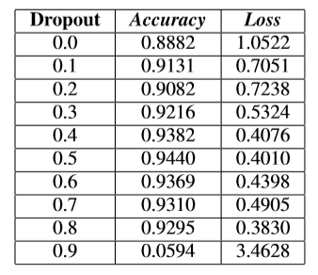
Dropout on Fully Connected Layer

Slide 26

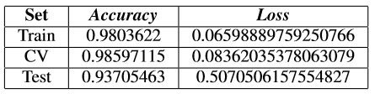

Dropout 0.5 at Fully Connected Layer

Slide 27



MaxPooling

Slide 28



Regularization (0.01)

