Slide 1
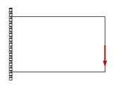
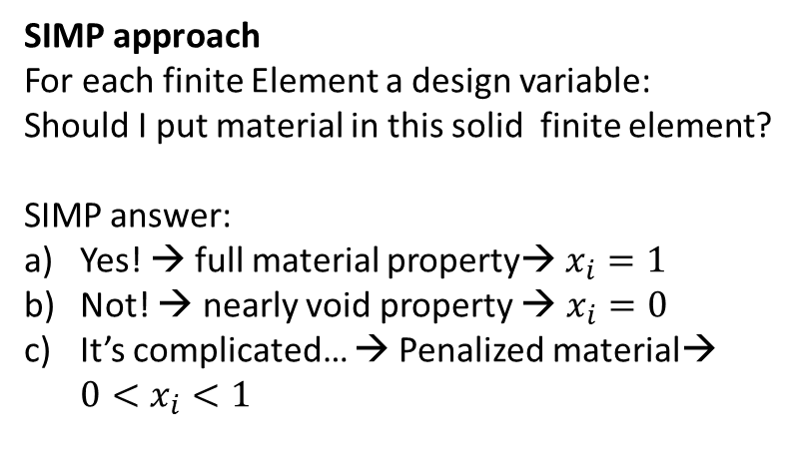
Topology Optimization challenge
I want the lightest acceptable structure, that fits in here!
Where should I put a solid material?
Where should I put voids?
SIMP approach
For each finite Element a design variable:
Should I put material in this solid finite element?
SIMP answer:
Yes! → full material property→ $x_{i}=1$
Not! → nearly void property → $x_{i}=0$
It’s complicated… → Penalized material→ $0<x_{i}<1$

Slide 2
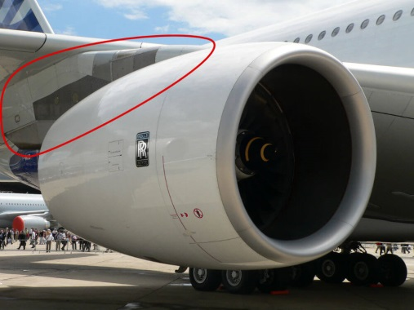
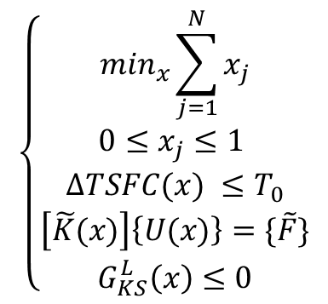
?
https://developer.x-plane.com/manuals/planemaker/
For the pylon design we want:
$$\left\{\begin{aligned}\begin{matrix}\min_{x}\sum_{j=1}^{N}{x_{j}} \\ 0≤x_{j}≤1 \end{matrix} \\ \begin{matrix}∆TSFC(x) ≤T_{0} \\ \begin{aligned}\left[\tilde{K}(x)\right]\left\{U(x)\right\}=\{\tilde{F}\} \\ G_{KS}^{L}\left(x\right)≤0\end{aligned}\end{matrix}\end{aligned}\right.$$
The lightest structure
Acceptable for Engine deformation → reduced Engine Fuel Consumption
Acceptable Equivalent stress → resists under the load

Slide 3
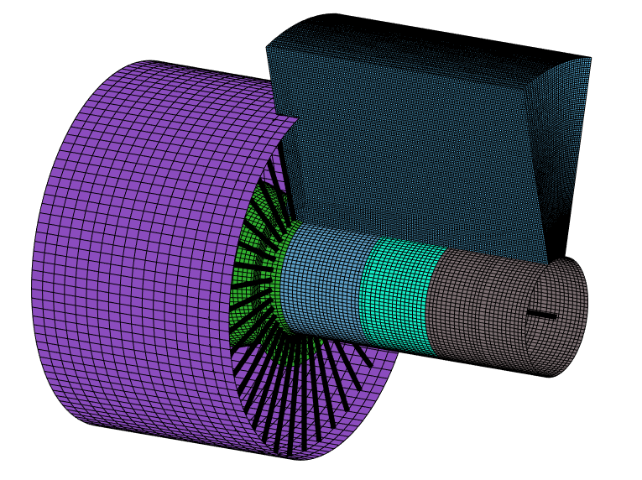
1,6M of DOFs
500K Design Variables
FE solver: Matlab native function ichol + minres
Optimization solver: MMA, stopping criteria: iter<=maxiter

