Slide 1
Chapter 7/Week 6 Presentation
Presented by: Kelly Huber & Casey Baldwin

Slide 2
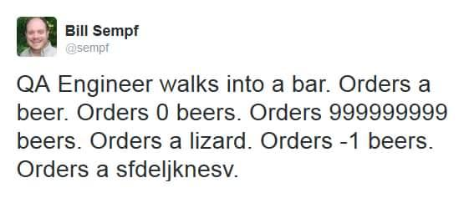
ERR!
An error is something unexpected happening.
In programming this is giving the program what it wants when it wants it.

Slide 3
Compilation Errors
These occur if you made a typing error
If you forget a comma, period, identifier, or semicolon
Compilation errors are lexical errors
The compiler catches lexical errors when it parses or reads the program’s plain text file

Slide 4
Runtime Errors
These occur when data fails to meet rules or the programming instructions defined by your program
Can happen in declaration, execution, and exception blocks
Occurs after the program is passed and literal values are assigned to local variables
Not so easy to see

Slide 5
Oracle Built in Exception Handling Functions
SQLCODE - this function returns the error number associated with an exception Returns: -negative number for all predefined exceptions (except the NO_DATA_FOUND exception) -positive 100 for a NO_DATA_FOUND -positive 1 when a user-defined exception is raised
SQLERRM - this function returns the error number and the message associated Returns: -code and message for unhandled error code or predefined exception name -positive 100 and a User-Defined Exception message for a user-defined message thrown by: RAISE user_defined_exception; -negative 20001 to negative 20999 and custom message for a user-defined exception thrown by: RAISE_APPLICATION_ERROR (error_code, customized message);

Slide 6
User Defined Exceptions
IF user_entry IS NULL THEN RAISE null_not_allowed; END IF; EXCEPTION WHEN null_not_allowed THEN raise_application_error (-20001,'This value can not be null.'); When OTHERS THEN ← Always use this to catch other errors Raise_application_error (-20002,’There was an unexpected error.’); END;

Slide 7
How to Call And Insert Into a Table
EXCEPTION WHEN OTHERS THEN ← This catches all errors not specified previously err_num := SQLCODE; ← SQLCODE is error number err_msg := SUBSTR(SQLERRM, 1, 200); ← SQLERRM returns the error message err_date := SYSDATE; ← Tells us the date of an error, time might also be helpful INSERT INTO error_table (error_number, error_message, error_date) VALUES (err_num, err_msg, err_date); END;

Slide 8
Why Insert Into a Table?
As long as the error reporting is setup correctly, large problems can be easily diagnosed to a module or block of code.
The table becomes ‘error log’, easy to search with a select statement.

