Slide 1

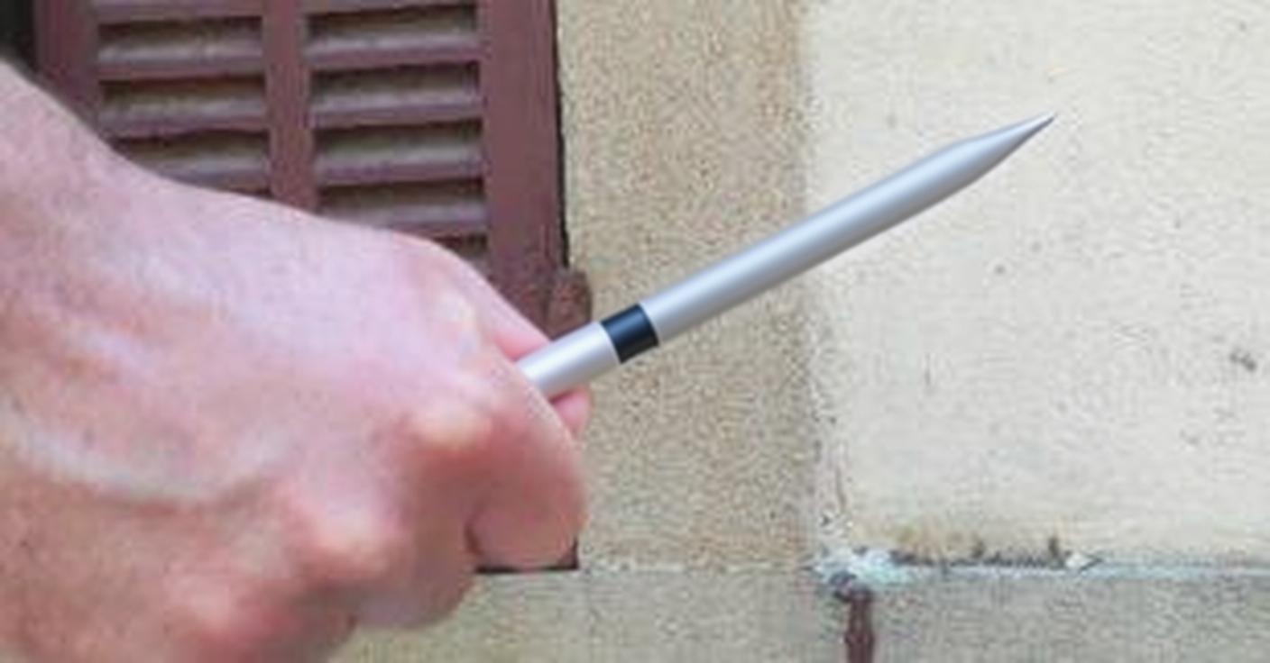
Prompt
Encoder
Decoder
Adapter 1
VLM
(无编解码器)
Adapter 2
Edit Model (无编解码器)
训练阶段1 (仅 Adapter 1)
训练阶段2 (仅 Adapter 2)
Prompt
VLM
Edit Model
prompt

