Slide 1
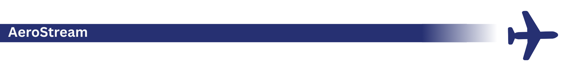
AeroStream Operational Efficiency
Simulated Airport Monitoring & Process Improvement
Suharsh Sandhu| May 15th, 2025

Slide 2
Project Overview
Simulated operations monitoring at a fictional airport terminal
Focus on check-in counter usage, passenger flow, and slot adherence
Built with Python, Power BI, SQL, and process mapping tools
Final goal: streamline counter allocation and reduce congestion

Slide 3
Key Insights
A3 and A10 counters had sustained usage over 77.7%
Only 15.5% of flights were on time
3.7% of terminal zone periods were over capacity
Morning hours showed consistent congestion

Slide 4
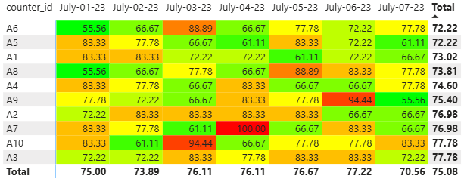
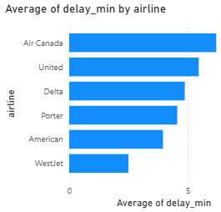
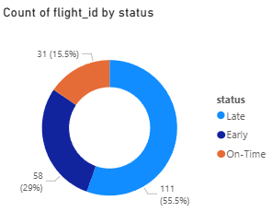
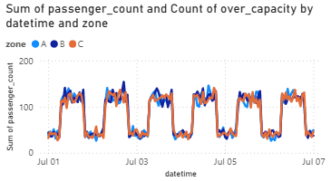


Power BI Visuals

Slide 5
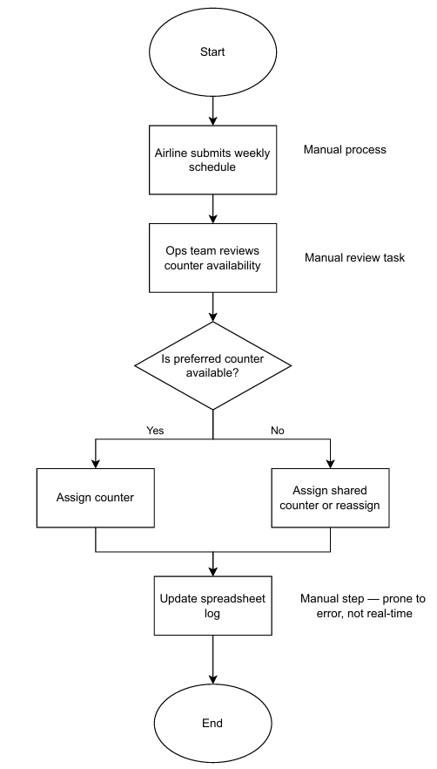
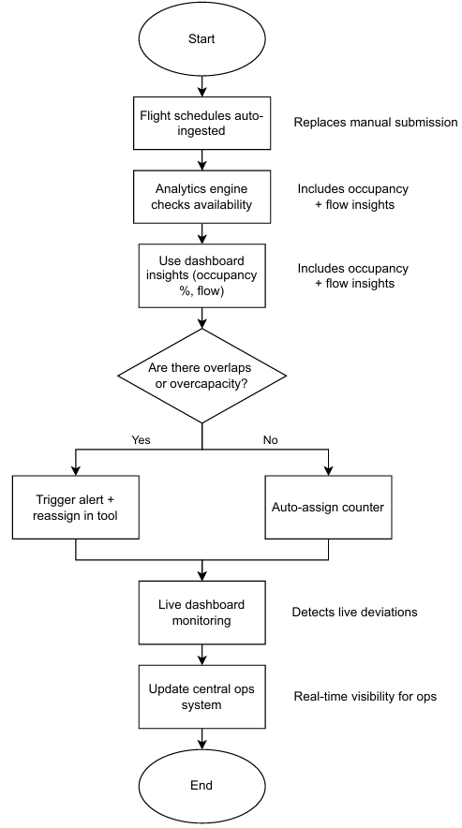
Process Mapping (As-Is vs To-Be)
As-Is:
- Manual
- Reactive
To-be:
- Automated
- Dashboard-guided
- Real-time reallocation

Slide 6
Simulation Recommendations
1. Automate counter assignments using analytics
2. Use dashboards for daily ops decisions
3. Trigger alerts for counter overuse or overlaps
4. Improve flight schedule reliability with carriers
5. Replace manual logs with a centralized system

Slide 7
Conclusion
AeroStream demonstrates how a simulated data-driven system can:
- Reduce manual inefficiencies
- Improve resource allocation
- Enhance airport decision-making and responsiveness

