Slide 1
SECURE DATA HIDING IN IMAGES USING STEGANOGRAPHY
CAPSTONE PROJECT
Presented By:
HARSHINI R
Student Name :
HARSHINI R
College Name & Department :
CMR INSTITUTE OF TECHNOLOGY
Computer Science and Engineering (Artificial Intelligence and Machine Learning)

Slide 2
OUTLINE
Problem Statement
Technology used
Wow factor
End users
Result
Conclusion
Git-hub Link
Future scope

Slide 3
Problem Statement
Maintaining the confidentiality of sensitive information during transmission is a significant challenge. Traditional encryption methods, though effective, often reveal the presence of secured data, potentially attracting unwanted attention.
This project focuses on developing an Image Steganography App that securely embeds secret messages within image files. Utilizing passcode-protected encryption and image processing techniques, the application enables users to discreetly hide and retrieve sensitive information without compromising the visual quality of the image, ensuring both security and subtlety in data transmission.

Slide 4
Technology used
Programming Language: Python
Image Processing: OpenCV
Numerical Operations: NumPy
Web Application Framework: Streamlit
File Handling: OpenCV and NumPy integration for image encoding/decoding
User Interface: Streamlit for interactive UI elements
Platform: Visual Studio Code

Slide 5
WOW FACTORS
Streamlit-Based Interactive Web App: While many steganography projects are command-line based, this app provides a user-friendly Streamlit interface, making it accessible to non-technical users without the need for complex setups.
Real-Time Encryption & Decryption with Download Options: The app not only encrypts and decrypts messages in real-time but also allows users to download the encrypted image directly through the interface.
Minimal Image Distortion: By embedding data into the blue channel of the image and carefully managing pixel modifications, the app ensures minimal distortion, maintaining the image's visual integrity.
Modular Design: The project is broken down into modular scripts (encrypt.py, decrypt.py, and main_app.py), promoting reusability and easy maintenance.

Slide 6
END USERS
Privacy-Conscious Individuals: Securely share confidential messages without attracting attention.
Students & Educators: Learn and teach concepts of steganography, cryptography, and data security.
Businesses & Professionals: Discreetly transmit sensitive data like passwords or private documents.
Cybersecurity Enthusiasts: Explore and experiment with data hiding techniques for security purposes.
Developers & Open-Source Contributors: Study image-based data encoding and contribute to project enhancements.

Slide 7
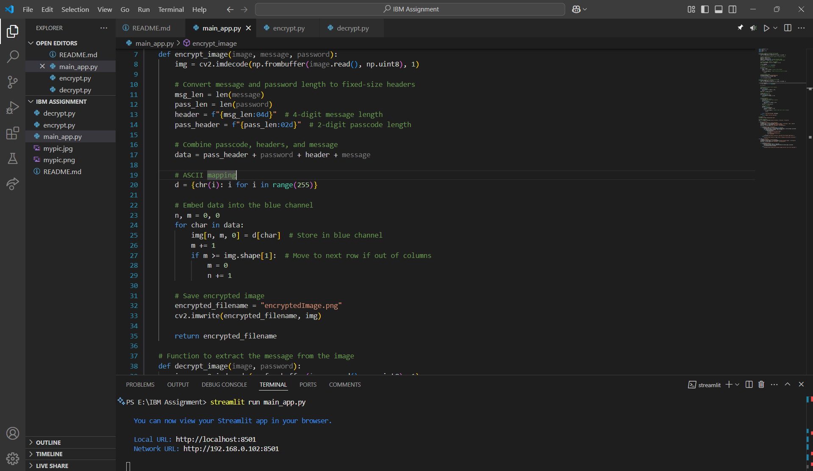
RESULTS

Slide 8
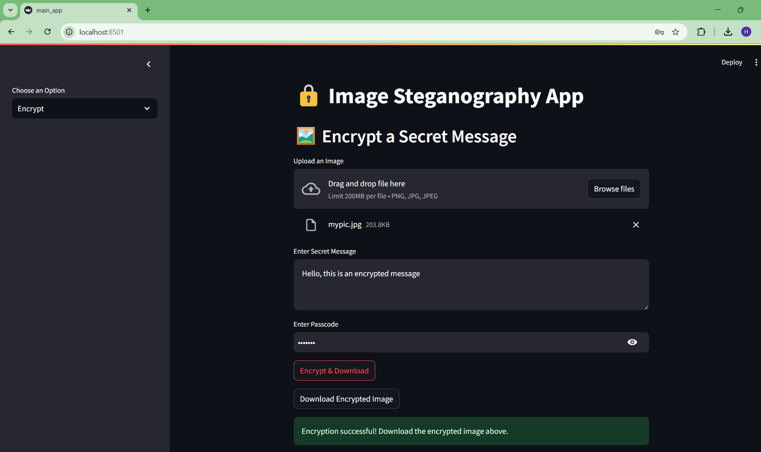
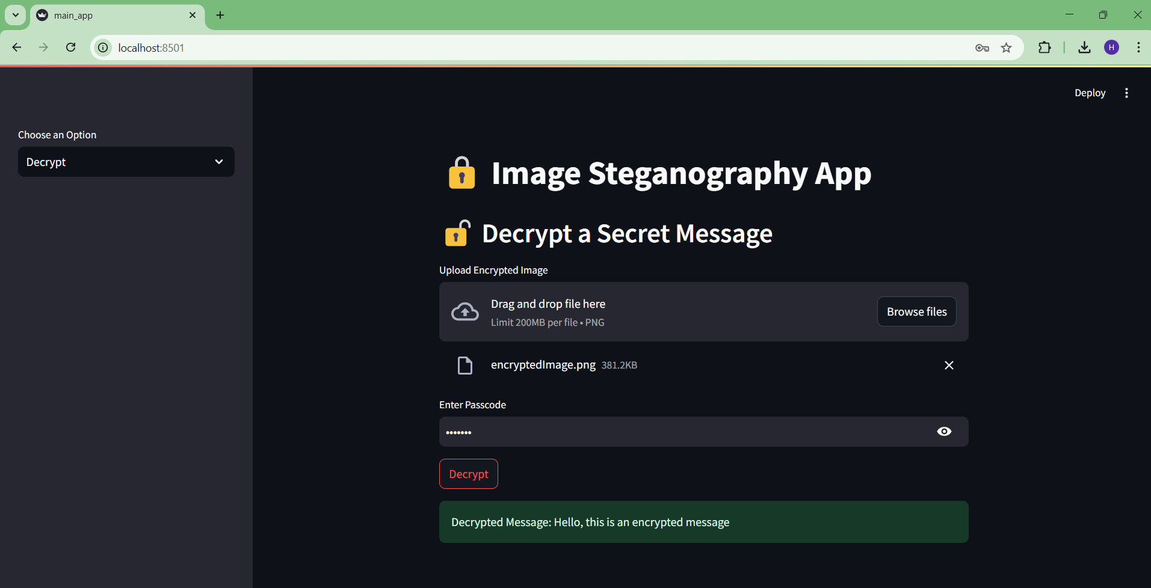
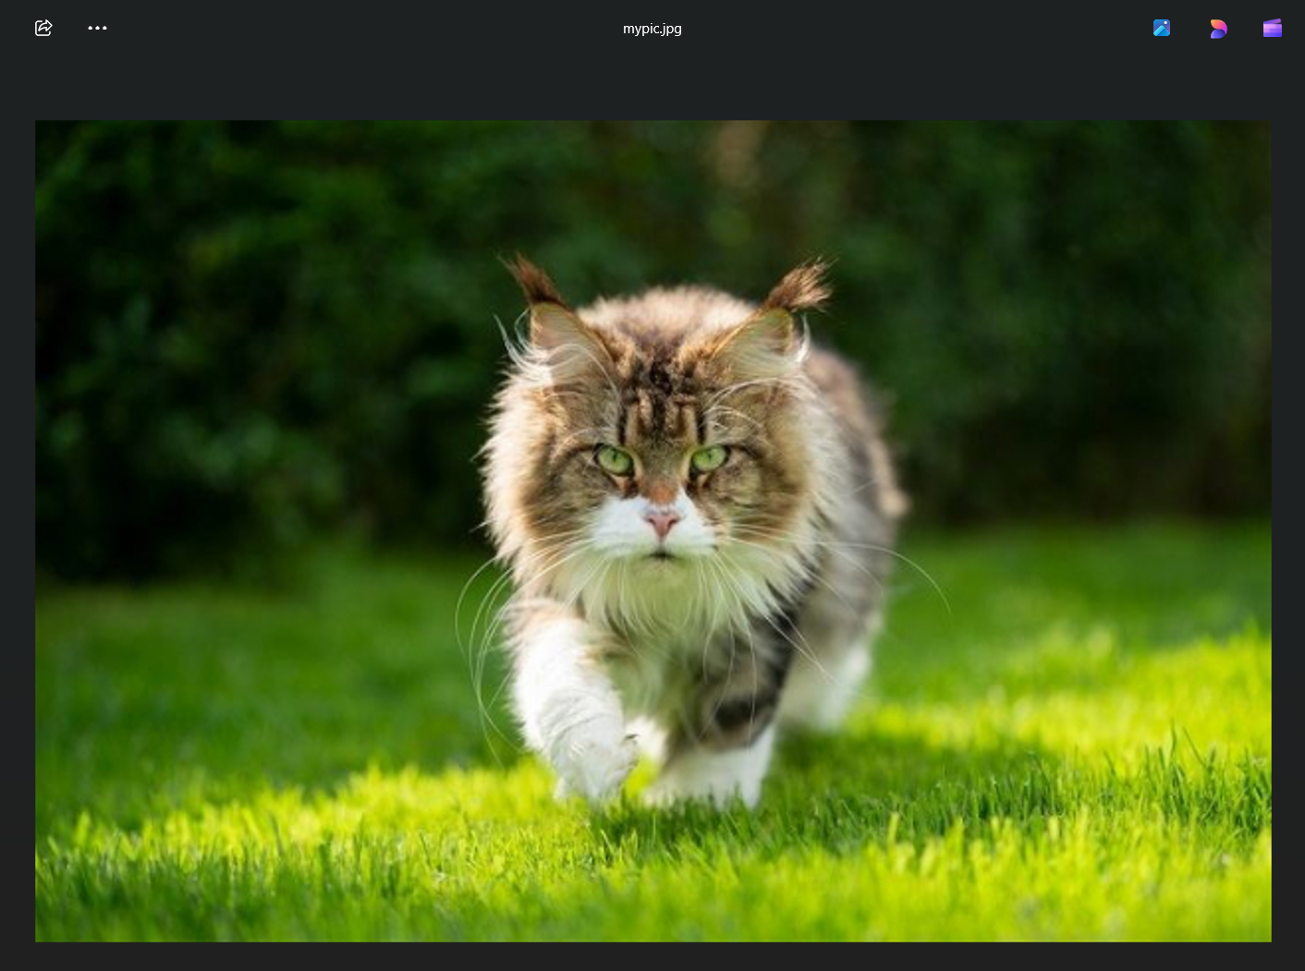
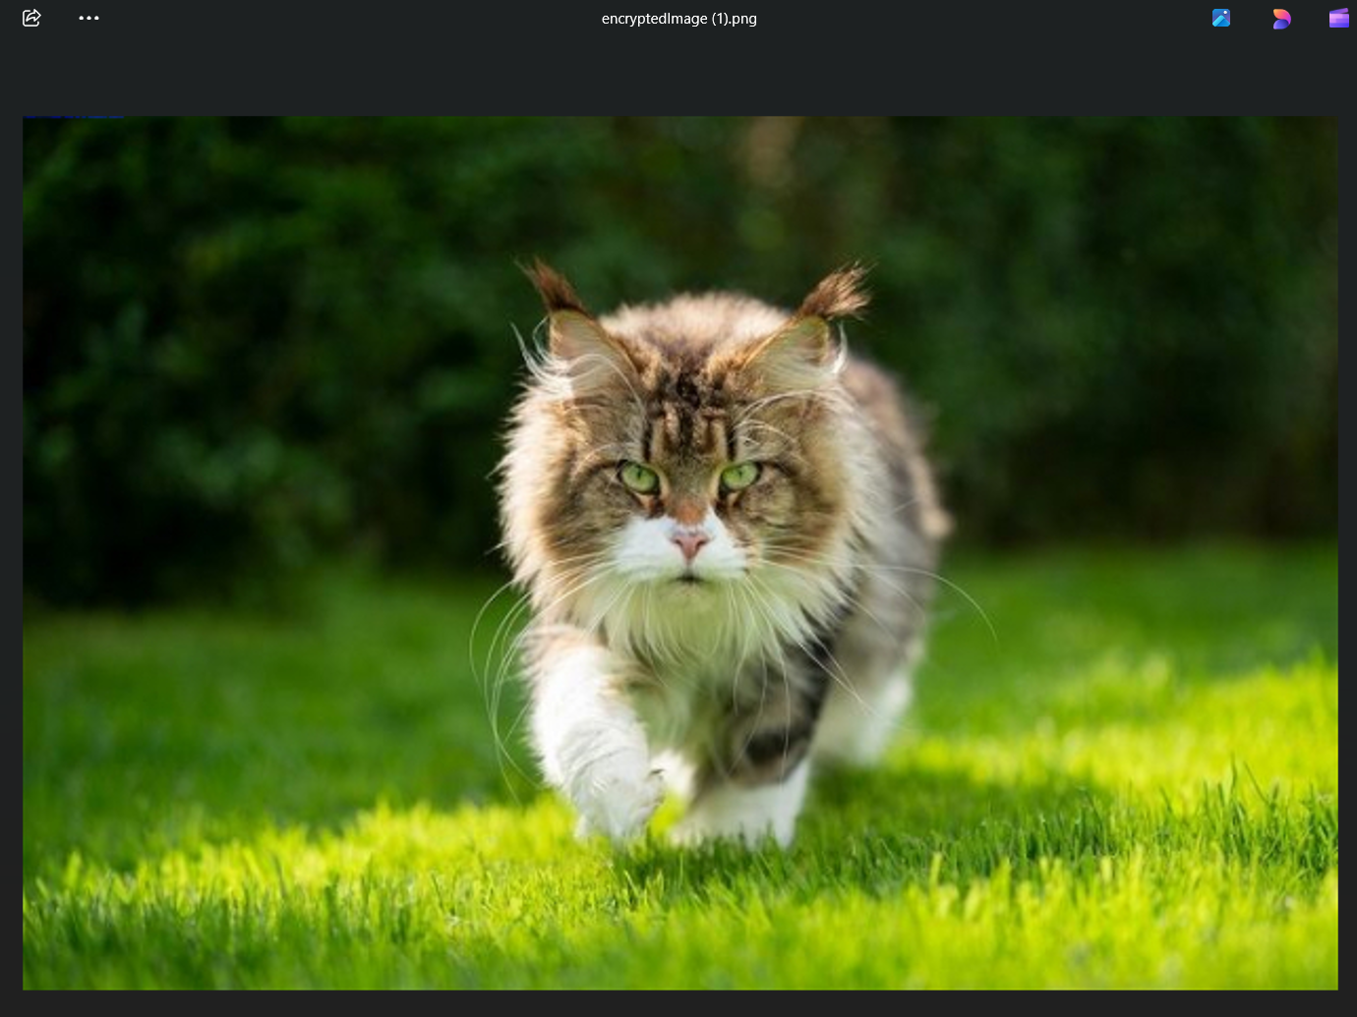
RESULTS

Slide 9
CONCLUSION
The Image Steganography App effectively addresses the challenge of maintaining the confidentiality of sensitive information during transmission.
By embedding secret messages within image files using passcode-protected encryption, the app ensures that hidden data remains inconspicuous, avoiding the attention that traditional encryption methods might attract.
Through the integration of image processing techniques and a user-friendly interface, the application enables secure and discreet communication without compromising the visual integrity of the image.
This solution not only enhances data privacy but also provides an accessible tool for users seeking subtle and reliable methods of secure information exchange.

Slide 10
GITHUB Link
https://github.com/HersheyR/Image-Steganography-App

Slide 11
FUTURE SCOPE
The Image Steganography App can be enhanced by integrating advanced encryption for improved security.
Expanding support to other media types, such as audio and video, can broaden its application.
Developing mobile and desktop versions will increase accessibility, while features like batch processing and cloud integration can enhance usability.

Slide 12
THANK YOU

