Slide 1
Remove Handwritten Struck-Out Text from Mathematical Answer Sheets via Deep Learning
Jiaqi Han
Notes:
大家好，我们的Project题目是：
使用深度学习方法，移除数学试卷上的涂改

Slide 2

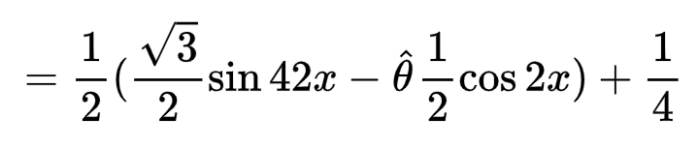




Background
In auto-grading system, the accuracy of OCR affect matters.
In practice, struck-out text severely disturb the recognition of text and formulas.
Wrong
Answer
? ? ?
Notes:
这个Project的提出是因为：
在开发自动批改系统的过程中，对文字和公式的识别，即OCR是很重要的因素；
而在实践中，我们发现涂改文字对文字和公式的OCR识别准确率有很大影响
所以我们希望在OCR前进行预处理，首先尽可能移除涂改

Slide 3
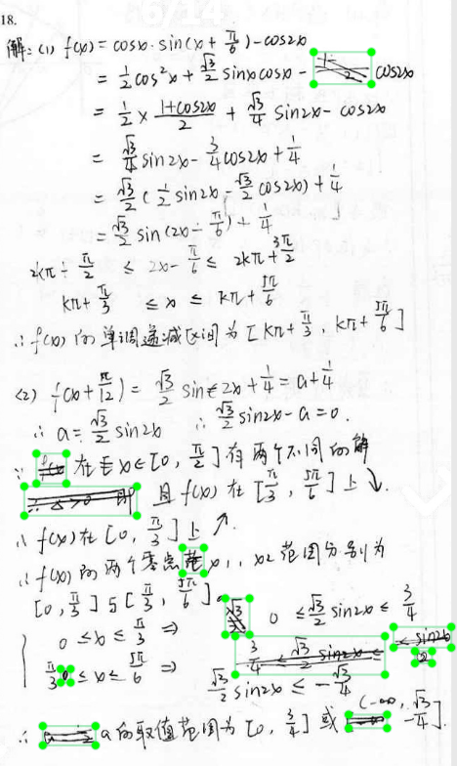
Target Problem
For mathematical answer sheets:
Remove the struck-out text, while preserve the non-struck-out text.
Regard this problem as object detection task.
Input: Grey scale image of mathematical answer sheets
Output: Rectangle bounding boxes of struck-out text
Notes:
我们的研究问题是：
对于数学试卷，在移除涂改的同时，尽可能保留非涂改
我们将这个问题视作目标检测工作
输入是灰度的试卷图
输出是一系列框着涂改的矩形bounding box

Slide 4
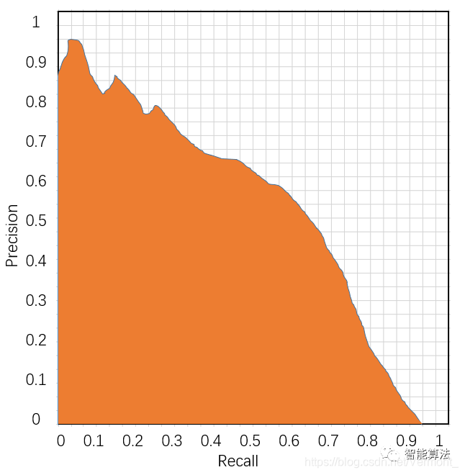
Evaluation
Objection is to improve the Average Precision (AP), which is also the area under Precision-Recall curve.
Improve the AP, make it as high as we can.
Notes:
然后是评判标准
评判指标是AP，也就是所有预测bounding box的平均查准率
（Precision-Recall曲线是将所有的预测bounding box，从置信度高到低，挨个计算pixelwise的precision和recall，precision是查准率，recall是查全率）
AP是Precision-Recall曲线下方的面积，这个指标被广泛应用在目标检测中
我们的目标是让AP尽可能高

Slide 5
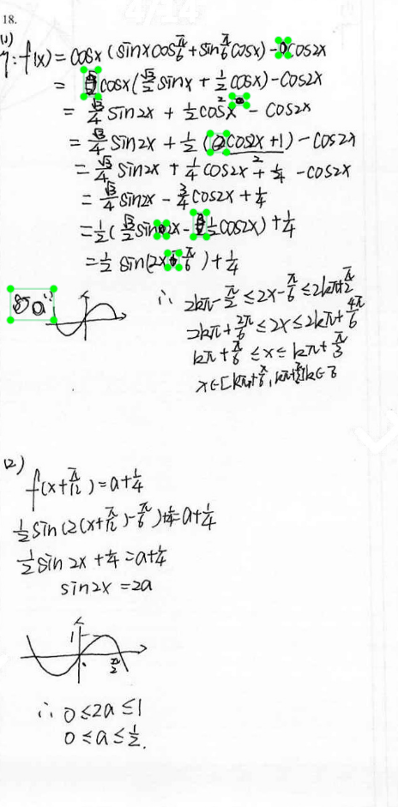
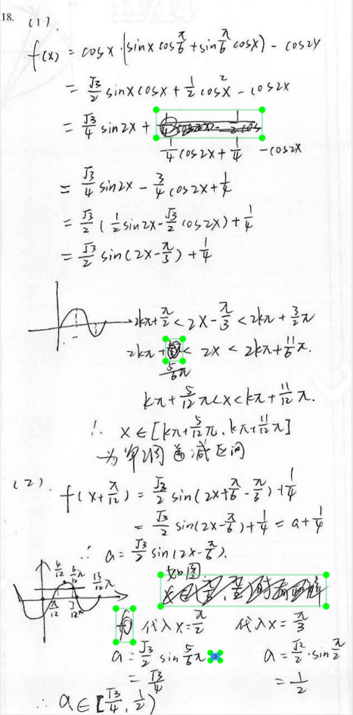
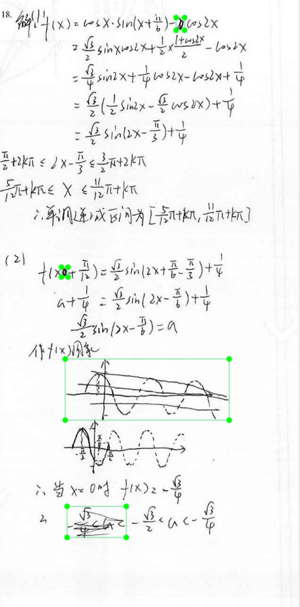
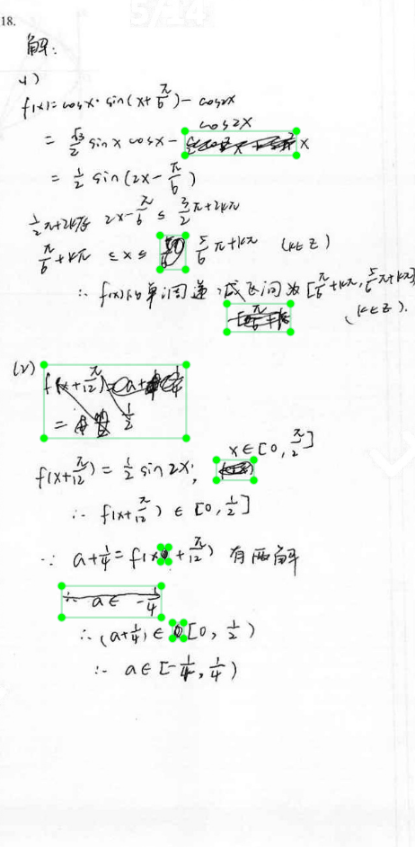
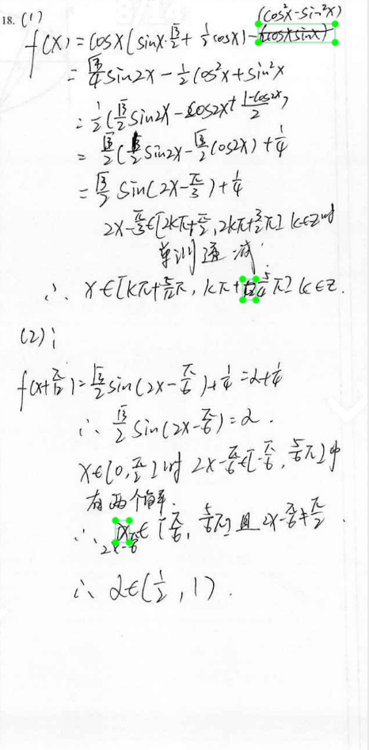
Resources
Annotated dataset of 632 eighth-grade students’ answers of one question in an exam.
All struck-out formulas, figures, letters, symbols, Chinese characters are annotated as one class.
Notes:
目前已有的资源是我们手工标注的632张学生答案，针对同一道三角函数题目
所有的涂改公式、图、字母、符号、汉字都被归为一类
目前的训练、验证、测试集划分是8:1:1

Slide 6
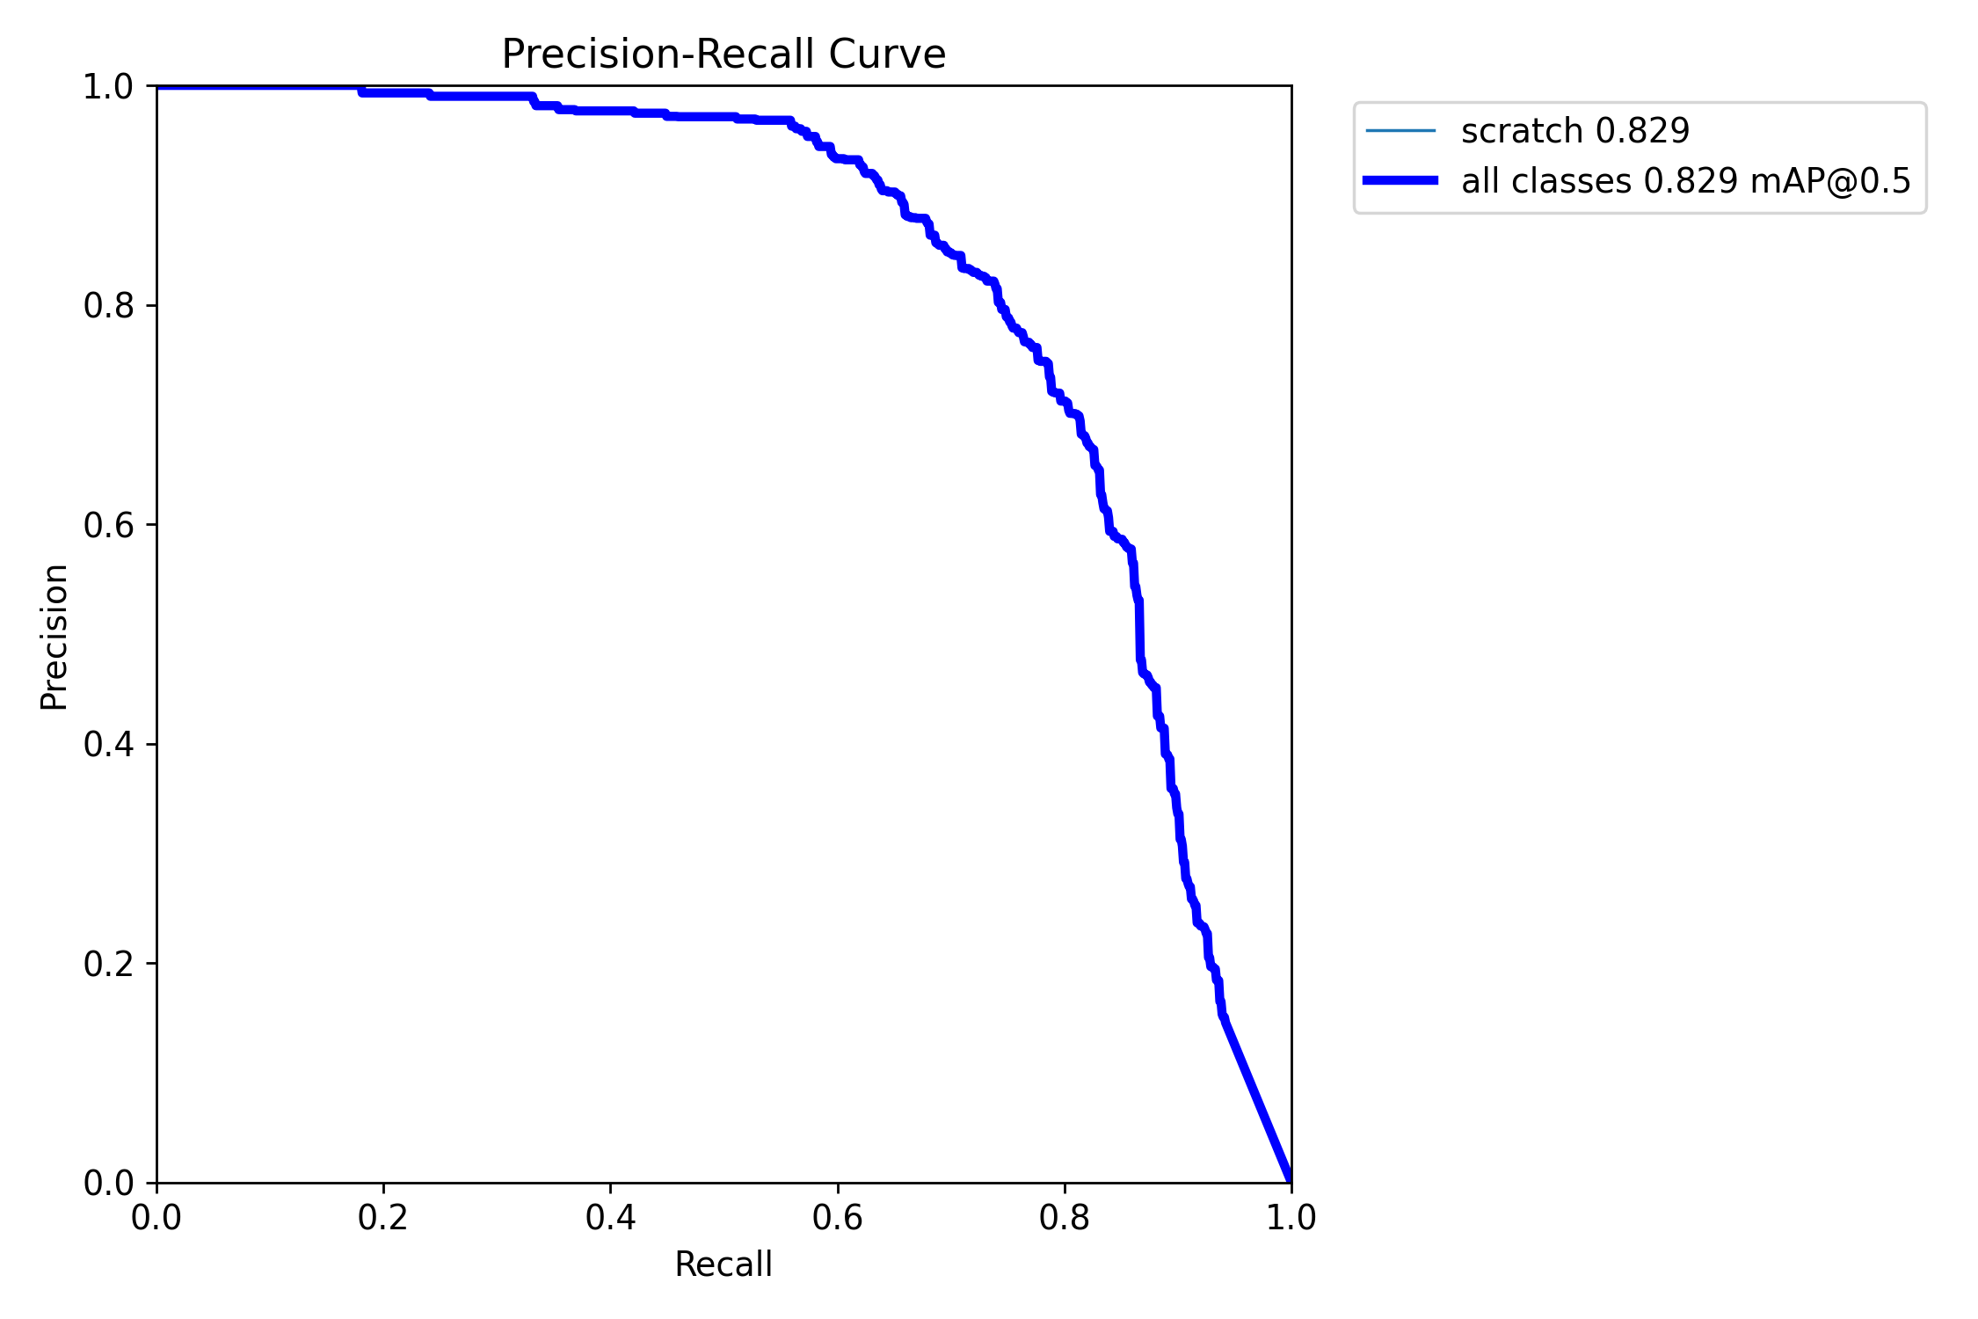
Baseline: Yolo v5
Epoch = 500
Precision – Recall Curve:
AP = 0.829
Notes:
我们把yolo v5作为Baseline，在它上面测试了效果
这是P-R曲线，AP值是0.829

Slide 7
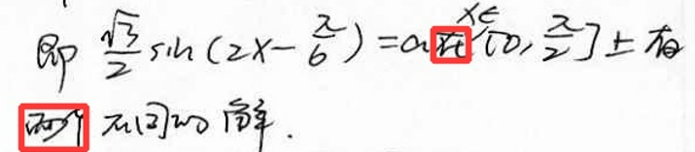
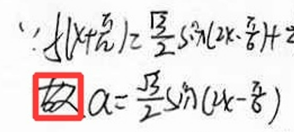
Difficulties
1. Chinese characters recognized as struck-out text.
Notes:
基于yolo这个baseline的结果，我们总结了涂改识别的一些难点
首先是汉字经常被识别成涂改

Slide 8
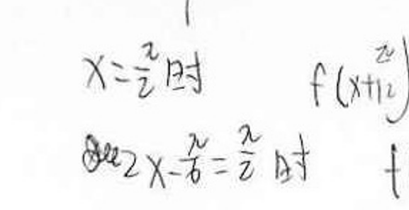
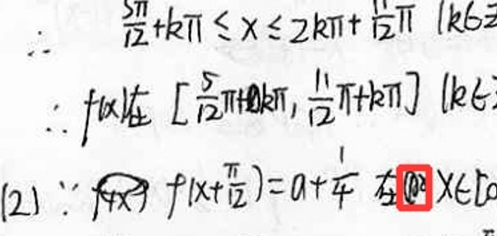
Difficulties
1. Chinese characters recognized as struck-out text.
2. Poor recognition of small struck-outs and small characters.
Notes:
然后是一些较小的涂改，一般只涉及1~4个字母或者符号，识别得不好

Slide 9
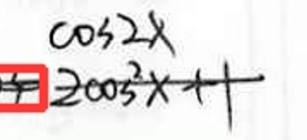
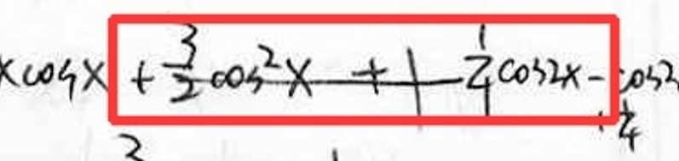
Difficulties
1. Chinese characters recognized as struck-out text.
2. Poor recognition of small struck-outs and small characters.
3. Long struck-out text not correctly recognized.
Notes:
以及，长划线经常遇到识别不到或者识别范围出错的问题

Slide 10
Methods
Test the performance of existing networks, combine or modify networks for higher performance.
1. Faster R-CNN
2. SSD
3. Easter 2.0
Other methods:
1. Data augmentation.
2. Utilize handwriting OCR pretrained model.
3. Refine the dataset to multiple classes.
Notes:
我们预计会测试Faster R-CNN、SSD、Easter2.0的效果，并且在他们上面进行修改来提升AP
我们还可能会采用一些数据增广方法，使用手写OCR识别的预训练模型，将数据分为多分类任务然后再合并的方法
Easter2.0是手写OCR识别的SOTA
数据增强包括加Mask

Slide 11
Thank you!

Slide 12
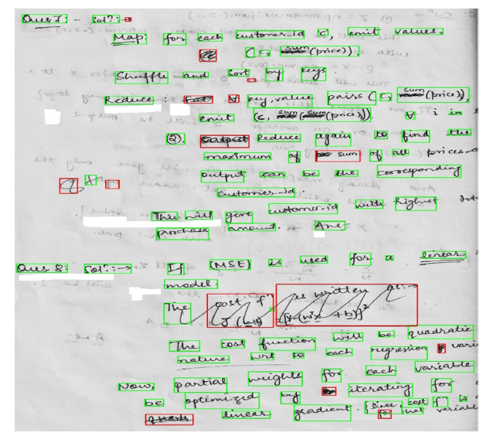
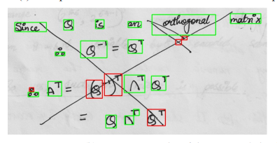
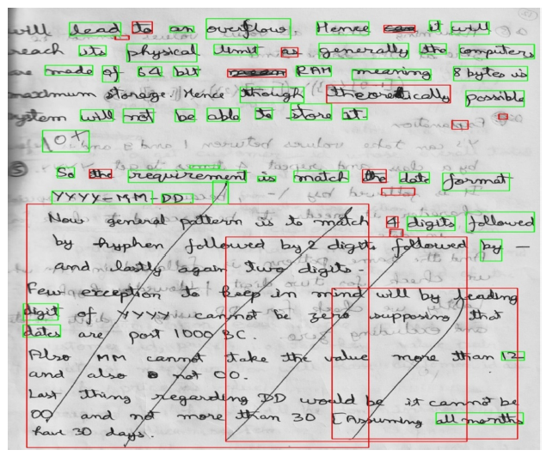
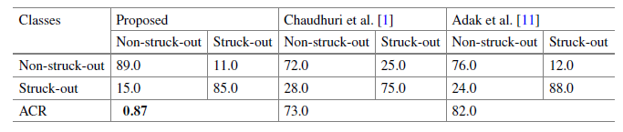
Existing work
Using Dense-net,
objection detection + classification
85% precision for struck-out text
Shivakumara, Palaiahnakote & Jain, Tanmay & Surana, Nitish & Pal, Umapada & Lu, Tong & Blumenstein, Michael & Chanda, Sukalpa. (2021). A Connected Component-Based Deep Learning Model for Multi-type Struck-Out Component Classification. 10.1007/978-3-030-86159-9_11.
Notes:
但是这篇工作主要专注于文本的涂改识别，但未必适合涉及大量公式、图的识别

