Slide 1

MegaMart Sales Analysis
Course: CDS 3533 - Big Data Analytics
Instructor: Dr. Amala Rajan
Semester: 202510
Students:
Maryam Ali (H00535836)
Hessa Khalfan (H00535166)

Slide 2
Project Overview
What is This Project About?
Analyzing sales data from MegaMart to understand its business performance.
Understanding the link between discounts and profitability through data analysis.
Using Big Data technologies like DigiXT, Trino SQL, and MongoDB for data processing and analysis.
Dataset: 9,994 records with 19 variables covering sales, customer, and product information.
Key Questions We Answer
1 | What is the quality of our data and how can we improve it?
2 | How can we process and store big data efficiently?
3 | What patterns and insights can we discover from the data?
4 | What do customers think about our products?

Slide 3
Dataset Overview
Dataset Structure
Data Categories
Identifiers (order_id, customer_id, product_id)
Temporal (order_date, ship_date)
Categorical (region, category, subcategory, segment, ship_mode)
Numerical (sales, quantity, discount, profit)
Unstructured (customer reviews (text data))
Aspect | Details
Name | megamart_CSV
Records | 9,994 transactions
Variables | 19 columns
Data Type | Transactional sales data

Slide 4
Key Statistics
Numerical Variables Summary
Statistic | Sales | Quantity | Discount | Profit
Mean | $229.86 | 3.23 | 0.156 (15.6%) | $28.66
Median | $54.49 | 3.00 | 0.200 (20%) | $8.67
Std Dev | $623.25 | 1.61 | 0.206 | $234.26
Minimum | $0.44 | -3.00 | 0% | -$6,599.98
Maximum | $22,638.50 | 9.00 | 80% | $8,399.98
Key Findings
Sales Distribution: A few large sales are pulling the average up. Most sales are much smaller than the average.
Profit Volatility: Extreme range from -$6,599.98 to +$8,399.98 with high standard deviation ($234.26) confirms unpredictable profitability.
Discount Pattern: The most common discount is 20%. Some discounts go up to 80%, which is very aggressive.

Slide 5
Data Quality Issues Found
Missing Values (Before Cleaning)
Outliers and Anomalies
Sales Outliers
1,167 records (11.7%) have unusually high sales
above $498.93
Profit Outliers
1,881 records (18.8%) total outliers: 604 low outliers (losses below -$39.72) 1,277 high outliers (profits above $70.82)
Quantity Anomaly
Minimum value: -3 Indicates returns or data entry errors requiring
investigation
Column | Missing | Percent (%) | Impact
order_date | 2,278 | 22.79% | Time-series analysis
quantity | 1,257 | 12.58% | Sales calculations
review | 2,380 | 23.81% | Sentiment analysis

Slide 6
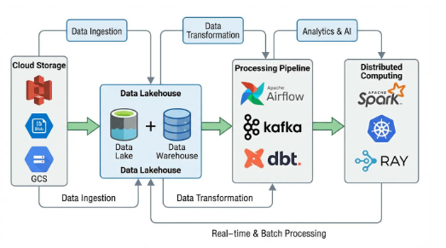
Data Storage & Processing Strategy
Storage Solution
Data Lakehouse Architecture: We use a Data Lakehouse. It combines the flexibility of a Data Lake with the structure of a Data Warehouse.
Cloud Storage (S3): This gives us low-cost, unlimited storage for all our data (structured and unstructured).
Processing Strategy
Batch Processing: We process data in large groups (batches) for maximum efficiency.
Optimization Techniques
Data Partitioning: We split data by date and region to make queries faster.
Data Virtualization: We create a single, unified view of all our data.

Slide 7
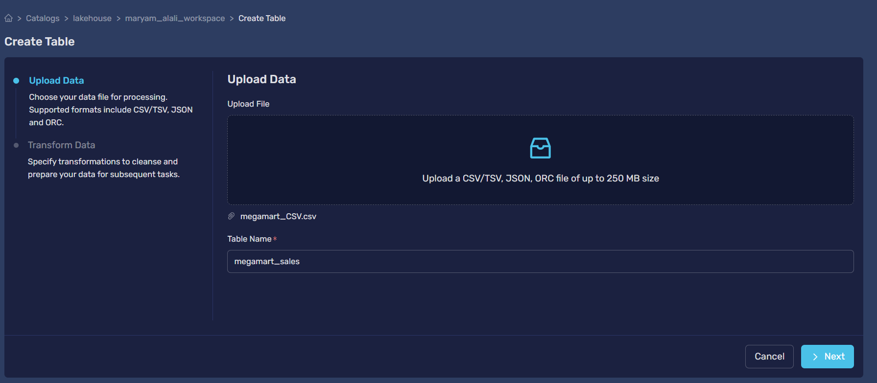
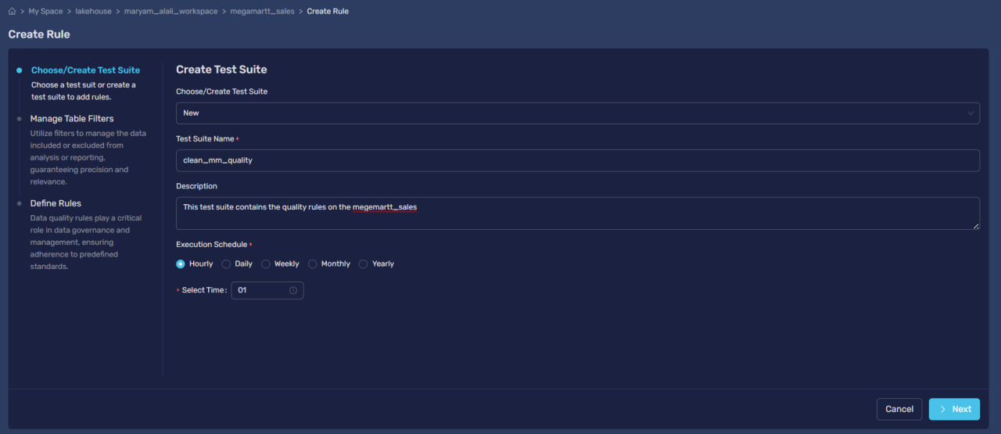
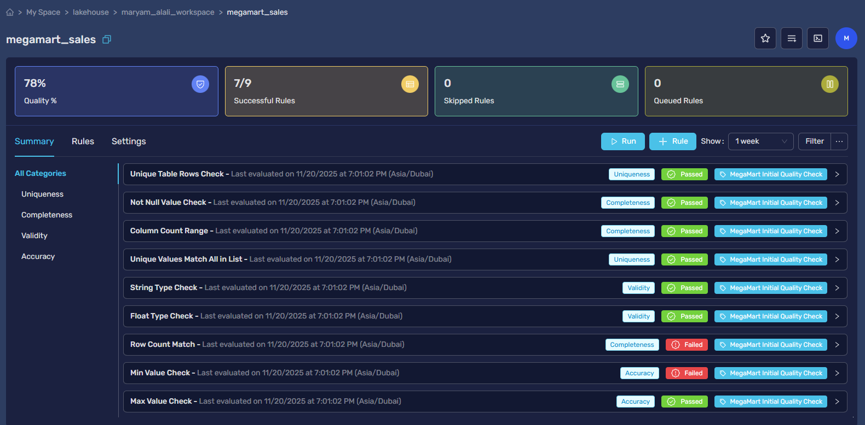
Data Quality Check in DigiXT(CLO2)
Task 4: Initial Quality Assessment
Ingested raw CSV file into DigiXT platform for comprehensive data quality evaluation.
Implemented test suite based on quality requirements to identify critical issues in the dataset.
Quality Metrics Checked:
Completeness - Missing values analysis
Accuracy - Outliers and anomalies detection
Consistency - Data types and formats validation
Validity - Business logic compliance

Slide 8
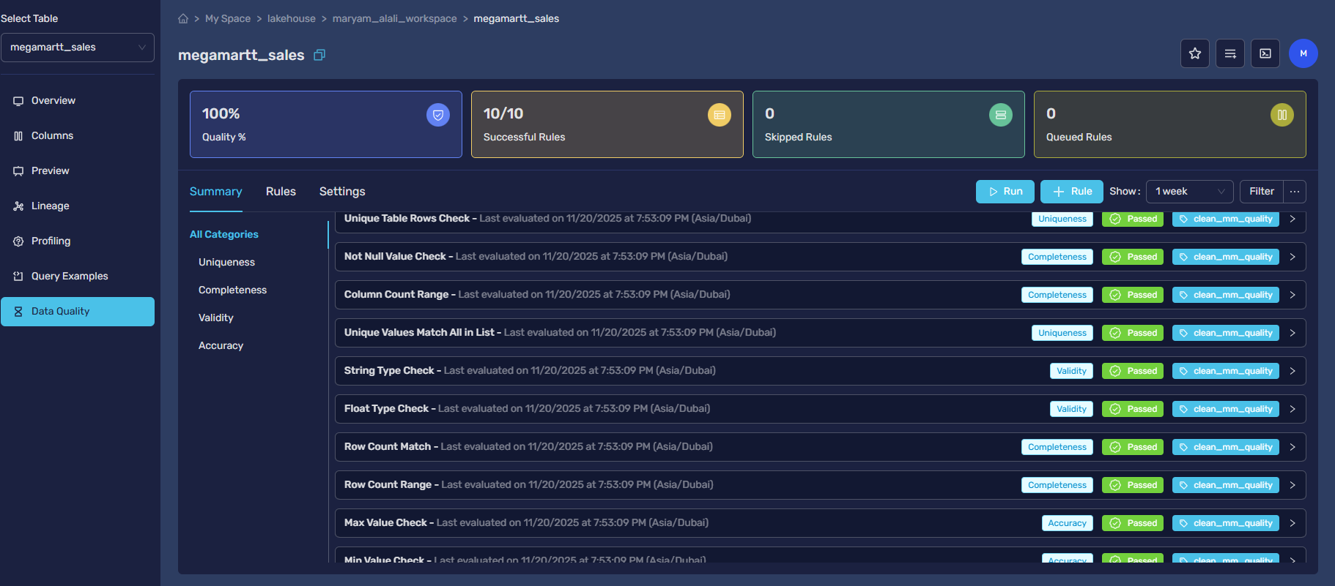
Data Preprocessing & Cleaning (CLO2)
Task 5: Cleaning Strategy
Handle Missing Values
order_date: Impute with median or remove records
quantity: Remove records with missing values
review: Keep as-is for sentiment analysis subset
Fix Anomalies
Negative quantity: Treat as returns or remove
Extreme outliers: Keep (valid high-value transactions)
Data Validation
Ensure all values are within valid ranges
Check data type consistency
Verify business logic compliance
Task 6: Re-validation
Ran quality checks again after cleaning
Confirmed improvement in data quality metrics
Reduced missing values significantly
Dataset now ready for analysis

Slide 9
Exploratory Data Analysis - Simple Queries
Task 7: EDA with Trino SQL
a) Simple Query
-- Previewing the core columns for our profitability analysis.
SELECT order_id, product_name, sales, discount, profit
FROM maryam_alali_workspace.megamartt_sales
LIMIT 10;
d) Group By query with HAVING
-- Identifying product sub-categories that become unprofitable
SELECT subcategory,
AVG(profit) AS average_profit,
AVG(discount) AS average_discount_applied
FROM maryam_alali_workspace.megamartt_sales
WHERE discount > 0
GROUP BY subcategory
HAVING AVG(profit) < 0
ORDER BY average_profit ASC;
b) Simple queries with filters
-- Isolating specific loss-making transactions
SELECT order_id, product_name, sales, discount, profit
FROM maryam_alali_workspace.megamartt_sales
WHERE profit < 0
AND discount > 0.5;
c) Group By Query
-- Analyzing the impact of different discount levels on profitability.
SELECT discount,
COUNT(order_id) AS number_of_orders,
AVG(profit) AS average_profit,
SUM(sales) AS total_sales
FROM maryam_alali_workspace.megamartt_sales
GROUP BY discount
ORDER BY discount ASC;
e) Order By Query
-- Order By Query: Identifying the top 15 worst-performing transactions (highest losses)
SELECT order_id, product_name, region, sales, discount, profit
FROM maryam_alali_workspace.megamartt_sales
ORDER BY profit ASC
LIMIT 15;

Slide 10
Advanced Queries - Joins & Subqueries
Task 8: Complex Analysis
a) Inner Join Query
c) Subquery
-- Finds the transaction details for the single sale with the highest profit.
SELECT order_id, product_name, sales, discount, profit
FROM maryam_alali_workspace.megamartt_sales
WHERE profit = (
SELECT MAX(profit)
FROM maryam_alali_workspace.megamartt_sales );
-- Finds products that are both highly profitable and high-volume sellers.
SELECT p.product_name, p.total_profit, s.total_quantity_sold
FROM maryam_alali_workspace.top_100_profit_products p
INNER JOIN maryam_alali_workspace.top_100_sales_products s
ON p.product_name = s.product_name;
b) Left Outer Join Query
-- Finds highly profitable products that are not selling in high volumes.
SELECT p.product_name, p.total_profit
FROM maryam_alali_workspace.top_100_profit_products p
LEFT JOIN maryam_alali_workspace.top_100_sales_products s
ON p.product_name = s.product_name
WHERE s.product_name IS NULL;
Query Capabilities Demonstrated
Inner Join: Combines related data from multiple tables
Left Join: Includes all records from left table with matching data
Subquery: Filters data based on aggregated calculations

Slide 11
Key Findings from EDA
1. The Discount Trap
2. Category Performance
3. Geographic Patterns
4. Profit Volatility
Higher discounts lead to lower profits. A 20% discount is common but hurts profitability.
Office Supplies is the most common category (60.3%). Binders is the top subcategory (15.24%). Profitability varies a lot between categories.
The West region has the most sales (32.05%). Standard Class is the main shipping method (59.72%). The Consumer segment is the largest (51.94%).
Profit ranges from a loss of -$6,599 to a gain of +$8,399. This wide range means profitability is very unpredictable.

Slide 12
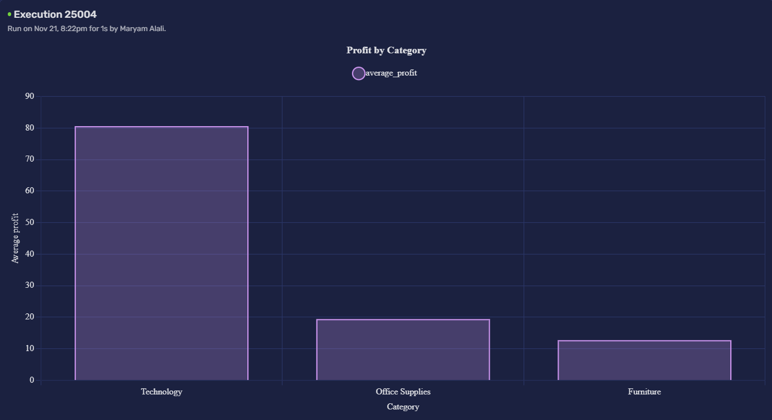
Data Product 1: Profitability Analysis
Story 1.1: Average Profit by Product Category
Story 1.2
-- Finds highly profitable products that are not selling in high volumes.
SELECT p.product_name, p.total_profit
FROM maryam_alali_workspace.top_100_profit_products p
LEFT JOIN maryam_alali_workspace.top_100_sales_products s
ON p.product_name = s.product_name
WHERE s.product_name IS NULL;
Key Insights:
Technology: Has the highest average profit per sale. This shows that customers are willing to pay more for these products.
Furniture: Shows moderate profit. There is a good opportunity to make more money here through better cost management and pricing.
Office Supplies: Has low average profit, even though it has the highest sales volume (60.3%). This reveals a major problem: selling a lot doesn't mean making a lot of profit.
1
Business Impact:
Focus marketing on the Technology category to make more money.
Find out why selling a lot of Office Supplies doesn't lead to high profit.
Consider changing the prices for Office Supplies to improve profit margins.
Move resources from low-profit to high-profit categories for a better return on investment (ROI).
1

Slide 13

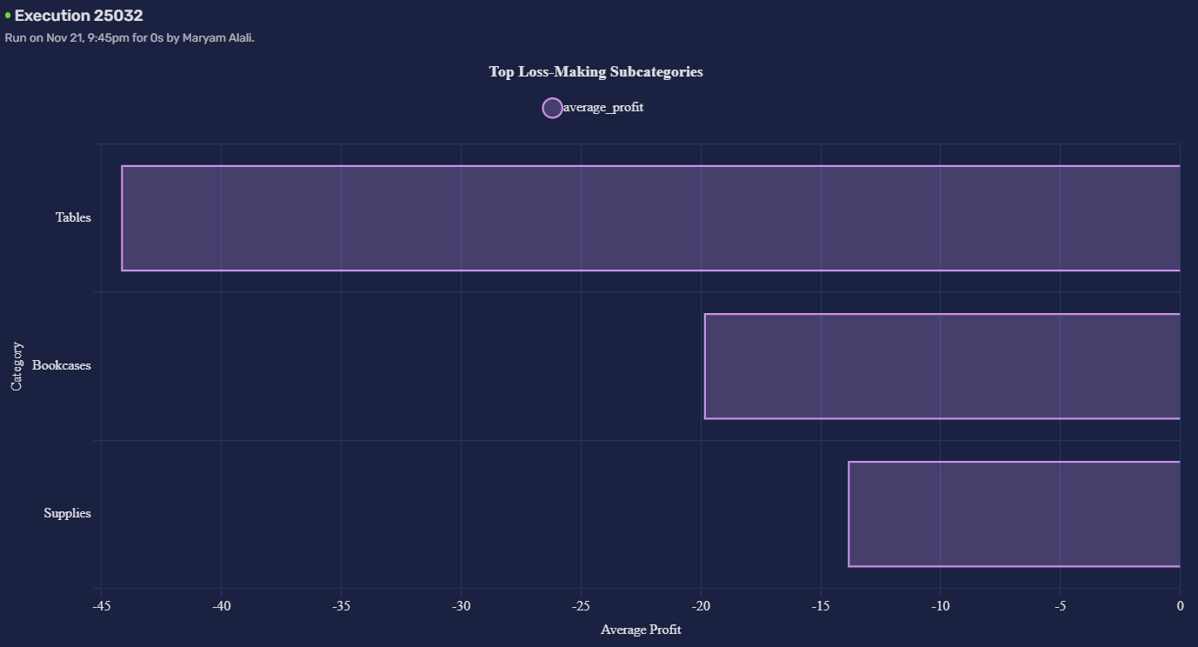
Data Product 1: Profitability Analysis
1.2: Average Profit by Product Category
Story 1.2
-- Finds highly profitable products that are not selling in high volumes.
SELECT p.product_name, p.total_profit
FROM maryam_alali_workspace.top_100_profit_products p
LEFT JOIN maryam_alali_workspace.top_100_sales_products s
ON p.product_name = s.product_name
WHERE s.product_name IS NULL;
Strategic Recommendations
1
Review Pricing Strategy
Analyze the pricing and discount rules for these loss-making items. Consider adjusting prices to improve profit margins while staying competitive.
2
Investigate Cost Structure
Examine the supply chain costs, shipping expenses, and vendor pricing. Look for opportunities to reduce costs or renegotiate with suppliers.
3
Consider Product Restructuring
Evaluate discontinuing products that consistently lose money, or replace them with higher-margin alternatives. Focus resources on profitable product lines.

Slide 14
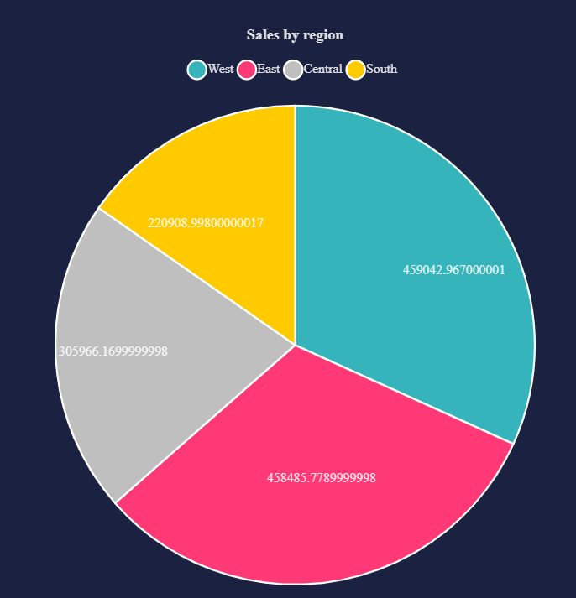
Data Product 2: Geographic Performance
Story 2.1: Total Sales Revenue by Region
Resource Allocation
Focus resources on the West. Keep investing in the leader.
Growth Opportunities:
Run targeted campaigns in the Central and South regions.
Regional Optimization:
Learn from the West's success and apply it to other regions.
Competitive Analysis:
Key Observation
West region is the leader. Central region is a growth opportunity.
Analyze competitors in each region to find growth advantages.

Slide 15
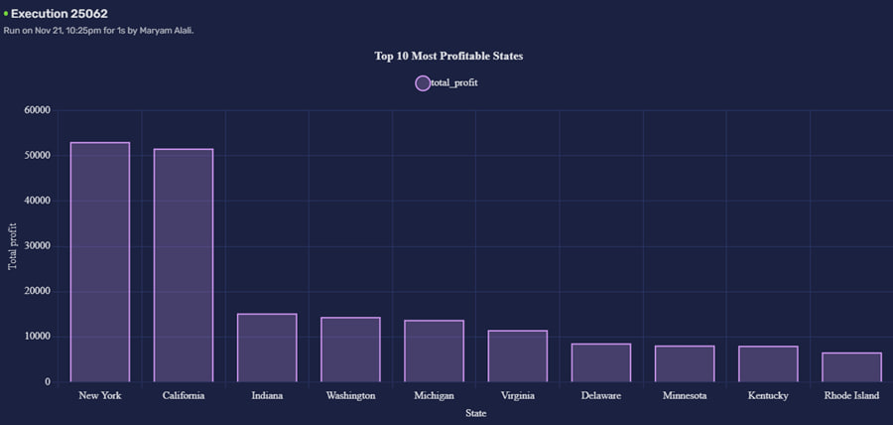
Data Product 2: Geographic Performance
Story 2.1: Total Sales Revenue by Region
1.Study Success Factors
Analyze why California and New York are so profitable. Then, copy their strategies.
2. Replicate Best Practices
Apply the successful strategies from top states to underperforming regions.
3.Targeted Regional Plans
Key Observation
California and New York have a combined profit of over $150K.
High profit does not always mean high sales in every state.
There is a big opportunity to improve profits in lower-performing states.
Create custom growth plans for states with untapped potential.

Slide 16
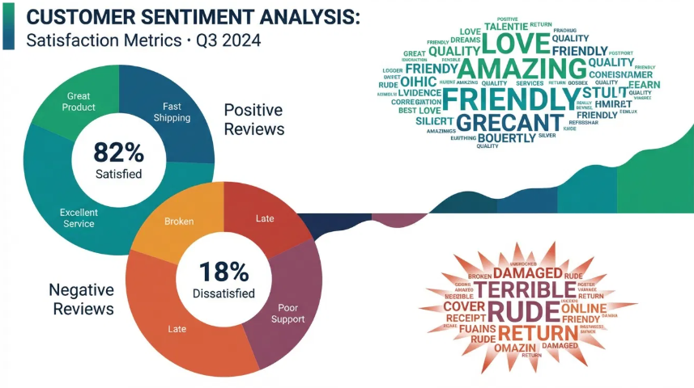
Customer Sentiment Analysis
Objective
Analyze customer opinions using review and product_id columns from the dataset through MongoDB NoSQL database.
Process
Selected specific products with reviews
Created MongoDB NoSQL database
Categorized reviews as positive/negative
Counted sentiment distribution
Sample Result
Product A | 85% positive
Product B | 60% positive
Product C | 45% positive
Insight: Customer satisfaction varies significantly by product

Slide 17

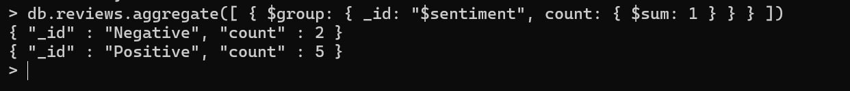
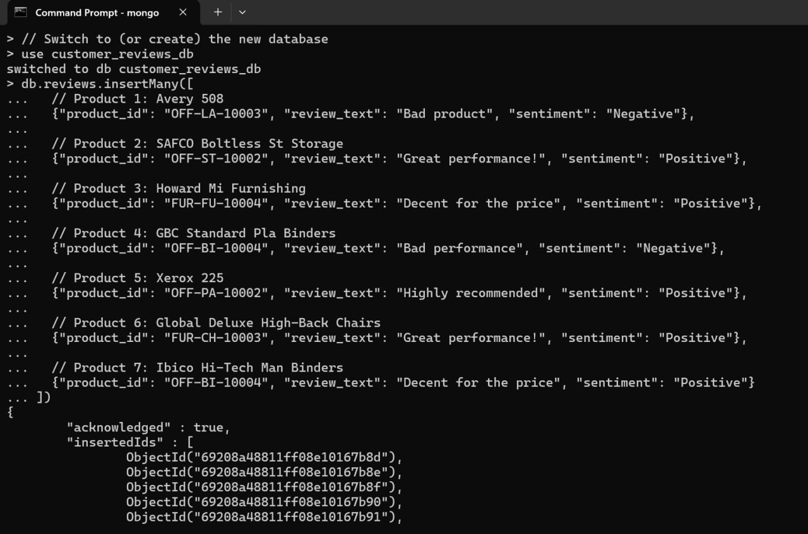
Customer Sentiment Analysis
Our 3-Step Process
1. Setup Database (MongoDB)
Connected to the MongoDB server.
Created a new database: customer_reviews_db.
2. Insert Data
Loaded customer reviews into a reviews collection.
Each review document contains: Product ID, Review Text, and Sentiment.
3. Analyze Sentiments
Used queries to count "Positive" and "Negative" reviews.
Used the Aggregation Pipeline to group and count all sentiments efficiently.
Conclusion
MongoDB is highly effective for analyzing unstructured customer feedback, allowing us to quickly understand customer opinions.

Slide 18
A 4-Step Plan for Growth
Fix the Discount Strategy
2
Improve the Product Mix
1
3
4
Stop high discounts. Keep them at 10-15% to protect profits.
Use big discounts only to clear out old stock.
Change prices based on demand (Dynamic Pricing).
nvest in what works. Focus on high-profit items like Technology.
Stop selling products that lose money, like Tables and Chairs.
Add new products with better profits, especially in Office Supplies.
Focus on Winning Regions
Put the Customer First
Copy the success of the West region and apply it to other areas.
Create growth plans for the Central and South regions.
Learn from top states and use their winning strategies.
Focus on product quality to get better reviews.
Connect customer happiness to your profit analysis.
Sell quality, not just quantity, to build customer loyalty.

Slide 19

THANK YOU

