Slide 1


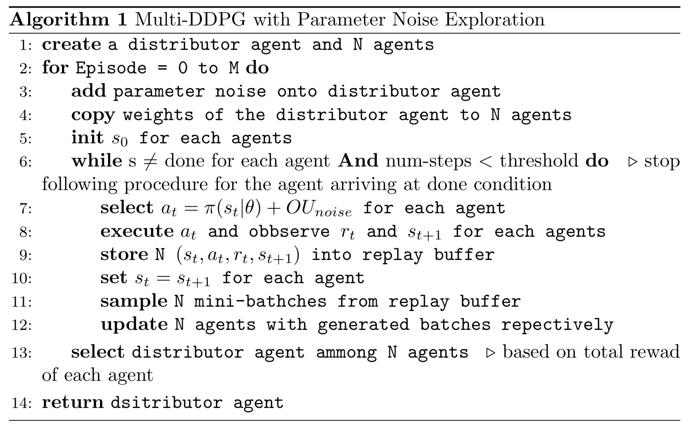
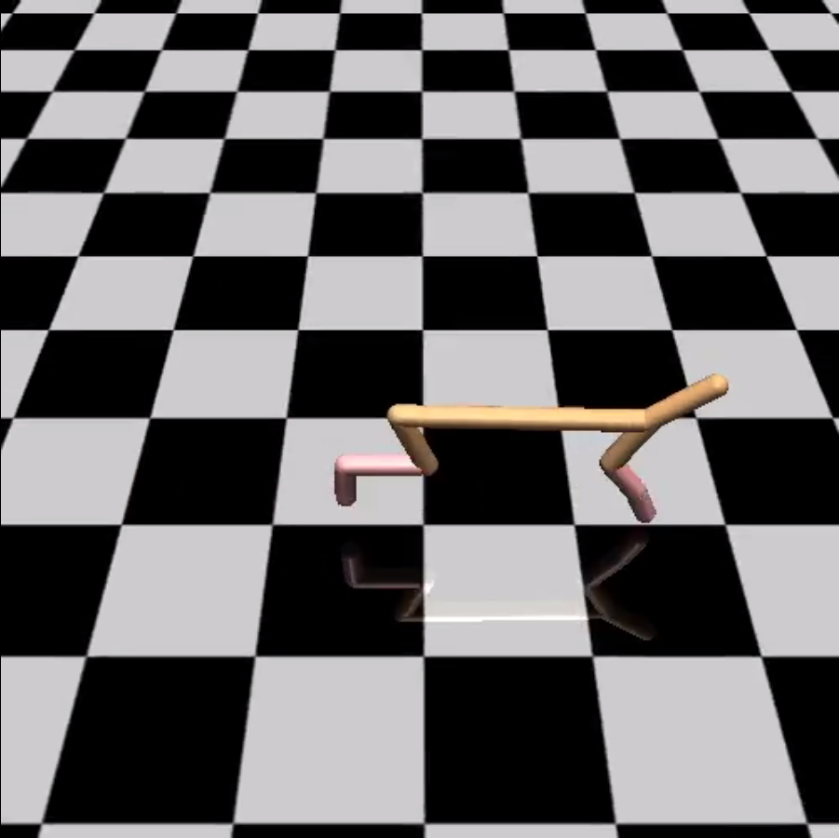
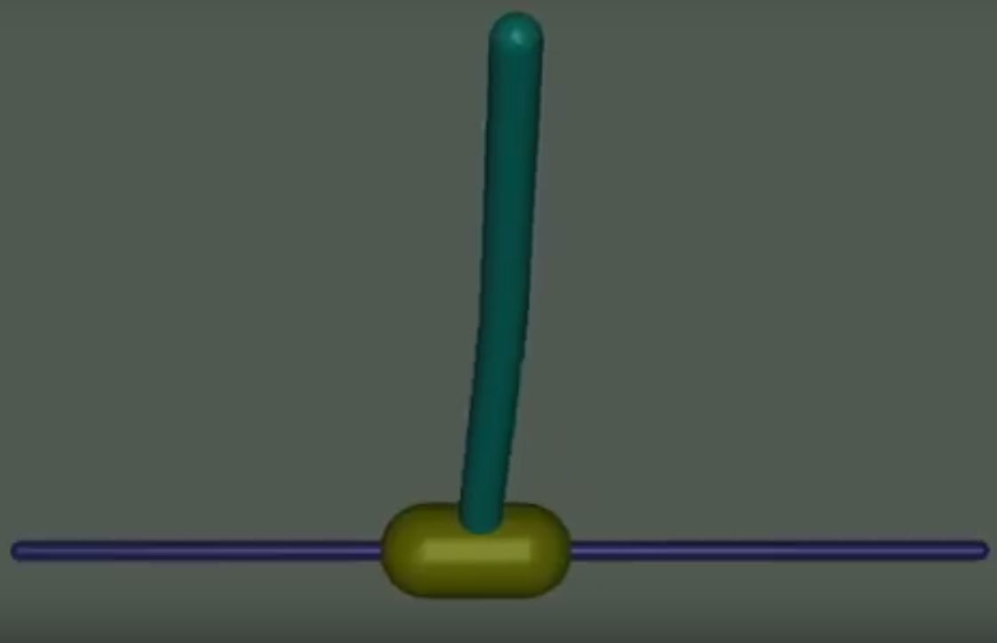
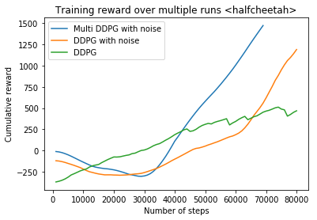
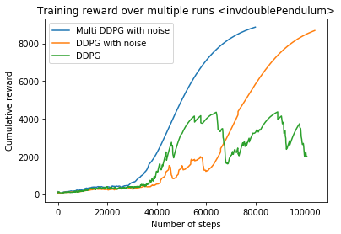
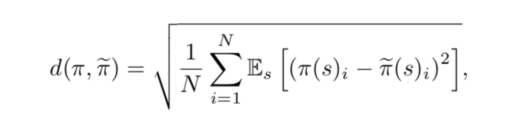
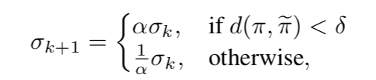
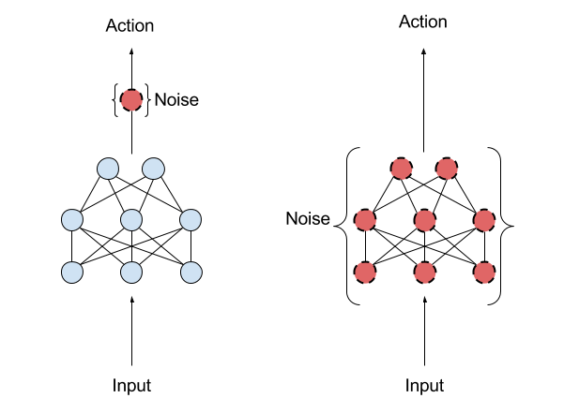
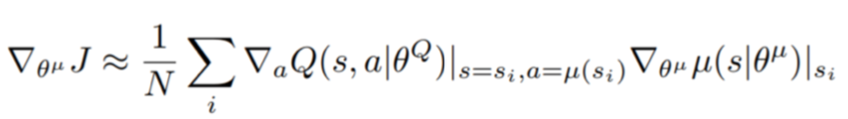
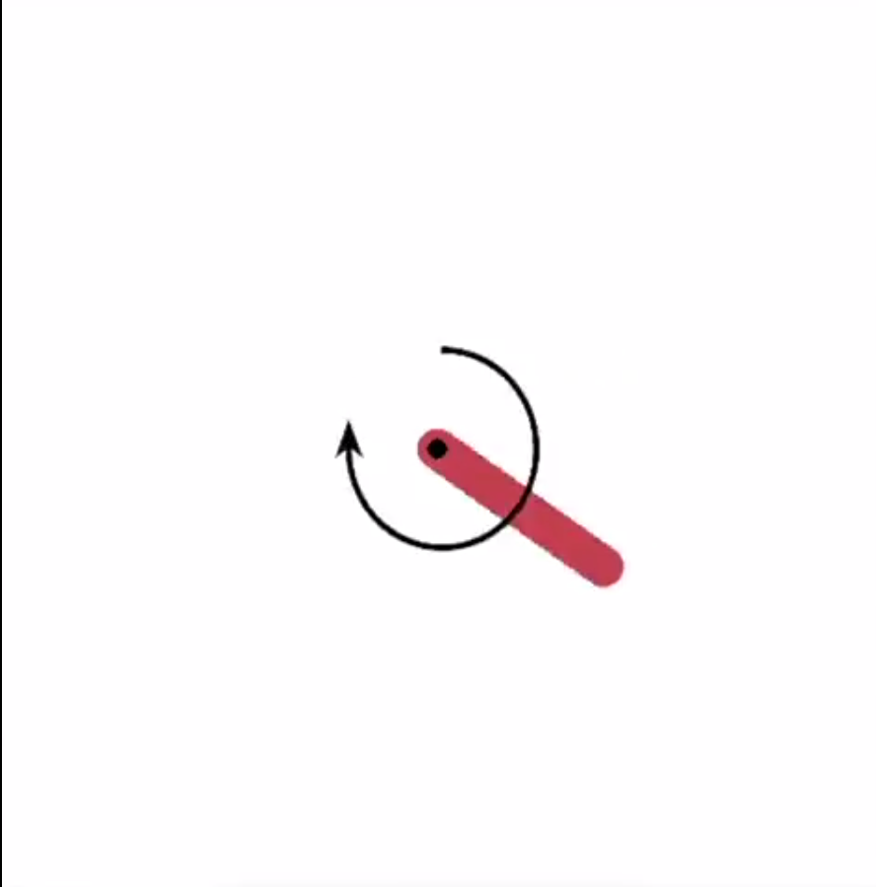
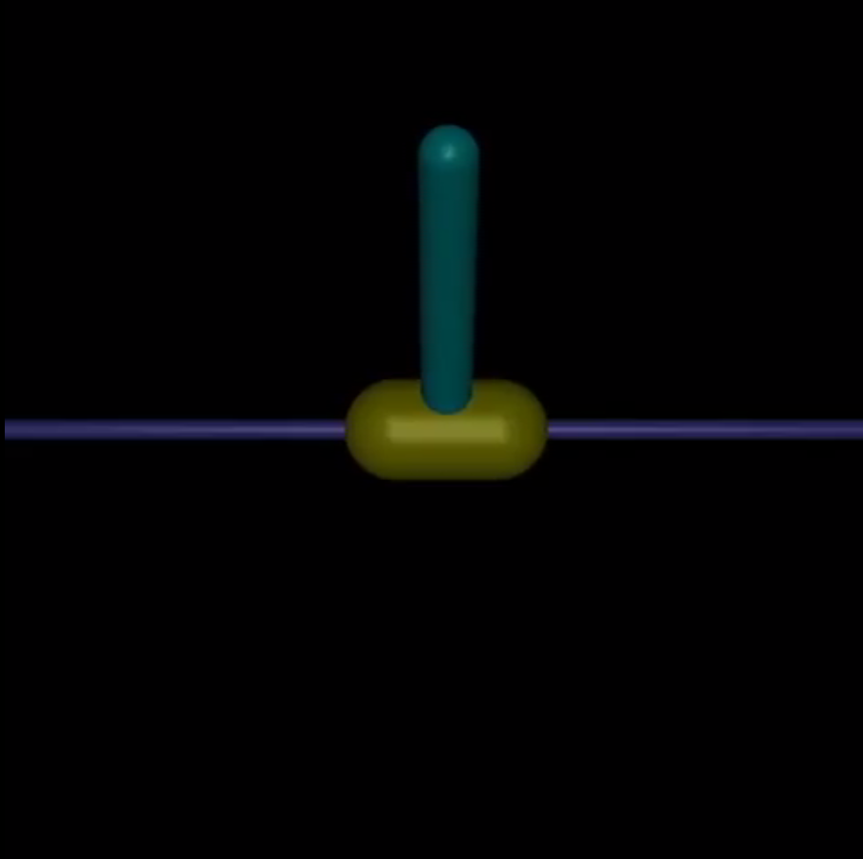
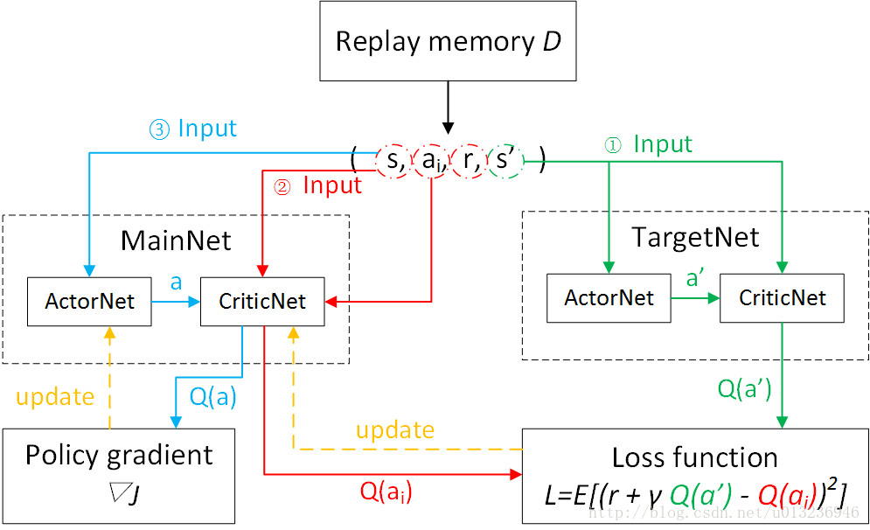
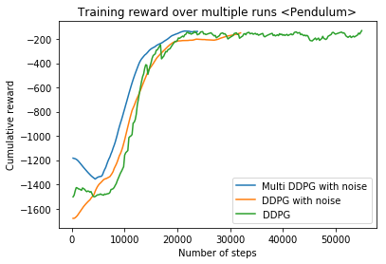
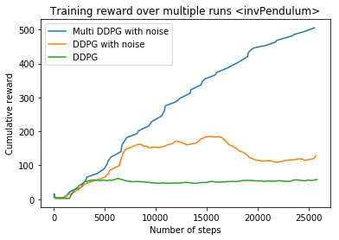
Multi-DDPG with Parameter Noise Exploration
Yuxin Han, Chuqiao Song, Lianming Shi
Department of Electrical and Computer Engineering, University of California, San Diego
INTRODUCTION
MATERIALS & METHODS
3. HalfCheetah 4. Double InvertedPendulum
In this project, we want to solve some deficiencies of traditional reinforcement learning algorithm, such as data inefficiency, computation inefficiency on single computer, unintelligent exploration problem, and not leveraging previous trained data.
With the baseline algorithm, parameter space noise for exploration, we can have a more intelligent way to do consistent exploration, and obtain a richer set of behavior.
However, this baseline algorithm with DDPG is not stable enough to solve continuous problems, and converge very slow. Therefore, we implement a so called Multi-DDPG structure to choose best agent among agents in current episode as a distributor for next episode is a way to reduce the chaos.
BACKGROUND
Parameter Space Noise for Exploration
Parameter noise adds adaptive noise to the parameters of the neural network policy, rather than to its action space. Traditional RL uses action space noise to change the likelihoods associated with each action the agent might take from one moment to the next. Parameter space noise injects randomness directly into the parameters of the agent, altering the types of decisions it makes such that they always fully depend on what the agent currently senses.
Action space noise (left), compared to parameter space noise (right)
DDPG
DDPG adapts the ideas underlying the success of Deep Q-Learning to the continuous action domain. It is an actor-critic, model-free algorithm based on the deterministic policy gradient that can operate over continuous action spaces.
By implementing this Multi-DDPG structure with parameter noise exploration, we are able to generate the independent experiences into the replay buffer, and to accelerate replay buffer refreshing to make data efficient. Finally, choosing a best agent among agents in current episode as a distributor for next episode is a way to reduce the chaos.
1. A distance measure for DDPG
2. Adaptive scaling
Multi-DDPG with parameter noise scales robust and outperform other methods with increasing action dimensionality and less iteration to converge.
3. Policy gradient for actor
4. Update for critic
CONCLUSION
In this work, we propose parameter space noise as a conceptually simple yet effective replacement for traditional action space noise like ɛ -greedy and additive Gaussian noise. This work shows that parameter perturbations can successfully be combined with contemporary off-policy deep RL algorithms DDPG and often results in improved performance compared to action noise. Also, by implementing Multi-DDPG structure, we can stabilize the variance of the vanilla DDPG parameter noise method. Experimental results further demonstrate that using parameter noise with Multi-DDPG allows solving environments with very sparse rewards quickly, in which action noise is unlikely to succeed. Our results indicate that parameter space noise is a viable and interesting alternative to action space noise, which is still the de facto standard in most reinforcement learning applications.
RESULTS
We compare vanilla DDPG with parameter noise DDPG and parameter noise Multi-DDPG, under pendulum, inverted pendulum, half-cheetah, and double inverted pendulum environments.
1. Pendulum 2. InvertedPendulum
REFERENCES
https://blog.openai.com/better-exploration-with-parameter-noise/
https://github.com/openai/baselines/tree/master/baselines/ddpg
https://arxiv.org/pdf/1706.01905.pdf
https://arxiv.org/abs/1509.02971
ACKNOWLEDGEMENTS
I would like to thank for our professor Michael Yip for providing technical support and answering questions.

