Slide 1
Git Tutorial
By Hesamadin Akrami
(Hesam Marshal)

Slide 2

Register in GitHub.com
Go to www.Github.com
Sign Up
Sign in

Slide 3
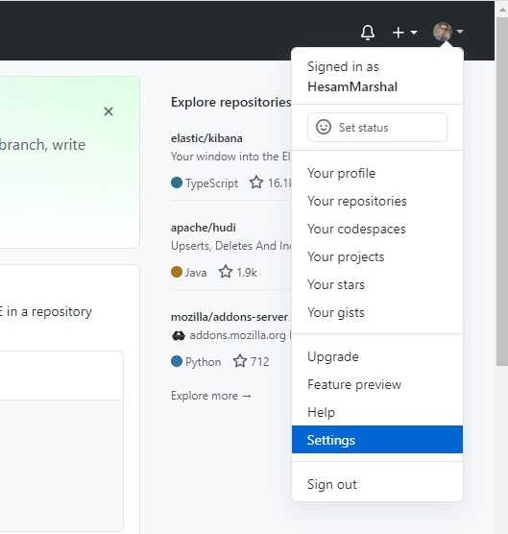
Go to the Settings
From to right push the down arrow
Select the Settings

Slide 4
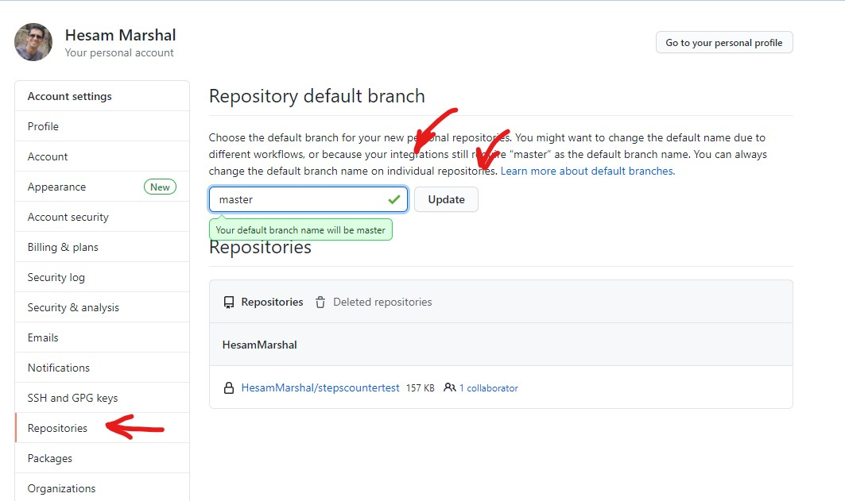
Change the main branch
1
From left panel select Repositories
2
Change the default branch to master
3
Push the upgrade button

Slide 5
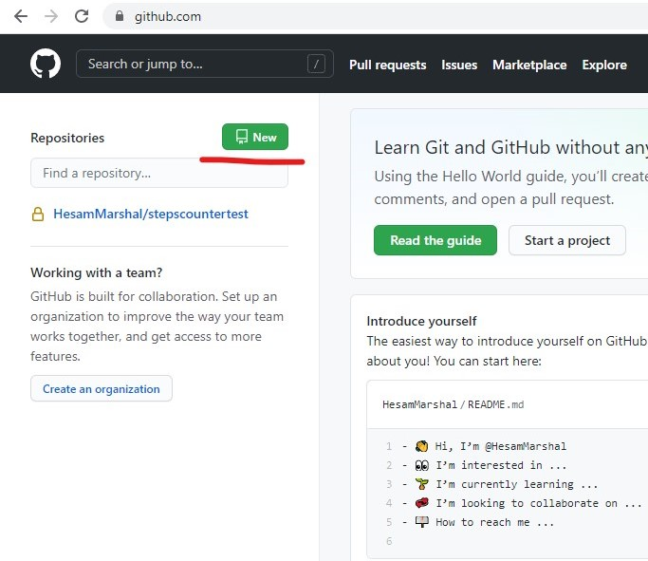
Create a new repository
Press the new button
Fill the fields

Slide 6
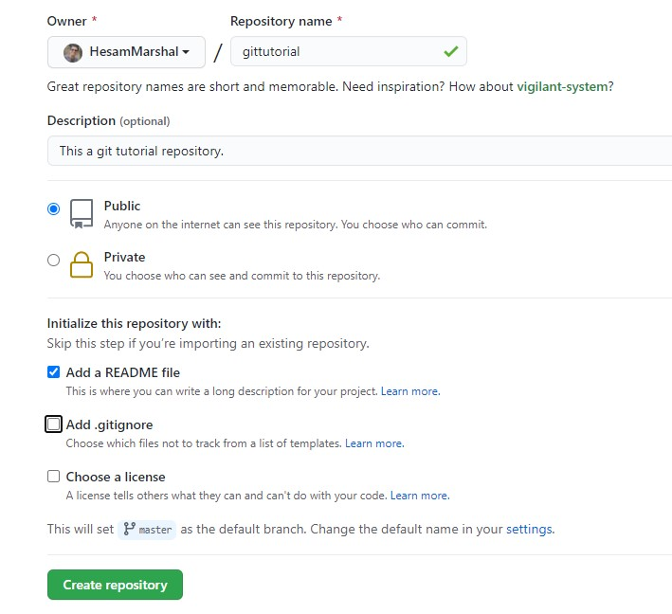
Fill the fields
Name your repository (e.g: gittutrial)
Descriptions (optional)
Public or Private
Add a README file (Optional)
Add .gitignore (Optiona)
Choose a license (Optional)
We will explain them latter

Slide 7
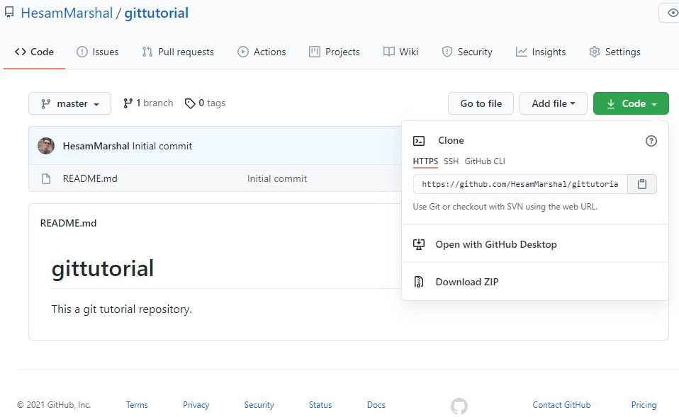
Your Repository
At left you can see content
Branch Name
Click the code button
This is the address of your repo

Slide 8
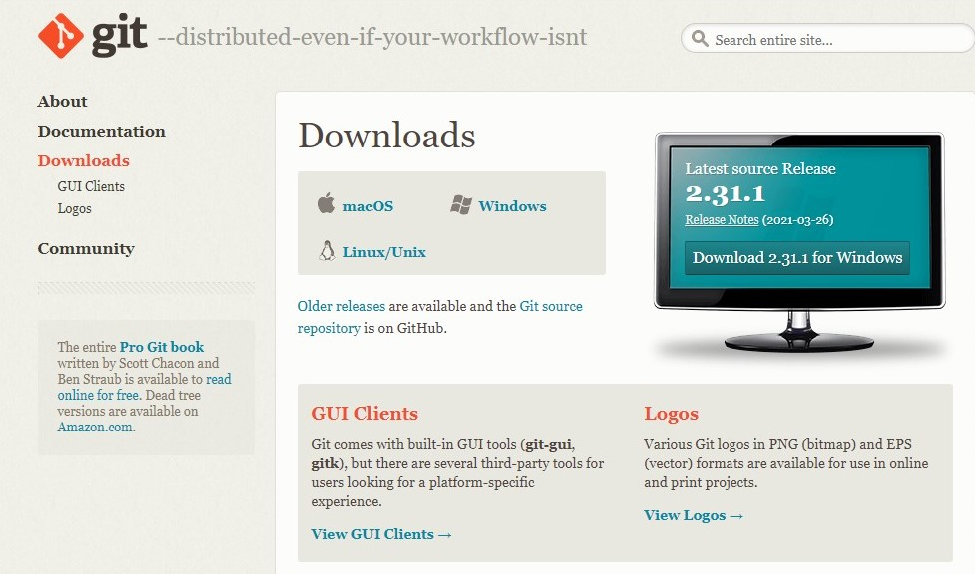
Git Software
Go to www.git-scm.com
Download
Install the git software

Slide 9
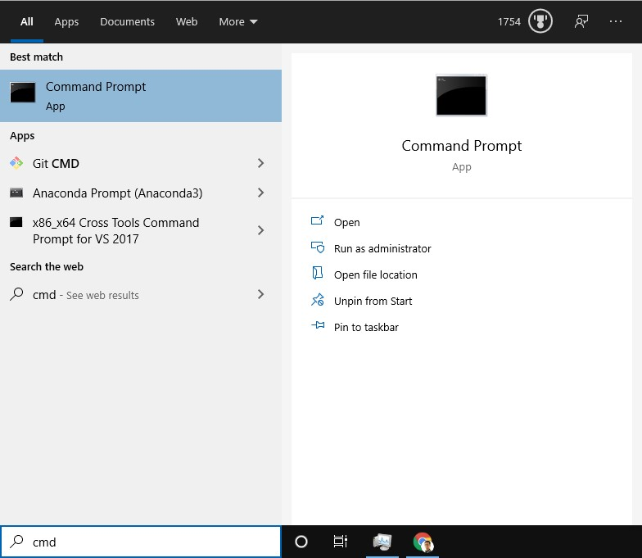
Open Command Prompt
Press windows button
Type cmd
Hit the Enter (or click by mouse)
If you are new to CMD don’t afraid of it.
I will add a Section and Explain about it.
just follow the steps and write them down.

Slide 10
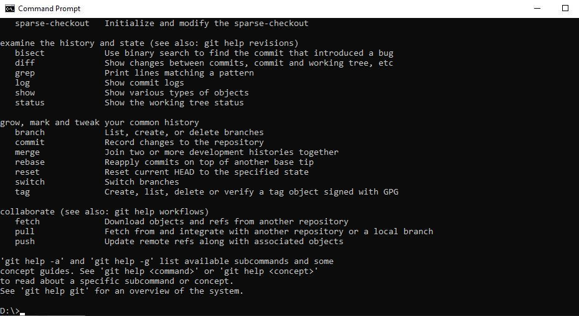
Check the git installation
Write git and hit the Enter. if you installed the got correctly you should get result like bellow.
Hurray! You are good!

Slide 11
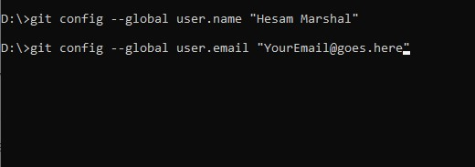
Configuring your git
git config --global user.name “FirstName LastName“
git config --global user.email “your email address"

Slide 12
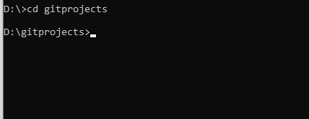
Create a folder for your projects
Create a folder for your Projects (e.g. gitprojects)
Change active directory to it cd gitprojects
Check the prompt is:
D:\gitprojects>

Slide 13
Clone your repository
Go to your repository
Copy the address

