Slide 1
Git Tutorial
By Hesamadin Akrami
(Hesam Marshal)

Slide 2
Register in GitHub.com
Go to www.Github.com
Sign Up
Sign in

Slide 3
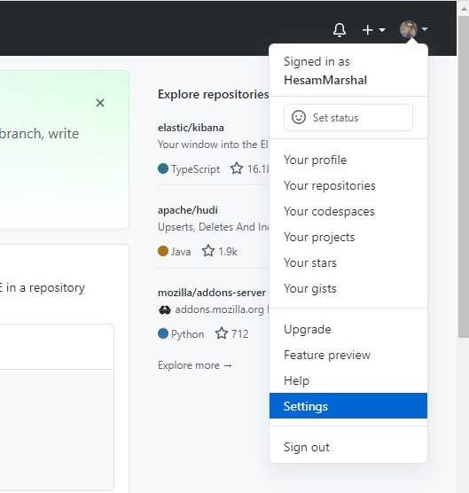
Go to the Settings
From to right push the down arrow
Select the Settings

Slide 4
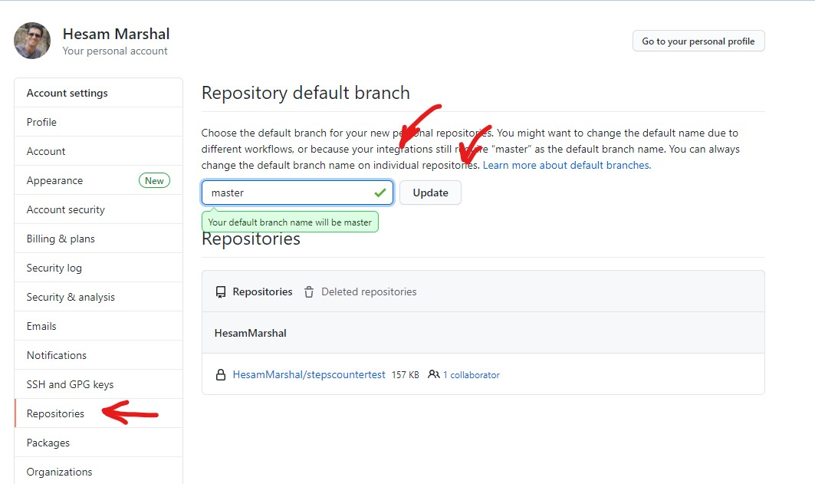
Change the main branch to master
1
From left panel select Repositories
2
Change the default branch to master
3
Push the upgrade button

Slide 5
Change the main branch to master
1
From left panel select Repositories
2
Change the default branch to master
3
Push the upgrade button

Slide 6
Change the main branch to master
1
From left panel select Repositories
2
Change the default branch to master
3
Push the upgrade button

Slide 7
Change the main branch to master
1
From left panel select Repositories
2
Change the default branch to master
3
Push the upgrade button

Slide 8
Change the main branch to master
1
From left panel select Repositories
2
Change the default branch to master
3
Push the upgrade button

Slide 9
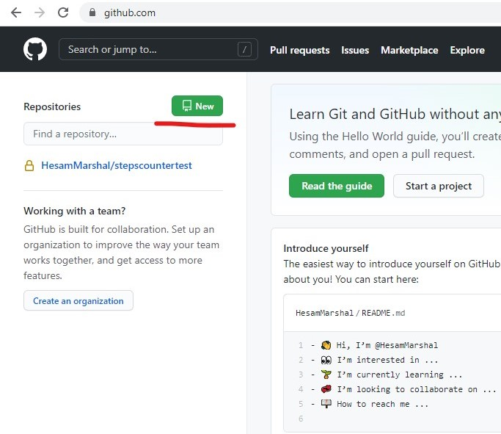
Create a new repository
Press the new button
Fill the fields

Slide 10
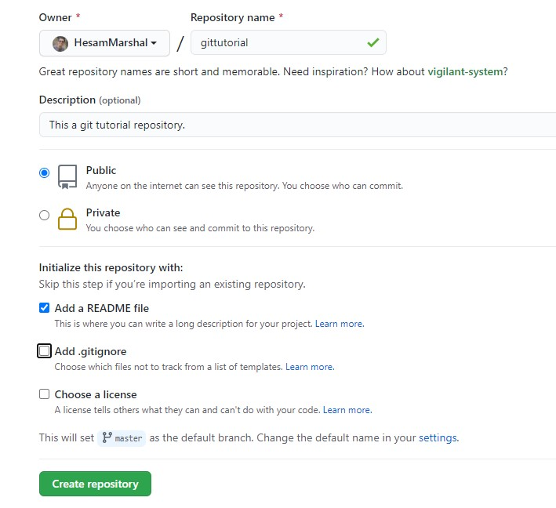
Fill the fields
Name your repository (e.g: gittutrial)
Descriptions (optional)
Public or Private
Add a README file (Optional)
Add .gitignore (Optiona)
Choose a license (Optional)
We will explain them latter

Slide 11
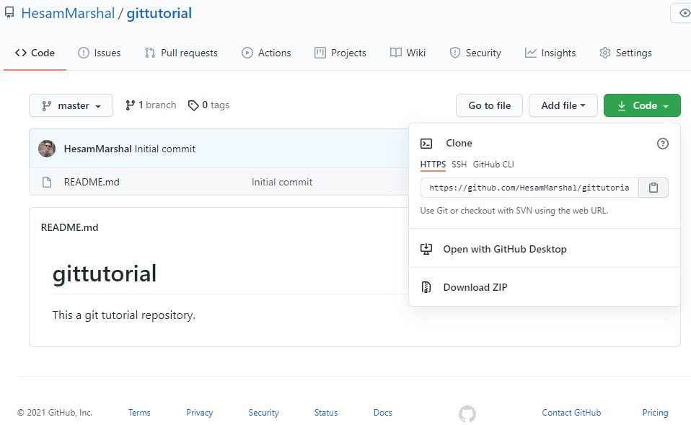
Your Repository
At left you can see content
Branch Name
Click the code button
This is the address of your repo

Slide 12
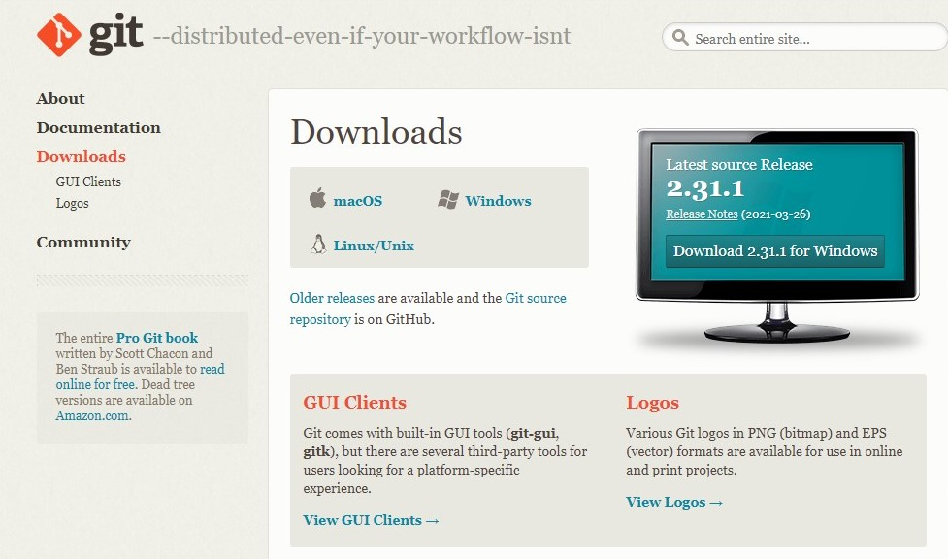
Git Software
Go to www.git-scm.com
Download
Install the git software

Slide 13
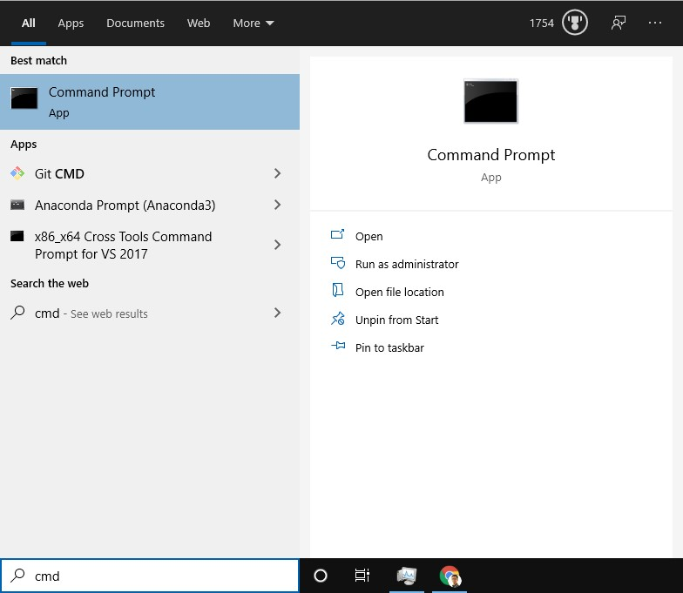
Open Command Prompt
Press windows button
Type cmd
Hit the Enter (or click by mouse)
If you are new to CMD don’t afraid of it.
I will add a Section and Explain about it.
just follow the steps and write them down.

Slide 14
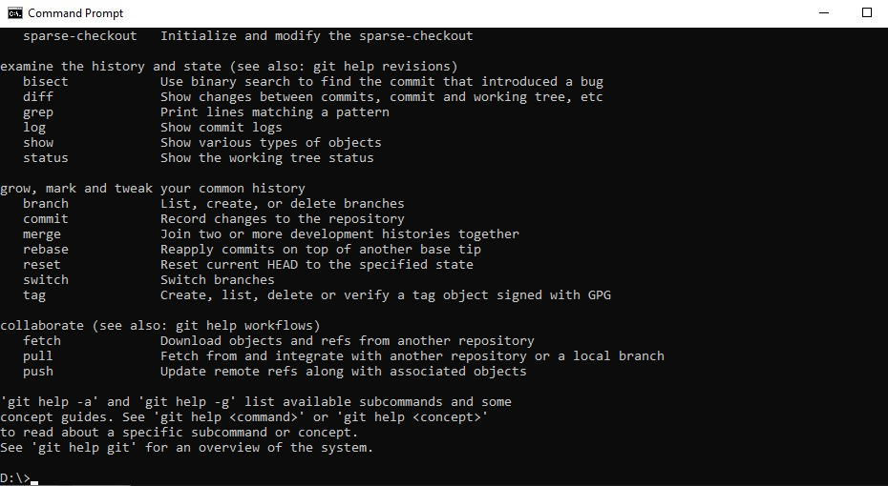
Check the git installation
Write git and hit the Enter. if you installed the got correctly you should get result like bellow.
Hurray! You are good!

Slide 15
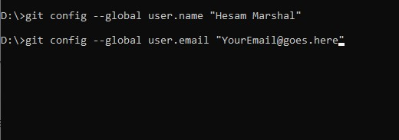
Configuring your git
git config --global user.name “FirstName LastName“
git config --global user.email “your email address"
git config --global core.editor "notepad"
To set your Name
Set the email same as your email you used in GitHub.com
To set your default editor to notepad

Slide 16
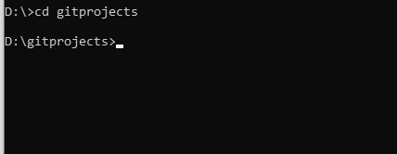
Create a folder for your projects
Create a folder for your Projects (e.g. gitprojects)
Change active directory to it cd gitprojects
Check the prompt is:
D:\gitprojects>

Slide 17
Clone your repository
Go to your repository
Copy the address

