Slide 1
CHAMAPLUS
A Credit-Aware Decision Support Platform for Informal Savings Groups in Kenya
Project Presentation
Edna Kemunto Bitange | BBIT/2023/41222
School of Computing and Informatics
Department of Enterprise Computing
Mount Kenya University | 2025/2026
Notes:
TIMING: ~45 seconds
WHAT TO SAY:
Good morning/afternoon, Chairperson, panel members, my supervisor, and everyone present.
My name is Edna Kemunto Bitange, registration number BBIT/2023/41222, from the School of Computing and Informatics, Department of Enterprise Computing, Mount Kenya University.
Today I present my final-year project: ChamaPlus — a Credit-Aware Decision Support Platform for Informal Savings Groups in Kenya.
ChamaPlus is a mobile platform that brings together membership, savings, lending, governance, reporting and credit-related decision support. The goal was not simply to replace a notebook with an app, but to create an integrated system that organizes chama activities and supports the people responsible for managing them.
I will explain the problem, the proposed solution and its design, then demonstrate the actual system.
TRANSITION: To understand ChamaPlus, I begin with the environment in which the problem occurs.

Slide 2
1. Project Context
Why this problem matters
The setting
The challenge
The opportunity
Chamas support collective saving, lending and group decision-making. As activities grow, accurate and connected records become increasingly important.
Records may be distributed across notebooks, spreadsheets and messaging channels, making it harder to maintain one reliable view of members, contributions, loans and meetings.
A mobile platform can bring these activities together, improve visibility and provide timely information while keeping human decision-making at the centre.
ChamaPlus | Mount Kenya University | 2025/2026
Notes:
TIMING: ~50 seconds
WHAT TO SAY:
Informal savings groups — chamas — are an important mechanism for collective saving, borrowing and financial cooperation in Kenya.
As a group becomes more active, the information to manage grows: members, roles, contribution cycles, loans, repayments, meetings, attendance, decisions and reports.
The challenge is fragmentation. Records may sit in notebooks, spreadsheets and messaging apps. That makes it hard to answer: Who contributed? What is the loan position? Who owes repayments? What is the chama's financial position?
The opportunity is a single mobile environment where related activities are managed and connected — with human decision-making still at the centre.
TRANSITION: From that context, what specific problem and gap does ChamaPlus address?

Slide 3
2. Problem and Identified Gap
From fragmented records to integrated decision support
Problem
Identified gap
• Fragmented membership and contribution records • Difficult loan and repayment monitoring • Manual reporting and delayed summaries • Limited visibility of committee processes • Weak separation of user responsibilities • Limited information to support lending decisions
Existing digital approaches can address individual functions, but the project identified a need for one mobile environment connecting: Membership + Savings + Lending + Governance + Credit support + Reporting
ChamaPlus | Problem → Gap → Proposed response
Notes:
TIMING: ~50 seconds
WHAT TO SAY:
The problem is broader than the absence of a mobile app.
Membership and contribution records can be fragmented. Loan monitoring is difficult when records are separate. Reports are manual and slow. Committee processes have limited visibility. Role separation is weak. Lending decisions lack structured support information.
I am not claiming no digital chama tools exist. The gap is an integrated mobile environment connecting membership, savings, lending, governance, credit support and reporting.
ChamaPlus is therefore an integrated information and decision-support platform — not a single-purpose contribution tracker.
TRANSITION: The project was guided by three objectives.

Slide 4
3. Project Objectives
What the project set out to achieve
01
Investigate challenges in manual and semi-digital chama management.
Design and develop an integrated mobile platform for membership, contributions, loans, governance, reporting and credit-aware decision support.
02
03
Test and evaluate the functionality, reliability and usability of the developed prototype.
ChamaPlus | Mount Kenya University | 2025/2026
Notes:
TIMING: ~45 seconds
WHAT TO SAY:
Objective 1: Investigate challenges in manual and semi-digital chama management — so features address real problems.
Objective 2: Design and develop an integrated mobile platform for membership, contributions, loans, governance, reporting and credit-aware decision support — the main development scope.
Objective 3: Test and evaluate functionality, reliability and usability — the project is not complete just because code exists; it must be validated.
These objectives link the problem, solution and evaluation.
TRANSITION: The solution is the ChamaPlus integrated platform.

Slide 5
4. Proposed Solution: ChamaPlus
One platform connecting the chama lifecycle
Membership
Savings
Lending
Users, chamas, roles
Cycles, contributions, history
Products, applications, votes, repayments
CHAMAPLUS
Governance
Decision Support
Visibility
Meetings, attendance, minutes, actions
Credit score and risk information
Dashboards, notifications, reports
ChamaPlus | Mount Kenya University | 2025/2026
Notes:
TIMING: ~50 seconds
WHAT TO SAY:
ChamaPlus connects six functional areas: membership; savings (cycles and history); lending (products, applications, voting, repayments); governance (meetings, attendance, minutes); decision support (advisory credit view); and visibility (dashboards, notifications, reports).
The value is in the connections. A member's contributions and later loan activity share the same identity. A loan involves application, committee review, disbursement and repayment — not one isolated transaction.
That integration is what makes this more than unrelated CRUD screens.
TRANSITION: One distinctive element is the credit-aware component.

Slide 6
5. The Credit-Aware Element
Decision support — not automated lending
Contribution consistency
Repayment history
Attendance
Membership duration
35%
35%
15%
15%
Member activity
Scoring model
Advisory score
Committee review
Decision
Human authority is retained: the score informs the committee; it does not approve or reject a loan automatically.
ChamaPlus | Mount Kenya University | 2025/2026
Notes:
TIMING: ~55 seconds — LIKELY PANEL QUESTION
WHAT TO SAY:
Credit-aware means the system uses recorded activity to produce an advisory score: contribution consistency 35%, repayment history 35%, attendance 15%, membership duration 15%.
Critical principle: the score does NOT automatically approve or reject a loan.
Flow: member activity → scoring model → advisory score → committee review → final decision.
The score supports the committee; it does not replace human governance. A score only reflects data in the system.
PANEL-READY LINE: "The system provides evidence for a decision; it does not make the decision on behalf of the chama."
TRANSITION: This required a maintainable architecture.

Slide 7
6. System Architecture
How the mobile platform is connected to the backend
Presentation / Mobile
Flutter + Dart Feature-based modules • Riverpod • GoRouter
API / Application
Django + Django REST Framework Authentication • permissions • business services
Data
MySQL relational database Users • memberships • contributions • loans • governance • reports
Implemented backend: 12 Django apps • 17 domain tables • 78 business endpoints
ChamaPlus | Mount Kenya University | 2025/2026
Notes:
TIMING: ~50 seconds
WHAT TO SAY:
ChamaPlus uses client-server architecture.
Presentation layer: Flutter mobile app (Dart, Riverpod, GoRouter, feature-based modules).
Application layer: Django REST Framework — authentication, permissions, business rules, APIs.
Data layer: MySQL — users, memberships, contributions, loans, governance, reports.
Implemented backend: 12 Django apps, 17 domain tables, 78 business endpoints.
The mobile app does not touch the database directly. Requests go through the API where auth and business rules apply — supporting security and maintainability.
TRANSITION: How was the project developed?

Slide 8
7. Methodology and Development Approach
Research approach + software development approach
Research approach
Software development
Applied design-and-development research • Problem identification • Requirements analysis • Artefact design and development • Evaluation of the prototype
Agile iterative and incremental development Requirements → Design → Implement → Test → Refine → Next increment Modules were developed progressively with continuous testing.
ChamaPlus | Mount Kenya University | 2025/2026
Notes:
TIMING: ~50 seconds
WHAT TO SAY:
Two methodological levels — do not confuse them.
Research: applied design-and-development research — identify problem, design solution, build artefact, evaluate prototype.
Software development: Agile iterative and incremental — NOT formal Scrum (no sprints, Product Owner, daily stand-ups).
Cycle: requirements → design → implement → test → refine → next increment.
Authentication and membership came first; contributions and loans built on that foundation. Testing ran throughout, not only at the end.
TRANSITION: Here is what was actually implemented.

Slide 9
8. What Was Actually Implemented
Prototype scope
Authentication & onboarding
Financial operations
Registration, login, password reset, chama creation/joining, invitations
Contribution cycles, contributions, loan products, applications, voting, disbursement, repayments
Governance & communication
Decision & reporting
Meetings, attendance, minutes, action items, notifications
Credit scoring, dashboards, reports, exports, member summaries, settings
Prototype exclusions: direct M-Pesa/payment gateway, direct SMS/email providers, full web admin portal, national-scale production deployment.
ChamaPlus | Mount Kenya University | 2025/2026
Notes:
TIMING: ~50 seconds
WHAT TO SAY:
Implemented: authentication and onboarding; financial operations (contributions, loans, voting, repayments); governance and notifications; credit scoring, dashboards, reports and exports.
Not in prototype: direct M-Pesa/payment gateway, direct SMS/email providers, full web admin portal, national production deployment.
Academically, I separate implemented scope from future work. The demo shows the prototype — not every possible financial feature.
TRANSITION: Was it tested?

Slide 10
9. Testing and Current Validation
Evidence that the prototype was exercised
124
244
15
Backend automated tests
Mobile automated tests
Representative functional test cases
Final test observation
243 of 244 mobile tests passed. One non-core report-export formatting test remained failing at final execution. Core workflows represented in the report's test cases passed.
ChamaPlus | Mount Kenya University | 2025/2026
Notes:
TIMING: ~50 seconds — BE TRANSPARENT
WHAT TO SAY:
Backend: 124 automated tests. Mobile: 244 automated tests. Plus 15 representative functional test cases.
Final result: 243 of 244 mobile tests passed. One non-core report-export formatting test failed.
Core workflows in the functional test cases passed. I report this honestly rather than claiming 100% success.
IF ASKED "Why not fix the last test?": It was isolated to export formatting, not core financial, auth or membership workflows. Recorded transparently in the report.
TRANSITION: Three main contributions.

Slide 11
10. Project Contribution
What ChamaPlus contributes
Operational integration
Decision support
Controlled access
Connects membership, savings, lending, governance and reporting in one mobile environment.
Uses recorded contribution, repayment, attendance and membership information to produce an advisory credit view.
Uses authentication and role-based permissions so financial and administrative functions are restricted to appropriate users.
ChamaPlus | Mount Kenya University | 2025/2026
Notes:
TIMING: ~45 seconds
WHAT TO SAY:
Contribution 1 — Operational integration: one mobile environment for membership, savings, lending, governance and reporting.
Contribution 2 — Decision support: advisory credit view from contribution, repayment, attendance and membership data — committee retains authority.
Contribution 3 — Controlled access: authentication and role-based permissions for financial and admin functions.
The contribution is the integration into a single decision-support environment — not one feature in isolation.
IF ASKED "What is innovative?": Not inventing digital savings, but integrating chama lifecycle modules with credit-aware support while retaining human committee authority.
TRANSITION: From explanation to the live product.

Slide 12
From the problem and design…
…to the implemented product.
Demo order: Login → Membership → Contributions → Loans → Credit Score → Governance → Reports
I will now demonstrate how ChamaPlus translates these design decisions into actual user workflows.
ChamaPlus | Live product demonstration
Notes:
TIMING: ~30 seconds then OPEN APP
WHAT TO SAY:
I have walked through the problem, gap, objectives, solution, credit-aware design, architecture, methodology, scope, testing and contribution.
Having established that foundation, I now demonstrate ChamaPlus and show how these design decisions appear in practice.
[OPEN CHAMAPLUS APPLICATION]
DEMO ORDER (~8–12 minutes after slides):
1. Login → dashboard — "Authentication governs all subsequent access."
2. Chama / members / roles — "Users operate within a chama context."
3. Contributions — cycle → record → history
4. Loans — product → application → voting → repayment
5. Credit score — EMPHASIZE: advisory only, committee decides
6. Governance — meeting → attendance → minutes
7. Dashboard / reports — monitoring and summaries
MEMORIZE THE STORY ARC:
Problem → Fragmentation → Integration gap → ChamaPlus → Credit-aware (not autonomous) → Architecture → Agile build → Implemented scope → Test evidence → Contribution → LIVE DEMO

Slide 13
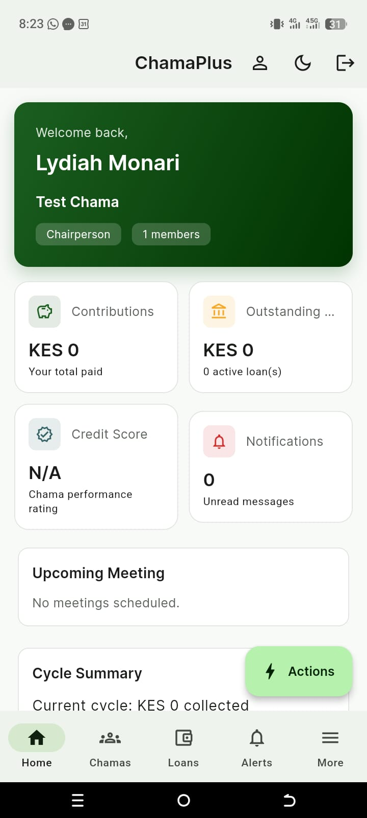
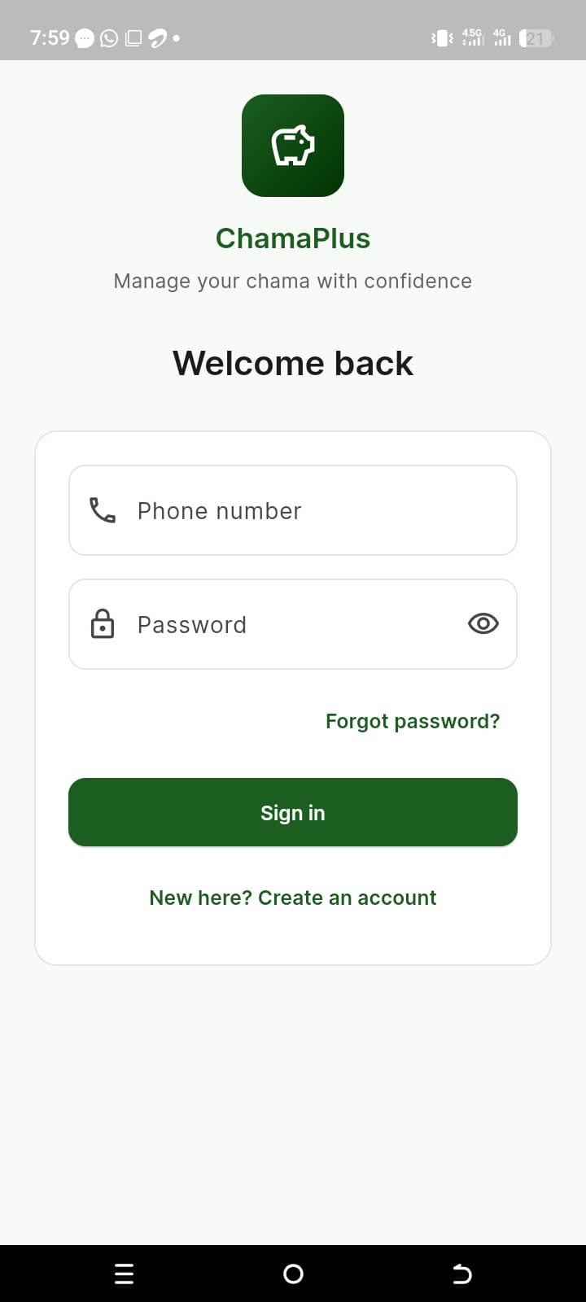
Backup. Implementation Preview
Optional — use only if live demo is unavailable
Login Screen
Dashboard
ChamaPlus | Mount Kenya University | 2025/2026
Notes:
OPTIONAL BACKUP SLIDE (Slide 13) — skip unless live demo fails.
Left: implemented Login screen. Right: Home dashboard after authentication.

