Slide 1

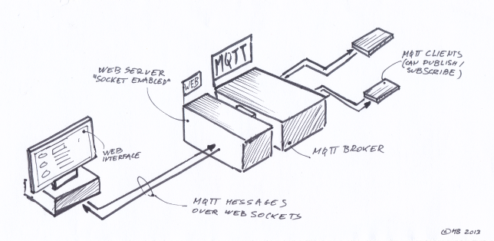





Slide 2

Protocolos del IoT: Http, Http2, Websockets y CoAP
Fundamentos de MQTT
Control de Mensajes
Qos
Sesiones
Authenticación, ACL (Listas de control de acceso)
ACL Plugin
SSL

Slide 3

& IoT
HTTP 1.1 / HTTP2 / Websockets

Slide 4

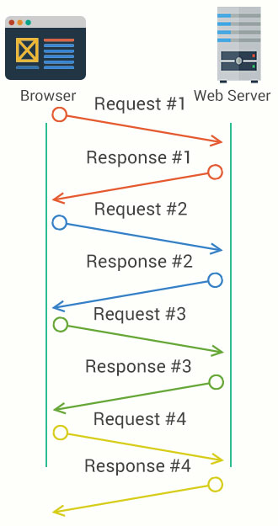
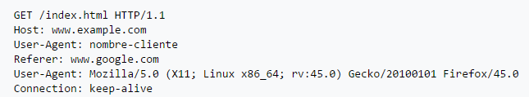

Protocolo orientado a envío de documentos / volumen de datos
ASCII-text based protocol => Parseo de Headers
Modelo Request / Response en una relación Cliente / Servidor
Cliente inicia la comunicación con el Servidor
Modelo de conexión 1 to 1
Buffer, IRQ/DMA, Ciclos de reloj, Consumo de batería …...
Request ~205 bytes
Response ~95 bytes

Slide 5
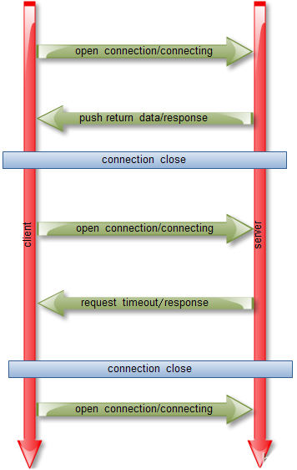
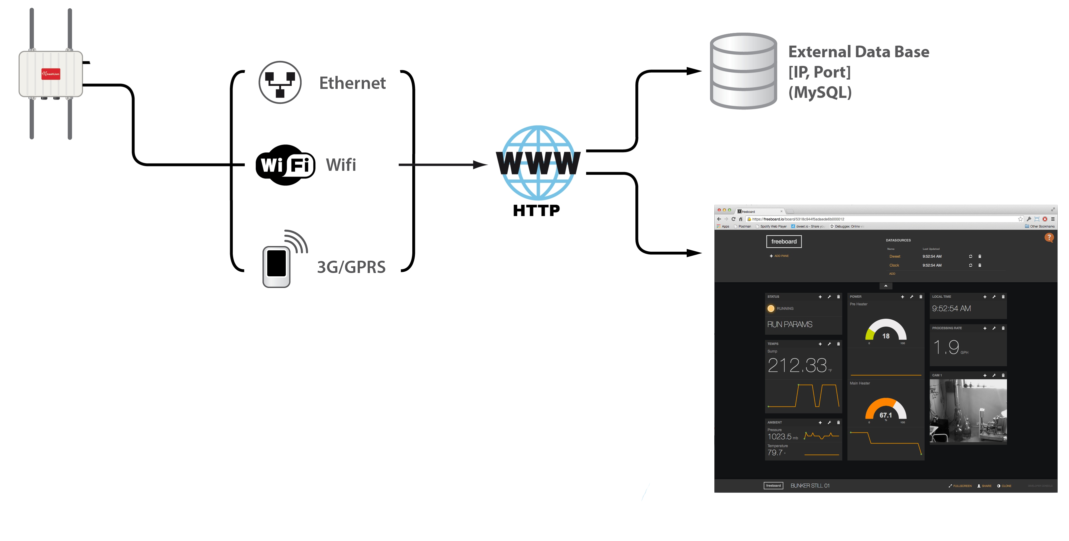
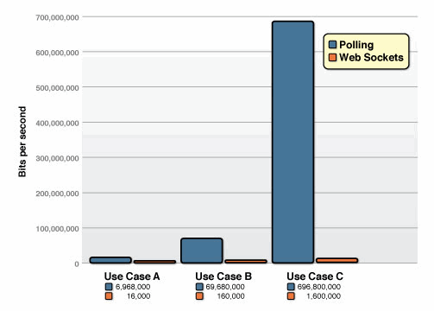
Real-Time & POLLING
A: 1,000 clients polling / second: Network throughput is (871 x 1,000) = 871,000 bytes = 6,968,000 bits per second (6.6 Mbps)
B: 10,000 clients polling / second: Network throughput is (871 x 10,000) = 8,710,000 bytes = 69,680,000 bits per second (66 Mbps)
C: 100,000 clients polling / second: Network throughput is (871 x 100,000) = 87,100,000 bytes = 696,800,000 bits per second (665 Mbps)
A: 1,000 clients receive 1 message per second: Network throughput is (2 x 1,000) = 2,000 bytes = 16,000 bits per second (0.015 Mbps)
B: 10,000 clients receive 1 message per second: Network throughput is (2 x 10,000) = 20,000 bytes = 160,000 bits per second (0.153 Mbps)
C: 100,000 clients receive 1 message per second: Network throughput is (2 x 100,000) = 200,000 bytes = 1,600,000 bits per second (1.5 Mbps)

Slide 6

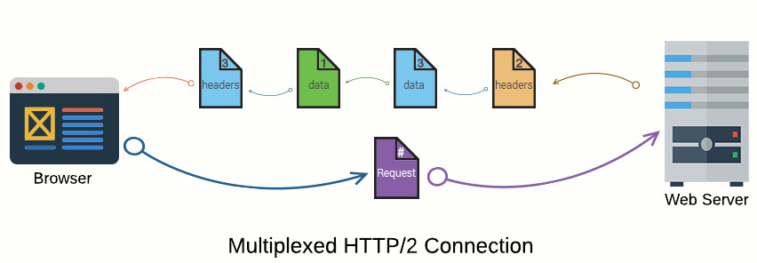
Pasa de ASCII a Binario
Conexión Multiplexada (solución para head-of-line blocking y pipelining)
HTTPs recomendado (No obligatorio..herencia de SPDY)
Compresión de headers HPACK (Gzip no compatible)
Mejora en Latencia y en consumo de Ancho de banda
Server “PUSH” proactivo
2.5x más rápido que HTTP1.1

Slide 7

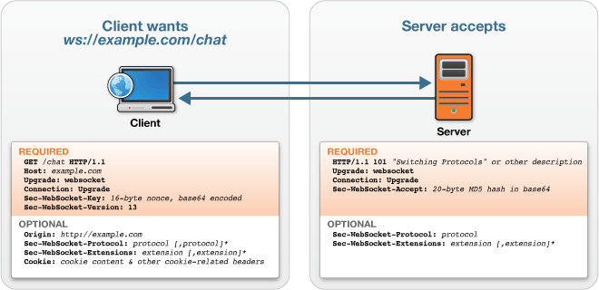
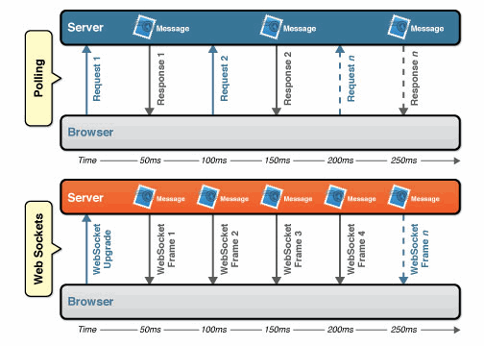
Soluciona los problemas con Polling / long-polling y streaming. Orientado a navegadores
Requiere HTTP para la petición de upgrade y handshake
1 conexión single socket TCP full-duplex bidireccional
Headers 2 bytes . Reduce latencia 3:1 Trafico de headers 1000:1
Modelo de conexión 1 to 1
Envio de datos tanto Binario como Texto (Clientes Javascript no soportan binario)

Slide 8
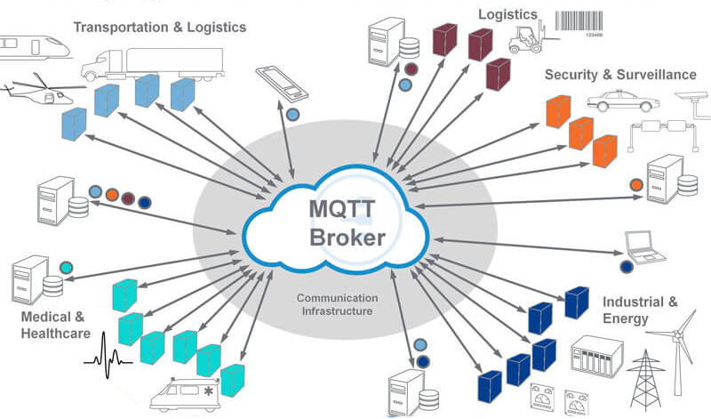

Slide 9
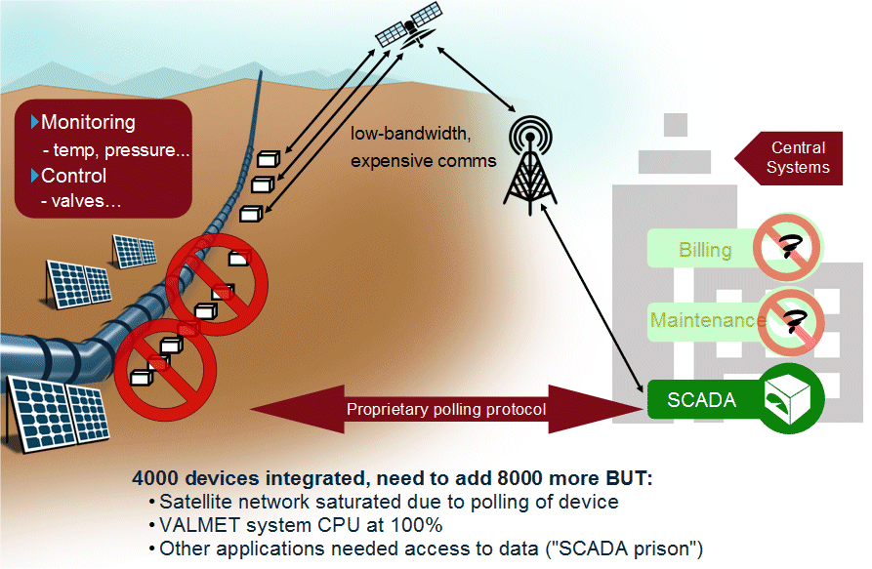
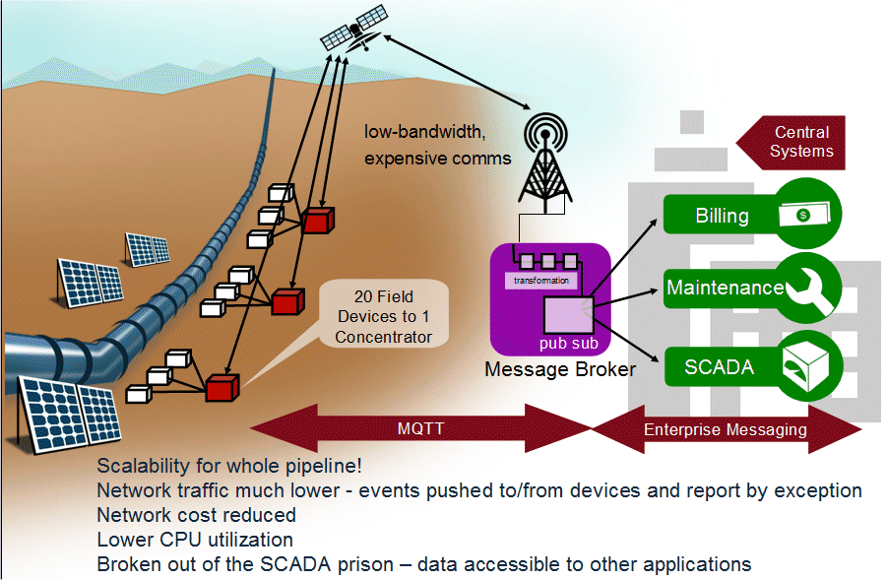
Protocolo orientado a redes con Bajo ancho de banda , poco confiables, Alta latencia y Alto coste x byte.
Mensajes de tamaño reducido
Reemplaza el polling por paradigma pub/sub
Industry Agnostic (Muy flexible en el envío de datos)
Modelo de conexión 1 to 0/1/N
Consume pocos recursos (Coretex-M full 22KB Rom 4KB Ram)
Consume poco CPU →Mejora el rendimoento de baterías
Arquitectura escalable desde 10K a Millones de clientes
Lógica implementada en broker
Implementa Qos (Quality of Service)
Inventado por Dr Andy Stanford-Clark de IBM, y Arlen Nipper de Arcom (now Eurotech), en 1999.
Open source. Amparado bajo el paraguas de la Eclipse Foundation desde en comienzo del 2012
Estandar OASIS desde 2014
16+ MQTT servers
40+ MQTT client libraries

Slide 10
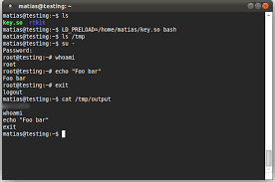
https://mosquitto.org/man/mosquitto-conf-5.html
CONFIGURACIÓN
/etc/mosquitto/mosquitto.conf
Listener 1883 127.0.0.1 [ * ]
Listener 1884 192.168.1.46 [ .* ]
password_file /etc/mosquitto/pwfile
allow_anonymous false
Crear Usuario
mosquitto_passwd -c /etc/mosquitto/pwfile nUser
Eliminar Usuario
mosquitto_passwd -D passwordfile nUser
/etc/mosquitto/pwfile
Listener 1883 127.0.0.1 [ * ]
Listener 1884 192.168.1.46 [ .* ]
password_file /etc/mosquitto/pwfile
acl_file /etc/mosquitto/aclfile
allow_anonymous false

Slide 11

MQTT
SECURITY
MQTT
SECURITY

Slide 12
ACL (Listas de control de acceso)
/etc/mosquitto/mosquitto.conf
Listener 1883 127.0.0.1 [ * ]
Listener 1884 192.168.1.46 [ .* ]
password_file /etc/mosquitto/pwfile
acl_file /etc/mosquitto/aclfile
allow_anonymous false
/etc/mosquitto/aclfile
# This affects access control for clients with no username.
topic read $SYS/#
# This only affects clients with username "roger".
user jerbas
topic write test/1
# topic test/1 topic readwrite test/1
user neno
topic read test/1
# This affects all clients.
pattern write $SYS/broker/connection/%c/state

Slide 13
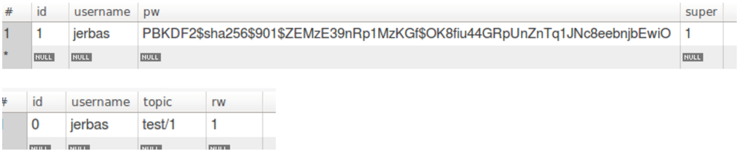
auth-plugin
Pbkdf2 algoritmo cifrado password
npm install mosquitto-pbkdf2
https://github.com/manolodd/pbkdf2-mosquitto
/etc/mosquitto/mosquitto.conf
auth_plugin /usr/lib/mosquitto-auth-plugin/auth-plugin.so
auth_opt_backends mysql
auth_opt_redis_host localhost
auth_opt_host localhost
auth_opt_port 3306
auth_opt_dbname HAC
auth_opt_user root
auth_opt_pass rootpassw
auth_opt_userquery SELECT pw FROM users WHERE username = '%s'
auth_opt_superquery SELECT COUNT(*) FROM users WHERE username = '%s' AND super = 1
auth_opt_aclquery SELECT topic FROM acl WHERE (username = '%s') AND (rw >= %d)
auth_opt_anonusername AnonymouS
CREATE TABLE `acl` (
`id` int(11) NOT NULL AUTO_INCREMENT,
`username` varchar(45) DEFAULT NULL,
`topic` varchar(45) DEFAULT NULL,
`rw` varchar(45) DEFAULT NULL,
PRIMARY KEY (`id`)
) ENGINE=InnoDB AUTO_INCREMENT=2 DEFAULT CHARSET=latin1;
CREATE TABLE `users` (
`id` int(11) NOT NULL AUTO_INCREMENT,
`username` varchar(45) DEFAULT NULL,
`pw` varchar(130) DEFAULT NULL,
`super` int(11) DEFAULT '0',
PRIMARY KEY (`id`)
) ENGINE=InnoDB AUTO_INCREMENT=2 DEFAULT CHARSET=latin1;
rw=0 →sin permisos
rw=1 → permisos read
rw=2 → permisos RW

Slide 14
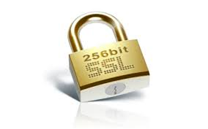
https://mosquitto.org/man/mosquitto-tls-7.html
Script :
https://github.com/owntracks/tools/blob/master/TLS/generate-CA.sh
A Mano SERVIDOR:
Generate a certificate authority certificate and key.
openssl req -new -x509 -days <duration> -extensions v3_ca -keyout ca.key -out ca.crt
Generate a server key.
openssl genrsa -des3 -out server.key 2048
Generate a server key without encryption.
openssl genrsa -out server.key 2048
Generate a CSR to send to the CA.
openssl req -out server.csr -key server.key -new
Send the CSR to the CA, or sign it with your CA key:
openssl x509 -req -in server.csr -CA ca.crt -CAkey ca.key -CAcreateserial -out server.crt -days <duration>
----------------------------------------------------------------------------------
A Mano CLIENTE:
Generate a client key.
openssl genrsa -des3 -out client.key 2048
Generate a CSR to send to the CA.
openssl req -out client.csr -key client.key -new
Send the CSR to the CA, or sign it with your CA key:
openssl x509 -req -in client.csr -CA ca.crt -CAkey ca.key -CAcreateserial -out client.crt -days <duration>
/etc/mosquitto/mosquitto.conf
listener 8883
cafile /etc/mosquitto/certs/ca.crt
certfile /etc/mosquitto/certs/hostname.localdomain.crt
keyfile /etc/mosquitto/certs/hostname.localdomain.key
# ----------------------------------------------------------
# Si requerimos certificado de cliente
# ----------------------------------------------------------
[ require_certificate true ]
[use_identity_as_username true]

Slide 15

BKS
(BouncyCastle) formato Adroid para el KeyStore que contiene el certificado de cliente
keytool -importcert -v -trustcacerts -file "path_to_cert/interm_ca.cer" -alias IntermediateCA -keystore "res/raw/myKeystore.bks" -provider org.bouncycastle.jce.provider.BouncyCastleProvider -providerpath "path_to_bouncycastle/bcprov-jdk16-145.jar" -storetype BKS -storepass mysecret

