Slide 1
Additional Topics
Linked servers
Service broker
Securing SQL server and DB encryption
Full-text search
SQL injection
Cursor
Administration Tasks
Backup
Restore
SQLCLR

Slide 2
Cursor
A cursor is a mechanism that processes the result set of a predefined query on a row-by-row basis

Slide 3
Understanding Cursors
Cursors extend processing of result sets
Allow positioning at specific rows
Retrieve one or more rows from the current position
Support data modification
Support different levels of visibility
Provide T-SQL statements access to data
Notes:
Cursor Benefits
You can process data on a row-by-row basis
SQL is a set-oriented language
Processing is normally done on all rows matching a given condition
Cursors allow for row-by-row processing
You can modify data on a row-by-row basis
You can bridge the gap between the set orientation of a relational database and the row orientation of most programming languages

Slide 4
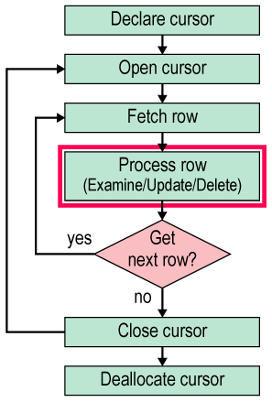
Cursor Life Cycle
1. Declare the cursor
2. Open the cursor
3. Fetch each row
4. Close the cursor
5. Deallocate the cursor
Notes:
Examples:
1)
declare s_cur cursor
for select st_id,st_fname from student
for read only --update
declare @id int
declare @name nvarchar(50)
open s_cur
fetch s_cur into @id,@name
begin
While @@fetch_status=0 --returns 0 success -- 1 failed --2 no more rows to fetch
begin
select @id,@name
fetch s_cur into @id,@name
end
end
close s_cur
deallocate s_cur
2)
declare t_cur cursor
for select t_id,t_name,sal from teacher
for update
declare @id int
declare @name nvarchar(50)
declare @s int
open t_cur
fetch t_cur into @id,@name,@s
begin
While @@fetch_status=0
begin
if @s<1000
begin
update teacher set sal= @s*1.10
where current of t_cur
fetch t_cur into @id,@name,@s
end
end
end
close t_cur
deallocate t_cur

Slide 5
Declare the Cursor
When you declare a cursor:
You specify the query
You specify the cursor mode
for read only
for update
Adaptive Server reserves memory resources for the cursor
Update Cursors is the Default Mode
Notes:
Rules for Using for update Cursors
The table on which a for update cursor is declared must either:
have a unique index
or
use the datapages locking scheme or datarows locking scheme

Slide 6
Global Variables for Cursors
@@rowcount
After a fetch, returns the total number of rows returned by all fetch statements for that cursor
After any DML statement in a cursor, returns the number of rows affected by that statement
@@sqlstatus
Returns 0 if the previous fetch was successful
Returns 1 for an error resulting from a fetch
Returns 2 if the previous fetch failed because there are no more rows to fetch
Notes:
sp_cursorinfo { cursor_level | NULL } [, cursor_name ]
Displays information about cursors
If you specify a level, information is returned only for cursors at the specified nesting level
If you specify NULL, information is returned for cursors at all nesting levels
If you specify a name, information is returned only for cursors having that name
fetch always moves the pointer down the result set
No way to move the pointer up in the result set
Closing and reopening a cursor resets the pointer to the beginning
By default, fetch always returns one row
Can use the set cursor rows option to change this setting
Syntax:
set cursor rows number for cursor_name
Example:
set cursor rows 5 for biz_book

Slide 7
Alternatives to Cursors
Cursors are not always the only way to accomplish a given task
Cursor Code Example 1 rewritten using the case statement:
select title_id, type,
case type
when "business" then price * $1.08
when "mod_cook" then price
end
from titles
where type in ("business", "mod_cook")
Cursor Code Example 1 rewritten using two queries:
select title_id, type, price * $1.08
from titles
where type = "business"
select title_id, type, price
from titles
where type = "mod_cook"

Slide 8
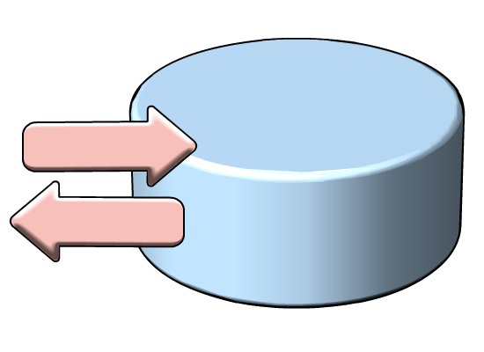

CLR Integration , Assemblies
Introduced in SQL Server 2005
Deploy custom developed CLR assemblies within the SQL Server Process
Leverage the .NET 2.0 API
Notes:
Explain that beginning with SQL Server 2005, customers have been able to create and integrate into SQL Server their own Common Language Runtime (CLR) assemblies. This means that customers can deploy C# and VB.NET code (or any CLR language) within the SQL Server process.
Explain that this is done by compiling CLR code into assemblies and that then these assemblies are loaded into SQL Server. This ability can help alleviate writing cumbersome procedural code in T-SQL. You also have the entire .NET API at your disposal for things like text parsing and math routines, to name but a few benefits.
Note to the students that CLR integration requires .NET programming knowledge. As this is an introductory level course we won’t be going very deep into the details.
BENEFITS TO USING CLR INTEGRATION
Efficient alternative to extended stored procedures
Ability to leverage comprehensive .NET class library APIs
Seamless debugging with other parts of SQL Server
Managed code can be used within SQL Server in most of the places where you are used to writing code:
Stored Procedures
Functions
Triggers
As well as a new type of code called custom aggregate functions…

Slide 9
Implementing Custom Aggregate Functions
Custom programs in an assembly that are imported into SQL Server® using the integrated CLR
Can be created using any .NET language such as C# and VB
CREATE ASSEMBLY StringUtilities FROM ‘PathToAssembly\StringUtilities.dll'
WITH PERMISSION_SET=SAFE;
CREATE AGGREGATE Concatenate(@input nvarchar(4000))
RETURNS nvarchar(4000)
EXTERNAL NAME [StringUtilities].[Concatenate]
Notes:
Explain that custom aggregates can be developed in SQL Server via CLR Integration.
Also explain that custom aggregates are programs created using a .NET language such as C#, VB.NET, etc. They are used to perform complex logic and calculations.
Custom aggregates are placed into .NET assemblies and loaded into a CLR enabled SQL Server with the CREATE ASSEMBLY statement.
The aggregate is then created with the CREATE AGGREGATE statement.
Be sure to mention that once a UDA is loaded into a SQL Server instance, it is readily used like any other built in aggregate.
Question: Why use a custom aggregation function if you're comfortable with handling the logic in T-SQL?
Answer: The custom aggregate will execute faster as it is compiled code (T-SQL is interpreted) and may also simplify queries by making them easier to read and understand, thus easing query maintenance.

