Slide 1

AWS
Building a Highly Available, Scalable Web Application
Abdelrahman Medhat
Omar Ayman
Hesham Abdelhamed
Ahmed Heikal
Paula Hakeem

Slide 2
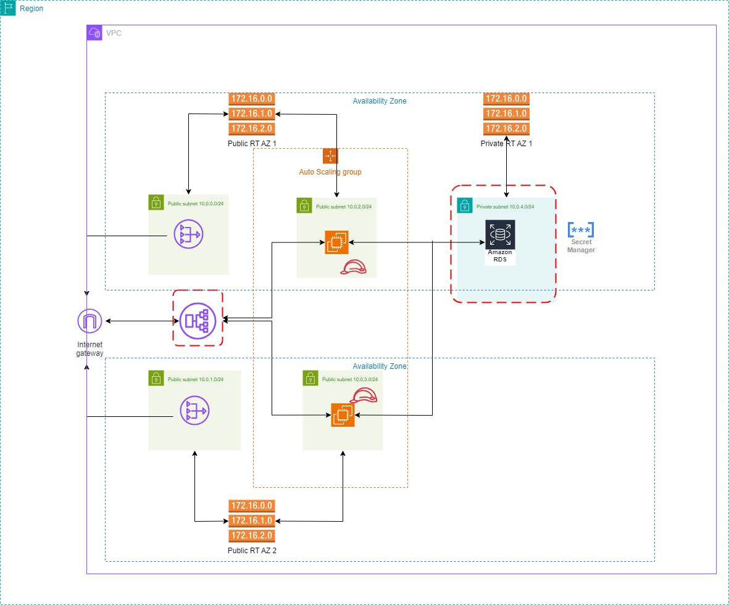
Architecture

Slide 3
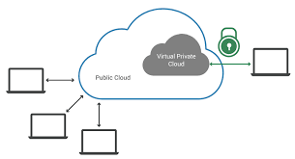
Architecture
EC2
VPC
Subnets
Azs
Security
RDS

Slide 4
Architecture
RDS
Configuration
Features
Security
IAM
Policies
Roles
EC2
Configuration
Features
Security
VPC
Subnets
Azs
Security
ALB

Slide 5
Architecture
IAM
Policies
Roles
ALB
Configuration
Features
EC2
Configuration
Features
Security
RDS
Configuration
Features
Security
VPC
Subnets
Azs
Security
ASG

Slide 6
Architecture
Internet Gateway
Integration
Benefits
IAM
Policies
Roles
ASG
Target Policy
Configurations
Features
ALB
Configuration
Features
EC2
Configuration
Features
Security
RDS
Configuration
Features
Security
VPC
Subnets
Azs
Security

Slide 7
Architecture
Internet Gateway
Integration
Benefits
RDS
Configuration
Features
IAM
Policies
Roles
ASG
Target Policy
Configurations
Features
ALB
Configuration
Features
EC2
Configuration
Features
Security
RDS
Configuration
Features
Security
VPC
Subnets
Azs
Security

Slide 8
Architecture
Internet Gateway
Integration
Benefits
RDS
Configuration
Features
IAM
Policies
Roles
ASG
Target Policy
Configurations
Features
Route Table
ALB
Configuration
Features
EC2
Configuration
Features
Security
RDS
Configuration
Features
Security
VPC
Subnets
Azs
Security

