Slide 1



L3: Texture Components and Euler Angles: part 2
27-750
Texture, Microstructure & Anisotropy
A.D. (Tony) Rollett
Last revised: 5th Sep. 2011

Slide 2
Lecture Objectives
Show how to convert from a description of a crystal orientation based on Miller indices to matrices to Euler angles, with brief descriptions of Rodrigues vectors and quaternions.
Give examples of standard named components and their associated Euler angles.
The overall aim is to be able to describe a texture component by a single point (in some set of coordinates such as Euler angles) instead of needing to draw the crystal embedded in a reference frame.
Show how to convert tensor quantities from a description in the reference frame to the same quantities referred to the crystal frame. This is the basic operation required to work with anisotropic properties in polycrystals.
Part 2 provides mathematical detail.
NB. We use an orthonormal (Cartesian) coordinate system in the crystal. For certain low symmetry materials, an additional transformation is required between the crystallographic frame and the orthonormal frame.
Obj/notation AxisTransformation Matrix EulerAngles Components

Slide 3
In-Class Questions: 1
What are direction cosines? Sketch a diagram to show what they are.
What is meant by a “transformation of axes”?
Given Miller indices of crystal directions parallel to the RD and ND (samples axes 1 & 3), explain how to construct the matrix that represents a transformation from the sample frame to the crystal frame.
Based on the definition of the rotation matrix for a rotation about x, y or z, show how the matrices for the individual Euler angles can be combined together to generate an orientation matrix.

Slide 4
In-Class Questions: 2
Given an orientation matrix based on Miller indices, and one based on Euler angles, explain the relationship between them.
Explain the difference between “active” and ”passive” rotations.
Write out a definition of a transformation matrix in terms of the old and new axes.
Explain how to obtain Euler angles from an orientation matrix (see Qu. 1 above).

Slide 5
In Class Questions: 3
Show that the 3 columns of the orientation matrix represent the coefficients of the unit vectors in (orthonormal) crystal coordinates that lie parallel to the 3 unit vectors of the sample frame. Hint: use the definition of the orientation matrix.
Show that the 3 rows of the orientation matrix represent the coefficients of the unit vectors in sample coordinates that lie parallel to the 3 unit vectors of the (orthonormal) crystal frame.
Explain why we need the two argument arc-tangent function to recover angles in the range 0-360°.

Slide 6
In Class Questions: 4
Explain how to obtain the rotation angle and rotation axis from an orientation matrix.
Give the definition of the Rodrigues vector in relation to a rotation axis and angle.
Give the definition of the unit quaternion, again in relation to a rotation axis and angle.

Slide 7
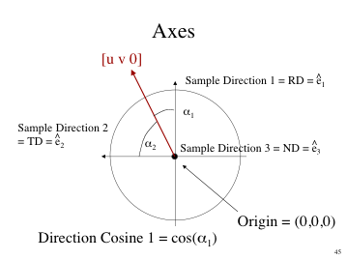
Direction cosines
Need the direction cosines for all 3 crystal axes. Before proceeding, we review the definition of direction cosine.
A direction cosine is the cosine of the angle between a vector and a given direction or axis.
A direction cosine is equal to the dot product of a unit vector with a given unit axis vector.
Sets of direction cosines can be used to construct a transformation matrix from the vectors.
Obj/notation AxisTransformation Matrix EulerAngles Components

Slide 8
Active versus Passive Rotations
Before we discuss the details of how to calculate orientation matrices, it is a good idea to summarize the difference between “active” and “passive” rotations, as mathematicians know them.
In materials science, we are mostly concerned with describing anisotropic properties of crystals and the aggregate anisotropy of polycrystalline materials, for which it is convenient to use tensors to describe those properties.
For tensor quantities, we commonly need their coefficients in either the sample frame or the crystal frame. For this we use “transformations of axes”, which are “passive rotations”, in the sense that the two frames share a common origin and differ by only a (proper) rotation. The tensor quantities do not rotate in real space, however.
In solid mechanics, however, it is more typical to need to describes the motions of objects. Certain motions are just rotations and one can think of rotating a vector, for example, about the origin, in which case one is describing an “active rotation”. Some object is rotated about the origin and moves through the frame.
For all work in texture we will consistently use axis transformations, a.k.a. passive rotations.

Slide 9
Rotation of axes in the plane: x, y = old axes; x’,y’ = new axes
v
θ
N.B. Passive Rotation/ Transformation of Axes
Obj/notation AxisTransformation Matrix EulerAngles Components
Notes:
New coefficients in the new set of axes for the SAME vector

Slide 10
Definition of an Axis Transformation: ê = old axes; ê′= new axes
We transform the coefficients of, e.g., a vector, v, from one set of axes to another
v
From Sample to Crystal (primed)
ê₃
ê’₃
ê’₂
ê₂
ê’₁
ê₁
Obj/notation AxisTransformation Matrix EulerAngles Components
Notes:
Physically, the vector does not change

Slide 11
Geometry of {hkl}<uvw>
Sample to Crystal (primed)
Miller index notation of texture component specifies direction cosines of crystal directions // to sample axes. Form the second axis from the cross-product of the 3rd and 1st axes.
^
^
e’₃
e₃ // (hkl)
[001]
[010]
^
e’₂
^
^
e₂ // t
^
e₁ // [uvw]
^
t = hkl x uvw
e’₁
[100]
Obj/notation AxisTransformation Matrix EulerAngles Components

Slide 12
Form matrix from Miller Indices
Basic idea: we can construct the complete rotation matrix from two known, easy to determine columns of the matrix. Knowing that we have columns rather than rows is a consequence of the sense of rotation, which is equivalent to the direction in which the axis transformation is carried out.
Obj/notation AxisTransformation Matrix EulerAngles Components

Slide 13
Bunge Euler angles to Matrix
Basic idea: construct the complete orientation matrix from individual, easy to understand rotations that are based on the three different Euler angles. Demonstrate the equivalence between the rotation matrix constructed from these rotations, and the matrix derived from direction cosines. “Rotation” in this context means “transformation of axes”.
Rotation 1 (φ₁): rotate axes (anticlockwise) about the (sample) 3 [ND] axis; Z₁.
Rotation 2 (Φ): rotate axes (anticlockwise)
about the (rotated) 1 axis [100] axis; X.
Rotation 3 (φ₂): rotate axes (anticlockwise)
about the (crystal) 3 [001] axis; Z₂.
Obj/notation AxisTransformation Matrix EulerAngles Components

Slide 14
Bunge Euler angles to Matrix, contd.
A=Z₂XZ₁
Obj/notation AxisTransformation Matrix EulerAngles Components

Slide 15
Matrix with Bunge Angles
A = Z₂XZ₁ =
[uvw]
(hkl)
Obj/notation AxisTransformation Matrix EulerAngles Components

Slide 16
Matrix, Miller Indices
The general Rotation Matrix, a, can be represented as in the following:
Here the Rows are the direction cosines for the 3 crystal axes, [100], [010], and [001] expressed in the sample coordinate system (pole figure).
[100] direction
[010] direction
[001] direction
Obj/notation AxisTransformation Matrix EulerAngles Components

Slide 17
Matrix, Miller Indices
The columns represent components of three other unit vectors:
[uvw]≡RD
TD
ND≡(hkl)
Here the Columns are the direction cosines (i.e. hkl or uvw) for the sample axes, RD, TD and Normal directions expressed in the crystal coordinate system. Compare to inverse pole figures.
Obj/notation AxisTransformation Matrix EulerAngles Components

Slide 18
Compare Matrices
[uvw]
(hkl)
[uvw]
(hkl)
≡
Basic idea: the complete orientation matrix that describes an orientation must be numerically the same, coefficient by coefficient, regardless of whether it is constructed from the Euler angles, or from the Miller indices. Therefore we can equate the two matrix descriptions, entry by entry.
Obj/notation AxisTransformation Matrix EulerAngles Components

Slide 19
Miller indices from Euler angle matrix
Compare the indices matrix with the Euler angle matrix.
n, n’ = arbitrary factors to make integers from real numbers
Obj/notation AxisTransformation Matrix EulerAngles Components

Slide 20
Euler angles from Orientation Matrix
Notes: the range of inverse cosine (ACOS) is 0-π, which is sufficient for Φ; from this, sin(Φ) can be obtained. The range of inverse tangent is 0-2π, so numerically one must use the ATAN2(y,x) function) to calculate φ₁ and φ₂. Caution: in Excel, one has ATAN2(x,y), which is the reverse order of arguments compared to the usual ATAN2(y,x) in Fortran, C (use ‘double atan2 ( double y, double x ); ‘) etc.!
Also, if the second Euler angle is too close to zero, then the standard formulae fail because sine(Φ) approaches zero (see next slide). The second formula deals with this special case, where the 1st and 3rd angles are linearly dependent; distributing the rotation between them is arbitrary.
Corrected -a₃₂ in formula for φ₁ 18th Feb. 05; corrected a33=1 case 13th Jan08

Slide 21
Special Case: Φ = 0
A = Z₂IZ₁ =
Set φ₁ = φ₂
I is the Identity matrix
Obj/notation AxisTransformation Matrix EulerAngles Components

Slide 22
Axis-Angle from Matrix
The rotation axis, r, is obtained from the skew-symmetric part of the matrix:
Another useful relation gives us the magnitude of the rotation, θ, in terms of the trace of the matrix, a_{ii}:
, therefore, cos θ = 0.5 (trace(a) – 1). See the slides on Rotation_matrices for what to do when you have small angles, or if you want to use the full range of 0-360° and deal with switching the sign of the rotation axis. Also, be careful that the argument to arc-cosine is in the range -1 to +1 : round-off in the computer can result in a value outside this range.

Slide 23
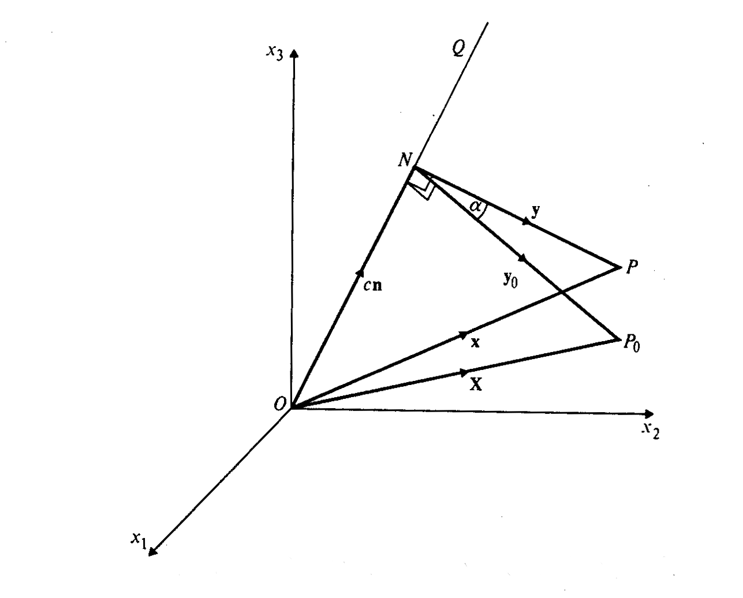
Rodrigues vector definition
We write the axis-angle representation as: where the rotation axis = OQ/|OQ|
The Rodrigues vector is defined as:
The rotation angle is α, and the magnitude of the vector is scaled by the tangent of the semi-angle.
BEWARE: Rodrigues vectors do NOT obey the parallelogram rule (because rotations are NOT commutative!

Slide 24
Conversions: matrix→RF vector
Simple formula, due to Morawiec:
Trace of a matrix:
tr(a) = a₁₁ + a₂₂ + a₃₃

Slide 25
Unit Quaternion: definition
q = q(q₁,q₂,q₃,q₄) = q(u sinθ/2, v sinθ/2, w sinθ/2, cosθ/2)
[u,v,w] is the unit vector parallel to the rotation axis.
Alternative notation (e.g. in Morawiec’s book) puts cosine term in 1st position, q(q₀,q₁,q₂,q₃) : q = (cosθ/2, u sinθ/2, v sinθ/2, w sinθ/2).

Slide 26
Conversions: matrix→quaternion
Formulae, due to Morawiec:
Note: passive rotation/ axis transformation (axis changes sign for for active rotation)
Note the coordination of choice of sign!

Slide 27
Summary
Conversion between different forms of description of texture components described.
Physical picture of the meaning of Euler angles as rotations of a crystal given.
Miller indices are descriptive, but matrices are useful for computation, and Euler angles are useful for mapping out textures (to be discussed).

Slide 28
Supplementary Slides
The following slides provide supplementary information on the mathematics that underpins orientations, transformations and rotations. More detail can be found in Ch. 2 of the lecture notes.

Slide 29
Notation: vectors, matrices
Vector-Matrix: v is a vector, A is a matrix (always a square matrix in this course).
Index notation: explicit indexes (Einstein convention): v_{i} is a vector, A_{jk} is a matrix (maybe tensor, though not necessarily).
Scalar (dot) product: c = a•b = a_{i}b_{i}; zero dot product means vectors are perpendicular. For two unit vectors, the dot product is equal to the cosine of the angle between them.
Vector (cross) product: c = c_{i} = a x b = a ∧ b = ε_{ijk} a_{j}b_{k}; generates a vector that is perpendicular to the first two. Two vectors that are perpendicular have a zero length cross product. The cross product defines a rotation axis that carries one vector into another. The magnitude of the cross product is the product of the magnitudes (lengths) of the vectors multiplied by the sine of the angle between them.
Permutation or alternating tensor, ε_{ijk}, is +1 for ijk=123, 231, 312, and -1 for ijk= 132, 213 and 321.
Obj/notation AxisTransformation Matrix EulerAngles Components

Slide 30
An axis system
Consider a right-handed set of axes defined by a set of three unit basis vectors, e.
Right-handed means that the scalar triple product, e₁xe₂•e₃ = +1
o

Slide 31
Direction cosines
α₁ = u = cosθ₁
α₂ = v = cosθ₂
α₃ = w = cosθ₃
x₃
a
θ₃
θ₂
x₂
θ₁
x₁

Slide 32
New Axes
Consider a new orthonormal system consisting of right-handed base vectors with the same origin, o, associated with the basis vectors. The vector is clearly expressed equally well in either coordinate system: Note - same vector, different values of the components. We need to find a relationship between the two sets of components for the vector.

Slide 33
Direction Cosines: definition
The two systems are related by the nine direction cosines, a_{ij}, which fix the cosine of the angle between the i^{th} primed and the j^{th} unprimed base vectors: Equivalently, a_{ij} represent the components of in according to the expression

Slide 34
Rotation of axes in the x-y plane
y
y’
v
x’
θ
x
x, y = old axes; x’,y’ = new axes
Passive Rotation/ Transformation of Axes

Slide 35
Example: rotation angle = 30°
y’
y
v
x’
θ
x
x, y = old axes; x’,y’ = new axes
Passive Rotation/ Transformation of Axes

Slide 36
Rotation Matrices
Since an orthogonal matrix merely rotates a vector but does not change its length, the determinant is one, det(a)=1.
Moreover, each row and each column is a unit vector, so these six relations apply, resulting in only 3 independent parameters:

Slide 37
Scalars, Vectors, Tensors
Scalar:= quantity that requires only one number, e.g. density, mass, specific heat.
Vector:= quantity that has direction as well as magnitude, e.g. velocity, current, magnetization; requires 3 numbers or coefficients (in 3D).
Tensor:= quantity that requires higher order descriptions but is the same, no matter what coordinate system is used to describe it, e.g. stress, strain, elastic modulus; requires 9 (or more, depending on rank) numbers or coefficients.

Slide 38
Scalars, Vectors, Tensors: NOTATION
General case: three dimensions
Vector: needs 3 numbers or coefficients to quantify its x, y and z components.
Two notations for vectors: “vector-tensor notation” where bold-face implies higher-than-scalar nature; “component notation” where a suffix(-es) show how many coefficients are needed.
Vector: either b or b_{i},i∈{1,2,3}, or, i∈{x,y,z}.
2nd rank tensor: either T or T_{ij}, i,j∈{1,2,3}
Advantage of vector-tensor notation is that the equations work in any reference frame. By contrast, when component notation is used, the actual values of the coefficients depend on which reference frame is used.
If you see subscripts attached to a quantity, it is (almost always) a tensor and the Einstein summation convention is assumed. The Einstein summation convention says that a repeated index (on the RHS) implies summation over that index (typically 1,2, and 3 in 3D).

Slide 39
Other Euler angle definitions
A confusing aspect of texture analysis is that there are multiple definitions of the Euler angles.
Definitions according to Bunge, Roe and Kocks are in common use.
Components have different values of Euler angles depending on which definition is used.
The Bunge definition is the most common.
The differences between the definitions are based on differences in the sense of rotation, and the choice of rotation axis for the second angle.
In physics, the Roe definition is standard.
Obj/notation AxisTransformation Matrix EulerAngles Components

Slide 40
Matrix with Kocks Angles
[uvw]
a(Ψ,Θ,φ) =
(hkl)
Note: obtain transpose by exchanging φ and Ψ.

Slide 41
Matrix with Roe angles
[uvw]
a(ψ,θ,φ) =
(hkl)

Slide 42
Euler Angle Definitions
Kocks
Bunge and Canova are inverse to one another Kocks and Roe differ by sign of third angle Bunge rotates about x’, Kocks about y’ (2nd angle)
Obj/notation AxisTransformation Matrix EulerAngles Components

Slide 43
Conversions
Obj/notation AxisTransformation Matrix EulerAngles Components

