Slide 1
Voting scheme for Automated Twin Extraction
4/26/18
Created by: Daniel Savage

Slide 2
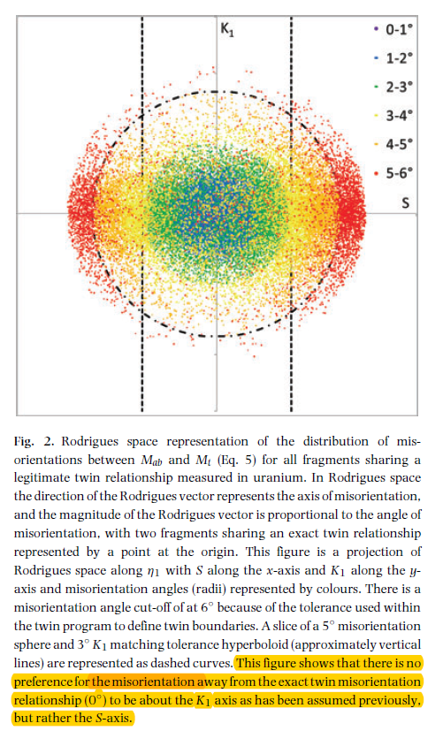
No point in using K1 matching S-axis matching?

Slide 3
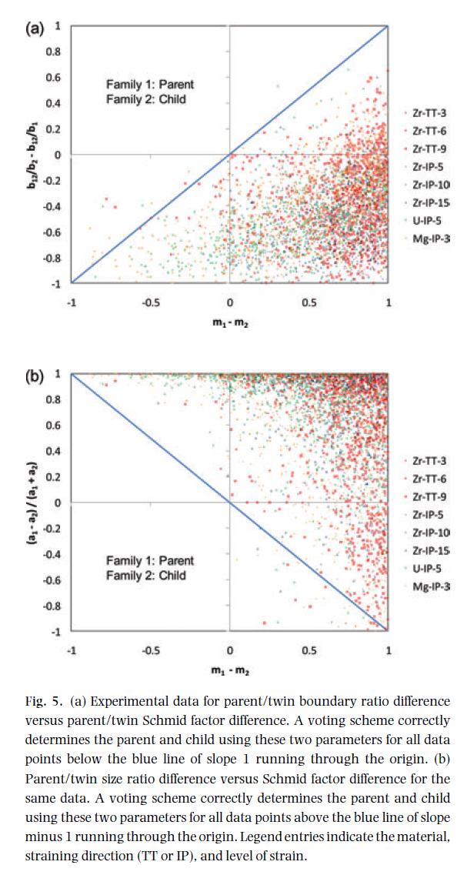
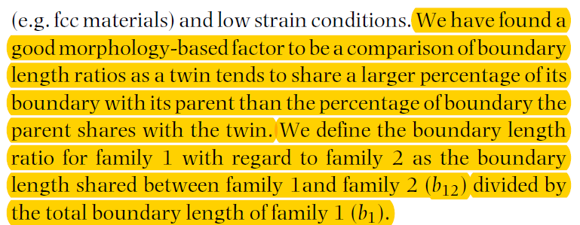
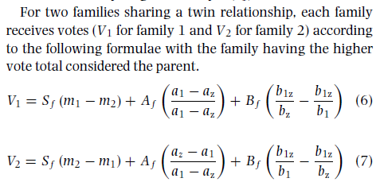
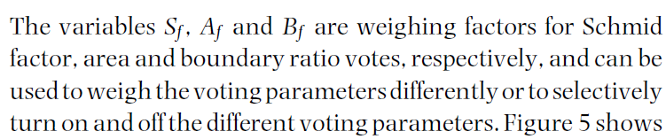
Main Voting scheme
From Figure 5. The boundary ratio and Schmid factor are very strong predictors. For the right dataset the area ratio could easily be enough by itself to determine parent.
+
+

Slide 4
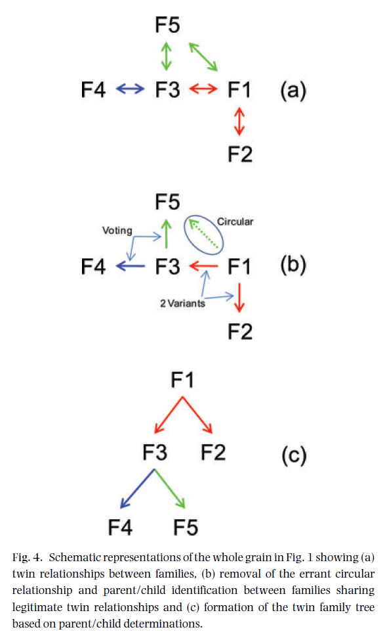
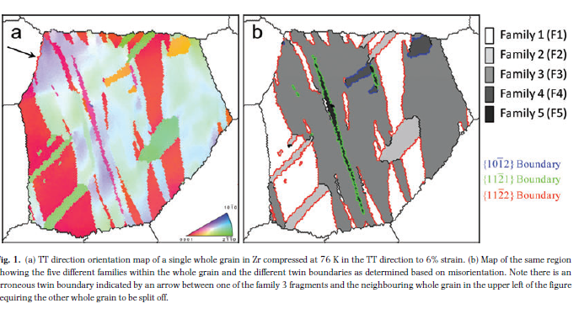
Enforcing valid twin relationships
F5 should not be a child of F1 because it is a secondary twin.
In this case voting was not used to determine the parent.

Slide 5
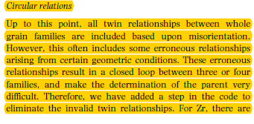
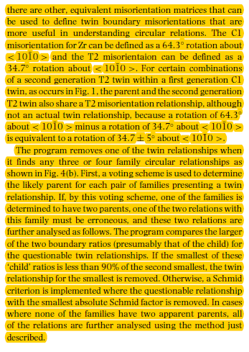
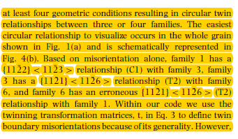
Enforcing valid twin relationships

Slide 6
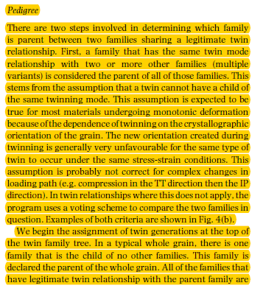
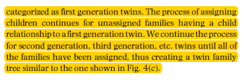
Pedigree

